Slide 1
NOTE
This file contains the PowerPoint presentation for the significant changes to the JFMM. It has been designed to be supported by the associated training notes document (JFMM_Training_Notes.docx). The pages of this file correspond to the Word document file included on this JFMM edition.
1

Slide 2
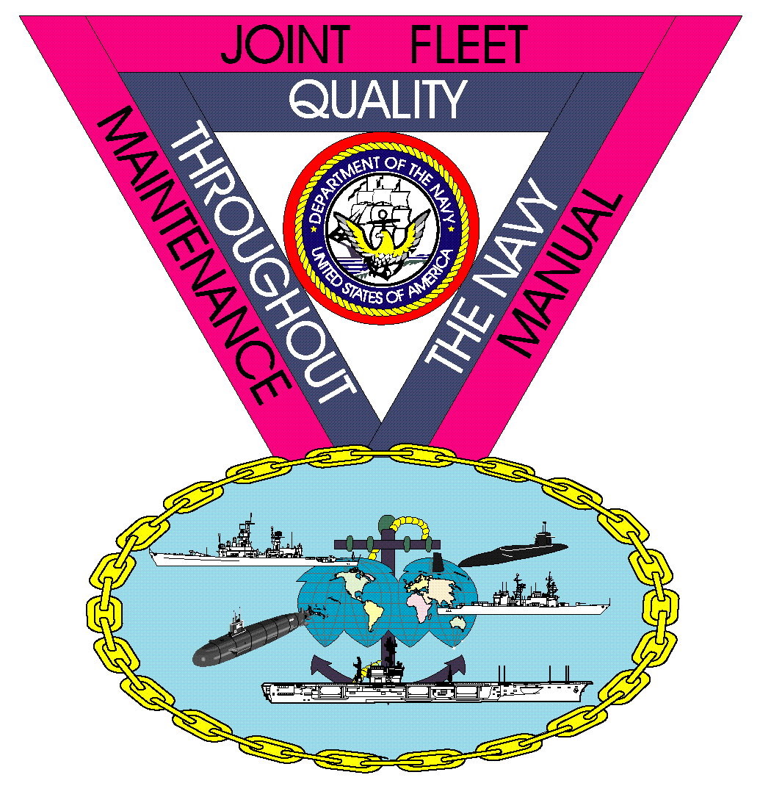
COMUSFLTFORCOMINST 4790.3
Rev D Change 4
2

Slide 3
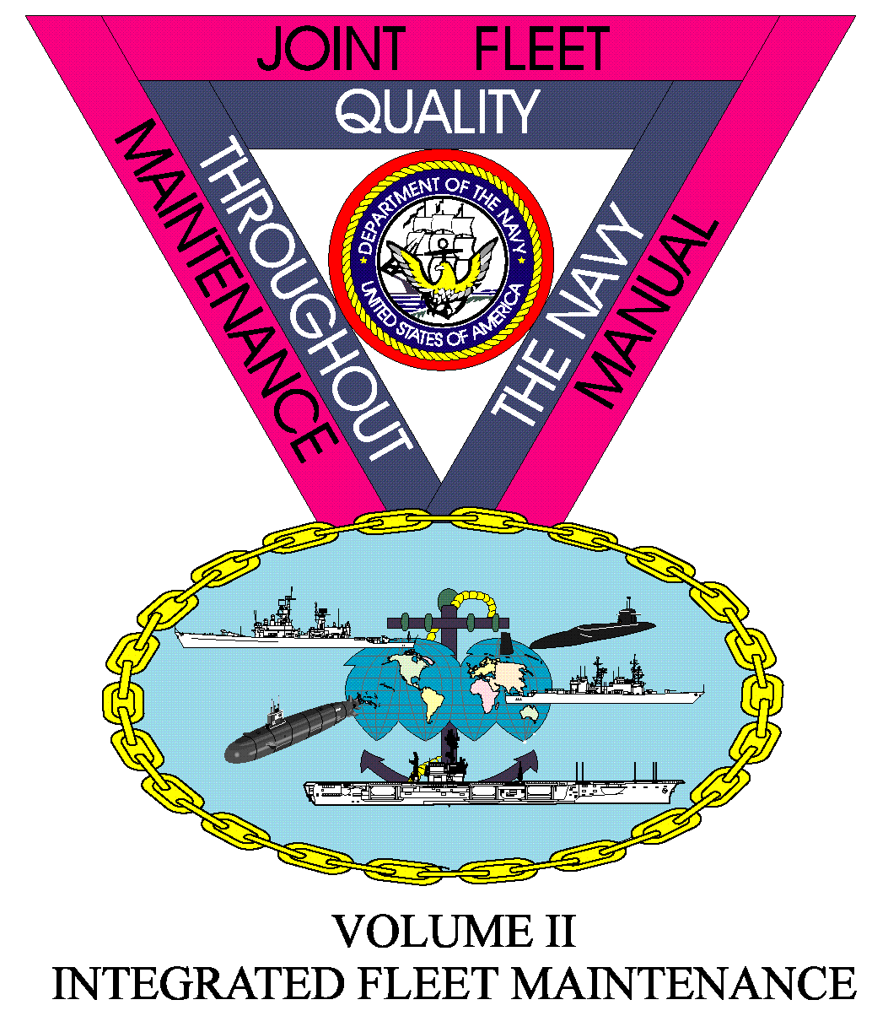
JFMM Volume I
NEW CONSTRUCTION
3

Slide 4
New Construction
Post Shakedown Availability
Modified the definition to reflect the current process.
Volume I, Chapter 6, Paragraph 6.1.a;

Slide 5
JFMM Volume II
INTEGRATED FLEET MAINTENANCE
5

Slide 6
CNO Scheduled Availabilities
Incremental Availabilities (Aircraft Carriers Only)
New sub-paragraph.
Surface Incremental Availability
New sub-paragraph.
Quality of Service Council
New sub-paragraph.
Fire Safety (Surface Force Ships Only)
TYCOM or ISIC (Group or Squadron).
Schedule Change Requests (Surface Force Ships Only)
New requirement to request a change to an approved availability schedule.
Volume II, Part I, Chapter 3, Paragraph 3.2.c; Volume II, Part I, Chapter 3, Paragraph 3.2.d;
Volume II, Part I, Chapter 3, Paragraph 3.6.3.2; Volume II, Part I, Chapter 3, Paragraph 3.3.8.2.o;
Volume II, Part I, Chapter 3, Paragraph 3.3.8.3.c(4); Volume II, Part I, Chapter 3, Paragraph 3.8.1; Volume II, Part I, Chapter 3, Paragraph 3.8.2;
6

Slide 7
Fleet Availabilities
Scheduled CMAVs (LCS Class Ships Only)
Clarified LCS CMAV definition.
Volume II, Part I, Chapter 4, Paragraph 4.3.2.d(1);
7

Slide 8
Ship Maintenance Validation, Screening And Brokering Surface Ship & Aircraft Work Package Preparation
“A” Branded Mandatory Technical Requirements
(Surface Force Ships Only)
Added a new sub-paragraphs defining and managing requirements.
FFP A-120 Award CONUS and Hawaii SURFOR Availability Milestones
Complete rewrite of Vol II-II-2 Appendix D₂ Updates to Appendix D₁ and Addition of D₃
Volume II, Part II, Chapter 1, Paragraph 1.5.5.i; Volume II, Part II, Chapter 1, Paragraph 1.5.5.j; Volume II, Part II, Chapter 2, Appendix D;
8

Slide 9
JFMM Volume III
DEPLOYED MAINTENANCE
9

Slide 10
Deployed Maintenance
Major rewrites of the Chapters
Review the revised chapters in their entirety.
Chapter 1 - Introduction.
Chapter 2 - Maintenance Organization and Capabilities.
Chapter 3 - Maintenance Management.
Chapter 4 - Scheduled Maintenance Planning, Preparation and Priorities.
Volume III, Chapter 1; Volume III, Chapter 2; Volume III, Chapter 3; Volume III, Chapter 4;
10

Slide 11
JFMM Volume IV
TESTS AND INSPECTIONS
11

Slide 12
Work Authorization
Work Authorization Procedure
Modified the work procedure for items concerning fire prevention, detection and response.
Added a new sub-paragraph defining the process for work not assigned to Ships Force, not falling under a Naval Supervisory Authority or a contractor.
Modified the sub-paragraph concerning the work, testing or equipment operations within the boundaries of systems transferred to a shipyard.
Volume IV, Chapter 10, paragraph 10.4.2.i; Volume IV, Chapter 10, paragraph 10.4.2.j;
Volume IV, Chapter 10, paragraph 10.4.3.o;
12

Slide 13
SOSMIL
Safety of Ship Maintenance Item List
Added note to ensure MIL-STD-1625 are met prior to relaxing SOS for select items while in drydock.
Added not applicable annotations to select items when in drydock.
Added not applicable annotations to select items when in drydock and dock is drained.
Volume IV, Chapter 10, paragraph 10.4.8.b; Volume IV, Chapter 10, paragraph 10.4.9; Volume IV, Chapter 10, paragraph 10.4.8.c; Volume IV, Chapter 10, paragraph 10.4.10.c;
13

Slide 14
Circuit Breakers
Major rewrite of the Chapter
Review the new chapter in its entirety.
Volume IV, Chapter 15;
14

Slide 15
Aircraft Launch and Recovery
Major rewrite of the Chapter
Review the new chapter in its entirety.
Volume IV, Chapter 16;
15

Slide 16
Submarine Antenna Testing
Hydrostatic Pressure Testing.
Modified testing requirements for submarine antennas and clarified deep dive testing applicability.
Volume IV, Chapter 22.3.1;
16

Slide 17
Gas Turbine Inspection for Surface Force Ships
Repair Before Operating (RBO).
Removed ability of a RBO to be departed via a DFS except for select conditions.
Volume IV, Chapter 23.8.1;
17

Slide 18
JFMM Volume V
QUALITY MAINTENANCE
18

Slide 19
Quality Maintenance Processes
Controlled Work Package
Clarified requirements for Ship’s Force retests of FMA or Ship’s Force nuclear work.
Added a NOTE prior to the sub-paragraph indicating work on the SUBSAFE/Non-SUBSAFE boundary will be managed as SUBSAFE work using CWP/REC controls.
Controlled Work Package Closeout
Modified the paragraph to clarify how CWPs will be closed out.
Volume V, Part I, Chapter 2, Paragraph 2.2.4.b(7); Volume V, Part I, Chapter 2, Paragraph 2.2.4.c; Volume V, Part I, Chapter 2, Paragraph 2.3.7.8;
19

Slide 20
Welder, Brazer and NDT Qualifications
Individual Qualification File
Modified the paragraph to agree with NAVSEA instructions.
Maintenance of Qualification
Modified the paragraph to agree with NAVSEA instructions.
Volume V, Part I, Chapter 4, paragraph 4.2.6; Volume V, Part I, Chapter 4, paragraph 4.3.5;
20

Slide 21
Departures From Specifications
Major Departures
Updated the sub-paragraph to change the periodicity to replace SSN 774 Class Torpedo Tube Muzzle Door K-Monel linkage to agree with the updated DDGOS.
Minor Departures
Further identified the DISSUB rescue components that require minor DFS from PMS deficiencies.
General Administrative Requirements
Expanded the sub-paragraph to require at least five working days to process a DFS. Added aircraft carriers only paragraph.
DFS Condition not Corrected (Submarines Only)
Added additional information to clarify ability of operational commander to waive DFS resolution for breif stops.
Non-Nuclear LARS
Established a new section identifying the current Non-Nuclear LAR process.
Volume V, Part I, Chapter 8, paragraph 8.2.5.r; Volume V, Part I, Chapter 8, paragraph 8.2.6.h; Volume V, Part I, Chapter 8, paragraph 8.3.1.g; Volume V, Part I, Chapter 8, paragraph 8.3.8.2; Volume V, Part I, Chapter 8, paragraph 8.5;
21

Slide 22
JFMM VOLUME VI
MAINTENANCE PROGRAMS
22

Slide 23
Surface Ship Corrosion Control
Peak Tanks (Aircraft Carriers Only)
Clarified which aircraft carrier tanks can be filled with fresh water.
Volume VI, Chapter 13, paragraph 13.4.3.f;
23

Slide 24
Surface Force Ship and Aircraft Carrier Modernization Program
Major rewrite of the Chapter
Review the new chapter in its entirety.
Volume VI, Chapter 36;
24

Slide 25
JFMM VOLUME VII
CONTRACTED SHIP MAINTENANCE
25

Slide 26
Cost Estimating
MSC Template Preliminary Estimates
Added a new paragraph concerning Master Specification Catalog Template Preliminary Estimates.
Volume VII, Chapter 5, paragraph 5.12;
26

Slide 27
Contract Administration
Corrective Action
Modified the paragraph to reflect current practice for Corrective Action Requests.
Volume VII, Chapter 11, paragraph 11.5.7;
27

