Slide 1
NOTE
This file contains the PowerPoint presentation for the significant changes to the JFMM. It has been designed to work with a Word document file that provides the specific changes. The pages of this file correspond to the Word document file included on this CD-ROM (JFMM Training Notes.docx).

Slide 2
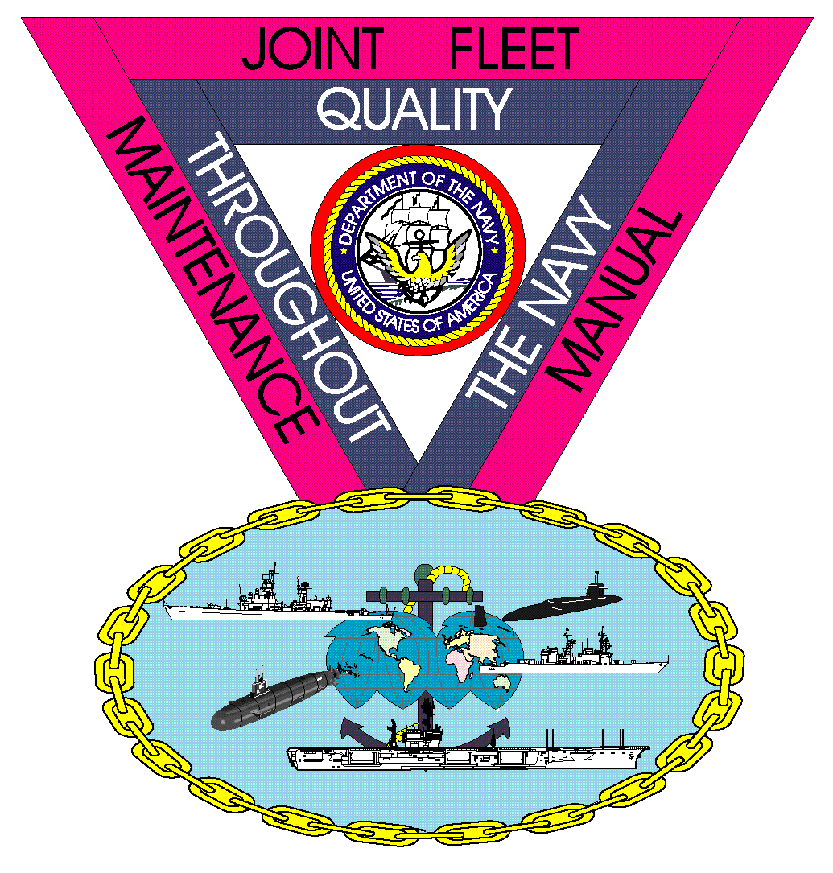
COMUSFLTFORCOMINST 4790.3
Rev D Change 3

Slide 3
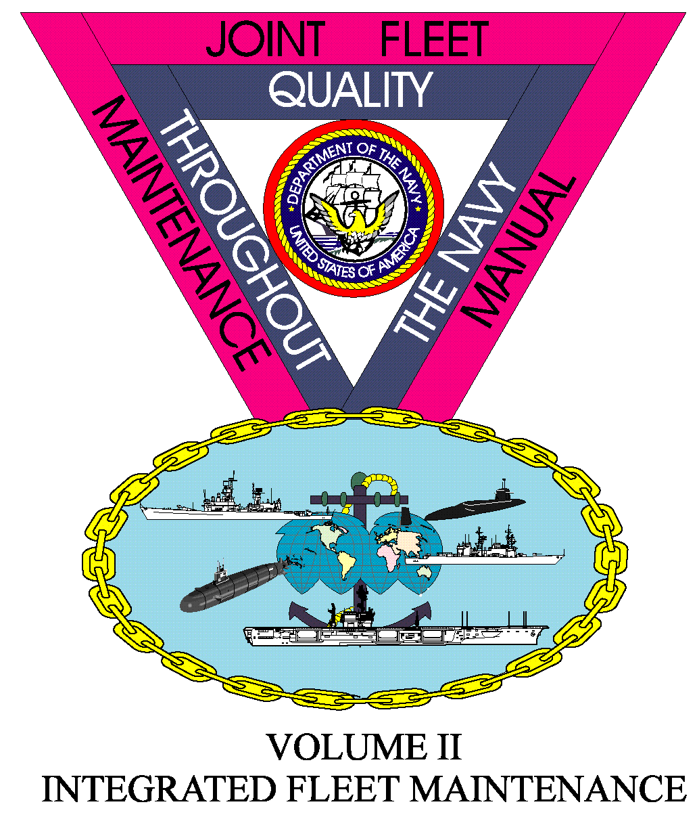
JFMM Volume I
NEW CONSTRUCTION

Slide 4
New Construction
Pre-Delivery
Updated the URO MRC process for new submarines to reflect the current process.
Established a PMR process outlined for initial PMR load-out during new construction.
Volume I, Chapter 3, Paragraph 3.6.2; Volume I, Chapter 3, Paragraph 3.6.3;

Slide 5
JFMM Volume II
INTEGRATED FLEET MAINTENANCE

Slide 6
Maintenance and Modernization
Mandatory Material List (Surface Force Ships Only)
New SURFMEPP Requirement
“A” Branded Deferral Process (Surface Force Ships Only)
“A” branded mandatory requirements not accomplished by the second FRP.
Days of Maintenance Delay
Added a new paragraph on “Days of Maintenance” to track extensions to CNO availabilities caused by maintenance or modernization decisions or performance.
Volume II, Part I, Chapter 3, Paragraph 3.5.1.2.9; Volume II, Part I, Chapter 3, Paragraph 3.5.5.6.e; Volume II, Part I, Chapter 3, , Paragraph 3.8;

Slide 7
Fleet Availabilities
Ammunition Off-Load
New required message during the planning phase.
Volume II, Part I, Chapter 4, Paragraph 4.6.1.2.o; Volume II, Part I, Chapter 4, Appendix I;

Slide 8
Ship Maintenance Validation, Screening And Brokering
Maintenance Management Automated Information System
Added a new paragraph to align for the Maintenance Management Automated Information System.
Volume II, Part I, Chapter 1, Paragraph 1.2; Volume II, Part I, Chapter 4, Appendix I;

Slide 9
JFMM Volume III
DEPLOYED MAINTENANCE

Slide 10
Strike Force Intermediate Maintenance Facility
Added a new chapter to identify and describe the Strike Force Intermediate Maintenance Facility
Review the new chapter in its entirety.
Volume III, Chapter 6;

Slide 11
JFMM Volume IV
TESTS AND INSPECTIONS

Slide 12
Work Authorization
Work Authorization Systems
Permitting use of electronic WAFs for Surface Force Ships.
Work Authorization Log or Index
Permitting the use of a WAF Index in lieu of a WAF log for Surface Force Ships.
New WAF Index
WAF Index for Surface Force Ships use.
Volume IV, Chapter 10, paragraph 10.4.e; Volume IV, Chapter 10, paragraph 10.4.1.2;
Volume IV, Chapter 10, Appendix A₂ ;

Slide 13
Distressed Submarine And Salvage Inspection
Previously Titled “Salvage Inspection”.
Renamed and modified the entire chapter to include current DISSUB requirements.
Volume IV, Chapter 18;

Slide 14
Board of Inspection and Survey Inspections Policy
Complete Chapter Rewrite.
Review the entire chapter in it’s entirety.
Volume IV, Chapter 26;

Slide 15
Reboiler Inspection
Complete Chapter Rewrite.
Review the entire chapter in it’s entirety.
Volume IV, Chapter 27;

Slide 16
JFMM Volume V
QUALITY MAINTENANCE

Slide 17
Organizational Responsibilities
Ship’s QAO Responsibilities (Submarines Only)
Added two new responsibilities for the ships QAO during the “Other Review” period.
Volume V, Part I, Chapter 1, Appendix A;

Slide 18
Departure from Specifications
Major Departures
Added two sub-paragraphs requiring a Major DFS concerning diesel engines.
Minor Departures (Submarines Only)
Added a new sub-paragraph for submarine escape component deficiencies requiring a Minor DFS if not corrected.
Major Departures – Scope of Certification
Added phrasing for Major DFS if deficiency is not corrected prior to a planned underway period.
Volume V, Part I, Chapter 8, paragraph 8.2.5; Volume V, Part I, Chapter 8, paragraph 8.2.6.j; Volume V, Part III, Chapter 8, paragraph 8.2.b;

Slide 19
JFMM VOLUME VI
MAINTENANCE PROGRAMS

Slide 20
Fleet Technical Assistance
FTA Policy – Requesting Assistance
Modified the manner in which Fleet Technical Assistance is requested to reflect the current process.
Volume VI, Chapter 2, paragraph 2.4.1;

Slide 21
Submarine Modernization
Ship Alterations Coordinator
Modified the process for reactor plant modifications completed by Ships Force.
TYCOM Alteration Kit
Modified the manner in which TYCOM Alteration Kit Program to reflect the current process.
Liaison Action Request
Updated the paragraph to emphasize an LAR is the preferred method when a technical problem occurs.
Volume VI, Chapter 3, paragraph 3.2.3.f; Volume VI, Chapter 3, paragraph 3.3.3;
Volume VI, Chapter 3, paragraph 3.5;

Slide 22
Motor Gas Handling & Storage
Complete Chapter Rewrite
Review the chapter in its entirety.
Volume VI, Chapter 10;

Slide 23
3-M Requirements
19-3 NAVIFOR Significant Chapter Rewrite
Review the chapter in its entirety
19-6 Naval Surface Force Complete Chapter Rewrite
Review the chapter in its entirety
Volume VI, Chapter 19-3; Volume VI, Chapter 19-6;

Slide 24
Maintenance Data System Afloat And Ashore General Requirements
Extensive Chapter Update
Modified the entire chapter to align with current MMAIS.
Review the chapter for complete changes
Volume VI, Chapter 19-7;

Slide 25
Periodic Maintenance Requirement Program
Calculating LMA Date
Updated the manner of calculating the Last Maintenance Action date to reflect current process.
Volume VI, Chapter 24, paragraph 24.2.4;

Slide 26
Unrestricted Operations
Calculating LMA Date
Updated the manner of calculating the Last Maintenance Action date to reflect current process.
Volume VI, Chapter 25, paragraph 25.2.3.1;

Slide 27
JFMM VOLUME VII
CONTRACTED SHIP MAINTENANCE

Slide 28
No Specific Training Required

