Slide 1

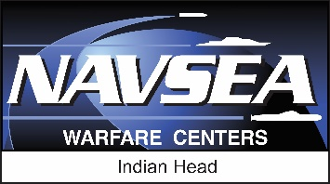
NAVSEA WARFARE CENTERS
Title
Presented to:
Xxxxx Xxxxxx
Xxx Xxxxxxxx Xxx x XX
Presented by:
Xx Xxxx Xxxxxxx
Title
- 00 Month 2023 -
CAPT Steve Duba, USN
Commanding Officer
Mr. Ashley G. Johnson, SES
Technical Director
Distribution Statement A (22-208): Approved for Public Release; distribution is unlimited
NAVSEA WARFARE CENTERS

Slide 2

Mission
NAVSEA WARFARE CENTERS
Research, develop, test, evaluate (RDT&E), manufacture and provide in-service support of energetics and energetic systems. Provide Soldiers, Marines, Sailors and Airmen with information and technology to detect, locate, access, identify, render safe, recover, exploit and dispose of explosive threats.
Range and
Speed
Propellants
Explosives
Fuels
Reactive materials
Rocket motors
Conventional ammunition
Lethality
Novel explosives
Reactive materials
Warheads
Casing
Modeling and simulation (M&S)
Conventional ammunition
Signatures Management
Propellants
Fuels
Rocket motor design
M&S
Safe and arm (S&A) devices
Safety
EOD
S&A / Fuzing
Aircrew escape
Packaging, Handling, Storage, and Transportation of Energetics
Insensitive munitions
Chem bio defeat
FLY FARTHER HIT HARDER SAVE LIVES
NAVSEA WARFARE CENTERS
Notes:
Our mission statement is given to us and describes why we exist – what we do every day in fulfilling our role and purpose.
Our mission is timeless – while mission of developing, providing and sustaining naval energetics does not change, specific priorities and products do change, but the overall mission remains the same.
Key thoughts:
1: IHD is full spectrum – from basic to applied research, manufacture, in service engineering to demil
2: Energetics AND energetic systems. IHD does not only focus on the “goo.” A system must ensure all aspects and components work together.
3: Very “purple” customer base. All services rely on IHD for its products and services.
4: Disposing of energetic material is a critical role
The energetics of a system determine all its key attributes – range, speed, lethality, signature, and safety.
Those listed below each are simply examples of the definition. Novel energetics are energetic molecules, ingredients, and formulations that are higher performing than traditional energetic materials, less sensitive to unplanned thermal, shock and impact stimuli yet cost effective to manufacture and integrate in to new and existing weapon systems.
This can be summarized by our tagline – fly farther, hit harder, save lives. It may sound like a cute slogan, but it really encompasses everything we do at Indian Head.
Fly Farther. We recognize the next conflict may likely require a longer reach and faster time on target. We work in propellants, fuels, and hypersonics to deliver these capabilities to the fleet, The “Fly” in fly farther is meant to be inclusive of all domains, not just air. Otto fuel for torpedoes is a national asset manufactured at Indian Head. Emplacement of underwater smart mining provides additional stand off as well.
Hit Harder. As General Mattis once said: “Everything we do must contribute to the LETHALITY of our military.” Energetics impact the lethality of every current weapon system. From the obvious work we do in explosives and warheads to the emerging areas such as reactive materials where we can make the case or lining provide additional energy on a target, Indian Head is a key contributor to our warfighters’ ability to deliver lethal effects when required.
Save Lives. Equally, if not more important than the two offensive tenets above, it is just as critical we ensure our courageous warfighters return home safely after execution of their dangerous missions. This includes our work in aircrew escape systems, explosive ordnance disposal, more reliable fuzing mechanisms to improved packaging, handling, storage, and transportation of energetics.

Slide 3

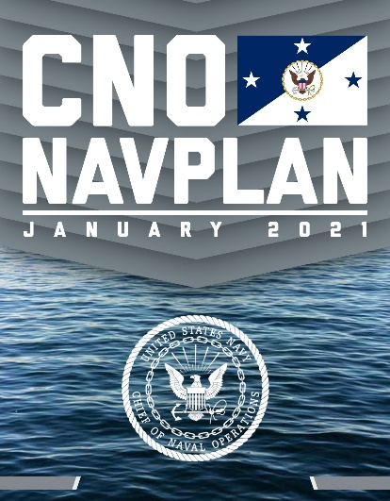
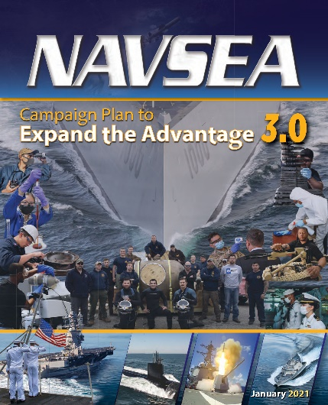
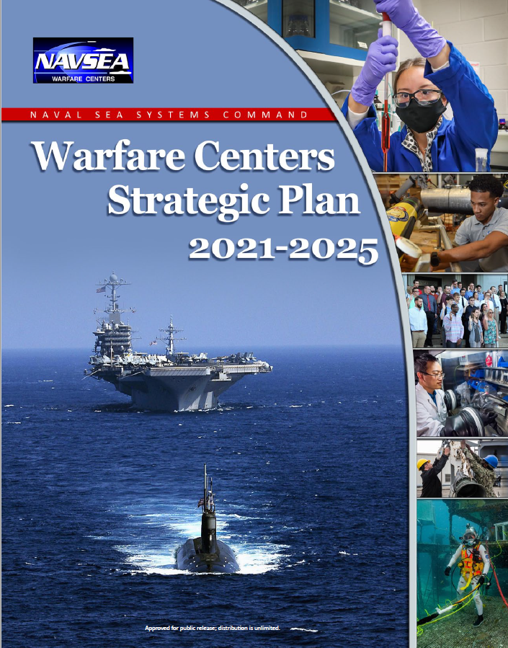
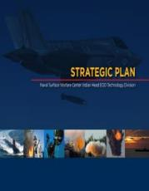
Strategic Thrusts
2022 National Defense Strategy
Defending the homeland
Deterring strategic attacks against the United States, Allies, and partners
Deterring aggression,
Building a resilient Joint Force and defense ecosystem.
Readiness
Capabilities
Capacity
Sailors
    Deliver combat power: on-time delivery of combat-ready ships, submarines and systems
    Transform our digital capability
    Build a team to compete and win
    Workforce and leadership development
    Mission-aligned strategies
    Technical innovation and excellence
    Business excellence and improvement
    Right culture/values
    Strengthen the Navy’s arsenal
    Molecule to mission (integrated capabilities)
    Workforce flexibility and agility
Vision: Outpace our Adversaries
Notes:
Our Strategic Plan (listed on the right) ties into both the National Defense Strategy, CNO’s NAVPLAN, the NAVSEA Strategic Business Plan, and the NSWC Strategic Plan.
Under CNO’s NAVPLAN, we align with the following guidance under the sailing directions of Readiness, Capabilities, Capacity, and Sailors:
• We will responsibly fund our readiness as we grow the fleet. We will never field a hollow force.
• Lethality and readiness are two sides of the same coin. We cannot deter our competitors with raw
capabilities alone. We must field a force that has demonstrated the skill and will to win.
• Expertly maintaining our platforms and systems is in our DNA. We will own this.
• Keeping ahead of our competitors requires us to rapidly field state-of-the art systems. Speed matters.
• While we need a larger fleet, the composition and capabilities of the fleet matter most.
• Our Sailors must be able to out think and outfight any adversary. They will remain the best trained
and finest educated naval force in the world.
• Our relentless approach to warfighting excellence will remain grounded in our core values
Our five goals are:
a) Reshape Facilities and Utilities
b) Establish Public-Private Partnerships
c) Develop New Products and Services
d) Sustain and Expand Core Product Lines
e) Reinvigorate Naval Energetics
Two Supporting Plans:
Process (TECH RIGOR & BUSINESS OPERATIONS)
People

Slide 4
Strategic Framework
Outpace our Adversaries
Molecule to
Mission
Strengthen the Navy’s Arsenal
Workforce Flexibility & Agility
Vision:
Strategic Imperatives:
CREATE
PRODUCE
ADAPT
Innovation
Integrated Capabilities
Collaboration
Ready Infrastructure
Production Capacity
Leadership
Workload Capacity
Flexible Capabilities
Focus Areas:
Notes:
Molecule to Mission - CREATE: Give our warfighters what they need to win
Deliver innovative solutions through collaboration and integration of our molecule-to-mission capabilities to keep our warfighters ahead of the game.
2) Strengthen the Navy’s Arsenal - PRODUCE: Give our warfighters enough to win
Strengthen the Navy's Arsenal through providing a ready infrastructure capable of wartime surge and maximizing production of the goods and services our warfighters rely on.
3) Workforce Flexibility & Agility - ADAPT: Give our warfighters what they need, when they need it
Increase the flexibility and agility of our workforce by combining the right mix of people with the right mix of capabilities, supported by effective leadership at all levels, so we can respond to warfighter demands on any timetable.

Slide 5
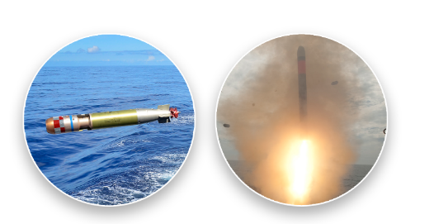
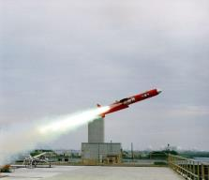
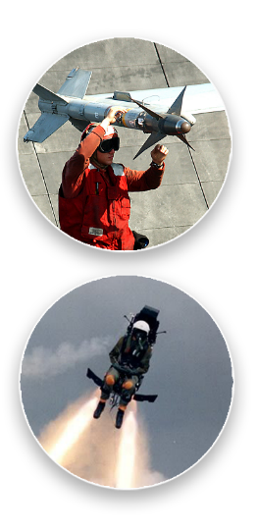
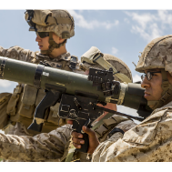
What Are Energetics?
Energetics define a weapon system’s performance:
Range, speed, lethality, signatures management, safety, logistics
Energetics include:
Ingredients (energetic materials, inert ingredients)
Formulations (explosives, propellants, fuels)
Energetic material systems (fuzes, rocket motors, warheads, munitions)
Energetics are essential to every warfighting domain:
Undersea (e.g., torpedo fuel, warheads, mines)
Surface (e.g., guns, STANDARD Missile, Sea Sparrow Missile)
Air (e.g., rockets, ejection seats, bombs, Sidewinder Missile)
Expeditionary (e.g., ordnance disposal, crew served weapons)
Energetic material systems are a critical enabler for all combat capability

Slide 6
The Navy’s Arsenal
  Purpose Built: established in 1890, NSWC IHD has been manufacturing energetics at war mobilization scales for over 125 years
  Navy’s Public Arsenal: SECNAV designated NSWC IHD as a Center for Industrial and Technical Excellence (CITE) for Energetics and Ordnance Systems Depot maintenance and Arsenal activities in 2014; the only such public naval arsenal
  Government Owned: NSWC IHD focuses on military products with critical national security importance, significant safety/environmental risks, and low profit potential for the private sector; public-private-partnerships (P3) in place to bolster the industrial base
  Necessary for Innovation: RDT&E, engineering and manufacturing combined at one site allows Navy to efficiently advance combat capability across ALL warfighting domains
NSWC IHD is the Navy’s surge energetics manufacturing site with the capabilities and expertise needed for wartime mobilization

Slide 7
Benefits of a GOGO Arsenal
Advance state of the art
  Low industry participation in energetics S&T and energetics manufacturing scale-up due to high-risk/low-reward
Foundational layer of the munitions industrial base (MIB)
  Sole/second source for critical munitions
  Public private partnerships enable expansion to new and legacy entrants to the MIB
  Provide risk mitigation and cost pressure for industry
  Maintain capacity for peacetime and wartime response
Maintain core expertise and capabilities as Navy’s trusted advisor
  Broad range of research, engineering and manufacturing competencies ensures the integrity, safety, reliability and performance of naval munitions
  Responsive at addressing industry and fleet issues with munitions
A healthy organic industrial base 1) drives energetics innovation; 2) meets surge manufacturing requirements; 3) sustains Navy’s energetics expertise
Notes:
This slide highlights key benefits to Navy maintaining a government-owned/government-operated (GOGO) arsenal with full-spectrum capabilities.

Slide 8


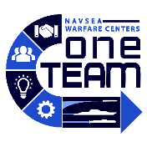

NAVSEA Warfare Centers:
10 Divisions – 1 Team
NSWC Crane Division
Crane, Ind.
NSWC Carderock Division
West Bethesda, Md.
NSWC Panama City Division
Panama City, Fla.
NSWC Dahlgren Division
Dahlgren, Va.
NSWC Port Hueneme Division
Port Hueneme, Calif.
NSWC Philadelphia Division
Philadelphia, Penn.
NSWC Corona Division
Corona, Calif.
NSWC Indian Head Division
Indian Head, Md.
NUWC Keyport Division
Keyport, Wash.
NUWC Newport Division
Newport, R.I.
Notes:
Indian Head is one of ten divisions of the NAVSEA Warfare Center. As a complete enterprise, there is nothing that we cannot perform together that any other organization can.
1. ~25,000 diverse and highly educated employees focused on innovation (~16,400 scientists, engineers, and technicians with ~750 Ph.D.s)
2. 129 unique Technical Capabilities across 10 Divisions
3. Operates under the Navy Working Capital Fund business model
4. Performs work our industry partners can’t, won’t or shouldn’t do.
5. Maintains more than 164 unique RDT&E facilities
6. Provide a bridge between the technical community and the warfighter
7. Determine and develop capabilities for the fleet
8. Verify the quality, safety, and effectiveness of platforms and systems
9. Design, develop, and field solutions for urgent operational fleet needs

Slide 9
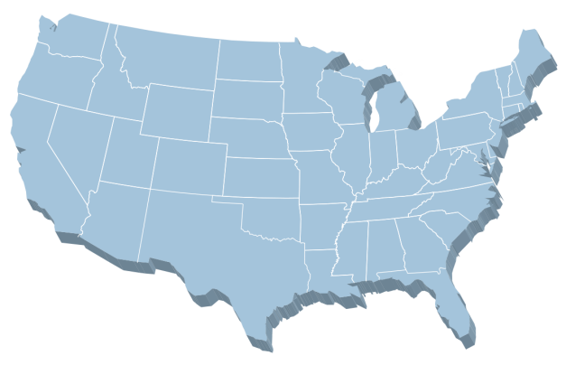



NSWC IHD Strategic Locations
Ogden, Utah: 22 civ.
Co-located at Hill Air Force Base
CAD / PAD Air Force Integrated Product Team
Crane, Ind.: 4 civ.
Design and construct portable armories
Provide automation for front gates
Indian Head, Md. (two sites): 1,874 civ., 55 mil.
NAVSEA Center of Excellence for Energetics
DoD EOD program lead
Expeditionary Exploitation Unit ONE (EXU-1)
Camp Pendleton, Calif.: 6 civ.
Demonstration and
Assessment Team
Assigned to D Department
Picatinny, N.J.: 268
civ., 3 mil.
Located at Picatinny Arsenal
Joint CoE for Guns and Ammo
Navy Package, Handling,
Storage and Transportation, Guns and Ammo
Rock Island, Ill.: 7 civ.
Quad-Cities Caliber Cartridge Case Facility
Aligned with G Department
McAlester, Okla.: 50 civ.
McAlester Army Ammunition Plant
Norfolk, Va.: 27 civ.
Demonstration and Assessment Team
Guns Division
CBR-D
Louisville, Ky.: 13 civ.
Naval Guns
* Ctr. numbers not included

Slide 10
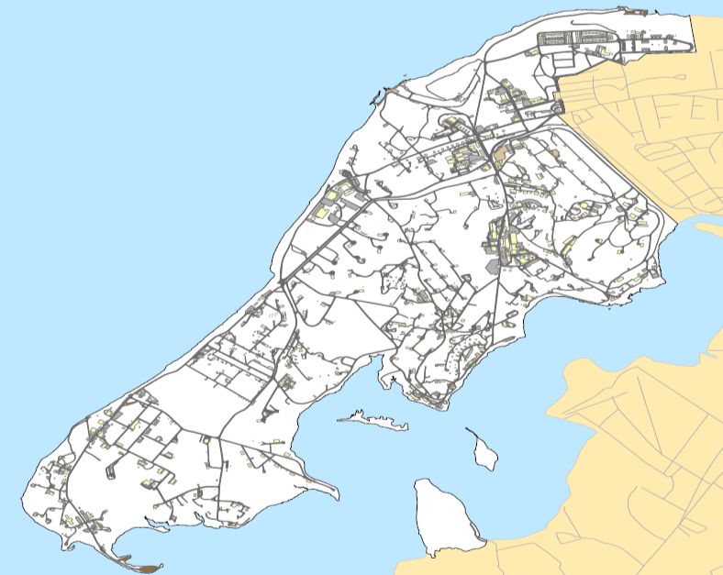
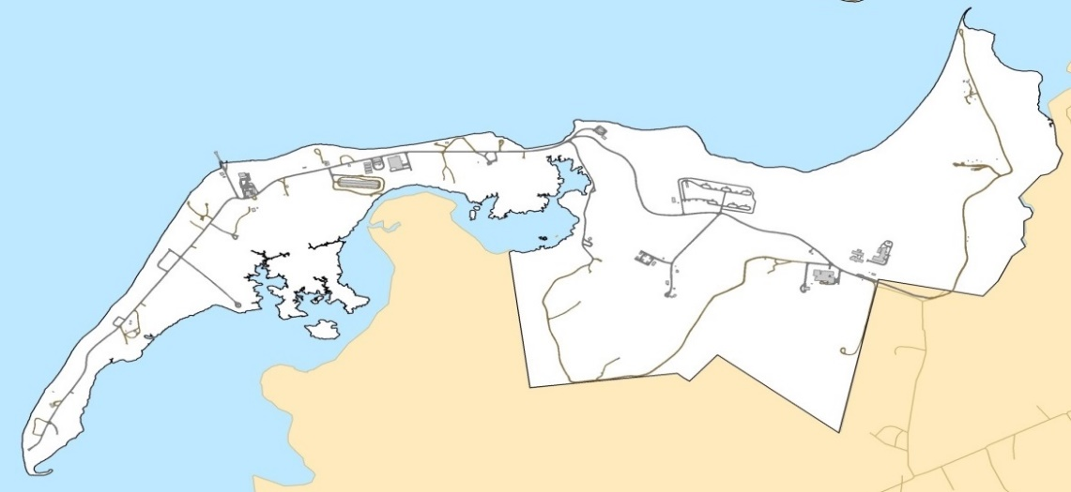
Industrial Complexes
Key
RDT&E
Expeditionary Exploitation Unit One (EXU-1)
Weapon Systems Eng
Engineering
Center for Applied Analytics Technology
Explosives Processing Development Eng
Manufacturing
Ordnance Test
Multiple
Chemical Biological Radiological Defense
Ordnance Dissection & Machining
Echelon V
Aircrew Escape (CAD/PAD)
Specialty Chemicals (Torpedo fuel)
Detonation Physics & Combustion
Cast Composite (Rocket motors & warheads)
Solventless Extruded Products (Rocket motors & JATOs)
Advanced Energetics Research Lab
Decon/Demil
Explosive Processing (Pressed explosives, hypersonic targets)
Solvent Based Energetics (Bombs & rocket motors)
Continuous Processing
Significant Detachments not shown:
Picatinny, Systems Integration
McAlester, Systems Engineering
Quad Cities Cartridge Case Mfg Facility
Explosive Ordnance Disposal (Full Spectrum EOD)

Slide 11
Numbers at a Glance
FY22 Execution
$626.6M direct / $187.4M indirect
Total Contracting Effort
Buildings Occupied
Total Square Feet
$348.9M
879
1,968,161
Civilian Staffing
Employees *
Top S&E Disciplines
Scientists and Engineers:
892
2,381
Average Years of Service
12
Average Age of Workforce
Workforce Education (Technical)
44
Bachelors: 581
Masters: 248
Ph. D.: 86
* Does not include contractors
Notes:
Over a $1B organization, about 50% direct work
# buildings and size of the land is a unique requirement compared to other organizations. A single explosive operations complex may require dozens of buildings to process, store and manufacture. This increases the cost and complexity to maintain all these unique buildings when compared to more traditional office style buildings
Another thing unique to Indian head is the diverse workforce we employ. About a 1/3 scientists and engineers, but many wage grade operators and technicians as well.

Slide 12









Organizational Structure
CNO
(Echl. I)
CO
TD
NAVSEA
(Echl. II)
Comptroller
Department
Contracts
Department
Corporate
Operations
Department
EOD
Department
NSWC/NUWC HQ
(Echl. III)
Systems
Engineering
Department
Systems
Integration
Department
Energetics
Manufacturing
Department
RDT&E
Department
NSWC IHD
(Echl. IV)
Expeditionary Exploitation Unit -1 (EXU-1)
JP
CAD / PAD Joint Program Office
EXU-1
(Echl. V)
Notes:
NSWC IHD - a field activity of the Naval Sea Systems Command and part of the Navy's Science and Engineering Establishment - is the leader in ordnance, energetics and EOD solutions. The Division focuses on energetics research, development, testing, evaluation, manufacturing, in-service support and disposal; and provides warfighters solutions to detect, locate, access, identify, render safe, recover, exploit and dispose of explosive ordnance threats.
There are 3 Business Operations Department and 5 Technical Departments
We also have a joint program offices for CAD/PAD. JPO, as a tenant command, supports both the NAVSEA Organic Capabilities Mission as well as the NAVAIR strategies with a bottom line Mission Statement, that 100% of all safety and egress systems in every tri-service, FMS and partner nation aircraft function as intended, are available when required and most importantly; no casualties and no aircraft degradation. Anything less is unacceptable.
JPO provides the bridge for NAVSEA to partner with NAVAIR, to advocate for the warfighter and to provide the tri-service CAD/PAD with proficiency in acquisition and program management expertise. JPO also advocates for our Industrial Partners to strengthen the CAD/PAD manufacturing baseline through a stronger more stable supply chain, building quality CAD/PAD and sustaining more lean productive operations.
JPO actively invests in and aggressively pursues emerging technologies, to improve organic capabilities, fosters partnerships and business solutions to expand and maintain the competitive edge for the warfighter.
EXU-1 is an Echelon 5 unit that reports to the NSWC IHD CO.

Slide 13
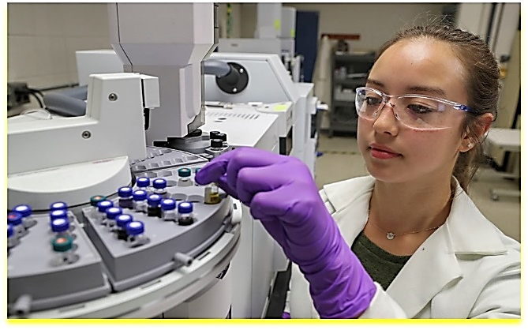
RDT&E (R) Department
Warfighting Impact
Integrated signatures program helps Warfighter diagnose threat to the “left of boom”
Advanced propulsion R&D will lead to future advances in weapon range and flexibility
Chemical, Biological, and Radiological Defense (CBRD) protects ships and facilities from attack and contamination
Capabilities and Facilities
Lines of Operation
Detonation science facility for controlled, dynamic research of energetic materials
Material properties laboratory and ordnance dissection for health analysis and aging
Non-destructive evaluation and analytical chemistry laboratories for in-house lot acceptance and quality assurance of products
Condition-controlled laboratories for high-fidelity R&D
Chemistry and biology labs (up to BSL-3), collective protection prototypes and over-water range testing for CBRD
Research and Development (Code R1)
Energetic materials science and technology to develop new chemicals, explosives, propellants and performance measurement concepts
CBRD (Code R2)
Full lifecycle support for CBRD in a maritime environment
Test and Evaluation (Code R3)
Detonation and combustion test and evaluation for performance, lifecycle analysis and lot acceptance
Notes:
Research and Technology Division (R1)
Synthetic chemists create new molecules/fuels/oxidizers with enhanced performance or sensitivity properties
Physicists and engineers develop novel propulsion techniques, energy release concepts, and target defeat approaches
Experts in detonation science and spectroscopy develop new diagnostic tools for fundamental understanding and surveillance
CBR-D (R22)
Leads CBR detection from development through lifecycle management with: detection research, Modeling and Simulation (M&S) and T&E.
Provides the full range of support for shipboard Collective Protective Systems (CPS) for ships and shore installations across the DoD.
Fields, installs and provides lifecycle management of CBR equipment on Navy ships, Coast Guard Cutters and fixed site locations with personnel located at Indian Head, Norfolk, San Diego and Yokosuka.
Laboratory Sciences branch currently transferring from NSWC Dahlgren specializes in: biological decontamination, novel materials development, wearable sensors and lab/field T&E.
Test and Evaluation (T&E) Division (R3)
Leads collaborative testing at internal Detonation Science Facility and at external range sites
Standard (X-Ray) and non-standard (computed tomography and high-speed radiography) non-destructive evaluation techniques used to confirm product quality
Mechanical properties, non-destructive evaluation, rocket motor, cartridge actuated devices and environmental testing
Unique Capabilities/Facilities:
The Detonation Science Facility exhibits 5 enclosed detonation chambers (up to 50 lbs. TNT) where careful detonation science and explosive characterization experiments are conducted
Ordnance dissection bays promote the health and lifetime analysis of rocket motors for DoD and industrial partners
In-house examination of products is made possible in our non-destructive evaluation area
Research and Development buildings provide condition-controlled areas (temperature, humidity, vibration) for careful measurements and instrumentation
BSL-3=Biosafety level 3, facilities handle microbes which can cause serious and potentially lethal disease via inhalation. Requires surveillance programs, immunizations, special safety cabinets/procedures/PPE. Second most restrictive BSL level.
High Fidelity R&D=State of the art facilities and laboratories with high resolution instrumentation that enable precise characterization and data collection methods including regular in service testing, life cycle studies, and evaluations of munitions.
Integrated Signatures Program: Primary mission is to characterize a wide variety of improvised threats (to include the full spectrum of CBRNE), per the sponsor’s direction (DTRA). These characterizations typically result in the generation of surrogates capable of emitting representative signatures of interest. The surrogates are deployed at multi-agency collaborative test events with the objective of developing and/or accessing detection devices. The majority of these characterization efforts are classified at the TS-SCI level (often including ACCMs). The C-ITT currently focuses heavily on C-UAS signature characterizations to include weaponized devices encountered across a range of AORs.

Slide 14
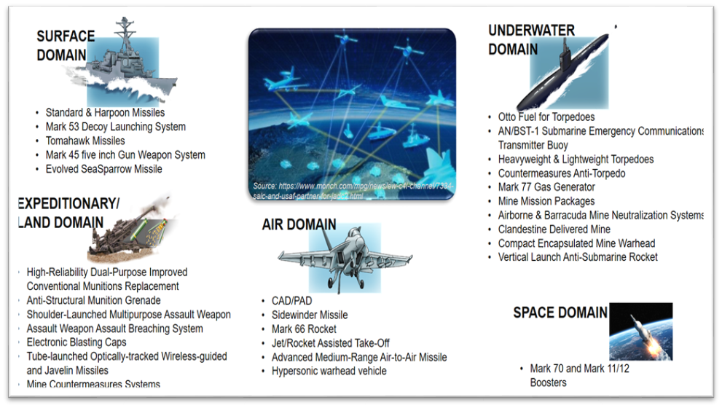
Systems Engineering (E) Department
Lines of Operation
Warfighting Impact
Energetics technology
Micro-electrical mechanical systems, lethality, blast effects, insensitive munitions and savings-through-simulation
Energetic systems
Engineering for all warfighter domains
CAD/PAD support of more than 3,000 ejection system components
Development, support and delivery of energetic system solutions across the full acquisition cycle to provide the warfighter with a kinetic advantage
Technical, acquisition and logistic product support across all domains (Surface, Undersea, Air, Land/Expeditionary, Space)
Ordnance assessments leading to service life extensions
Capabilities and Facilities
MEMS explosive-certified cleanroom, characterization and test
Polymer and metal additive manufacturing capability (3D printing)
CAD/PAD virtual fleet support
High Performance Computing (HPC) for advanced modeling and simulation
Airguns test rounds from 3” - 21”
Energetics Solutions for development efforts and existing products
Exploitation
Electrostatic Discharge Test Facility
Notes:
Warfighting Impact
STANDARD Missile and Evolved SeaSparrow (ESSM) support for rocket motor propulsion
Ordnance Assessment (OA): “flying farther” also includes flying longer. Our OA provides analyses enabling the Fleet to increase service lives of energetic components saving money and extending inventories
Lines of Operation
Division E4 (System Safety Division): Performs System Safety for conventional weapon systems, associated components and other devices that contain energetics.
Capabilities and Facilities
NSWC IHD has the only explosively certified cleanroom in the country. This allows us to integrate explosives with tiny electrical and mechanical components to create MEMS components
We have both Metal and Polymer (plastic) 3D Manufacturing capabilities suitable for prototype production
CAD/PAD Virtual Fleet Support – we manage the supply systems for aircrew escape ejection system CAD/PAD components (over 3,000 active components) allowing the warfighter to obtain any component within one week from order request.
Clandestine Delivered Mine is an underwater mine being developed in response to an urgent need. The mine is being developed for delivery by a large diameter UUV. The engineering department is teamed with NSWC-PC and responsible for Safety and Arm Device.
Airguns: The engineering department utilizes a verity of airguns to develop warhead and Fuze systems. The airguns simulate environments such as gun setback loads or are used to accelerate test articles to velocity for impact testing.

Slide 15
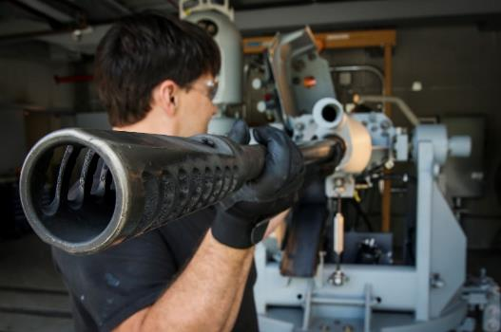
Systems Integration (G) Department
Lines of Operation
Warfighting Impact
In-service engineering agent and acquisition engineering agent for guns and ammo
Conventional ammunition commodity management
Weapons and armament PHST design agent and ISEA
Gun weapon systems standardized pier-side maintenance and repair
Mobile Ammunition Evaluation and Repair Unit
Gun weapon system casualty report support
Fleet liaison for guns and ammo (LANT FLT / PACFLEET)
PHST member of Board of Inspections and Survey, and Weapons System Explosive Safety Evaluation Board member
Capabilities and Facilities
16,000 sq. ft. Packaging, Handling, Storage and Transportation test facility
Gun stand complex
12,000 sq. ft. minor caliber lab
Medium/minor caliber live fire range facility
Quad City Cartridge Case Facility
Notes:
Warfighting Impact
Standardized Pier-side Maintenance and Repair (SPMR) is an 8 week maintenance evolution at pier-side during a ships maintenance availability. During an SPMR, additional ordnance alteration may be installed to further improve the weapons performance. The SPMR refurbishes rusted and worn out parts and extends the life of a gun. At the mid-point of a MK 45 Mod 4 Gun’s 30 year life it is removed from the ship and returned for depot repairs and replaced with a new gun. The cost of an SPMR is approximately $750K while the cost of a replacement is millions of dollars. The SPMR process has been extended to all of our shipboard guns; for some of the newer guns, the SPMR methodology is just being developed.
Mobile Ammunition Evaluation and Repair Unit (MARUE) –MAERU, under the auspices of OPNAV 8000.16 NOMP, is tasked to inspect and maintain the Navy’s 2T/0T/2E (Surface conventional/USMC/Aviation – 20/25MM) ammunition by conducting visual surveillance sampling. Surveillance Site Visits are conducted three times per year at 9 different OCONUS locations on a rotational basis. It enables us to monitor and maintain the Navy’s Ready For Issue (RFI) serviceable stock and eliminate and reduce the high cost of transportation costs, by performing in-place evaluation and on-site maintenance.
Fleet Liaisons are present to address LANTFLEET and PACFLEET issues with any guns or ammunition, they can frequently quell any concerns before they reach the higher echelons
Live Fire Test Range – Our outdoor range facility is used for function casualty testing of NAVAIR Auto Guns (M61A1, M197 and GAU-12) and lot acceptance testing of NAVAIR Ammunition. It is also used for acceptance testing of Mk 38 Mod 2 Guns.
The Quad City Cartridge Case (QCCCF) facility is an Army ammunition plant located at the U.S. Army Arsenal in Quad City, Ill., and is operated by the command to manufacture Navy 5" cartridge case ranging from 40mm through 155mm. The QCCCF is a state-of-the-art facility with deep drawn technology that produces premium brass and steel cartridge cases for use by the fleet.
The deep-drawn cartridge case production capability was located at the former Riverbank Army Ammunition Plant (RBAAP) in Riverbank, Calif. When RBAAP was closed through the BRAC of 2005, the brass and steel deep-drawn cartridge cases capabilities were relocated to Rock Island Arsenal, Ill. The new facility was completed in 2011 and named the Quad City Cartridge Case Facility. In 2011, the steel case production line was successfully tested and proven out in its new location. Due to decreased procurements for cartridge cases, QCCCF was laid away in 2014. NSWC Indian Head Division began the reactivation of QCCCF for research, development and production efforts in 2017. QCCCF is a Government-Owned, Contractor-Operated facility.

Slide 16
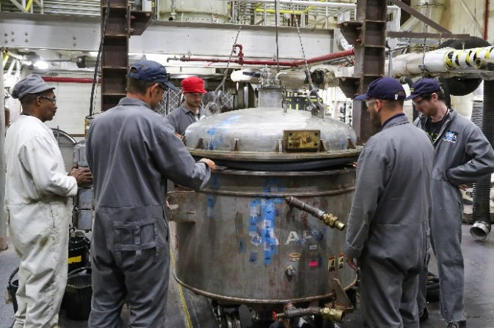
Energetics Manufacturing (M) Department
Lines of Operation
Warfighting Impact
Energetic development, scale-up and qualification
Design, development and low-rate initial production/full-scale production of energetic materials and ordnance end-items
Flexibility to make products from mortars to rockets through the same processing line: from 5 grams to more than 1 million pounds
Maintains in-house energetics processing capabilities and engineering expertise to:
    Act as sole source, second source and emergency supplier
    Provide expertise allowing program offices to act as “smart buyers” for the DoD, foreign military sales and other customers
Provider of Otto Fuel II torpedo fuel
CAD/PAD manufacturing and centralized stock point
    Sole stock point of all Navy CAD/PADs
    Able to ship parts anywhere around the globe
Capabilities and Facilities
Cast explosive and cast-composite propellant manufacture; pressed and melt cast explosives and warheads
Large rocket motor casting, assembly, and rework
Solvent-based and solventless mixing and extrusion
Washout and explosive machining
Chemical manufacturing and scale up
Agile Chemical Facility, a state-of-the-art nitration facility
CAD/PAD, pyrotechnics and rocket motor igniters
Decontamination and disposal
Advanced manufacturing machine shop
Precision CNC machining; NAVAIR/AWS certified welding, NAVSEA certified paint inspectors; certified weight testing
Depot source of repair and maintenance
Designated overhaul point, Depot Source of Supply for Packaging, Handling, Storage and Transportation (PHS&T)
Notes:
Warfighting Impact
We are the sole provider of liquid monopropellant (OF II) for the United States and our allies and have manufactured the compound for more than 50 years. We continue to manufacture 250K lbs per year while our primary nitration facility is being renovated to allow greater flexibility, lower cost and improved safety.
Consolidated Stock Point (CSP)
We are the sole provider of Navy CAD/PADs. Using our CSP, sailors can requisition any Navy CAD/PAD that is needed and have the item in hand within a week.
Lines of Operation
The department has flexible facilities that can be readily modified for product development, qualification and production. This allows us to make small quantities (50 grams) to a million pounds based on our customers needs.
NSWC IHD is a major contributor to the Navy’s munitions programs and has developed almost all of the IM PBX formulations that are currently used by the Navy.
Unique Capabilities
NSWC IHD has the capability to process 50 grams to a million pounds using a variety of different processes: composite formulations made in horizontal and vertical mixers, unique and specialty chemicals made in reactors, pressed explosives both as cartridge loaded pellets and pressed directly into hardware. We also maintain the capability to manufacture CAD/PADs and igniters.
We have the ability to quickly manufacture prototype tooling/equipment using additive manufacturing.
Polymer-bonded explosive mixing/casting: Polymer (plastic) acts as binding agent for crystalline energetic material (e.g. RDX). Required for materials that can’t be melt cast in a mold to make the final shape, so the energetic formulation must be mixed then cast. The material’s mechanical behavior and processing is often reminiscent of playdoh.
Otto Fuel II: Unique blend of components enabling oxidizer free ignition and propulsion capability, therefore ideal for underwater. Production is inherently dangerous and technically difficult so not feasible privately at relevant scales.
Agile Chemical Facility (ACF): Previously IHD ran two separate facilities that could only produce a limited set of nitrate esters at limited scales. Nitrate esters are essential energetic ingredients in legacy and future energetic materials. In particular, one plant could only run at massive full scale production levels. ACF brings a vertically integrated manufacturing capability enabling operations from scale up to full scale production of a much wider variety of nitrate ester materials. Among these are materials that should lead to significant performance improvements in a variety of energetic materials and formulations.

Slide 17

Explosive Ordnance Disposal
(D) Department
Warfighting Impact
Technical Data and Procedures
Foreign Materiel Acquisition and Exploitation
Explosives Detection Equipment Program
Demonstration and Assessment Team and EOD Technology Assessment Team
Underwater EOD
EOD Unmanned Systems
Ordnance Disrupt/Modeling & Simulation
Anti-Terrorism/Force Protection
Keep Them Off The Wall
Lines of Operation
EOD Information Management
  Collection, analysis, development and dissemination of procedures and countermeasures information to the Joint Service EOD community
EOD Systems
  Provides EOD support across the Development and Acquisition Spectrum: S&T, prototyping, POR development, T&E, engineering agent/ISEA, support/sustainment, disposal
Battle Lab
  Provides a cycle of equipment review and evaluation to feed capability gap assessment, COTS/MCOTS buying decisions, requirements development, and technology implementation at the speed of relevance
Capabilities and Facilities
Co-located with EOD service detachments and Joint EOD Executive Agency Support office
24-7 / 365 warfighter call-back ability to Technical Support Center
Explosive test and robotics test ranges
Magnetic Signature Test Facility
Prototyping facilities to accelerate ideas/rapid support for 3D printing
Explosive Chemistry Laboratory
Electronics Laboratory
EOD Library
Disassembly complex
Notes:
Lines of Operation:
EOD Information Management Division: five branches to accomplish the processes of collection, analysis, development and dissemination of countermeasure information to the JSEOD community.
Logistics (D3): provides worldwide logistics support for EOD customers, including complete life-cycle logistics support to field and maintain JEOD tools and equipment. Warfighting Impact
AEODPS - The process for EOD Countermeasures Development is a series of inter-related activities that results in information products globally used by JSEOD forces, U.S government federal agencies, and Allied Nations to counter threats posed by unexploded ordnance, IEDs and WMDs.
JEOD Decision Support system (JEOD DSS): ACAT-IVT Program-of-Record is sponsored by PMS-408 EOD that resides on the JEODNET. The JEODNET enclave includes the network and information systems infrastructure that provides global mission essential support for EOD personnel.
Foreign Materiel Acquisition and Exploitation (D12): Responsible for three primary functions; 1) acquire foreign manufactured ordnance; 2) exploit said ordnance to produce documented weapons technical information; and 3) follow-on development, test and validation of render safe and disposal procedures for use by the EOD community.
Advanced EOD Robotic Systems (AEODRS): This is family of open architecture robots which will be available in three platform sizes.
DAT: The NSWC IHD Demonstration and Assessment Team specializes in conducting warfighter suitability assessments to help engineers and warriors better understand each other, and enhance technology innovation by getting warfighter input to the developers early in the acquisition process. In addition, the DAT has an extensive cyber portfolio focusing on threat mitigation, baking cyber defense into technologies early in their development. The DAT focuses on getting the best possible technological solutions to the warfighter at the pointy end of the spear by engaging with them early and often in the developmental process.
WILL NEED TO BE UPDATED TO RECOGNIZE THE REORG/BATTLELAB

Slide 18
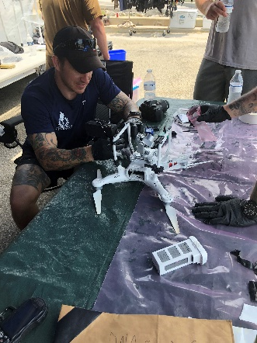
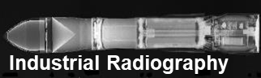
Expeditionary Exploitation Unit One (EXU-1)
Organization and Manning
Type II Sea Duty Operational Command (Ech V)
ISIC: NSWC Indian Head Division
Mission
Technical Exploitation Platoons (TXP) and Advanced Exploitation Company (AXC) that provide expeditionary exploitation support to collect, process, exploit and analyze conventional and improvised threats in support of fleet and joint commanders, the intelligence community, interagency, allied and partner nations to prevent technical surprise, develop countermeasures and enable attribution.
Capabilities
Globally deployable, tailored to Fleet requirement
Expeditionary Mine Countermeasures Exploitation
Level I Tactical Exploitation (Field)
Level Level II Operational Exploitation (Lab)
Level III Reach back (CONUS)
Foreign Materiel Acquisition
Intelligence Community & SOF Interoperability
Surface and Underwater Post Blast Analysis
Electronic Exploitation
Notes:
The Expeditionary Exploitation Unit (EXU-1) is the Department of Defense's (DoD) premier expeditionary improvised and conventional weapons exploitation and acquisition organization -- operating in both terrestrial and maritime environments. Maritime Exploitation (MX), Surface Exploitation (SX), and Foreign Materiel Acquisition (FMA) Platoons collect, process, exploit and analyze improvised and conventional weapons, ordnance and components, on land and at sea, for the purpose of providing near real-time technical intelligence to tactical commanders, EOD community, service components, (DoD) national level intelligence agencies, and allied and partner nations.
Mission
The EXU-1's mission is to collect, process, exploit and analyze enemy improvised weapons (to include Improvised Explosive Devices (IEDs)), conventional ordnance and related materials for the purpose of providing support to near-real time Technical Intelligence to tactical and operational commanders and EOD forces. EXU-1's secondary mission is to provide tailored deployable technical intelligence and Foreign Material Acquisition (FMA) support to Service, DoD, and National Level Intelligence activities as directed by higher authority.
Objective
The EXU-1's objective is to provide Level 1-2 adaptable, scalable, mobile capability (personnel and equipment) for collection, exploitation, and analysis of improvised and conventional weapons to support land and maritime missions. This capability is tailored to meet mission requirements.

Slide 19

Questions?

Slide 20
Back-up Slides
Please use the following Distro A slides to compliment and tailor your brief to suit your individual audiences. Slides can be used in any amount of order based on your needs.
Slides are grouped in accordance to their general characterization.

Slide 21


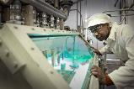
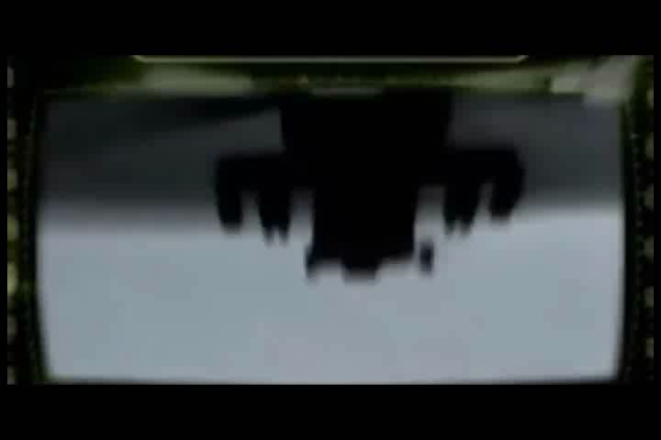

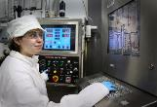


Molecule-to-Mission Across the DoD
Air Launched 2.75 inch Rockets
The command is the Warfighter’s source for production of the 2.75 inch rocket: from propellant manufacturing to production of the warhead. We make and deliver the tools to give our Warfighter the winning edge.
Cartridge Actuated Devices / Propellant Actuated Devices (CAD/PAD)
NSWC Indian Head Division manufactures CADs/PADs for aircrew escape ejection systems. Our Virtual Fleet Support facility allows the Warfighter to obtain any component within one week from order request.
Science and Technology (S&T)
Research and Development (R&D)
Testing and Evaluation (T&E)
Product Delivery
Warfighter Support
Notes:
IHD is a has full spectrum capabilities. Here are two examples highlighting what we mean by full spectrum to meet the needs of the warfighter.
The unique capability at Indian Head exists nowhere else in the nation
The ability to develop new energetics, manufacture at pilot scale, assemble and ship all within the fenceline of Indian Head provides significant savings in terms of cost, time, and safety implications.
1) 2.75 inch rocket - The Zuni rocket was invented at IHD and continues to be one of the most in demand air launched rockets
The Engineering Manufacturing Department can design, develop and produce energetic materials and ordnance end-items with the flexibility to make products from mortars to rockets through the same processing line: from 5 grams to more than 1M lbs. In this case, it is 2.75 inch rockets for various helicopter models. The command is the warfighter’s source for production of the 2.75 inch rocket: from propellant manufacturing to production of the warhead. We make and deliver the tools to give our warfighter the winning edge.
2) CAD/PAD
The command designs, develops, manufactures and is the central stockpoint for CAD/PAD items used in aircrew escape ejection systems. Our Virtual Fleet Support facility allows the warfighter to obtain any component within one week from order request. The video shows CAD/PAD testing on an F/A-18 Hornet.

Slide 22
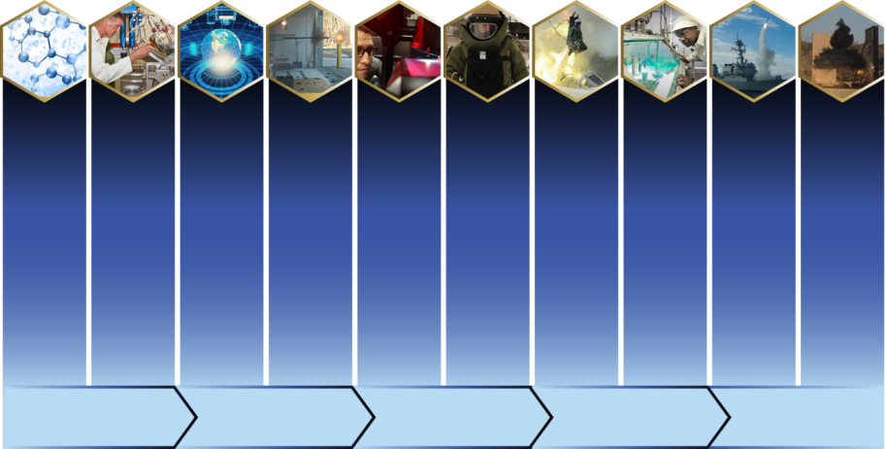
NSWC Indian Head
Mission: Research, develop, test, evaluate (RDT&E), manufacture and provide in-service support of energetics and energetic systems. Provide Soldiers, Marines, Sailors and Airmen with information and technology to detect, locate, access, identify, render safe, recover, exploit and dispose of explosive threats.
Vision: Outpace our Adversaries
Key Highlights:
Navy’s Center of Excellence for energetics
SECNAV designated Arsenal for energetics and ordnance systems
Only DON activity delivering full-spectrum energetics solutions from basic research through disposal
(U)
6.1
6.2
6.3
6.4
6.5
6.7
Advanced Tech Development
Engineering and Manufacturing Development
Basic Research
Demonstration and
Validation
Operational Systems Development
Manufacturing and
In-service Engineering
Acquisition Engineering
Fleet Support
Applied Research
Demilitarization/Disposal
SCIENCE AND TECHNOLOGY
(S&T)
RESEARCH AND DEVELOPMENT
(R&D)
TESTING AND EVALUATION (T&E)
PRODUCT DELIVERY
WARFIGHTER SUPPORT

Slide 23
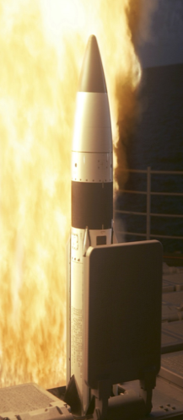
What Are Energetics?
Energetics define a weapon system’s performance:
  Range, speed, lethality, signatures management, safety, logistics
Energetics include:
  Ingredients → Formulations → Energetic material systems
Energetics are essential to every warfighting domain:
  Undersea (e.g., torpedo fuel, warheads, mines)
  Surface (e.g., guns, SM, ESSM)
  Air (e.g., rockets, ejection seats, bombs, Sidewinder Missile)
  Expeditionary (e.g., ordnance disposal, crew served weapons)
Energetic material systems are a critical enabler for all combat capability
Notes:
Talking point: symbiotic relationship with China Lake as keepers of Navy’s energetics expertise

Slide 24

The Navy’s Arsenal
  Purpose built in 1890
  Navy’s public arsenal
  Government owned
  Required for surge
  Leader in innovation
  Navy’s trusted experts
NSWC IHD is the Navy’s only Government owned and operated surge energetics manufacturing site with the capabilities and expertise needed for wartime mobilization
Notes:
Talking point: IHD provides full-spectrum support (cradle to grave) for Navy energetics. Support for PEO U&W includes:
PMA-208
Manufacturing: Mk 70 booster Mods and Mk 70 PUSH (new production) for GQM-163A Coyote
PMA-280
Tomahawk Weapon System
Testing: Functional ground testing (FGT) of AUR missiles
R&D: Warhead development (FY25 POM)
Engineering/Logistics: Energetics IPT lead, Logistics IPT support (McAlester Det.)
PMA-242
Airborne rockets and naval targets
Engineering/Logistics: Navy RATO/JATO rockets, Technical Design Agent for Mk 66 (Tri-Service)
Manufacturing (rockets): Mk 152 warhead, LAU-61-G/A, Mk 90 propellant grain,
Manufacturing (RATO): Mk 117/Mk 85/Mk 129 rocket motors to support BQM-74E,-177,-34 naval targets
PMA-201
CAD/PAD sustainment and engineering
GP Bomb RDX fill
JDAM/LRASM/SDBII/SLAM ER/Harpoon PHS&T
ESD testing
Harpoon ENCAP energetics, ordnance assessment

Slide 25

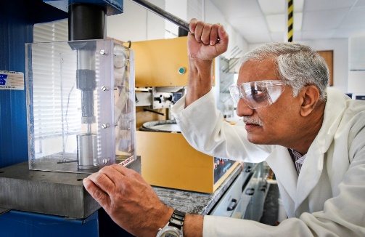
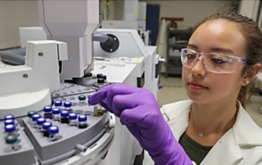

RDT&E (R) Department
Warfighter Impact
Qualification of PBXIH-136 UW Explosive Formulation
Chemical Biological & Radiological Fleet
Integration & Support
Shipboard Collective Protection
Blast Assisted
Munition Advanced
Low Cost Munitions Ordnance Replacement
Reactive Material for Enhanced Lethality
Top Customers
WFC Collaborations
NSWC DD: CBR Defense – RDT&E
NAWC WD China Lake and NSWC DD: advanced gun propellants and primers and a gun launched solid fuel ramjet projectile to improve range of 5” guns; novel processing methods for enhanced performance formulations
NSWC DD: Accelerated development of Reactive Materials technology and advanced gun propellants and primers for large caliber guns.
NSWC Philadelphia: Share ColPro engineering agent roles for ship integration.
NSWC PCD: CBR Defense in the area of individual protective equipment.

Slide 26
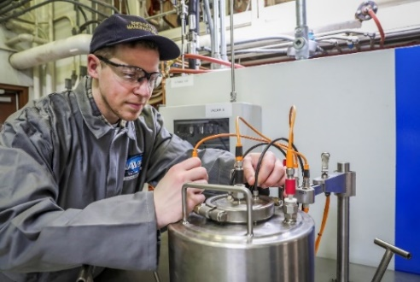
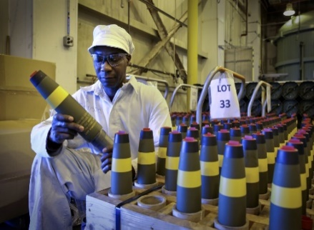
Energetics Manufacturing (M) Department
Warfighter Impact
CXM AF-5/7
CKU-5 Rocket Catapult
MK90 Propellant Grain Production
Otto Fuel II
CKU-7 Rocket Catapult
Top Customers
WFC Collaborations
NSWC DD: Support Navy gun program/development
NSWC DD: Explosive Waste disposal
NUWC NPT: Disposal of Mk75 gas generators

Slide 27
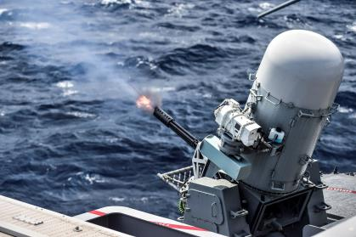
Systems Integration (G) Department
Warfighter Impact
Standard Pier-Side Maintenance & Repair (SPMR)
Shipboard Gun Installation Support
Ordnance Handling Equipment (OHE) ISEA
Conventional Ammunition IS & Acq Spt
Mobile Ammunition Evaluation & Reconditioning Unit (MAERU)
Quad Cities Cartridge Case Facility Reactivation
Top Customers
WFC Collaborations
NSWC DD: Mk 45 Gun Weapon System Technical Enhancement Training and Design Agent for 2T Conventional Ammunition
NSWC PHD: Fleet Integrated Support Team (FIST) optimizes support to the fleet via the RMC’s
NUWC & NMC Pearl Harbor Detachments Stowage Density: Mk 48 Torpedo Stackable Transportation & Storage Cradle Design, NSWC CR: Pyro Demo In Service & Acquisition Engineering Support
NSWC DD, NSWC IHD Develop and test the JENGA 5 inch round
Shipboard Weapons Integration Team (SWIT) is a NAVSEA/NAVAIR team that assures new weapon systems are properly supported and able to move as intended aboard ship
NSWC Crane: Collaborate with Crane to provide acquisition engineering support for PYRO Demo commodities for the Navy

Slide 28
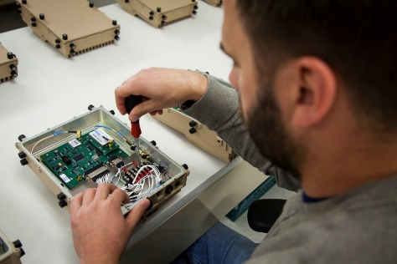
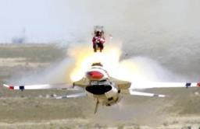
Systems Engineering (E) Department
Warfighter Impact
Clandestine Delivered Mine (CDM)
Mk 70 Booster Mod for GQM-163A Target
Heavy Weight (HW) Torpedo Prototype (Contender)
Parachute Deployment Rocket Motor (PDRM) Mod 1
Expeditionary Program Office (NEPO) Depot Spt Services
Top Customers
WFC Collaborations
NSWC PCD: Autonomous AAV / MK154 (NISE 219)
NUWC NPT, NSWC CD: RPG of the Sea
NSWC CD: Exploitation of Foreign Mine Influence Fuzing
NSWC DD: Clandestine Delivered Mine
NSWC PCD: NSWC DD: System Safety
NSWC CD: Dynamic System Mechanics Advanced Simulation (DYSMAS)

Slide 29
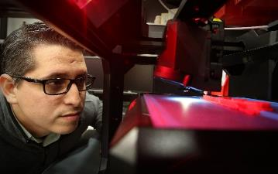
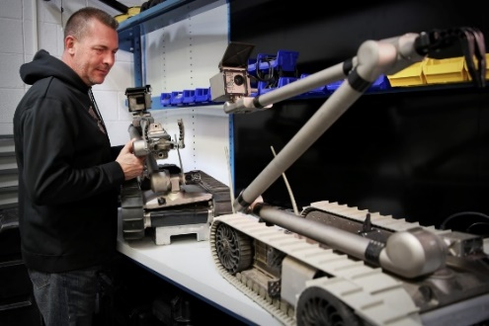
Explosive Ordnance Disposal
(D) Department
Warfighter Impact
JEOD Pubs (AEODPS/
60-series)
JEOD NIPR/
SIPR Portal
JEOD
Robotics
Explosive Detection Equipment
JEOD Tools /
Technology & Sustainment
Top Customers
WFC Collaborations
NSWC Crane: EOD and JCREW programs (Collaborate on several PoRs), also proposing Joint NISE 219 w/Crane for Hemlock program
NSWC Dahlgren: New/developing collaboration on unmanned communications utilizing IHD Developed FlexCSR Radio and encryption as well as UAS efforts (DD), future NISE 219 proposals
NSWC Carderock: 2017 ANTX UGV (IHD) launched off USV
Multiple: Unmanned Vehicles & Autonomous Systems (UVAS) WG – Since 2017 weekly interface between WFCs on projects, unmanned systems needs, etc.

Slide 30
Roles of the Warfare Centers
NAVSEA WARFARE CENTERS
Make naval technical programs successful
Provide a bridge between the technical community and the warfighter
Determine and develop capabilities for the fleet
Verify the quality, safety, and effectiveness of platforms and systems
Design, develop, and field solutions for urgent operational fleet needs
Operating Principles
Part of the Naval Research & Development Establishment (NR&DE)
Technical Capabilities - disciplined process for accepting and assigning the right work to the right Division
Operate under the Navy Working Capital Fund business model
Workforce size based on funded workload
Perform work our industry partners can’t, won’t or shouldn’t do
One Team: Expanding the Advantage
NAVSEA WARFARE CENTERS
Notes:
Slide demonstrates unique mission, roles & responsibilities of Warfare Centers.
We perform vital, inherently governmental functions across the warfare system life-cycle, are stewards of technical capabilities and critical knowledge, and fill a vital role in bridging the gap between military problems and technical feasibility.
We bridge the early research and concept development with technology development, transition and ISE support to the fleet.
We fulfill our role of smart buyer role by applying necessary end-to-end analysis, development science and engineering support, TDA functions and T&E.

Slide 31
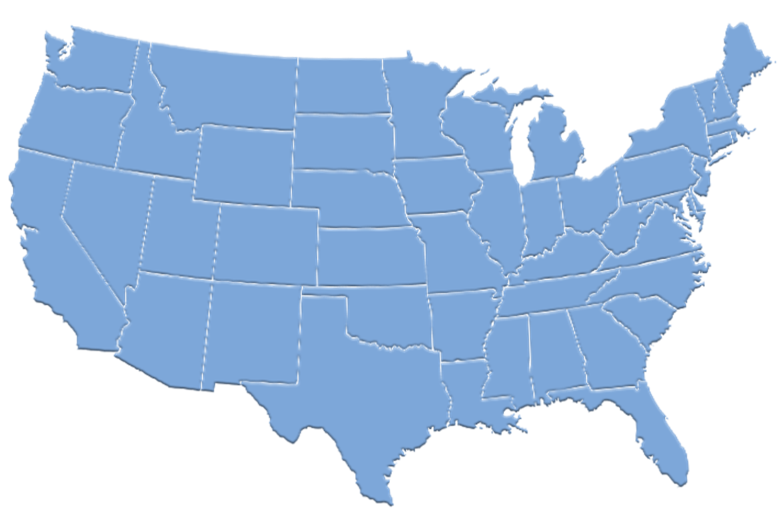
NAVSEA Warfare Centers at a Glance
NUWC Keyport Div
Keyport, WA
NSWC Crane Div
Crane, IN
Naval Sea Logistics
Center (NSLC)**
Mechanicsburg, PA
NUWC Headquarters
NUWC Newport Div
Newport, RI
NSWC Philadelphia Div
Philadelphia, PA
NSWC Carderock Div
West Bethesda, MD
NSWC Headquarters
Washington, D.C.
NSWC Dahlgren Div
Dahlgren, VA
NSWC Port
Hueneme Div
Port Hueneme, CA
Combat Direction
Systems Activity*
Dam Neck, VA
NSWC Indian Head Division
Indian Head, MD
NSWC Corona Div
Corona, CA
* Part of NSWC Dahlgren Division
** Part of NUWC Keyport Division
NSWC Panama City Div
Panama City, FL
Warfare Center
Quick Facts
~24,479 diverse and highly educated employees focused on innovation (~16,400 scientists, engineers, and technicians with ~750 Ph.D.s)
129 unique Technical Capabilities (TCs) across 10 Divisions
Operates under the Navy Working Capital Fund (NWCF) business model
Disciplined process for accepting and assigning the right work to the right WC Division based on TCs
Part of the Naval Research & Development Establishment (NR&DE)
Size of the workforce is based on the funded workload
Performs work our industry partners can’t,
won’t or shouldn’t do.
Maintains more than 164 unique RDT&E facilities
Notes:
Size of the Warfare Centers’ workforce is based on the funded workload.
We perform work our industry partners can’t, won’t or shouldn’t do.
Warfare Centers maintain more than 164 unique RDT&E facilities.
We have 22,060 diverse and highly educated employees focused on innovation (~14,700 scientists, engineers, and technicians with ~600 Ph.D.s).
There are 128 unique Technical Capabilities spread across our 10 Divisions.
We aren’t mission funded; we operate under the Navy Working Capital Fund business model.

Slide 32




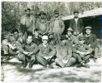




Command Timeline
1917: The Explosive D plant opens.
1973: CAD/PAD work is assigned to Indian Head.
1947: Indian Head establishes R&D Department.
2013: NAVSEA announces the merger of NSWC Indian Head Division and Naval EOD Technology. NSWC IHEODTD is formed.
1890: Ens. Robert Dashiell takes over construction and supervision of the new Naval Proving Ground upon its relocation to Indian Head.
1942: Explosive Investigation Laboratory established at Stump Neck Annex.
1954: The Biazzi Nitroglycerine Plant opens.
2007: Naval EOD Technology Division aligns under NAVSEA as a division of NSWC.
1900: Indian Head begins producing smokeless powder. Dr. George Patterson is brought aboard as the station’s first chief chemist.
2015: Indian Head celebrates its 125th Anniversary.
1960: An overhead of the Polaris Plant.
1927: Indian Head begins work on torpedo fuzes, anti-submarine fuzes, signals and buoys.
1946: Navy WWII veterans employed at Indian Head’s extrusion plant pose for a photo.
FLY FARTHER HIT HARDER SAVE LIVES

Slide 33
Economic Impact
Where We Live
Maryland:
56%
NSWC IHD
Total Maryland FY22 Payroll
$346 million
FY22 Maryland
Contract Dollars
$44.6 million
Other states:
21%
Virginia:
23%
County-by-County Breakdown (Maryland)
Charles County 68%
Saint Mary’s 12%
Prince George’s 10%
Calvert 3%
Anne Arundel 3%
Other 4%

Slide 34
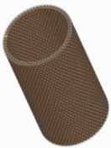

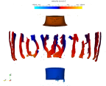
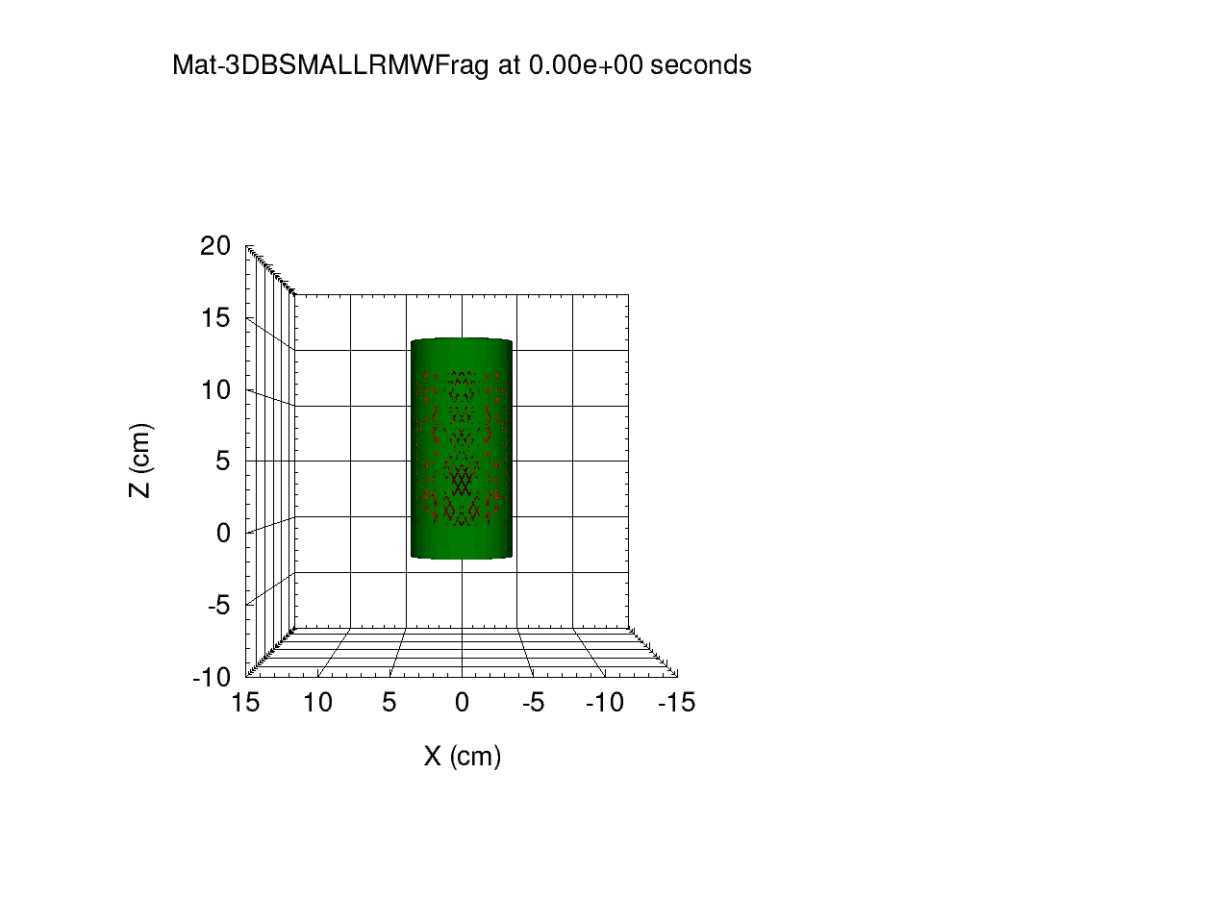
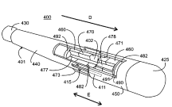
Technology Transfer
NSWC IHD Technology Transfer initiatives look to jointly develop dual-use technologies with academic and private industry partners, develop collaborations with partners interested in access to our unique expertise and facilities, and assist in the commercialization and marketing of out intellectual property.
Partnering Agreements
73 Active CRADAs
4 Patent License Agreements
9 Educational Partnership Agreements
8 Partnership Intermediary Agreements
10 Year Metrics
CRADAs
  144 collaborations
  $18 million
Patents
  172 patents awarded
  $71,000 in revenue
34

Slide 35
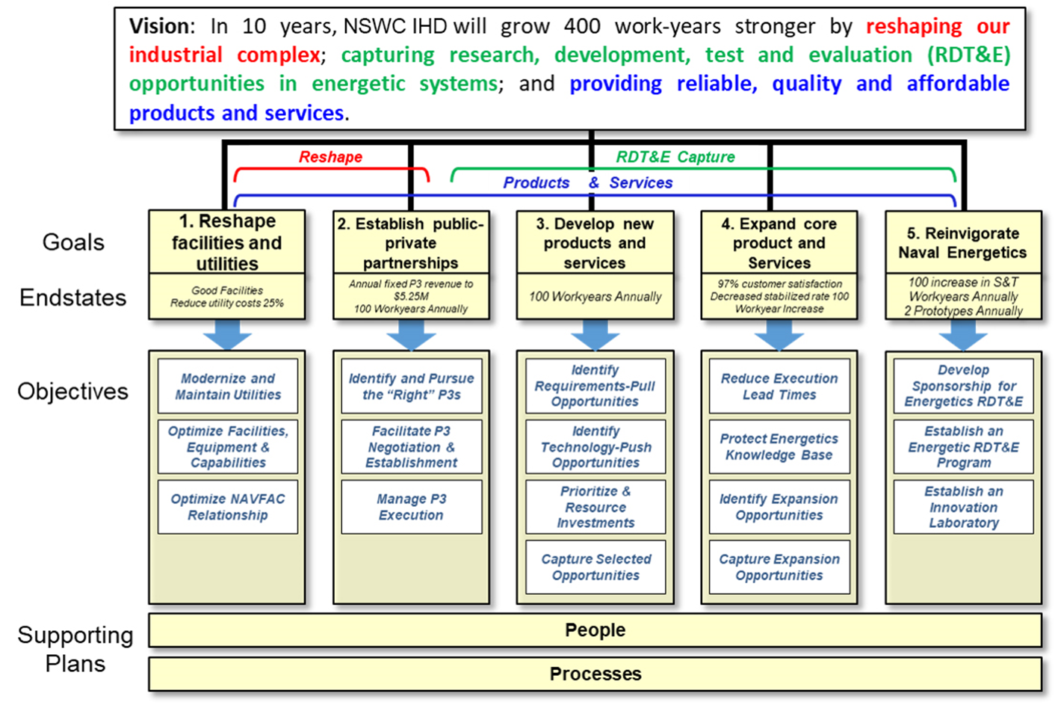
Strategic Vision and Goals

Slide 36


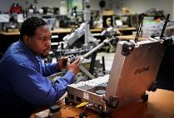
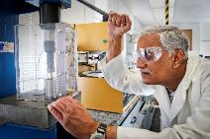
Occupational Demographics
l
l
Trades and technicians both unique and essential for explosive manufacture, scale-up, laboratory operations and energetic tests and evaluations.

Slide 37
S&T/RDT&E

Slide 38
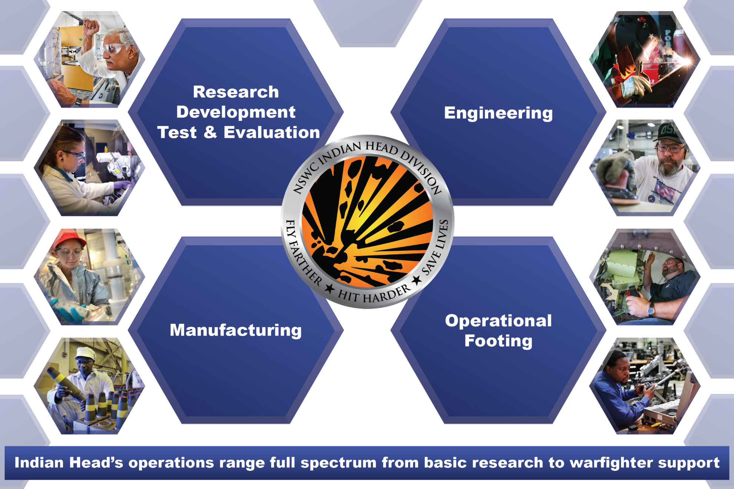
NAVSEA WARFARE CENTERS
Full Spectrum Capabilities
Notes:
IH is made up of 4 specific capabilities which make our organization unique from others.
We have cradle to grave operations. We can develop a prototype (RDT&E) and turn it into an actual product to delivery (Manufacturing) all in-house. We even have boots on the ground for direct warfighter support.

Slide 39

Technical Departments
RDT&E (R)
Systems Engineering (E)
Systems Integration (G)
Energetics Manufacturing (M)
Explosive Ordnance Disposal (D)
Expeditionary Exploitation Unit One (EXU-1)

Slide 40
Molecule-to-Mission
6.1
6.2
6.3
6.4
6.5
6.7
Advanced Tech Development
Engineering and Manufacturing Development
Basic Research
Demonstration and
Validation
Operational Systems Development
Manufacturing and
In-service Engineering
Acquisition Engineering
Fleet Support
Applied Research
Demilitarization/Disposal
SCIENCE AND TECHNOLOGY (S&T)
RESEARCH AND DEVELOPMENT (R&D)
TESTING AND EVALUATION (T&E)
PRODUCT DELIVERY
WARFIGHTER SUPPORT
Only DoN activity delivering both energetics and EOD technology solutions from basic research through disposal
Notes:
This reflects full spectrum capabilities:
We have cradle to grave operations. We can develop a prototype and turn it into an actual product to deliver all in-house.

Slide 41

Scientific Technical Staff
Technical Director
Mr. Ashley Johnson, SES
Key
= Senior Technologists
= Senior Scientists
Deputy Technical Director
Mr. Steve Meade (Acting)
Principal Technical Manager for RDT&E
Dr. Heather Hayden
= Chief Engineer
Chief Technology Officer
Dr. Kerry Clark
Senior Scientist
Dr. Alfred Stern
Senior Scientist
Mr. Carl Gotzmer
Chief Engineer
(Command)

Slide 42
Explosive Ordnance Engineering
(SEA-05E)
Deputy Warrant Officer
Ashley Johnson, SES
Deputy Director
Spencer Johnson
Technical Warrant Holders
Explosives (05E1)
Michael Kenyon
PHS&T (05E2)
David Hoegler
Propellants and Energetics Propulsion (05E3)
Dr. Jamie Gumina
CAD / PAD (05E4)
John Burchett
EOD (05E5)
Michael Hollander
Small Arms (05E6)
David Long
Anti-Terrorism Afloat (05E7)
Mike Konerman
Notes:
The Technical Director, Mr. Ashley Johnson is dual-hatted. He is also the SEA05E Deputy Warrant Officer for explosive ordnance engineering.
SEA05E executes the Technical Authority and the independent technical rigor to ensure that
technically sound, safe and reliable munition systems are delivered and maintained for the Navy.

Slide 43
Technical Capabilities
EOD / improvised explosive device (IED) / counter radio-controlled IED electronic warfare (CREW) threat and countermeasure information development and dissemination
EOD / IED / CREW technology development and integration
Emergent and national-need requirement energetics, S&T, ordnance components and systems
Air warfare energetics, ordnance components and systems
Surface warfare energetics, ordnance components and systems
Expeditionary and undersea warfare energetics, ordnance components and systems
EOD Unmanned Systems
Conventional and Improvised Weapons Exploitation
Chemical, Biological, and Radiological Defense Systems
Force Protection Systems Engineering, Integration, and Equipment Ashore

Slide 44
Center for Industrial
and Technical Excellence
NSWC IHD received Title 10 sec 274 designation as a Center for Industrial and Technical Excellence (CITE) for Energetics and Ordnance systems Depot maintenance and Arsenal activities in May 2014.
CITE designation provides the legal authority for NSWC IHD to form Public-Private Partnerships (P3).
  Workloads critical plant complexes
  Facilitates collaboration with private industry
  Reduces total ownership costs to the NAVY, promoting financial viability
To date we have entered into five P3 agreements with Private Industry
  Chemring – APOBS Grain Manufacture
  Chemring – Mk90 Grain Manufacture
  NEIH – Rocket Motor and Warhead Manufacture
  GreyOps – Explosive Neutralization Tools for EOD Applications
  GMP - RDT&E and Manufacture of Energetic Materials and Ordnance Systems
We are currently engaged in active P3 negotiations with several companies and expect three new P3s to be finalized in FY2021

Slide 45
Warfighter Products

Slide 46
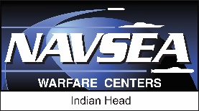
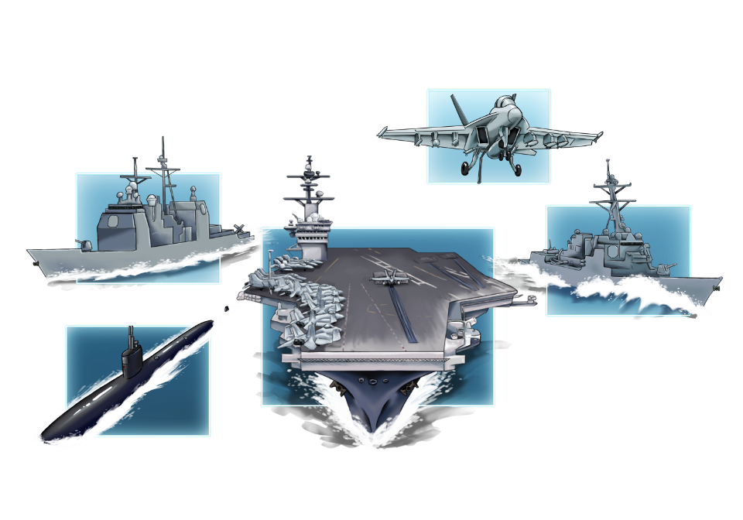
CARRIER STRIKE GROUP
Phalanx CIWS
SM-2 Missile
MK-53 Decoy Launching System
Tomahawk Missiles
MK-45 5-inch Gun
NSWC IHD provides products that
are utilized across all Carrier Strike
Group vessels and aircraft.
CAD/PAD
Sidewinder Missile
MK-45 5-inch Gun
Standard Missile
Tomahawk Missiles
Otto Fuel for Torpedoes
Phalanx CIWS
MK-53 Decoy Launching System
Evolved SeaSparrow Missile
MK-53 Decoy Launching System
CAD/PAD
Countermeasure Anti-Torpedo
Phalanx CIWS
Otto Fuel for Torpedoes
Tomahawk Missiles
CAD/PAD
Notes:
NSWC IHD is responsible for the following:
Otto Fuel for Torpedoes: We are the sole provider of liquid monopropellant (Otto Fuel II) for the United States and our allies and have manufactured the compound for more than 50 years. We continue to manufacture 250K lbs per year while our primary nitration facility is being renovated to allow greater flexibility, lower cost and improved safety.
MK-45 5-inch Gun: Command is the in-service engineering agent (ISEA) and acquisition engineering agent for guns and ammo. The Systems Integration Department’s Standard Pier-Side Maintenance and Repair (SPMR) unit refurbishes rusted and worn out parts and extends the life of a gun. At the mid-point of a MK 45 Mod 4 Gun’s 30 year life, it is removed from the ship and returned for depot repairs and replaced with a new gun.
SM-2 and Evolved SeaSparrow Missiles (ESSM): The command’s System Engineering Department provides rocket motor propulsion support for both the SM-2 and ESSM. The department’s ordnance assessment capabilities provides analyses enabling the Fleet to increase service lives of energetic components saving money and extending inventories.
Phalanx Close-In Weapons Support (CIWS): The command’s Systems Integration Department provides in-service fleet support for CIWS, and other naval gun systems, to include SPMR during a ship’s maintenance availability; providing a Mobile Ammunition Evaluation and Repair Unit to recondition ammunition at NMC OCONUS sites 3 per year on a rotational basis; and acting as fleet liaisons to address LANTFLEET and PACFLEET issues with any guns or ammunition.
Countermeasure Anti-Torpedo (CAT): Our Systems Engineering Department provides CAT warhead and fuzing support.
CAD/PAD: The command designs, develops, manufactures and is the central stockpoint for CAD/PAD items used in aircrew escape ejection systems. Our Virtual Fleet Support facility allows the warfighter to obtain any component within one week from order request. Tasked as a Tri-service organization, responsible for qualification of all CADs/PADs (surface, sub-surface, and air) and their ballistic systems and service life ordnance assessment after deployment. The E2 CAD/PAD Division is the in-service engineering agent for aircrew equipment such as automatically inflated air/deck-crew personnel life preservers (FLU-8/A and -12/A) and CADs for pilot personnel parachute release (SEAWARS) upon water immersion. Aircraft products: Stores Release, Countermeasure, Engine Fire Extinguisher Cartridges, Egress Systems, Ejection Seat Components, Cable Cutters.
MK 53 Decoy Launching System (DLS) (Nulka): A rapid-response active expendable decoy system capable of providing defense for ships against modern anti-ship missiles (ASM). Developed in cooperation with Australia, Nulka means 'be quick' in the Australian Aboriginal dialect. It is intended to counter a wide spectrum of present and future radar-guided ASMs. The system can either be integrated with the Combat System or used with the stand-alone Fire Control System.
The Tomahawk Land Attack Missile (TLAM): An all-weather, long range, subsonic cruise missile used for deep land-attack warfare, launched from U. S. Navy surface ships and U.S. Navy and United Kingdom Royal Navy submarines. IHEODTD Surface Systems Engineering Branch provides engineering services for rocket motors and other energetic components of surface-launched missiles and rocket boosters. The branch administers and conducts technical and project management functions for STANDARD missile propulsion and warhead items, gas generators and target propulsion units. It provides energetic engineering support for TOMAHAWK rocket motors.
Sidewinder Missile:
Aircrew Systems:

Slide 47
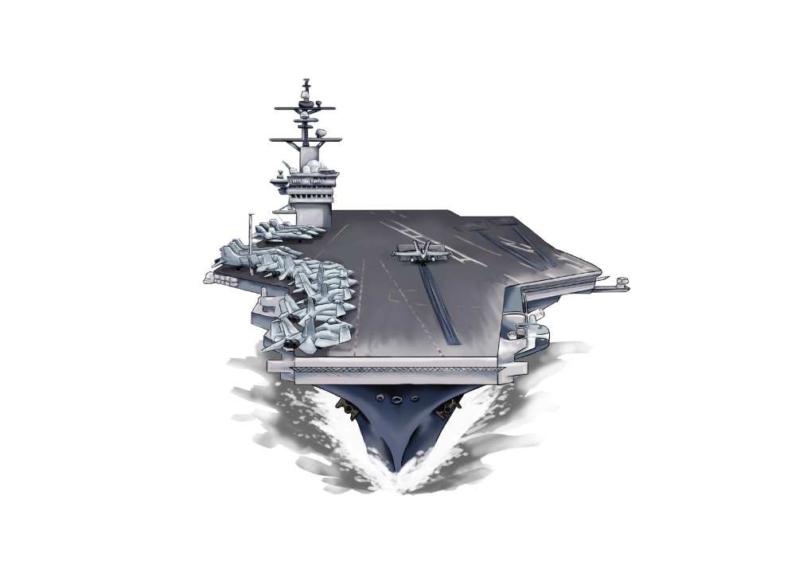
CARRIER PRODUCTS
Phalanx CIWS
MK-53 Decoy Launching System
Countermeasure Anti-Torpedo
Evolved SeaSparrow Missile
Notes:
The MK 53 Decoy Launching System (DLS) (Nulka): MK 53 Decoy Launching System (DLS) (Nulka): A rapid-response active expendable decoy system capable of providing defense for ships against modern anti-ship missiles (ASM). Developed in cooperation with Australia, Nulka means 'be quick' in the Australian Aboriginal dialect. It is intended to counter a wide spectrum of present and future radar-guided ASMs. The system can either be integrated with the Combat System or used with the stand-alone Fire Control System.
SM-2 and Evolved SeaSparrow Missiles (ESSM): The command’s System Engineering Department provides rocket motor propulsion support for both the SM-2 and ESSM. The department’s ordnance assessment capabilities provides analyses enabling the Fleet to increase service lives of energetic components saving money and extending inventories.
Phalanx Close-In Weapons Support (CIWS): The command’s Systems Integration Department provides in-service fleet support for CIWS, and other naval gun systems, to include SPMR during a ship’s maintenance availability; providing a Mobile Ammunition Evaluation and Repair Unit to recondition ammunition at NMC OCONUS sites 3 per year on a rotational basis; and acting as fleet liaisons to address LANTFLEET and PACFLEET issues with any guns or ammunition.
Countermeasure Anti-Torpedo (CAT): Our Systems Engineering Department provides CAT warhead and fuzing support.

Slide 48
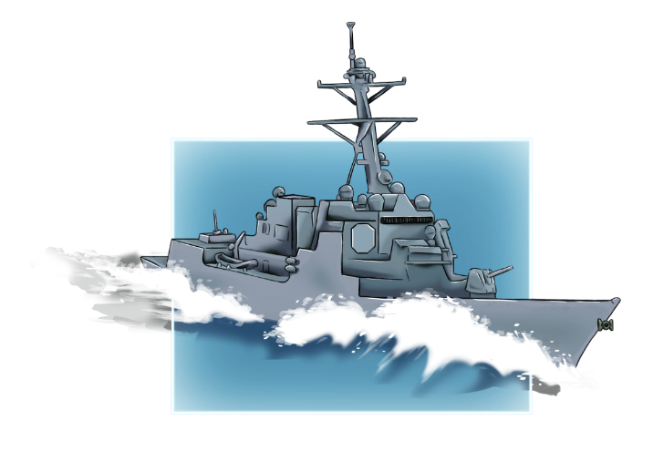
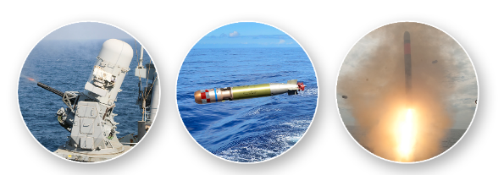
DESTROYER PRODUCTS
MK-45 5-inch Gun
SM-2 Missile
Tomahawk Missiles
Otto Fuel for torpedoes
Phalanx CIWS
MK-53 Decoy Launching System
Notes:
MK-45 5-inch Gun: Command is the in-service engineering agent (ISEA) and acquisition engineering agent for guns and ammo. The SPMR refurbishes rusted and worn out parts and extends the life of a gun. At the mid-point of a MK 45 Mod 4 Gun’s 30 year life it is removed from the ship and returned for depot repairs and replaced with a new gun.
The Tomahawk Land Attack Missile (TLAM): An all-weather, long range, subsonic cruise missile used for deep land-attack warfare, launched from U. S. Navy surface ships and U.S. Navy and United Kingdom Royal Navy submarines. IHEODTD Surface Systems Engineering Branch provides engineering services for rocket motors and other energetic components of surface-launched missiles and rocket boosters. The branch administers and conducts technical and project management functions for STANDARD missile propulsion and warhead items, gas generators and target propulsion units. It provides energetic engineering support for TOMAHAWK rocket motors.
Otto Fuel for Torpedoes: We are the sole provider of liquid monopropellant (Otto Fuel II) for the United States and our allies and have manufactured the compound for more than 50 years. We continue to manufacture 250K lbs per year while our primary nitration facility is being renovated to allow greater flexibility, lower cost and improved safety.
Phalanx CIWS: The command’s Systems Integration Department provides in-service fleet support for CIWS, and other naval gun systems, to include SPMR during a ship’s maintenance availability; providing a Mobile Ammunition Evaluation and Repair Unit to recondition ammunition at NMC OCONUS sites 3 per year on a rotational basis; and acting as Fleet Liaisons to address LANTFLEET and PACFLEET issues with any guns or ammunition.
The MK 53 Decoy Launching System (DLS) (Nulka): A rapid-response active expendable decoy system capable of providing defense for ships against modern anti-ship missiles (ASM). Developed in cooperation with Australia, Nulka means 'be quick' in the Australian Aboriginal dialect. It is intended to counter a wide spectrum of present and future radar-guided ASMs. The system can either be integrated with the Combat System or used with the stand-alone Fire Control System.
SM-2 Missile: The command’s System Engineering Department provides rocket motor propulsion support for the SM-2 missile. The department’s ordnance assessment capabilities provides analyses enabling the Fleet to increase service lives of energetic components saving money and extending inventories.

Slide 49
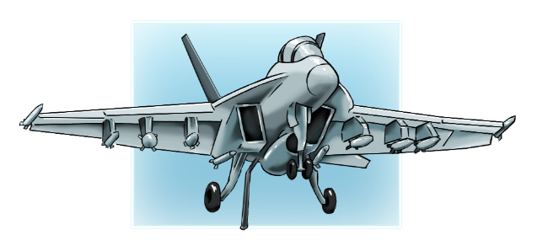
AIRCRAFT PRODUCTS
Sidewinder Missile
CAD/PAD Products
2.75 in. Rockets
Notes:
CAD/PAD: The command designs, develops, manufactures and is the central stockpoint for CAD/PAD items used in aircrew escape ejection systems. Our Virtual Fleet Support facility allows the warfighter to obtain any component within one week from order request. Tasked as a Tri-service organization, responsible for qualification of all CADs/PADs (surface, sub-surface, and air) and their ballistic systems and service life ordnance assessment after deployment. The E2 CAD/PAD Division is the in-service engineering agent for aircrew equipment such as automatically inflated air/deck-crew personnel life preservers (FLU-8/A and -12/A) and CADs for pilot personnel parachute release (SEAWARS) upon water immersion." Aircraft CAD/PAD products include: Stores Release, Countermeasure, Engine Fire Extinguisher Cartridges, Egress Systems, Ejection Seat Components, Cable Cutters

Slide 50
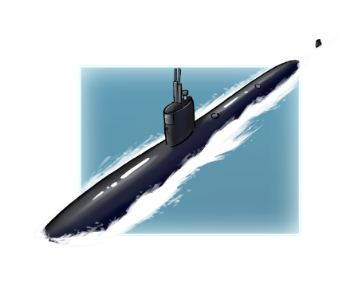
SUBMARINE PRODUCTS
Otto Fuel for Torpedoes
Tomahawk Missiles
CAD/PAD
Notes:
Otto Fuel for Torpedoes: We are the sole provider of liquid monopropellant (Otto Fuel II) for the United States and our allies and have manufactured the compound for more than 50 years. We continue to manufacture 250K lbs per year while our primary nitration facility is being renovated to allow greater flexibility, lower cost and improved safety.
The Tomahawk Land Attack Missile (TLAM): An all-weather, long range, subsonic cruise missile used for deep land-attack warfare, launched from U. S. Navy surface ships and U.S. Navy and United Kingdom Royal Navy submarines. IHEODTD Surface Systems Engineering Branch provides engineering services for rocket motors and other energetic components of surface-launched missiles and rocket boosters. The branch administers and conducts technical and project management functions for STANDARD missile propulsion and warhead items, gas generators and target propulsion units. It provides energetic engineering support for TOMAHAWK rocket motors.
CAD/PAD: "Tasked as a Tri-service organization, responsible for qualification of all CADs/PADs (surface, sub-surface, and air) and their ballistic systems and service life ordnance assessment after deployment. CAD/PADs are utilized for buoy procurement/in-service support.

