Slide 1
Long-Term Strategy for DoD Trusted Foundry Needs
Mr. Robert A. Gold
Deputy Assistant Secretary of Defense, Systems Engineering
Director, Engineering Enterprise
July 27, 2016

Slide 2
DASD, Systems Engineering

Slide 3
Spectrum of Supply Chain Risks
Quality
Escape
Reliability Failure
Fraudulent
Product
Malicious
Insertion
Reverse Engineering
Information
Losses
Product defect/ inadequacy introduced either through mistake or negligence during design, production, and post-production handling resulting in the introduction of deficiencies, vulnerabilities, and degraded life-cycle performance.
Mission failure in the field due to environmental factors unique to military and aerospace environment factors such as particle strikes, device aging, hot-spots, electro-magnetic pulse, etc.
Counterfeit and other than genuine and new devices from the legally authorized source including relabeled, recycled, cloned, defective, out-of-spec, etc.
The intentional insertion of malicious hard/soft coding, or defect to enable physical attacks or cause mission failure; includes logic bombs, Trojan ‘kill switches’ and backdoors for unauthorized control and access to logic and data.
Unauthorized extraction of sensitive intellectual property using reverse engineering, side channel scanning, runtime security analysis, embedded system security weakness, etc.
Stolen data provides potential adversaries extraordinary insight into US defense and industrial capabilities and allows them to save time and expense in developing similar capabilities.
DoD Program Protection focuses on risks posed by malicious actors

Slide 4
Ensuring Confidence in Defense Systems
Threat:
Adversary who seeks to exploit vulnerabilities to:
Acquire program and system information
Disrupt or degrade system performance
Obtain or alter US capability
Vulnerabilities:
All systems, networks and applications
Intentionally implanted logic (HW/SW)
Unintentional vulnerabilities maliciously exploited (e.g., poor quality or fragile code)
Controlled defense information resident on, or transiting supply chain networks
Loss or sale of US capability that provides a technological advantage
Consequences:
Loss of data; system corruption
Loss of confidence in critical warfighting capability; mission impact
Loss of US capability that provides a technological advantage
Access points are throughout the acquisition life cycle…
…and across numerous supply chain entry points
Government
Prime, subcontractors
Vendors, commercial parts manufacturers
3rd party test/certification activities
Notes:
SR Case # 15-S-0089

Slide 5
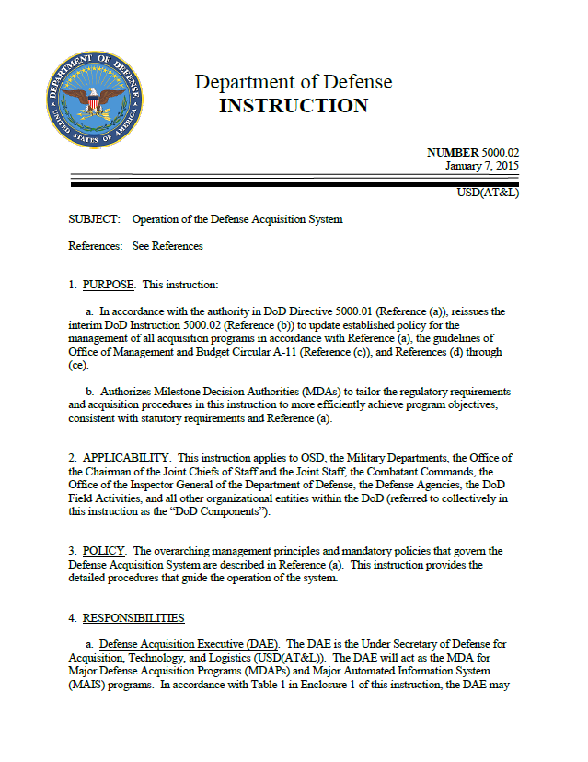
Program Protection Planning Policy
System Security Engineering is accomplished in the DoD through program protection planning (PPP)
DoDI 5000.02 requires program managers to employ system security engineering practices and prepare a Program Protection Plan to manage the security risks to critical program information, mission-critical functions and information
Program managers will describe in their PPP:
Critical Program Information, mission-critical functions and critical components, and information security threats and vulnerabilities
Plans to apply countermeasures to mitigate associated risks:
Supply Chain Risk Management
Hardware and software assurance
Plans for exportability and potential foreign involvement
The Cybersecurity Strategy and Anti-Tamper plan are included

Slide 6
Joint Federated Assurance Center
JFAC is a federation of DoD software and hardware assurance (SwA/HwA) capabilities and capacities
To support programs in addressing current and emerging threats and vulnerabilities
To facilitate collaboration across the Department and throughout the lifecycle of acquisition programs
To maximize use of available resources
To assess and recommend capability and capacity gaps to resource
Innovation of SW and HW inspection, detection, analysis, risk assessment, and remediation tools and techniques to mitigate risk of malicious insertion
R&D is key component of JFAC operations
Focus on improving tools, techniques, and procedures for SwA and HwA to support programs
Federated Organizations
Army, Navy, AF, NSA, DMEA DISA, NRO, MDA laboratories and engineering support organizations; Intelligence Community and Department of Energy
The mission of JFAC is to support programs with SwA and HwA needs

Slide 7
Long Term Trusted Foundry Strategy
Supports activities to ensure critical and sensitive integrated circuits are available to meet DoD needs
Program goals:
Protect microelectronic designs and intellectual property (IP) from espionage and manipulation
Advance DoD hardware analysis capability and commercial design standards, e.g., physical, functional, and design verification and validation
Mature and transition new microelectronics trust model that leverages commercial state-of-the-art (SOTA) capabilities and ensures future access
Technical challenges:
Develop alternate trusted photomask capability to preserve long-term trusted access and protection of IP
Scale/enhance the government’s ability to detect security flaws in integrated circuits
Leverage academic and industry research for assuring trust from any supplier
Program partners:
DoD science & technology (S&T), acquisition communities, academia, industry
Provides technical solutions that can be leveraged by government and industry to enable microelectronics trust

Slide 8
Microelectronics Strategy Challenges
Commercially-driven
Moderate volumes required
Some Trust & assurance challenges
3rd Party IP necessary
$ to access
DoD-driven
Availability concerns
Yield & complexity challenges
Specialized IP needed
$$ to maintain
State-of-the Practice (SOTP)
Legacy
& Boutique
State-of-the-Art (SOTA)
Science &
Technology
Follows SOTA (offshore) threatening DoD Subject Matter Expertise
Investing in assurance and beyond silicon-based components
Limited short-term impact on SOTA
Commercially-driven
High volumes desired
Trust & Assurance challenges
3rd Party IP necessary
$$$ to access
Four Distinct Interrelated Domains

Slide 9
Long-Term Strategy Time Line
Trusted Foundry projects:
Alternate Source for Trusted Photomasks
Preparation activities
Capability Development
Deploy new capabilities
Verification and Validation (V&V) Capabilities and Standards for Trust
Preparation activities
Improve capabilities and capacity, and provide support to program needs, for analysis of microelectronics trust
Identify and develop standards, practices, and partnerships to improve availability of trust from commercial providers
Advanced Technology and Alternative Techniques for Microelectronics Hardware Trust
Preparation activities
Capability development and demonstration
Deploy new capabilities and approaches
Related activities supporting the long-term strategy:
During this period, acquisition programs fund and execute LTBs using the Trusted Foundry
Work with GF to preserve Trusted Foundry
Programs fund and execute Lifetime Buys
DPA Title III Project for photomask facility upgrade at Trusted Supplier
Upgrade
Provides upgrade to mask tooling and secure processing at Trusted Supplier’s facility required for the alternate source
DoD Trusted Foundry Program Consolidation
Transition
Consolidates NSA TAPO’s role and responsibilities for DoD Trusted Foundry Program at DMEA
2015 2016 2017 2018 2019 2020 2021 2022 2023 2024

Slide 10
Teaming and Partnerships
are Key to Success
Many stakeholders are involved in the success of the long-term strategy:
Leadership from OSD, Services, Agencies
Performers including NSWC Crane, DMEA, DARPA, and other DoD S&T organizations and laboratories
Integration and support of functions of:
DoD Trusted Foundry Program
DMEA Trusted Supplier Accreditation Program
Joint Federated Assurance Center
Microelectronics trust S&T and transition activities
Building and leveraging partnerships with Defense and commercial industry and academia
Coordination with other U.S. Government agency partners
Bottom line: structuring activities to meet acquisition program needs for trust and access to state of the art microelectronics

Slide 11
Assurance Strategy for FPGAs
FY 2016 goals for this effort:
Produce a coherent, focused strategy/plan for FPGA assurance
Leverage existing USG and industry efforts to the maximum extent possible
Promote community awareness of related USG efforts via a series of workshops and conference calls sponsored by OASD(R&E), in coordination with the JFAC, NSA and SNL
As a community, identify the portfolio of related efforts on which we should focus with the goal of synchronizing and eliminating stove-pipes and separate, single-point solutions when possible
Identify gaps and/or activities requiring investment and elevate relevant needs to the Joint Federated Assurance Center (JFAC) Steering Committee (SC) for prioritization and direction regarding resourcing
In particular, align with, and inform, the FY 2017 execution plan for the Trusted Foundry Program Element (PE)

Slide 12
The Way Ahead
Program engagement
Foster early planning for HwA and SwA, design with security in mind
Implement expectations in plans and on contract
Support vulnerability analysis and mitigation needs
Community collaboration
Achieve a networked capability to support DoD needs: shared practices, knowledgeable experts, and facilities to address malicious supply chain risk
Industry engagement
Communicate strategy to tool developers
Develop standards for common articulation of vulnerabilities and weaknesses, capabilities and countermeasures
Advocate for R&D
HwA and SwA tools and practices
Strategy for trusted microelectronics that evolves with the commercial sector
People!
Improve awareness, expertise to design and deliver trusted systems

Slide 13
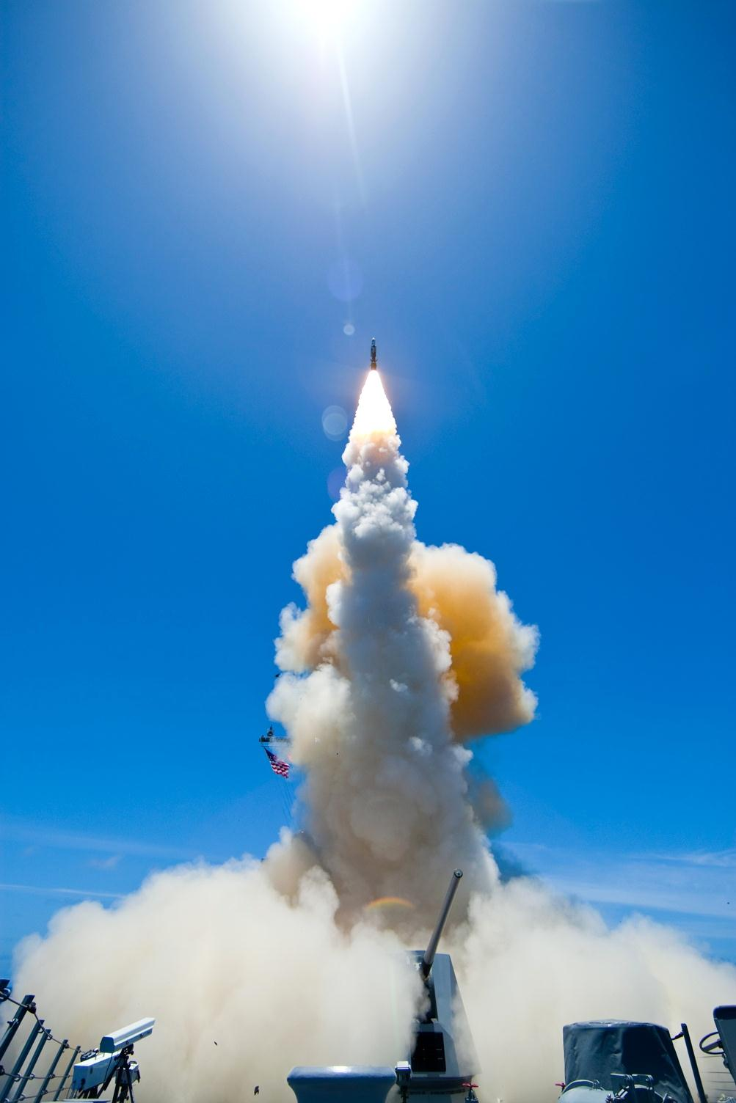
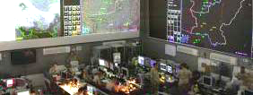
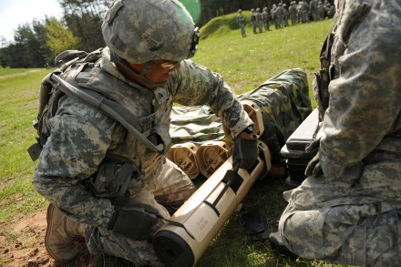
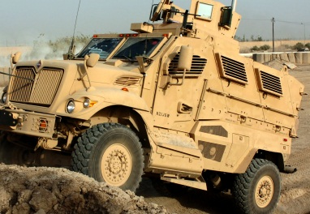
Systems Engineering: Critical to Defense Acquisition
Defense Innovation Marketplace
http://www.defenseinnovationmarketplace.mil
DASD, Systems Engineering
http://www.acq.osd.mil/se
Twitter: @DoDInnovation

Slide 14
Advanced Technology and Alternative
Techniques for Microelectronics Hardware Trust
Matures, demonstrates, operationalizes and pilots S&T program products that are needed to technically achieve microelectronics trust and fully leverage the commercial marketplace in the following areas:
Design for Trust Techniques: Design implementation concepts for IP, parts assemblies, and sub-systems that restrict their full use and functionality to trusted operation
IP Protection: Protect IP from exploitation in trusted as well as untrusted environments, to include control of the timing of its use as well as methods to conceal, reconfigure, partition, or employ IP in new ways. For example:
Alter manufacturing to insert sensitive IP into product in a trusted environment after commercial processing is completed, e.g., split manufacturing or other methods
Low-volume SOTA: Innovative methods that permit cost-effective trusted manufacturing of advanced DoD custom microelectronics in low volumes
Electronic Component Markers: Technologies that uniquely tag components and subassemblies with identifiers that can be quickly verified while traversing the supply chain to ensure their continued trust
Imaging Technologies and Forensics : Advanced capabilities to efficiently evaluate dense, SOTA commercial microelectronic components
Computing Infrastructure and Processing Methods: Increases computing throughput and provides the new processing methods required to implement the technologies above

Slide 15
Microelectronics Trust Verification Technologies
Microelectronics trust verification and test technologies are required when Trusted Foundry options are not available
Core DoD technical laboratories have recently been chartered by DEPSECDEF as a Joint Federated Assurance Center (JFAC) to provide this type of support to programs
Long-term challenges have been identified:
Ability to analyze leading-edge technologies; throughput/time required for analysis; skilled workforce; databases/libraries of specific IP blocks, and COTS modules; and analysis of non-ASIC components (e.g., FPGAs)
Three capability areas core to microelectronics analysis and verification will be improved:
Physical Verification: Destructive analysis of Integrated Circuits and Printed Circuit Boards
Functional Analysis: Non-destructive screening/verification of select critical circuits
Design Verification: Verification/assurance of designs, IP, netlists, bitstreams, firmware, etc.
Enhancements to current technical capabilities will be addressed in a collaborative nature amongst the core technical laboratories (DoD as well as DoE), driven by projected and realized out-year demand

Slide 16
Alternate Source for Trusted Photomasks
Develop Trusted photomask capability in addition to GF Trusted Photomask shop capabilities
Currently, non-IBM Trusted photomask sizes are limited to state-of-the-practice dimensions
Enhanced Trusted photomask capability is needed for existing Trusted Foundries
In the event that the GF Trusted Foundry closes, DoD would lose access to Trusted photomasks for leading-edge designs
Provides a redundant Trusted photomask capability for protection of lead-edge designs and IP
Without trusted flow in the mask data preparation and mask manufacturing processes, leading-edge designs may be at increased risk for theft and malicious alterations
This investment ensures the integrity of the tape-in/mask release, mask manufacturing, and authentication process for photomasks for leading-edge designs by establishing secure, SECRET-level capabilities with a leading photomask supplier. This supplier has business relationships with multiple leading-edge foundries

Slide 17
Assurance Systems Engineering
Quality
Escape
Malicious
Insertion
Info.
Loss
Quality
Escape
Counterfeit
& Excess
Rev. Eng.
Quality
Escape
Malicious
Insertion
Rev. Eng.
Info.
Loss
Program
Development &
Capabilities
PPP
CPI
Pack.
&Test
Verify &
Validate
Prog.
& SW
Integrate
&Test
Operate
& Maint.
Design
Verify
Mask
Fabrication
…
…
Confidentiality
System
Security
Archit.
Trusted
Mask
Availability
HwA
SwA
PPP
Assured
Design
Threat
Op. Sec.
Integrity
Innovate
& Develop
JFAC
& Industry
Upgrade
& Adapt
Efficacy
Impact
Mitigation

