Slide 1
Scanning Microwave Microscopy:
Sub-surface Nano-electronic Characterization?
MIM 2016
July 26, 2016
Jonathan D. Chisum
jchisum@nd.edu

Slide 2

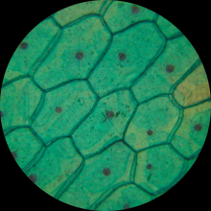
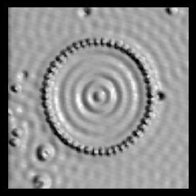
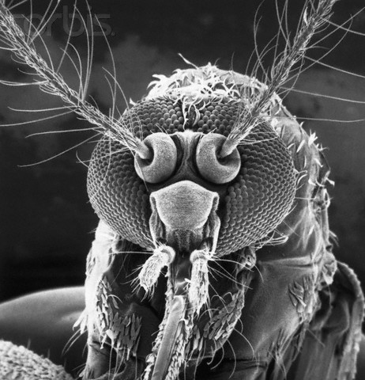
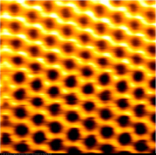
Microscopy for Nano-characterization
Scanning Probe Microscopy
 | Method
Parameter | Optical | STM | SEM | AFM
Contrast | reflection | Topography, chemistry | scattered e⁻ | Topography
Region | Surface w/ depth of field | Surface | Surface w/ depth of field | Surface
Resolution | 200 nm | sub-nm | nm | nm
Duration | real time | N² | N² | N²
Prep. | various | planar, conductive | gold plate, vacuum | planar
AFM is tool of choice for nano-electronics
Notes:
Optical -> onion skin
STM -> clean gold surface
AFM -> Graphite
SEM -> photoresist
NFMM ->

Slide 3
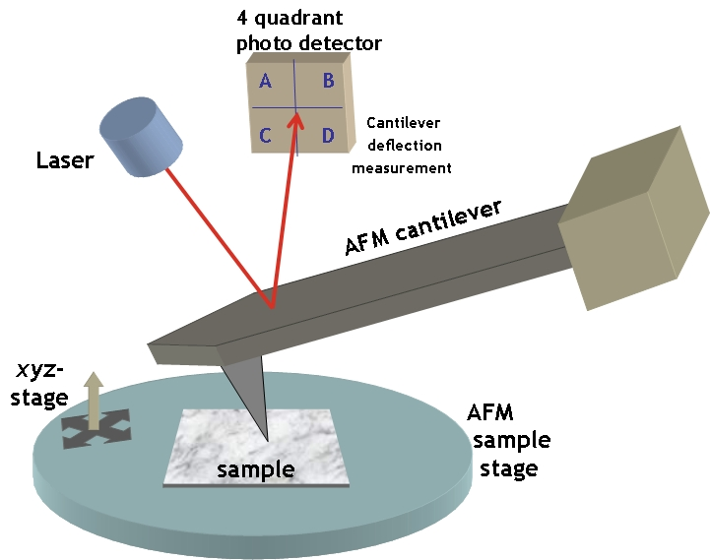
AFM for Nano-electronics
Nano-materials and nano-devices demand nanometric electrical characterization
Material diversity (conducting, semiconducting, insulating) eliminates surface treatment (e.g., STM, SEM)
Planarity requirement of AFM is not an issue in nano-electronics
AFM is a generally a topographic measurement so flexibility must come from [1]:
  Method variants (instrument)
  Tip diversity
Instrument
Opensource Handbook of Nanoscience and Nanotechnology/CC-BY-2.5
[1] Oliver, Rep. Prog. Phys. 71 (2008) 076501

Slide 4
Nano-electronic Applications of AFM
Defect detection in boules of Si [2]
Surface roughness of wafer polishing [3]
Surface finish of etching in micromachining [4]
Photoresist characterization [5]
Oxidation [6] and metallization [7] assessment
Defect characterization in deposition [8]
These are surface measurements. Sub-surface requires cross-sectioning via cleaving or ramps via FIB milling.
[2] Nishikawa et al., Japan J. Appl. Phys. 1, 36 6595-600
[3] Abe et al., Japan J. Appl. Phys. 1 31 721-8
[4] Baum & Schiffrin, J. Micromech. Microeng. 7 338-42
[5] Huck et al., Langmuir 15 6862-2
[6] Ohmi et al., IEEE Trans. Electr. Dev. 39 537-45
[7] Chyan et al., J. Electrochem. Soc. 143 92-6
[8] Oliver et al., J. Cryst. Growth 289 506-14
[9] Saive et al., J. Adv. Funct. Mater. 2013 23, 5854

Slide 5
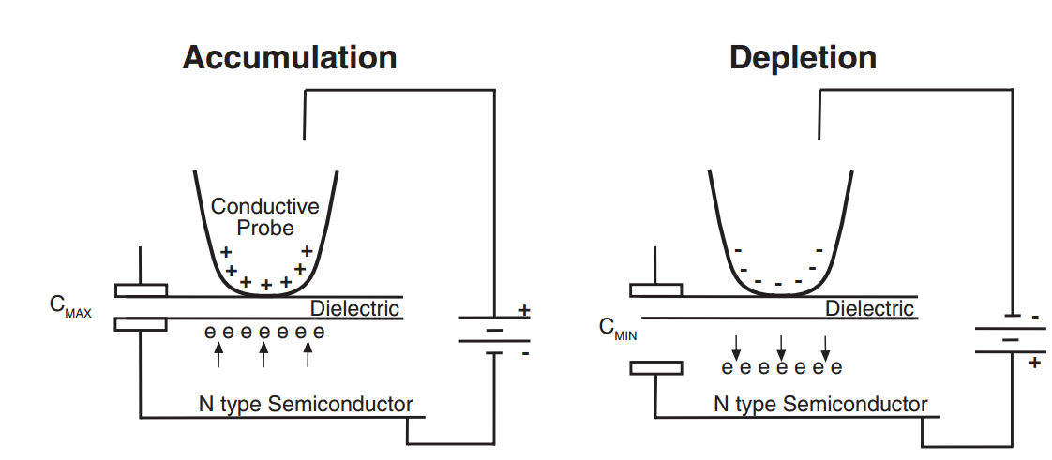
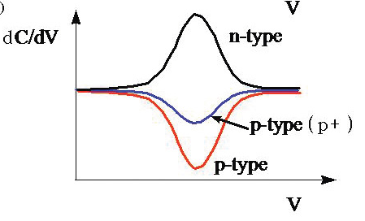
AFM Variants
EFM, KPFM: Electrical Force, Kelvin Force, surface potential microscopy scans in tapping mode and measures local surface potential. Requires a topography scan and a “lift” scan to differentiate van der Waal’s forces from Coulomb forces
SCM: Scanning Capacitance uses a metal-coated tip scanned in contact-mode and measures MOS capacitor under AC bias. |dC/dV| measures carrier concentration and angle(dC/dV) determines p/n-type.
Veeco Support Note No. 289A
Park AFM Mode Note, “SCM”

Slide 6
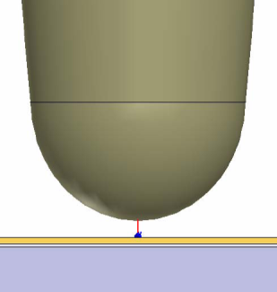
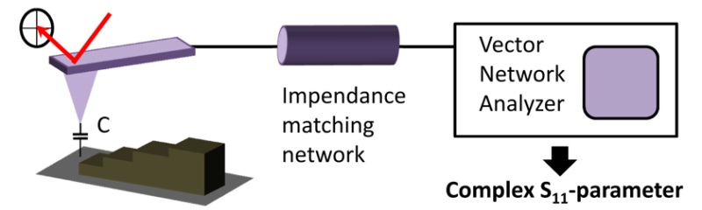
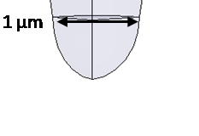
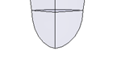
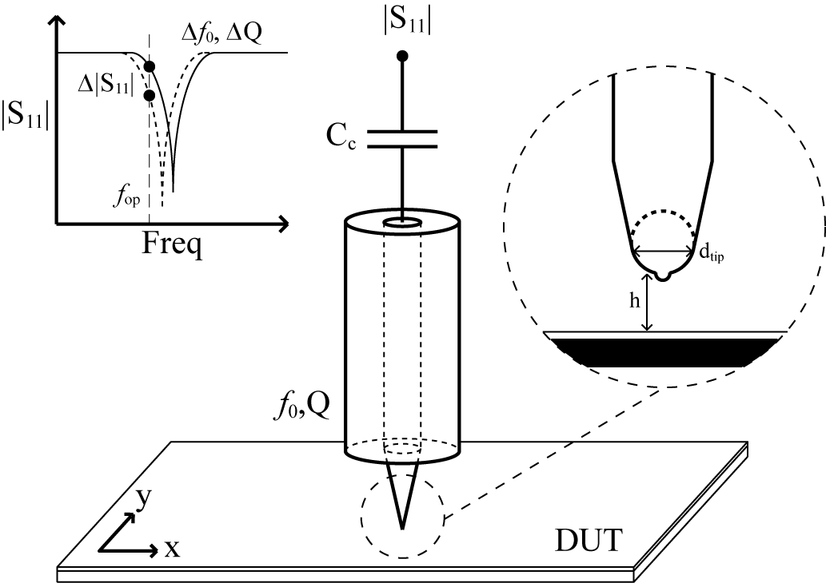
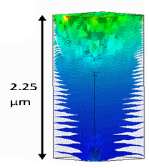
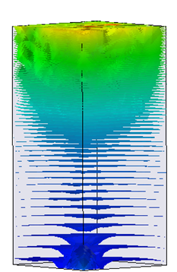
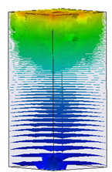
AFM Variants (cont’d)
C-AFM: (a.k.a, TUNA) Tunneling current through an oxide layer is measured with a linear current amplifier.
SSRM: Characterizes carrier concentration in semiconductors through spreading resistance.
SMM: Measures complex impedance (permittivity and conductivity) which permits measurement of doping and has sub-surface sensitivity w/o cross-sectioning.
f₀, Q
1 µm
2.25 µm
Cu
0.1µm
Si
1.75 µm
1.00 µm
0.87 µm
1 GHz
3 GHz
4 GHz

Slide 7
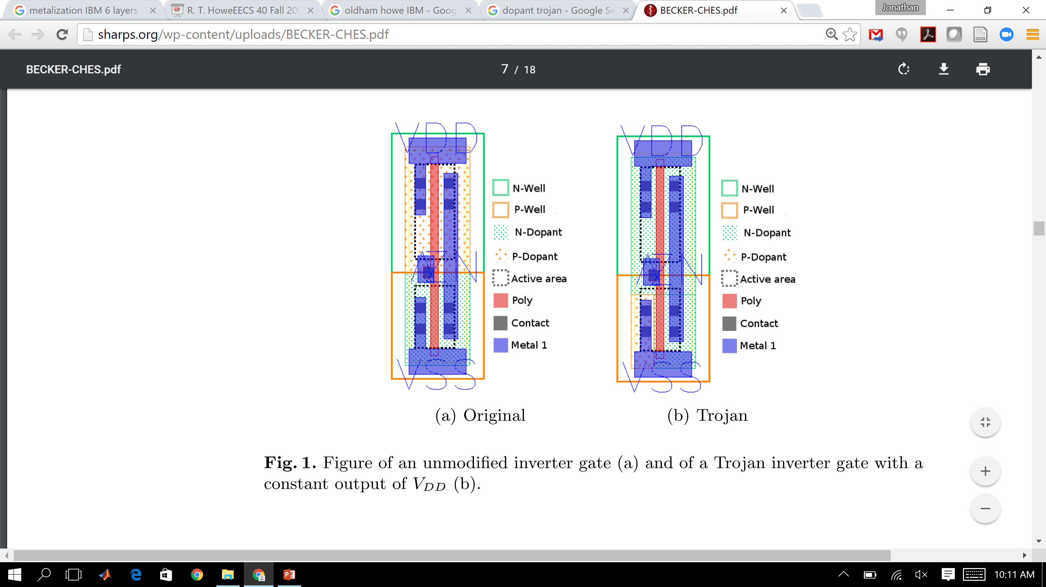
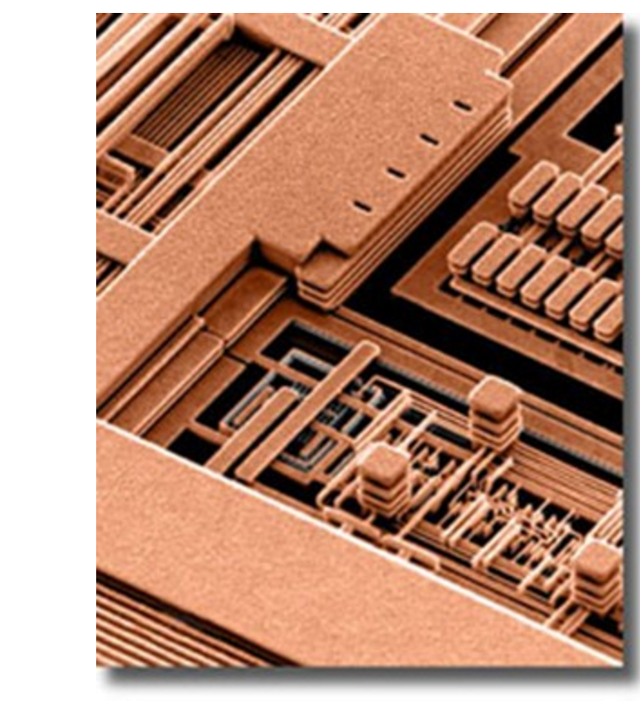
Dopant-level Characterization
Metal
Recent hardware Trojans have shown up in dopant (bottom of metal) and require no change in metallization
Top-metal is a Faraday cage
Dopant access requires backside scanning
Wafer thinning is critical but only goes so far…
N-type
P-type
Becker et al., CHES 2013
Need to understand scanning
at depth
Microscope photo of IBM’s Copper wiring on CU-11 ASIC 130nm technology

Slide 8
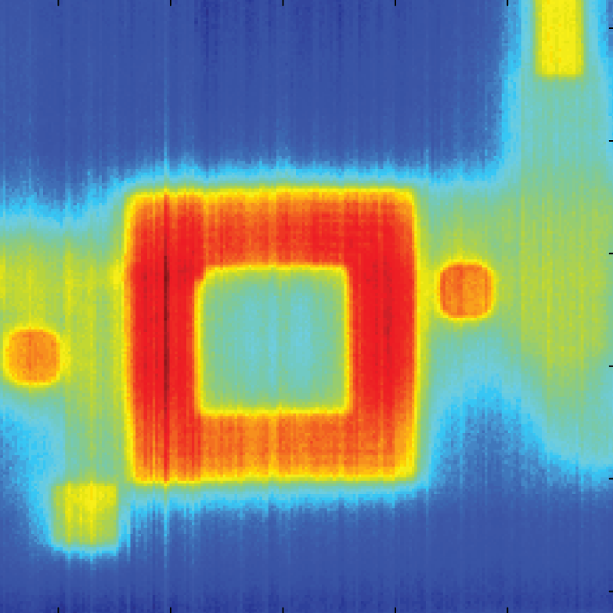
Microscopy
AFM Variant
 | Method
Parameter | Optical | STM | SEM | AFM | SMM
Contrast | reflection | Topography, chemistry | scattered e⁻ | Topography | μ, ε, σ
Region | Surface w/ depth of field | Surface | Surface w/ depth of field | Surface | Surface, Sub-surface
Resolution | 200 nm | sub-nm | nm | nm | nm
Duration | real time | N² | N² | N² | N²
Prep. | various | planar, conductive | gold plate, vacuum | planar | planar
Notes:
Optical -> onion skin
STM -> clean gold surface
AFM -> Graphite
SEM -> photoresist
NFMM ->

Slide 9
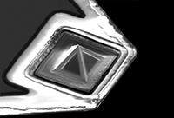
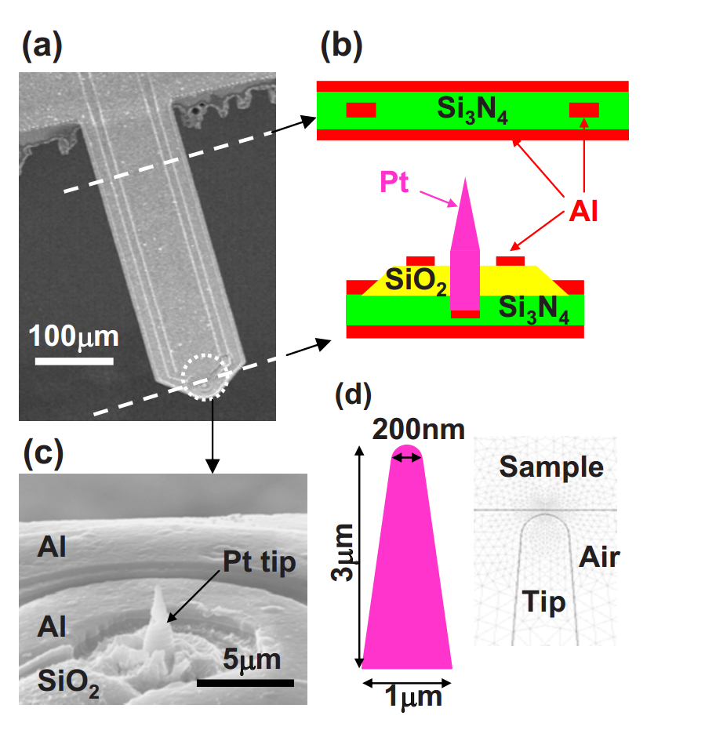
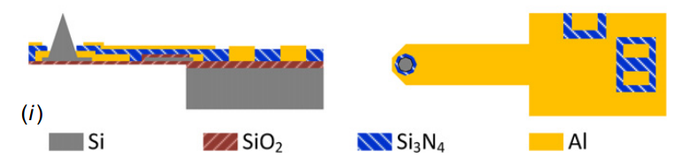
Tip Modifications: SMM
CPW and Stripline cantilevers shields parasitic capacitance and efficiently delivers microwave signal
Micromachined or FIB deposited tips
PrimeNano
sMIM150-G5
http://www.asylumresearch.com/Probe/SMIM150-G5,PrimeNano
Yang et al., J. Micromech. Microeng. 24 (2014) 045026
Need method of assessing tip designs with complex geometries
Lai et al., Appl. Phys. Lett. 93, 123105 (2008)

Slide 10
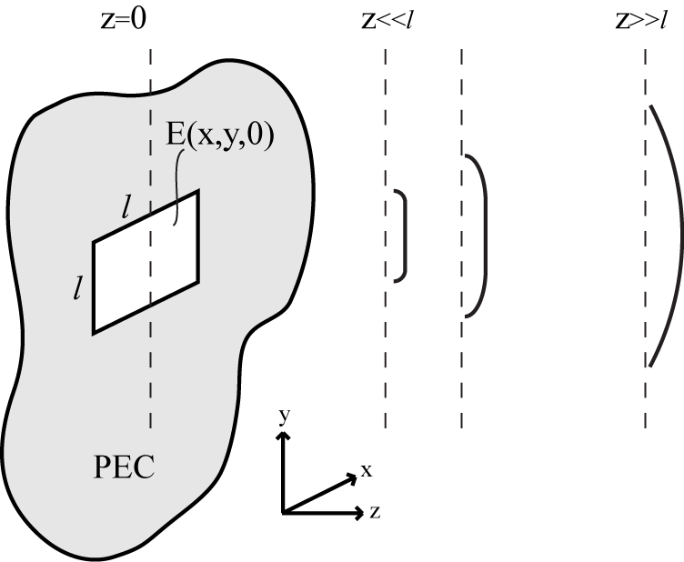
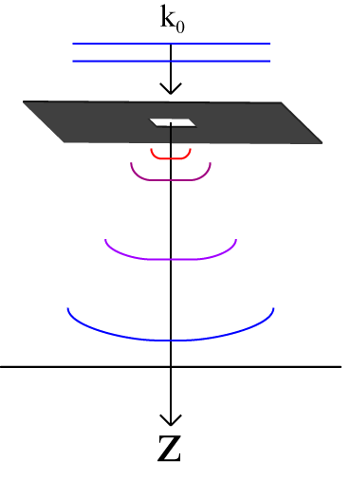
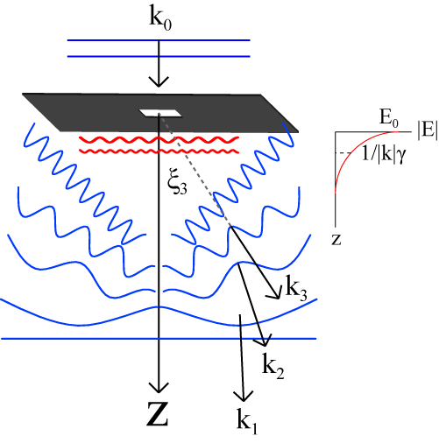
Analytical Resolution: Rectangular Aperture
k_{i}
k_{i}
k_{r}
Indistinguishable.
Distinguished
Propagating
Evanescent
(Decaying confined field)
(Propagating Spherical Wave)
Notes:
-- For now we will solve the problem of a uniform plane wave incident on a sub-wavelength aperture (l<<lambda) at (z=0). The uniform plane wave illuminates the aperture with a uniform distribution (rect-functions).
-- Though this solution is not our specific NFMM scenario we will show that it describes the main features of our NFMM scenario and is an analytically tractable problem.
-- We desire an expression for the E-field at every point in space (z>0). Maxwell’s equations in the source-free region (z>0) yield the source-free wave equation. However, this 2nd order PDE is not generally solvable but we can take the 2D F.T. of the E-field which reduces the 2nd order PDE to a 2nd order ODE which is solvable. The solution yields an expression for the z-dependence of the double F.T. of E. Specifically, it is an exponential decay from the aperture along the z-axis.
-- But, we did not want a solution for the F.T.{E}, rather E itself. We need only inverse F.T. the solution to find the actual E-field at any point in along the z-axis.
-- This F.T. process yields a superposition of complex exponential basis functions which are, in our case, plane waves propagating at various angles. Hence, we end up with the “angular spectrum”.

Slide 11
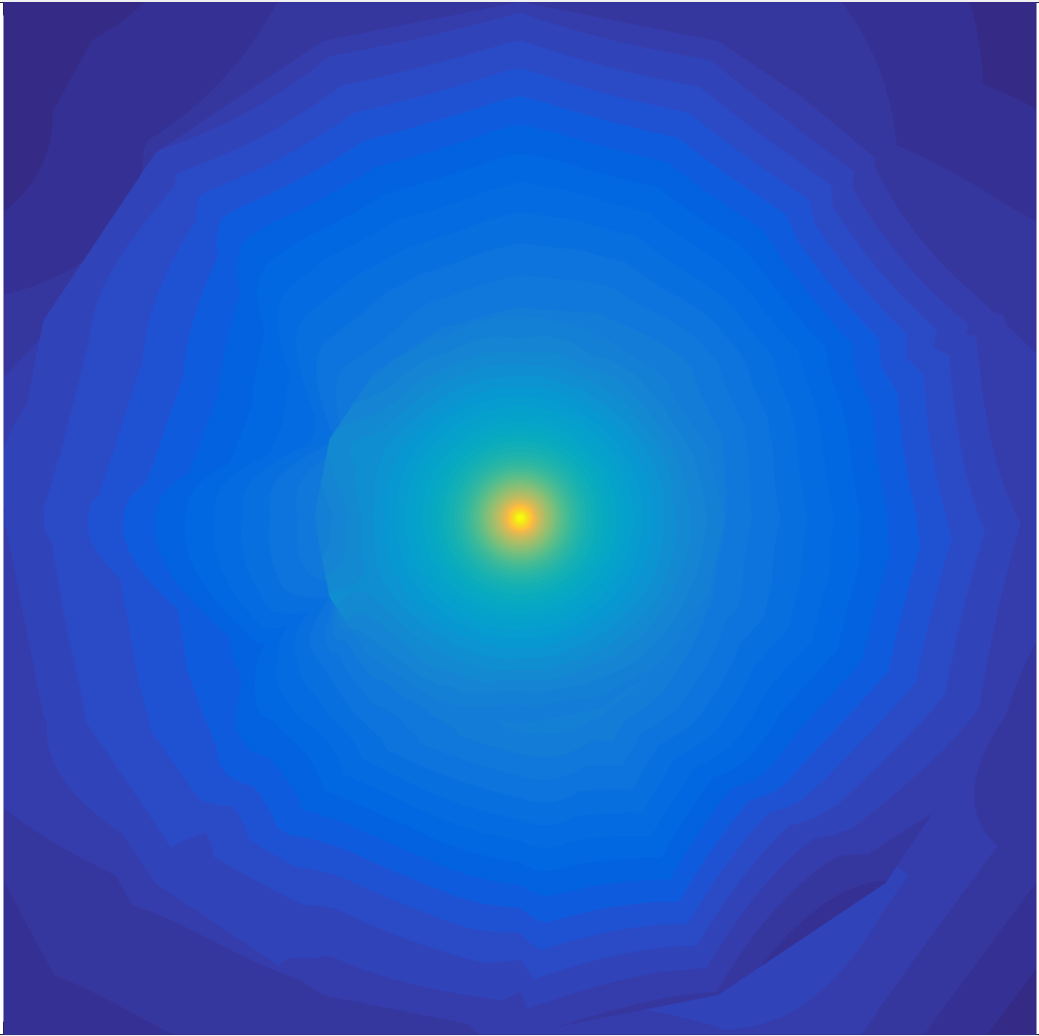
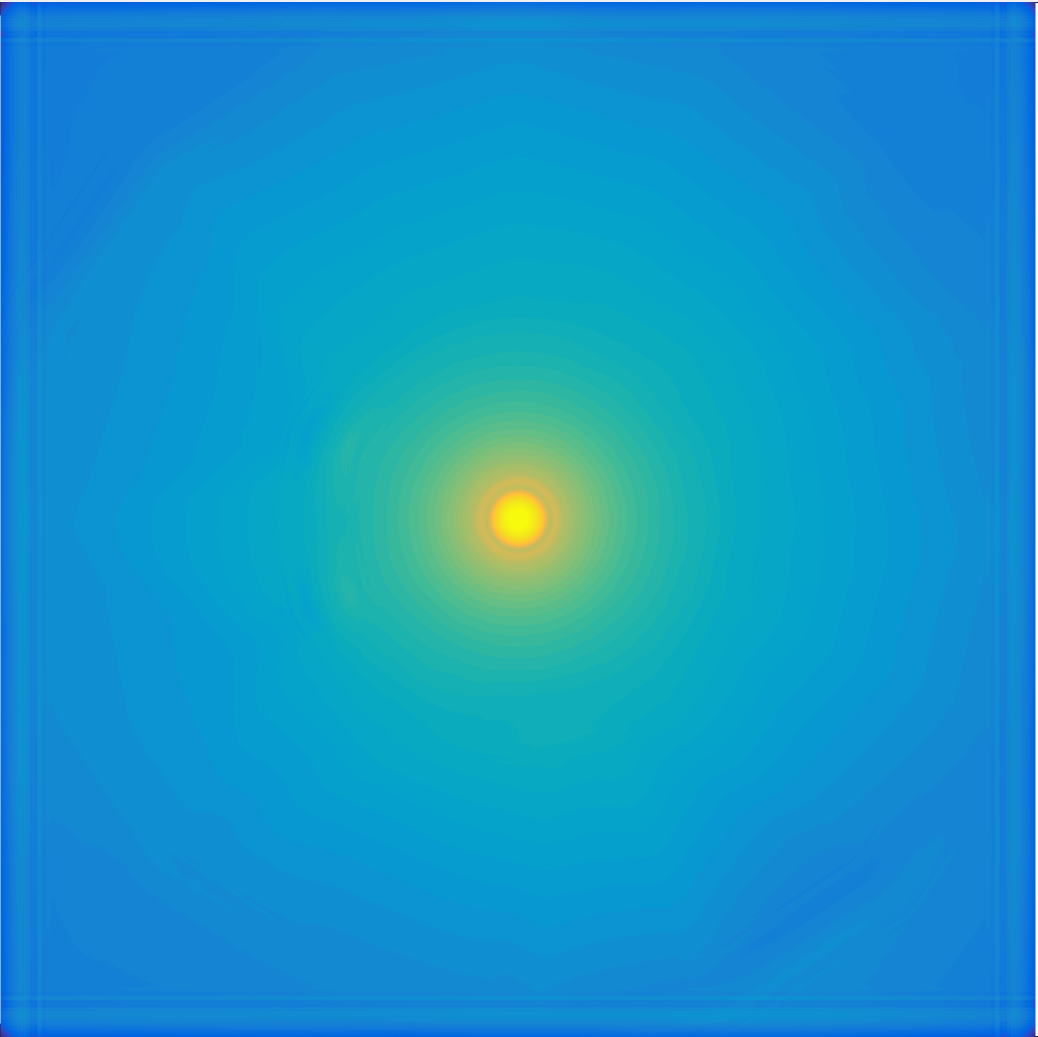
Angular Spectrum at Depth
Field distribution at a point z₀ can be projected through a homogenous medium to any point z₁
Fourier Transform of “aperture”
wave propagation
z₀=0 nm
Requires aperture distribution and homogeneous medium
z₁=50 nm

Slide 12
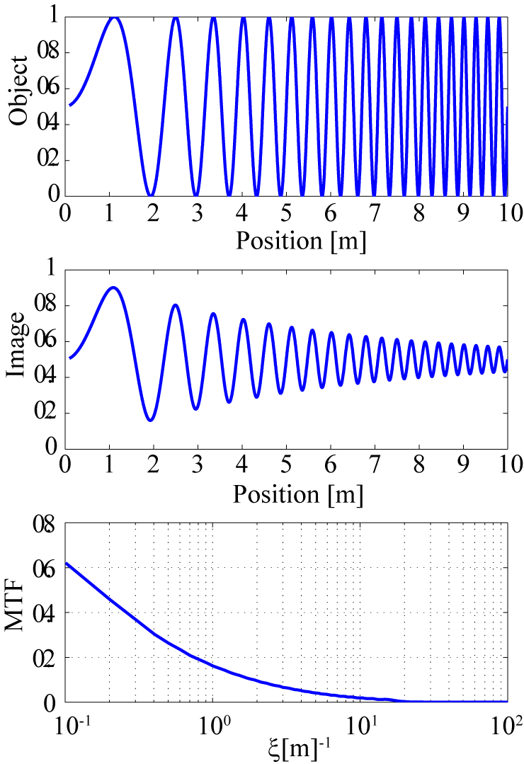
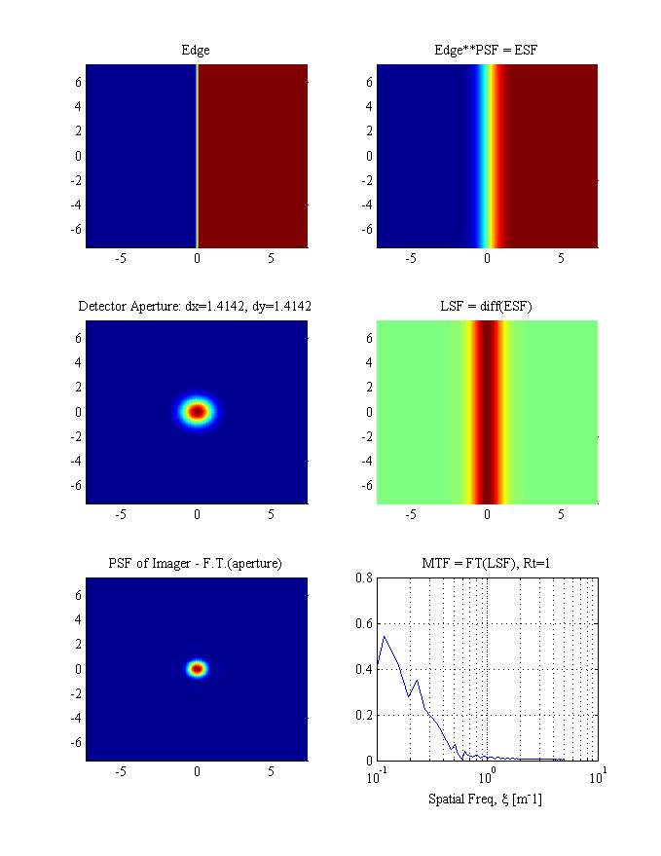
Image Theory
PSF

Slide 13
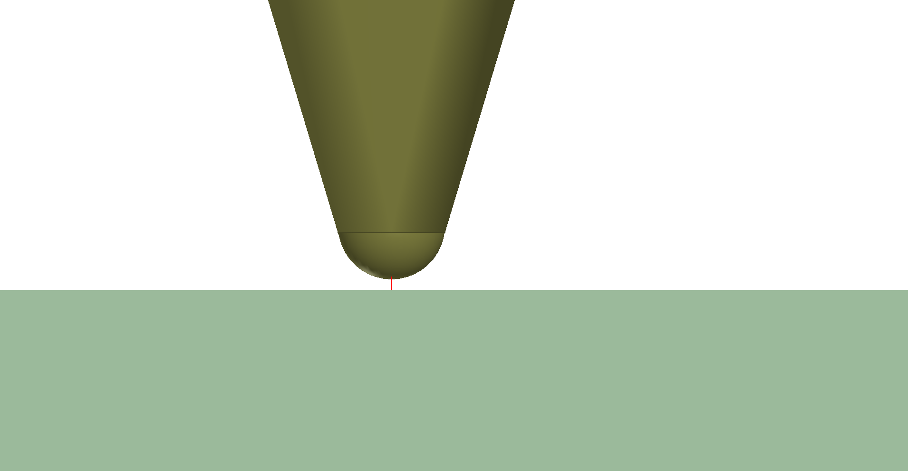

SMM PSF from Full-wave Simulation
Setup: 25nm conductive tip 5nm over bulk silicon
Conical and Pyramidal tips
Cross-sectional field profiles measured versus depth in 25 nm steps
x
z
Surface profile
Conical tip
Surface profile
Pyramidal tip
x
y

Slide 14
Field Cuts at Depth
Surface (z=0)
Sub-surface (z=-350 nm)
Evanescent field strength decays exponentially

Slide 15



Modulation Transfer Function
$MTF\left(ξ,η\right)=|OTF\left(ξ,η\right)$|=|𝔉{PSF(r)}|
Surface (z=0)
d_{tip}=50nm
Normalized MTF (A.U.)
$$Noise floor$$
Sub-surface (z=-350 nm)
$$\text{−6}\text{dB} Noise floor$$
Spatial Frequency (lines/meter)
Depth | Conical | Pyramidal
0 nm | 15 MLines/meter (1.3 d_{tip}) | 13 MLines/meter (1.5 d_{tip})
2d_{tip}, 100 nm | 1.3 MLines/meter (15 d_{tip}) | 1.3 MLines/meter (15 d_{tip})
7d_{tip}, 350 nm | 500 kLines/meter (40 d_{tip}) | 720 kLines/meter (28 d_{tip})
6dB reduction in noise floor increases max spatial frequency by 4x

Slide 16

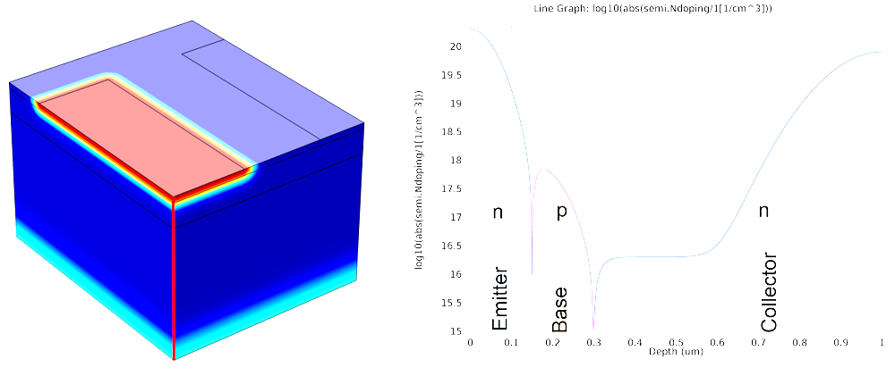
Conclusions: Increasing sensitivity?
Resolution is 1/10th at depth of 100nm (2d_{tip})
Reducing noise floor allows for sensitive detection
Modulate dopants w/ back-side IR lasers (Si is transparent to IR), possibly use cryogenic cooling
Dopant modulation
Sub-resolution steps
IR laser
Lock-in
f_{mod}
f_{mod}

Slide 17
Acknowledgements
Student: Nicholas Estes
Collaborators: Dr. Anthony Hoffman, Dr. Zoya Popovic, Dr. Suman Datta, Mr. Matthew Kay

Slide 18
Backup

Slide 19
Modulation Transfer Function
Edge Target
PSF
ESF
Measure
O
=
2D
ESF
LSF
MTF
1D
Process
d/dx
F{•}

Slide 20
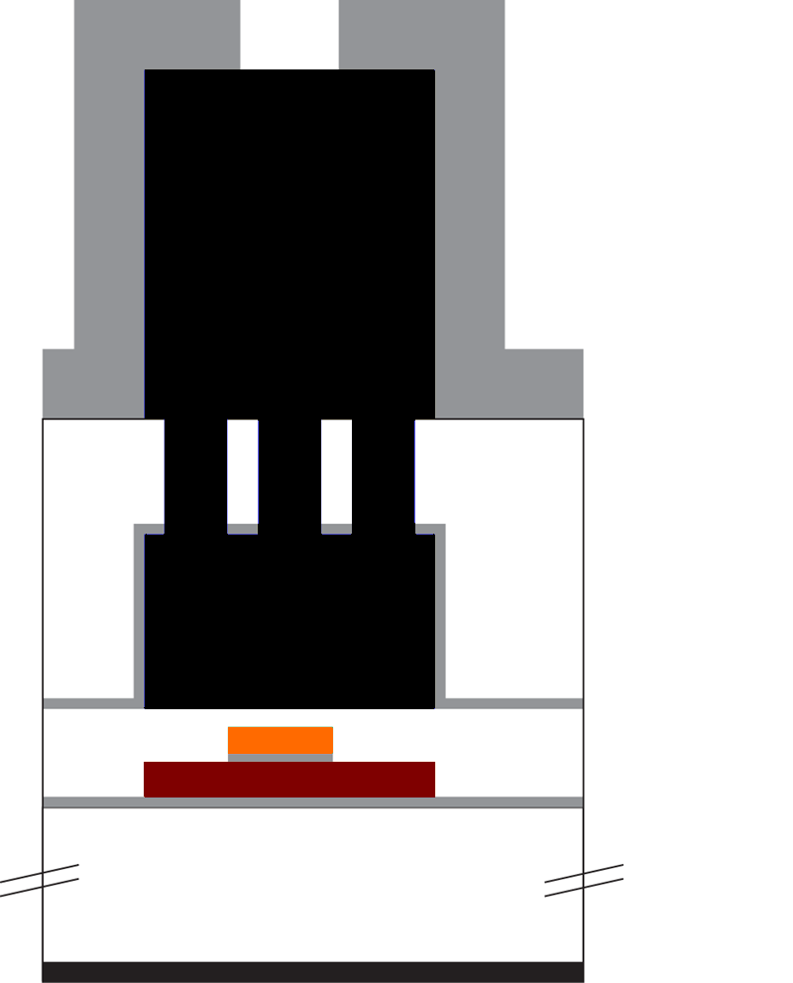
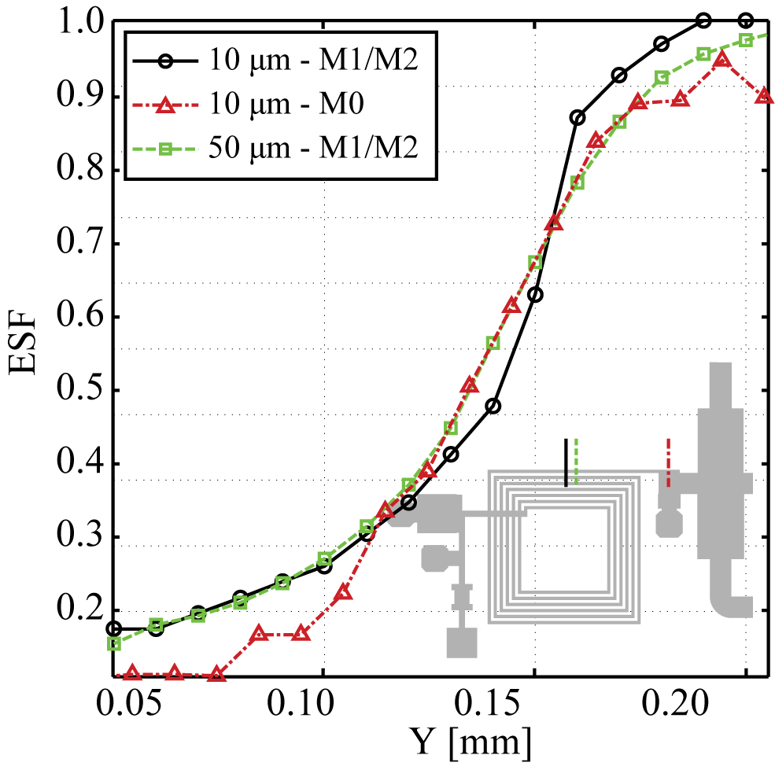
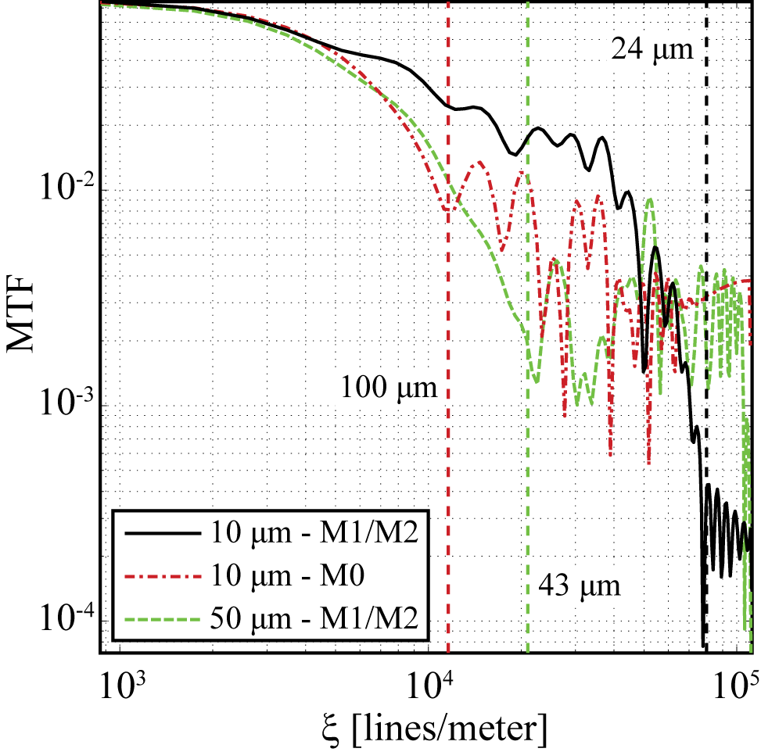
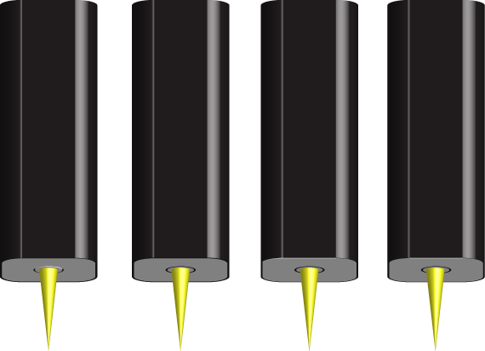
MTF
M1/M2 scanned below 1um of SiN passivation
M0 scanned below 1um SiN passivation and 7.92 um of BCB
Resolution at depth is a questions of SNR
5.32 μm
4.73 μm
7.92 μm
10μm
10μm
50μm
Noise floor
M1/2
M0
M1/2

Slide 21
“Super” resolution
k_{i}
k_{i}
k_{r}
Indistinguishable.
Distinguished
Notes:
-- For now we will solve the problem of a uniform plane wave incident on a sub-wavelength aperture (l<<lambda) at (z=0). The uniform plane wave illuminates the aperture with a uniform distribution (rect-functions).
-- Though this solution is not our specific NFMM scenario we will show that it describes the main features of our NFMM scenario and is an analytically tractable problem.
-- We desire an expression for the E-field at every point in space (z>0). Maxwell’s equations in the source-free region (z>0) yield the source-free wave equation. However, this 2nd order PDE is not generally solvable but we can take the 2D F.T. of the E-field which reduces the 2nd order PDE to a 2nd order ODE which is solvable. The solution yields an expression for the z-dependence of the double F.T. of E. Specifically, it is an exponential decay from the aperture along the z-axis.
-- But, we did not want a solution for the F.T.{E}, rather E itself. We need only inverse F.T. the solution to find the actual E-field at any point in along the z-axis.
-- This F.T. process yields a superposition of complex exponential basis functions which are, in our case, plane waves propagating at various angles. Hence, we end up with the “angular spectrum”.

Slide 22
“Super” resolution (cont’d)
f₀=1GHz, λ=0.3 m
Propagation |  |  | Wavelength |  |  | Angle
α | γ |  | λ_{x} | λ_{z} |  | ξ |  | Comment
0 | 1 |  | ∞ | 0.3 |  | 0 |  | z-prop (ξ=0), xy-uniform
0.1 | 0.995 |  | 3 | 0.301 |  | 5.7 |  | Prop at ξ, transverse-uniform
.75 | 0.661 |  | .4 | .454 |  | 49
1 | 0 |  | .3 | ∞ |  | 90 |  | x-prop (ξ=90), yz-uniform
1.1 | -j0.46 |  | .27 | +j0.65 |  | 90+j25 |  | x-prop, y-uniform, z-decay
5 | -j4.89 |  | .06 | +j.06 |  | 90+j131
Incident
k₁
k₃
Angling, Far-field
X-resolution is 90-degrees, with strong evanescent decay.
k₃
90-deg (x↔y)
90-deg, Near-field

Slide 23
Pathological Example
If the spatial correlation distance is less than the tip width unique detection is possible.
C = C0*(7/10)+C0’*(3/10)
C = C0*(7/10)+C0’*(3/10)
C = C0*(8/10)+C0’*(2/10)

