Slide 1
Cyberspace: A Contested Operational Environment Microelectronics Integrity Meeting 26 July 2016
Mr. John Garstka
Deputy Director for Cyber & Space Programs
ODASD/C3CB, OUSD/AT&L

Slide 2
Outline
Cyberspace – An Operational Domain
DoD Cyber Strategy
Cyber Resilience

Slide 3
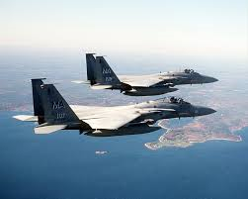
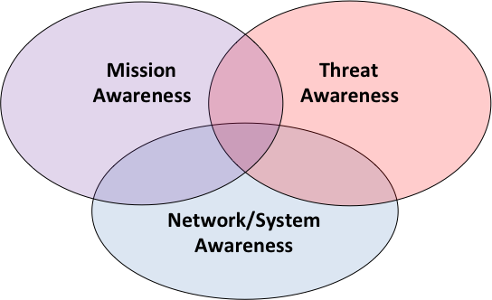
Cyberspace is an Operational Domain
“Non-cyber forces dependent upon cyberspace to operate ”
“Cyber forces operating in cyberspace”

Slide 4
Cyberspace is a Contested Operational Domain
Deny
Deceive
Disrupt
Degrade
Destroy
Cyberspace is an operational domain and an increasingly contested environment
Notes:
Cyber – Surveillance and Reconnaissance (C-SR) and Cyber-Operational Preparation of the Environment (C-OPE) are applicable to all phases when authorization from leadership is obtained.
Defensive Cyber Operations (DCO) is a set of continuous activities leveraging the principles of Sun Tzu and the Black Swan Theory to become more open and anticipatory vice reactive.
Offensive Cyber Operations (OCO) is the application of C-SR and C-OPE to ensure the desired effects can be applied to adversarial systems and capabilities at a time, location and severity of our choosing.

Slide 5
“Know Your Adversary”
“Know yourself, know your enemy”
Sun Tzu
Sun Tzu

Slide 6
DoD Cyber Strategy: DoD Cyber Missions
DoD must defend its own networks, systems, and information.
DoD must be prepared to defend the United States and its interests against cyberattacks of significant consequence.
If directed by the President or the Secretary of Defense, DoD must be able to provide integrated cyber capabilities to support military operations and contingency plans.
Source: DoD Cyber Strategy - April 2015

Slide 7
DoD Cyber Strategy: Strategic Goals
1. Build and maintain ready forces and capabilities to conduct cyberspace operations.
2. Defend the DoD information network, secure DoD data, and mitigate risks to DoD.
3. Be prepared to defend the U.S. homeland and U.S. vital interests from disruptive or destructive cyberattacks of significant consequence.
4. Build and maintain viable cyber options and plan to use those options to control conflict escalation and to shape the conflict environment at all stages.
5. Build and maintain robust international alliances and partnerships to deter shared threats and increase international security and stability.
Source: DoD Cyber Strategy - April 2015

Slide 8
NDAA 16 - Section 1647: Evaluation of Cyber Vulnerabilities of DoD Weapon Systems
NDAA 16 Section 1647:
“Not later than 180 days after the date of the enactment of this Act, the Secretary shall submit to the congressional defense committees the plan of the Secretary for evaluations of major weapon systems under subsection a.”
Overview of Legislation
1 | Conduct prioritization of critical of major weapon systems (WS)
2 | Develop a strategy for conduct of evaluations in FY16-19
3 | Develop a funding profile to conduct evaluations
4 | Develop strategies for mitigating risks of cyber vulnerabilities Plan submission to include current state Qtr’ly report to provide status of ongoing activities
 | Submit plan for evaluations to Congress
5 | Submit quarterly findings reports IAW section 484 of title 10 United States Code
“…complete an evaluation of the cyber vulnerabilities of each prioritized weapon system of the
Department of Defense by not later than December 31, 2019.”

Slide 9
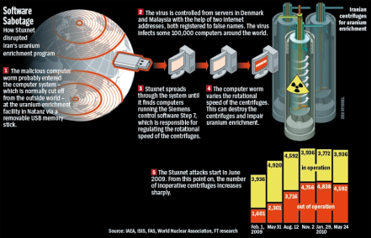
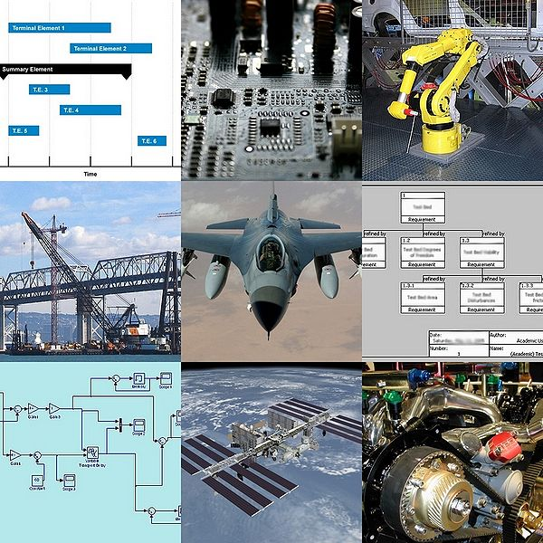
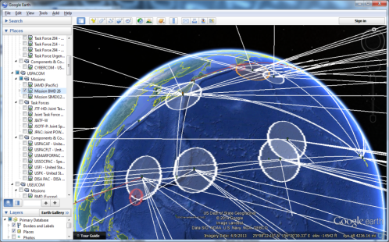
Assessing “Cyber” Resilience
Perimeter Analysis
System Engineering Teams
Share
Links &
Networks
Dependencies
Access
Virtual Single Network
Connect
Operational Environment
Cyber Contested Environment
Cyber Risk Analysis System Design Teardown
More than Network Disruption
Mission Analysis
Identify the Highest Priority
Systems
Look Deep Into a system design
UNCLASSIFIED

Slide 10
Example - Commercial Vehicle: Lots of Networked CPUs
Small-CPU embedded systems are nearly 100% of the commuting environment
At least by numbers of CPUs
Often there is a collection of small CPUs in an embedded system
Embedded/CPU survivability represents unique problems
Survivability may require more than reliability (fault tolerance)
Not everything can be treated like a desktop computer or server
“Connecting” or combining embedded systems to general purpose computing is hard to do well
UNCLASSIFIED

Slide 11
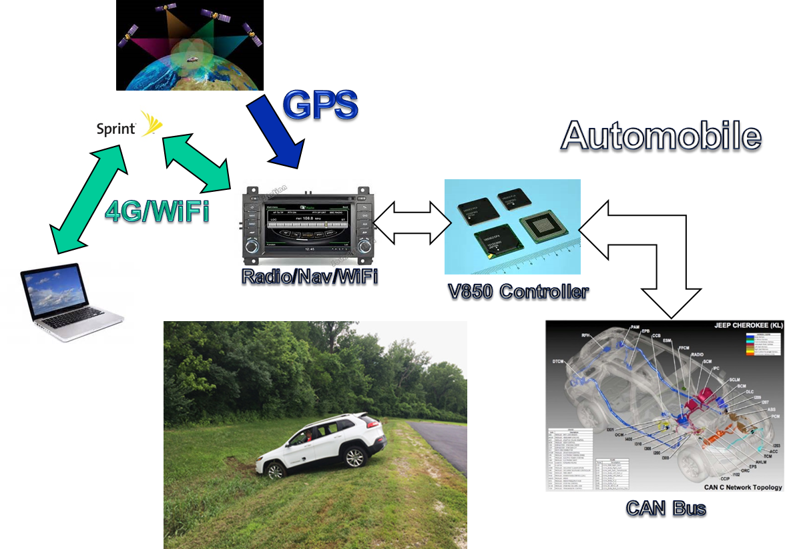
Example – Commercial Vehicle: Cyber Resilience Challenge
How to Detect?
How to Protect?
How to minimize effects?
What can be built in?
How can the risk be assessed?
Given system diversity
With limited people
Within real time & SWAP Limits
How can a operational System of Systems be made resilient when it was not designed that way?
UNCLASSIFIED

Slide 12
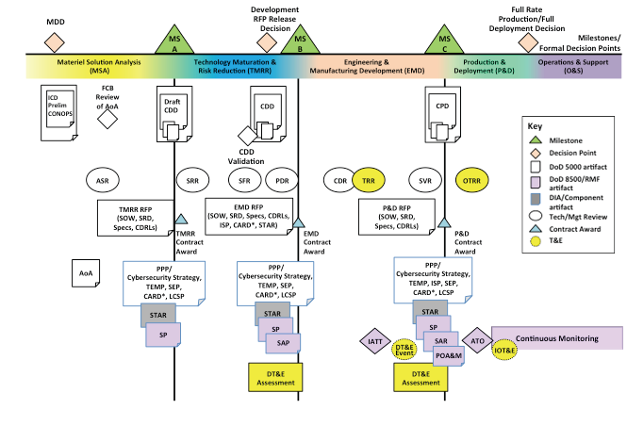
Mapping Cybersecurity to Acquisition “PM Cybersecurity Guidebook*”
Policy: “Cybersecurity requirements must be identified early and included throughout the lifecycle of systems including acquisition, design, development, developmental testing, operational testing, integration, implementation, operation, upgrade, or replacement of all DoD IT supporting DoD tasks and missions.”
* Program Manager’s Guidebook for Integrating the Cybersecurity Risk Management Framework (RMF) into the System Acquisition Lifecycle: https://acc.dau.mil/CommunityBrowser.aspx?id=721696
Notes:
Program Manager’s Guidebook for Integrating the Cybersecurity Risk Management Framework (RMF) into the System Acquisition Lifecycle: https://acc.dau.mil/CommunityBrowser.aspx?id=721696

Slide 13
Summary
Cyberspace is a Contested Operational Domain
DoD Systems need to be able to operate in contested cyber environment
Cyber Resilience is Not Optional

