Slide 1
Manufacturing & Industrial Base Policy Perspectives
July 27, 2016
Under Secretary of Defense for Acquisition, Technology and Logistics
USD(AT&L) Manufacturing and Industrial Base Policy

Slide 2
Authority and Organization
2011, USC Section 139c of Title 10
Established Deputy Assistant
Secretary of Defense for
Manufacturing and Industrial Base Policy
DASD (MIBP)
Principal advisor to USD (AT&L) for:
DoD policies for the maintenance of the US defense industrial base (IB)
Budget matters related to the IB
Anticipating and closing gaps in manufacturing capabilities or defense systems
Assessing impacts related to mergers, acquisitions, and divestitures
Monitoring and assessing impact of foreign investments in the US.
Executing authorities under Sections 2501and 2505 U.S.C. Title 10
Secretary of Defense
Deputy Secretary of Defense
USD (AT&L)
PDUSD (AT&L)
DASD (MIBP)
MIBP Mission: Support access to robust, secure and innovative industrial capabilities to fulfill short- and long-term National Security requirements

Slide 3
Mission Roles and Responsibilities
Advanced Manufacturing Capabilities
Create, expand, or preserve domestic industrial manufacturing capabilities to meet national defense requirements
Invest in cross-cutting, multi-system-benefit manufacturing R&D
Establish national public-private partnerships to spur innovation in U.S. manufacturing
Programs
Defense Production Act Titles I, III
U.S. Code Title 10 Section 2521, Defense Manufacturing Technology Program
North American Technology and Industrial Base Organization (NATIBO)
Industrial Base Assessments
Conduct detailed analyses of the defense industrial base to identify fragile capabilities
Lead DoD in all matters relating to mergers, acquisitions, and divestitures
Draft company and industrial base sector assessments, Reports to Congress, etc
Global Markets
and Investments
Analyze the national security implications of foreign investments in the U.S.
Proactively assess global market trends related to the defense industrial base
Program
Defense Production Act Title VII
Mission:
Ensure robust, secure, resilient, and innovative industrial capabilities upon which the Department of Defense can rely to fulfill the Warfighter’s requirements
Business Intelligence and Analytics
Develop and utilize business intelligence tools and capabilities to proactively assess the industrial base
Operate as a shared service for MIBP and other customers

Slide 4
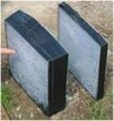
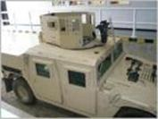
Manufacturing
DPA Title III – Expansion of Productive Capacity and Supply
Authorizes use of unique economic incentives to create, expand or preserve domestic industrial manufacturing capabilities for industrial resources, technologies, and materials needed to meet national defense requirements
Title III Program Director
Melinda Woods
Melinda.k.woods.civ@mail.mil
Fast Facts
Enacted in 1950
Not a permanent authority. (Reauthorized thru Sept 30, 2019)
Economic Incentives:
Purchases
Purchase commitments
Production equipment installation
Contracting activities/ technical projects managed by the Air Force.
http://www.dpatitle3.com
We ARE NOT:
R&D
Buying supplies, parts, or systems
We ARE:
Paying companies to create, expand, or modernize production capacity
Buying and managing government-owned production equipment integral to a company’s business
Title III Program Director
Melinda Woods
Melinda.k.woods.civ@mail.mil
ALON
Transparent
Armor

Slide 5
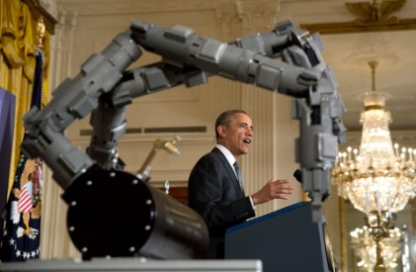
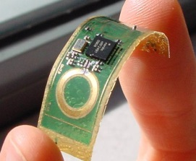
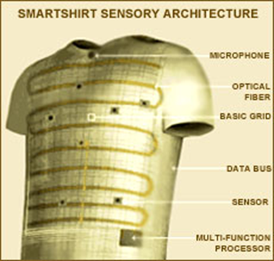
Manufacturing
Manufacturing Technology (ManTech)
Anticipates and closes gaps in manufacturing capabilities for affordable, timely, and low-risk development, production, and sustainment of defense systems
Acting Program Director
Tracy Frost
Tracy.g.frost.civ@mail.mil
Strategic Thrusts:
Responsive manufacturing technology investments
Active support for
Collaborative manufacturing enterprise
Strong institutional focus on manufacturability
Strong manufacturing process maturity
Healthy, sufficient, and effective defense manufacturing infrastructure and workforce
Fast Facts
ManTech focuses on the development of early stage (TRL 1,2,3) advanced manufacturing technologies and processes
ManTech programs across the DoD: participating Defense Agencies, and OSD
FY 2011 NDAA transferred oversight responsibilities of ManTech to DASD(MIBP)
https://www.dodmantech.com
Acting Program Director
Tracy Frost
Tracy.g.frost.civ@mail.mil

Slide 6
Manufacturing
DoD Manufacturing Innovation Institutes (MIIs)
Strengthening the innovation, performance, and competitiveness of the U.S. manufacturing base by bridging the current gap between basic research and product development/fielding and providing DoD with access to key, domestic enabling technologies
Acting Program Director
Tracy Frost
Tracy.g.frost.civ@mail.mil
Established MIIs:
Fast Facts
Public-private partnership (led by non-profit)
Minimum 1:1 cost share (Govt. and Industry)
Self-sufficient after 5 years
Federal investment range $55M - $110M
5 year Cooperative Agreement
Addt’l 2 years to complete funded projects
Regional hubs of manufacturing excellence
Invest in applied research
Industrially-relevant manufacturing technologies broad application; accelerate innovation; bridge the gap between basic research and product development/fielding (TRL/MRL 4-7)
https://www.dodmantech.com/Institutes/
America Makes
Est. AUG 2012 (Youngstown, OH)
Digital Manufacturing and Design
Innovation Institute (DMDII)
Est. FEB 2014 (Chicago, IL)
Lightweight Innovations For
Tomorrow (LIFT)
Est. FEB 2014 (Detroit, MI)
Integrated Photonics (IP)
Est. JUL 2015 (Rochester, NY)
Flexible Hybrid Electronics (FHE)
Est. AUG 2015
Revolutionary Fibers and Textiles (RFT)
Est. APR 2016
MIIs in Development:
Two Additional MIIs
Planned for 2016 and 2017
Acting Program Director
Tracy Frost
Tracy.g.frost.civ@mail.mil

Slide 7
Manufacturing
Industrial Base Analysis and Sustainment (IBAS)
Sustain existing Fragile and Critical Industrial Base capabilities with identifiable future needs that are at risk of being lost
Address Industrial Base Vulnerabilities
Unique Capabilities -– Lifelines and Safe Harbors for critical, unique capabilities with fragile business cases.
Design Teams – Preserving Critical Skills for technological superiority.
Industrial Base Supply, Expansion & Competition – Supporting expansion of Reliable Sources.
Fast Facts
New start in 2014
Closely aligned with Fragility and Criticality Program
RDT&E BA 7 color-of-money for operational systems development and pre-planned product improvement.
http://ibasp-public.ria.army.mil/
IBAS Program Director
Brad Nelson
Bradley.k.nelson2.civ@mail.mil

Slide 8
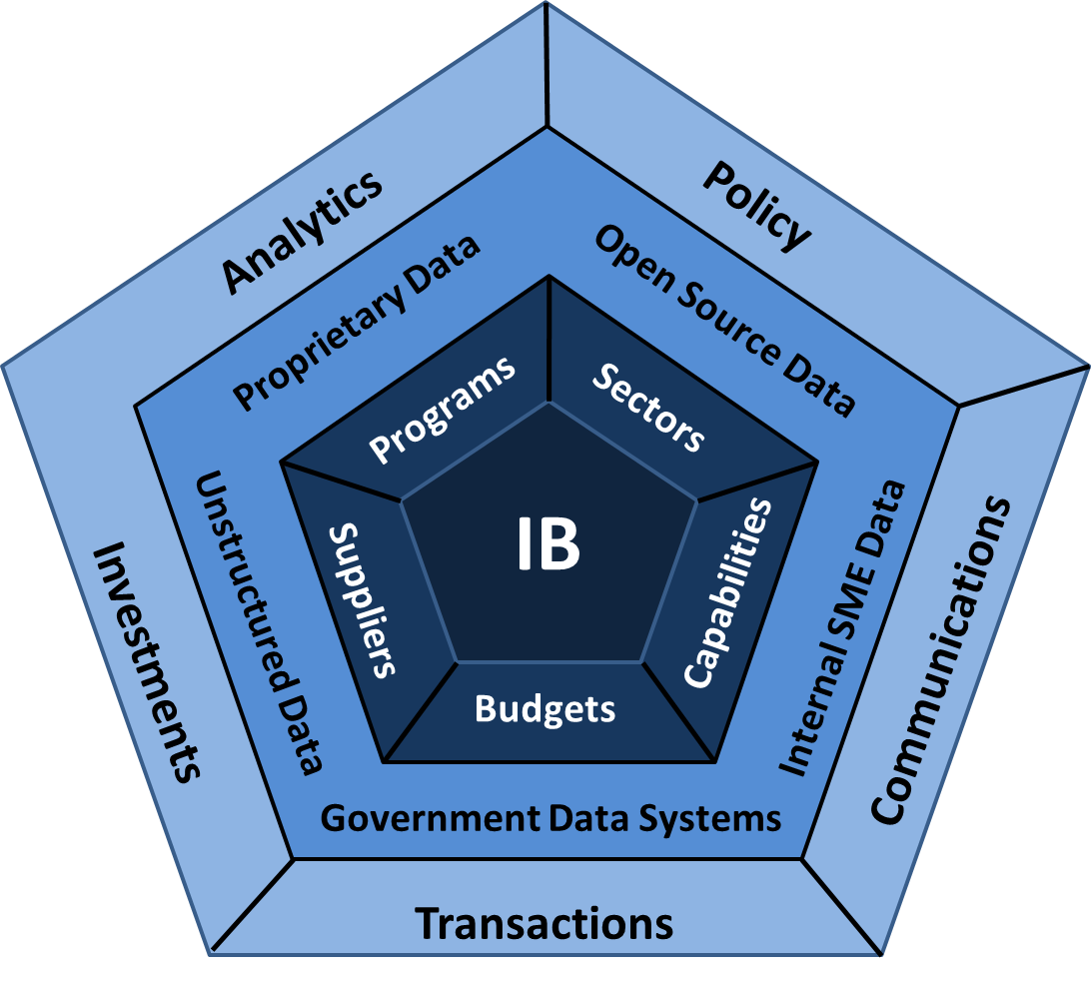
Assessments
Industrial Base Assessments
Deliver industrial base assessments and risk-based analysis to decision makers to support robust, secure, innovative, affordable and technologically superior defense industrial capabilities today and in the future
Industrial Assessments Director
Robert Read
robert.m.read6.civ@mail.mil
Fast Facts
Capabilities
Identify and monitor IB risk
Provide views of IB
Modeling, Predictive and Trend analysis
Assess domestic and global IB capabilities
Assess risks from counterfeiting & obsolescence
Products
Industrial Sector Summary
Risk-based analysis
Budget and program impacts on IB
Corporate transaction impact on IB
Financial analysis and company assessment
Fragility/Criticality Sector IB Risk Assessments
Using BIG DATA principles to provide more effective and timely predictive analytics on global and domestic IB trends and health
Industrial Assessments Director
Robert Read
robert.m.read6.civ@mail.mil

Slide 9
Recent & Current Activities
DoD Executive Agent (EA) for Printed Circuit Board and Interconnect Technology
DoD Directive 5101.18E, June 12, 2016
Study of field failures involving counterfeit electronic parts
Section 238(d) National Defense Authorization Act for FY16, due May 2017
Trusted Foundries for Strategic-Hardened Microelectronics
HASC Report 114-537, National Defense Authorization Act for FY17, due September 2016

Slide 10
Industry Outreach
Leading DoD relationships with industrial associations
Working with our industry partners to sustain the health of the Defense industrial base
Promoting innovation
Investing in technology
Preserving capability & capacity
Leveraging commercial / non-traditional suppliers
Contact Information
Robert Irie, (robert.e.irie.civ@mail.mil)

