Slide 1
NSWC Crane Microelectronics Integrity Meeting
Panel 1: Defense Microelectronics Industrial Base
David W. Bergman, VP Standards & Training, IPC

Slide 2

Background and History
Founded in 1957 as the Institute of Printed Circuits with six Member Companies
Strong Foundation as Technical Organization Dedicated to Meeting Industry Needs
Focus on Design, PCB Manufacturing and Electronics Assembly

Slide 3

IPC Today
IPC is an international industry association dedicated to furthering the competitive excellence and financial success of more than 3,700 member companies that make, use, specify and design printed boards and assemblies, including those in: advanced microelectronics
  aerospace and military
  automotive
  computer
  industrial equipment
  medical equipment and devices
  telecommunications industries

Slide 4


Major Program Areas
What We Do
Standards
Training & Certification
Management Programs
Conference & Exhibitions
Professional Development – Technical Education
Market Research
Statistical Programs
Public Policy Advocacy

Slide 5
IPC and NSWC Crane
Long History of cooperation
IPC signed a Cooperative Research and Development Agreement (CRADA) with NSWC Crane in 2001.
IPC support for E/CIT
Lobbied for funding for the Electrochemistry Engineering Facility/Electronic Interconnection Research and Development Program, designed to strengthen the abilities of both the Department of Defense and the U.S. Printed Circuit Board industry to support the military's printed circuit board
Consistent support for NSWC Crane as Executive Agent for Printed Circuit Boards

Slide 6
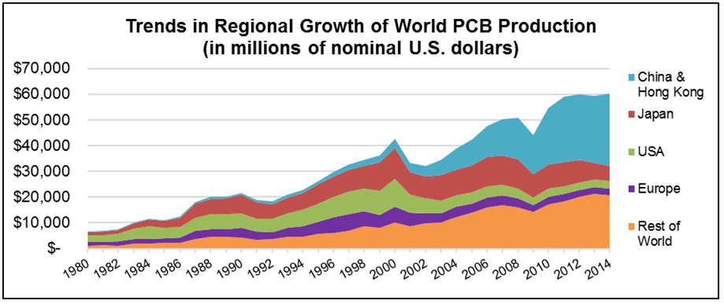

Slide 7
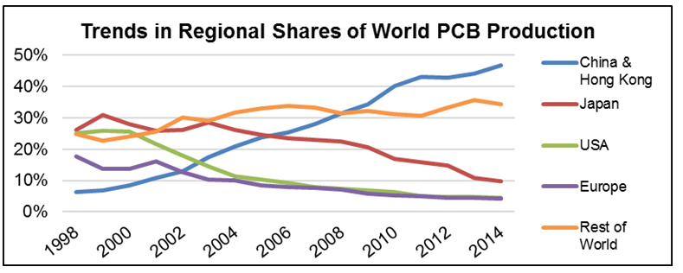

Slide 8
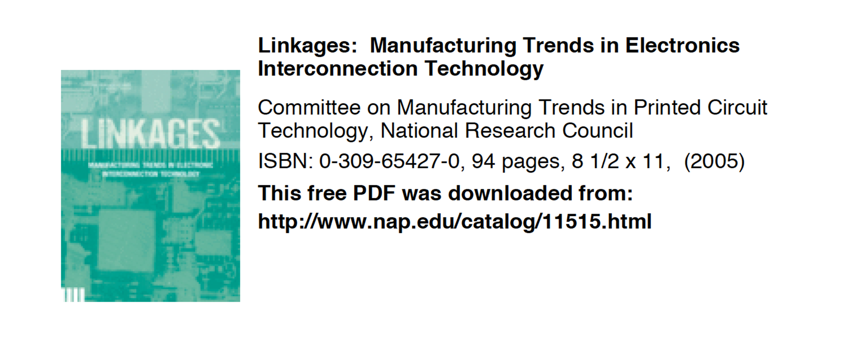
National Academy study

Slide 9
National Academy study
Recommendation 2: The Department of Defense should develop a method to assess the materials, processes, and components for manufacture of the printed circuit boards (PrCBs) that are essential for properly functioning, secure defense systems. Such an assessment would identify what is needed to neutralize potential defense system vulnerabilities, mitigate threats to the supply chain for high-quality, trustworthy PrCBs, and thus help maintain overall military superiority. The status of potentially vulnerable materials, components, and processes identified as critical to ensuring an adequate supply of appropriate PrCBs for defense systems should then be monitored.

Slide 10
National Academy study
Recommendation 4: The Department of Defense (DoD) should ensure access to new printed circuit board (PrCB) technology by expanding its role in fostering new PrCB design and manufacturing technology. DoD should sponsor aggressive, breakthrough-oriented research aimed at developing more flexible manufacturing processes for cost-effective, low-volume production of custom PrCBs. In conjunction with this effort, DoD should develop explicit mechanisms to integrate emerging commercial PrCB technologies into new defense systems, even if that means subsidizing the integration. These mechanisms should include more innovative design capabilities and improved accelerated testing methods to ensure PrCBs' lifetime quality, durability, and compliance with evolving environmental regulations for the conditions and configurations unique to DoD systems.

Slide 11
IPC Programs
IPC Standards
  IPC 6012/ IPC-2221
Validation Services
  QML 6012

Slide 12
IPC provides test coupon designs for product acceptance
    Test coupons are fabricated by printed board shop
    Coupons are thermally stressed, microsectioned and then evaluated
    Intended to demonstrate the conformance of the product currently being manufactured by the fabricator to meet IPC-6010 series requirements
  Schematic files for IPC test coupons
    IPC has historically provided “fixed” schematics for these test coupon designs in “Gerber” .gbr file format
    IPC has provided these Gerber files as electronic artwork to board fabricators building printed boards to IPC-6010 series requirements (e.g., IPC-A-47-G)
    IPC Test Coupons – A Primer

Slide 13
IPC Test Coupons – Outta Time – 35 years old
IPC-2221 legacy test coupon designs became severely outdated
    Coupon designs were made in the 1980’s
    OEMs have in turn not been getting data that is representative of the product boards they are currently purchasing

Slide 14
  IPC-2221B Coupon Generator
IPC has released the IPC-2221B Gerber Coupon Generator
    Enables users to input their own design parameters (layer count, drill, layer features, etc.) and provides automatic error checking against IPC-2221B design rules when using the input interface
    The software program’s current release addresses the “AB/R” and “D” coupons for PTH integrity verification - the most popular and complex test coupon designs (out of a total of 12) as required by IPC-6010 performance specifications

Slide 15
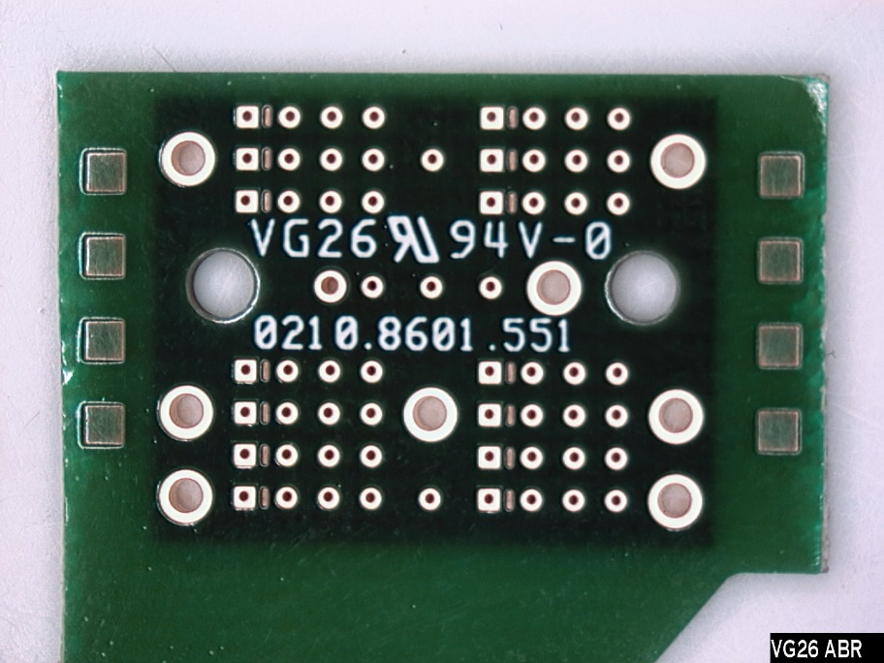
New IPC-2221B Coupon Set
IPC-2221B released a whole new suite of coupon designs
    Represents current printed board fabrication technology
    Complex designs of various hole sizes and types
    Existing Gerber artwork paradigm no longer works - complexity adds difficulty in fabricators relying on “fixed” Gerber files provided by IPC

Slide 16
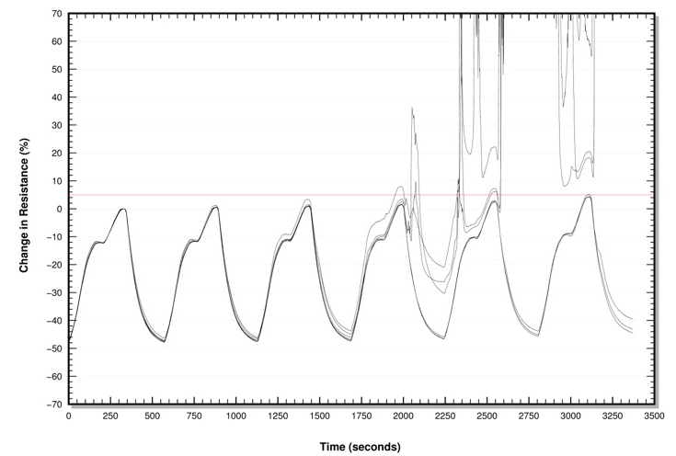
Through hole via

Slide 17
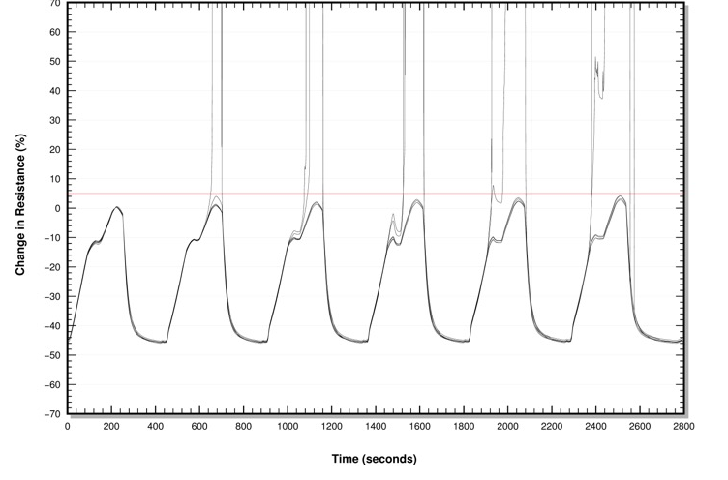
Stacked Vias

Slide 18
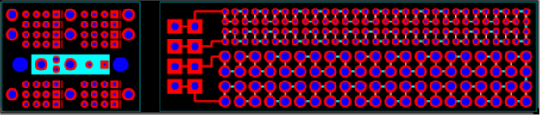
6012/600 QML Program

Slide 19
Drivers for this Program
IPC Members, Committee Chairs, Suppliers, and OEMs wanted a program to determine which printed board manufacturers met or exceeded the IPC standards and test methods
List of Trusted Suppliers provided to the industry
Industry wanted One Master Database to view all test data reports

Slide 20
Program Overview
Process Focused Audits
3 year Certifications
Audits conducted by trained IPC personnel
Annual Assessments (metrics are collected)
Program Visibility – VS Website
  www.ipc.org/validation

Slide 21
How Does the Program Work
Master Database archives all test coupon results
  Conformance based testing
  Subscription will be available for OEMs to view the test data reports
3 reflow options/3 cycle ranges
Test Coupon Submissions:
  Class 3 will be Quarterly
  Class 2 will be Semi-Annually
    Required to maintain certification
Once certified the PB Manufacturer will be listed on the IPC Validation Services QML web site

Slide 22
Program Status
QML:
  J-STD-001/610 most popular
    J-STD-001 Space Available
  620 gaining acceptance
  1071 and 1072 updated standards soon to be released
  6012/600 new for 2016 gaining momentum
QPL:
  J-STD-004, 005, 006 are Available
  CC-830 committee currently is updating the standard and test methods
  4101 is in planning stages

Slide 23
31032
Feedback from both OEM and current PCB fabricators is collaboration between IPC 6012 QML and MIL-PRF-31032 would be beneficial
IPC exploring ways to tie in needs of 31032 in with 6012
  Drafting 31032 addendum to 6012 as has been done for aerospace and automotive industries
Seeking further collaboration

Slide 24
Protecting IP – IPC 1071A
Best Industry Practices for Intellectual Property Protection in Printed Board Manufacturing
Purpose The purpose of this standard is to assist printed board (PB) manufacturers in the development of requirements for the protection of intellectual property (IP) for their customers in commercial, industrial, and military and other high reliability markets. This standard will focus on protection of the inherent IP designed into the printed board such that IP flows from the customer to the PB manufacturer and IP that is incorporated into the PB is protected.
1.3.3 Level 3 Advanced Level for Military, Government, and Commercial Intellectual Property Protection This level of requirements provides the highest intellectual property protection and is best suited for military and other high security systems. Items manufactured under Level 3 IP protection must be manufactured in the United States or in a State Department and DoD (or other appropriate government agency) approved location under the strict supervision of employees with U.S. or other required citizenship or residency status.

Slide 25
Traceability Standard IPC-1782
Standard for Manufacturing and Supply Chain Traceability of Electronic Products Based on Risk
This standard defines a template which can be used for, but not limited to, the following products: Assembled PCBs, electronic products and assemblies, typically comprising SMT components (including discrete components), through-hole components and base materials (laminate, glass, resin, etc.)
The document was developed based on a system-wide shutdown of operations due to a failed part from AT&T.
Several OEMs have their own traceability requirements, so this document was developed so there is one industry standard that can be applied. The original focus was on SMT parts, but it is written in such a way as it can be applied to any aspect of the supply chain.

Slide 26
David W. Bergman
Vice President Standards & Training
IPC - Association Connecting Electronics Industries
3000 Lakeside Drive Suite 105N
Bannockburn, IL 60015-1249 USA
+1 847-597-2840 tel
DavidBergman@ipc.org
www.ipc.org
Thank you

