Slide 2
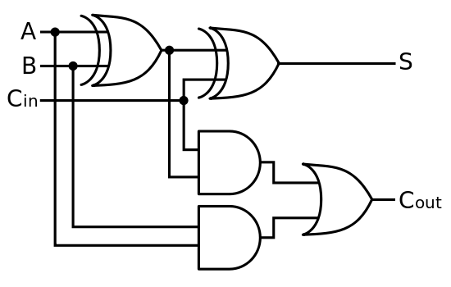
FPGAs (Field-Programmable Gate Arrays) map digital logic to a reconfigurable circuit.
Map

Slide 3
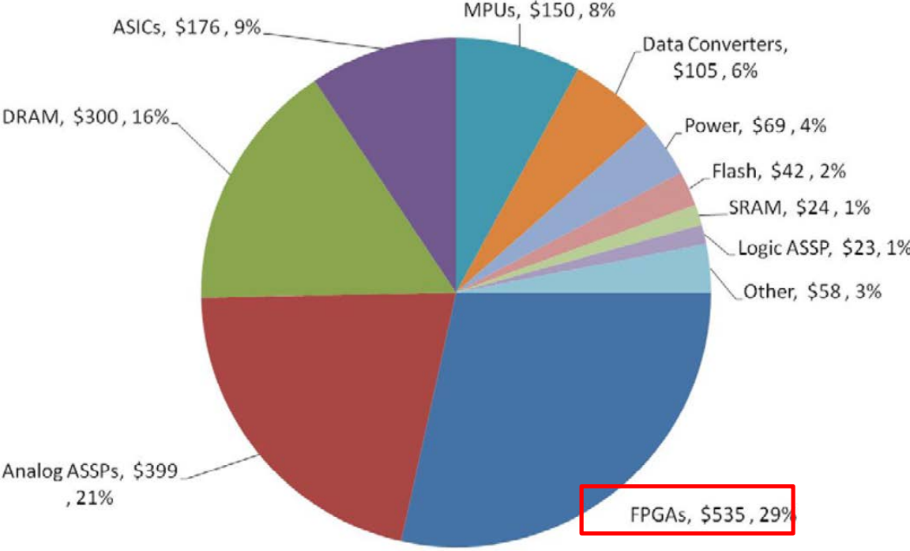
FPGAs are Important!
FPGAs, $535 M, 29%
IDA report, Examination of DoD’s Use of Microelectronics in Weapon Systems, 2013

Slide 4
FPGAs are Good!
Shorter development times
Lower costs
Simplifies design flows
with near ASIC performance

Slide 5
How could FPGAs be bad?
Bitstreams

Slide 6

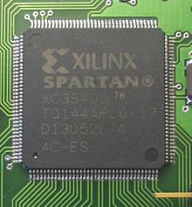


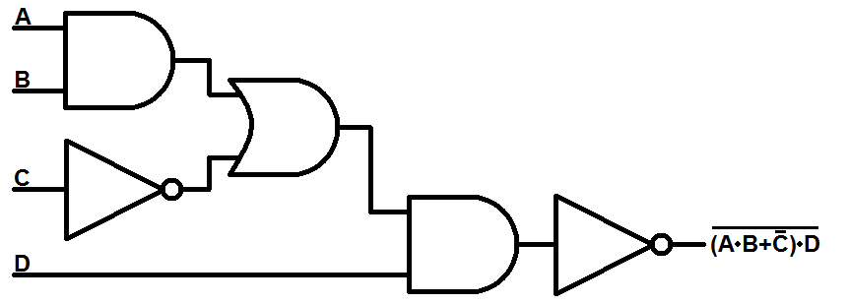
Bitstreams: FPGA Configuration Files
FPGA
Manufacturer
FPGA
Bitstream Development Software
Bitstream
Bitstream Tamper
Insert Trojan
IP Piracy
User
Design

Slide 7
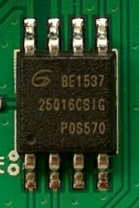


Most bitstreams are stored off chip*, which makes them vulnerable to tampering.
Bitstream
Memory Chip
FPGA
*On-Chip discussed later

Slide 8
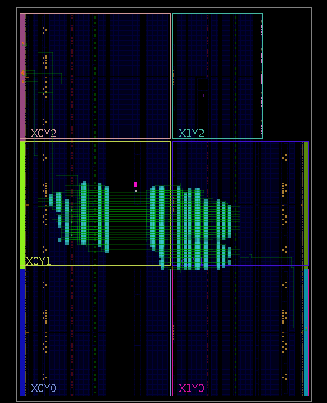
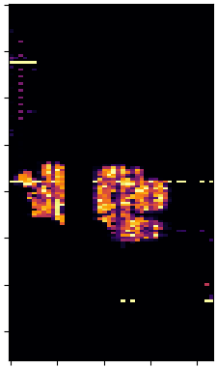
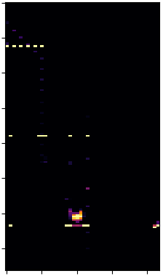
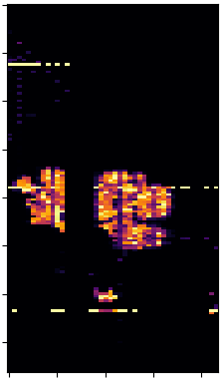
Threat Model: Bitstream Tampering
User Design
User Design
User Design
Trojan
Trojan
FPGA Design Software
Bitstream Analysis
(Indiana University)
Trojan Design
User Design w/ Trojan Inserted

Slide 9
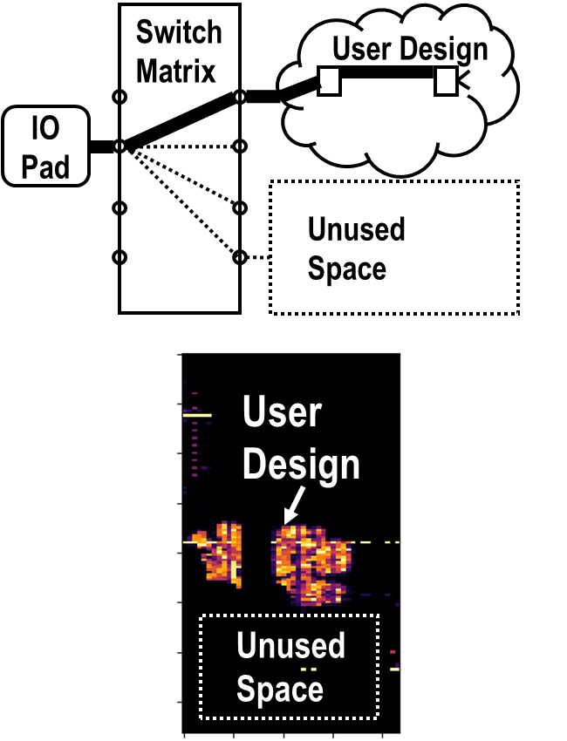
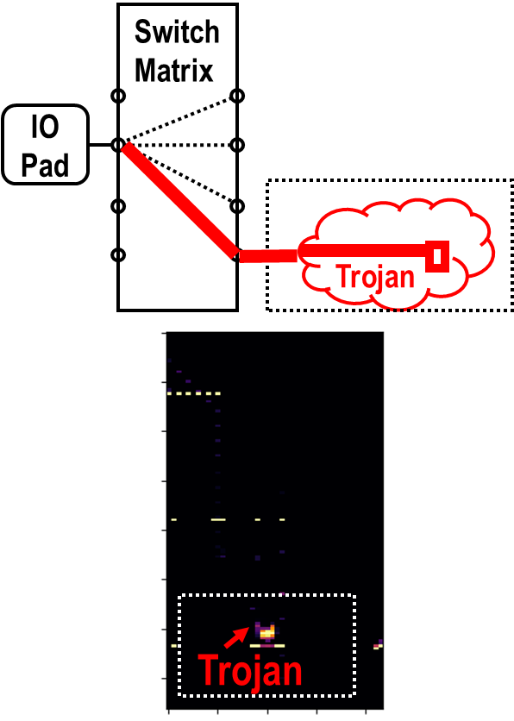
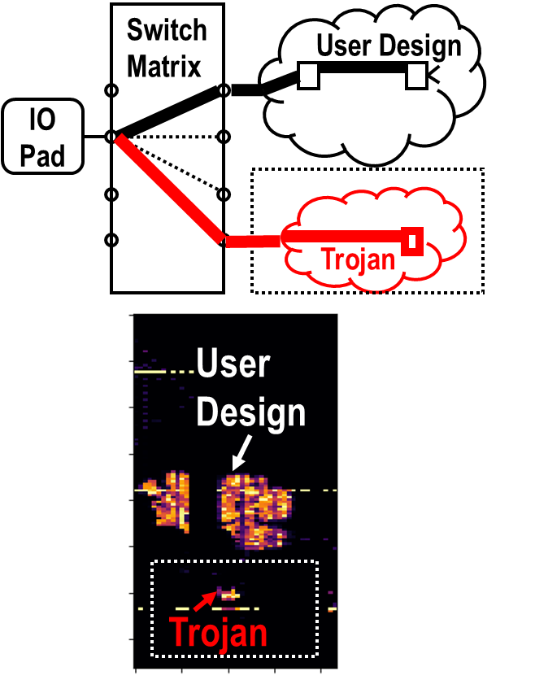
PadLock: Bitstream Tamper Prevention
A. R. Duncan “Rethinking FPGA Security: FPGA Bitstream Tampering Attacks and Countermeasures”

Slide 10
PadLock: Runtime Deletion and Regeneration
Switch
Matrix
User Design
Switch
Matrix
User Design
IO Pad
IO Pad
Unused Space
Unused Space
t=t0: Connections and nodes missing
Initial Bitstream
Time (t)

Slide 11
PadLock: Runtime Deletion and Regeneration
Switch
Matrix
User Design
Switch
Matrix
User Design
IO Pad
IO Pad
Unused Space
Trojan
t=t0: Attacker inserts trojan
Initial Bitstream
Time (t)

Slide 12
PadLock: Runtime Deletion and Regeneration
Switch
Matrix
User Design
Switch
Matrix
User Design
IO Pad
IO Pad
Unused Space
Trojan
t=t1: Runtime deletion
(Trojan deleted)
Initial Bitstream
Time (t)

Slide 13
PadLock: Runtime Deletion and Regeneration
Switch
Matrix
User Design
Switch
Matrix
User Design
IO Pad
IO Pad
Unused Space
Trojan
t=t2: Runtime regeneration
(Trojan non-functional)
Initial Bitstream
Time (t)

Slide 14
Can On-Chip bitstreams prevent bitstream tampering?
Yes, but…
Notes:
Yes, but

Slide 15

On-Chip bitstreams have >25x lower capacity.
Off-Chip Storage
On-Chip Storage
Bitstream
FPGA
Bitstream
Memory
FPGA
Flash: 0.5M Logic Gates​, 28 nm
Antifuse: 2M Logic Gates, 150 nm
SRAM: 50M Logic Gates, 16 nm
Notes:
SRAM = 50M gates https://www.xilinx.com/news/press/2015/xilinx-delivers-the-industry-s-first-4m-logic-cell-device-offering-50m-equivalent-asic-gates-and-4x-more-capacity-than-competitive-alternatives.html
antifuse = 2M gates https://www.microsemi.com/product-directory/fpga-soc/1641-antifuse-fpgas

Slide 16
New non-volatile memories are the future for secure FPGAs.
PCRAM, MRAM, RRAM
Higher capacity than traditional non-volatile
Retains on-chip bitstreams
Improved security and performance
Notes:
PCRAM: Intel Xpoint
MRAM: GF 22FDX, Samsung, TSMC, Everspin
RRAM: Intel 22nm

Slide 17
Challenges with new memories
Cost
Resistance-to-digital conversion overheads
Physical inspection

Slide 19
Backup

Slide 20

SRAM-based FPGAs are too insecure.
FLASH
FPGA
Encryption
Design
Design
Hash
Transfer
Hash
Decryption
We can decrypt, modify, re-hash, and re-encrypt this.
Notes:
FIXME: Lock Color

Slide 21
Fuse-based FPGAs are slow and small.
SRAM: Intel Stratix 10GX 5500 Datasheet
Fuse: Microsemi Axcelerator AX2000 Datasheet
Notes:
172X
Changes to process technology, running behind advanced nodes
https://static6.arrow.com/aropdfconversion/1d8119f92f1f3d442967352f61675d8d6b2cf7ab/s10-overview.pdf
Table 1: “Core Performance” – 1 GHz
Table 4: “GX 5500/SX 5500” 5510 KLE’s
https://www.microsemi.com/document-portal/doc_download/130669-axcelerator-family-fpgas-datasheet
Table 1: 10,752 + 21,504 “Cells” = 32256
Page 1: 350MHz

Slide 22
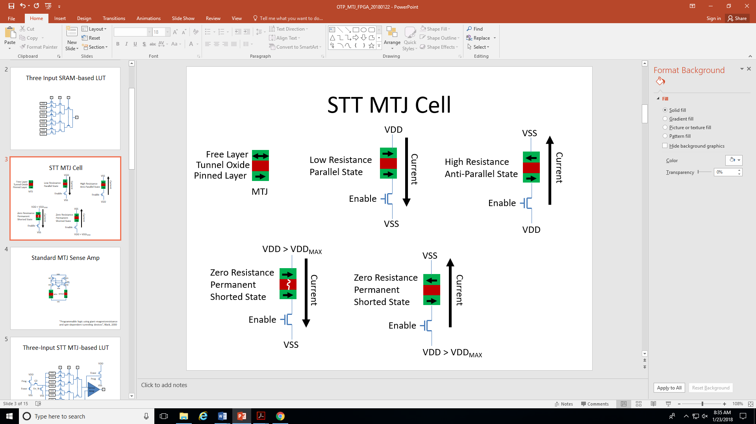
MRAM (Magnetoresistive Random-Access Memory)

Slide 23
MRAM (Magnetoresistive Random-Access Memory)
Programming a ‘0’
Programming a ‘1’

Slide 24
MRAM-based FPGAs should provide:
Better security than SRAM
More radiation hardness than Flash
Higher performance than Fuses

Slide 25
Interconnect

