Slide 1
Illuminating the Supply Chain
Microelectronics Integrity Meeting
Naval Surface Warfare Center
Crane
George Thompson, IDA
2 August 2017

Slide 2
Evolution of Supply Chain Management
“An army marches on its stomach”
Modern logistics
Containerization, Just in Time, Theory of Constraints, Electronic Data Exchange…..,
Globalization
Transition from logistics to Supply Chain management
Cooperation across the supply chain
Sharing inventory and demand data
Partnerships
Big data, Web 2.0 analogy, Big data vs. Clean data
The Supply Chain is Fundamentally Evolving; Will Our Strategies and Tools Keep Up?

Slide 3
Location and Number of Apple Suppliers per Country
iPhone 6
http://comparecamp.com/how-where-iphone-is-made-comparison-of-apples-manufacturing-process/
Globalized Supply Chains, including research, development, and design are the new normal Implications for the Trust and Assurance of COTS

Slide 4
Expansion of Scope of Supply Chain Management
Shift in focus from upstream to the entire Value Chain
Evolution from low cost manufacturing to including IP, Design, Market Access, M&A, and Strategic Destiny
Changing business relationships
Samsung Apple cooperation
Common architecture (ARM)
iPhone/Galaxy Patent War
Tesla-Panasonic
Samsung Fab
Samsung Galaxy
ARM IP
Smart Phone Patent Wars
Apple iPhone
Samsung Fab (Later TSMC)

Slide 5
Opportunities and Risks of a Global Supply Chain
Faster, cheaper, better
Ability to benefit global centers of expertize, virtual agglomeration
Suppliers may understand changing demand signals better, given access to enough data
“Open” supply chains, transparency, collaborative models
Loss of control of data or context
Exposure to deliberate or negligent hostile acts
Insertion of corrupt IP, designs, CAD tools……
Reverse ITAR, formal or informal

Slide 6
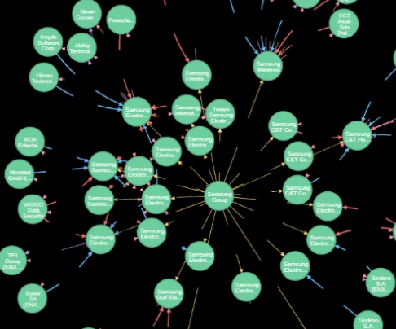
Visualization and Illumination Tools for Creating Strategic Context
CONIAS Risk Intelligence
Mapping supply chain relationships
Risk assessments
Early warning of dependencies
Business, geographic, technology
Rapid response support to events
A Globalized Supply Chain will Require Global Situational Awareness

Slide 7
Thank you

