Slide 1

CAPT Mark Oesterreich, USN
Commanding Officer
NSWC Crane
Dr. Brett Seidle, SES
Technical Director
NSWC Crane
Radiation Hardening and Trust in a COTS Age
Matthew Gadlage, Ph.D.

Slide 2
Outline
The promise of COTS (commercial off the shelf) technologies in radiation environments
  Technology trends are in our favor
  Rad-hard by design (RHBD) has gone mainstream
The problem with COTS
  Counterfeits! Trust!!!
  (Often) you have no insight into ‘inner workings’ of chip

Slide 3
“Types” of Radiation Effects
Total Ionizing Dose
Single-Event Effects
  In Space
  Terrestrial (soft errors)
Dose Rate
  Upset
  Survivability
Neutron-Induced Displacement Damage

Slide 4
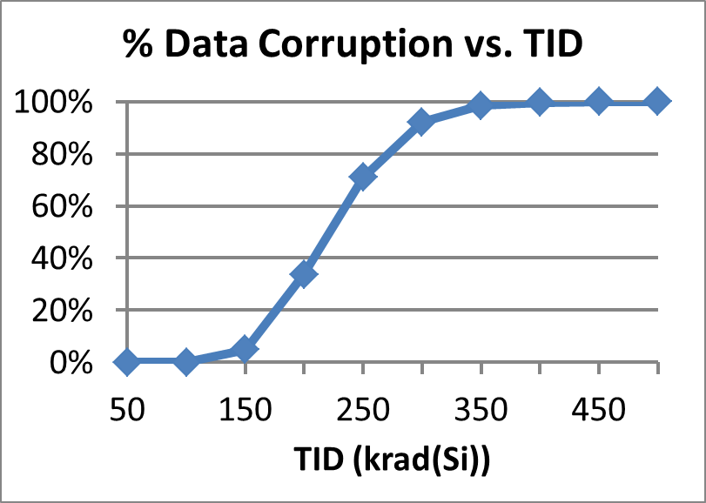
“Types” of Radiation Effects
The accumulation of radiation damage leading to a degradation of an electronic device’s performance.
Total Ionizing Dose
Single-Event Effects
  In Space
  Terrestrial (soft errors)
Example: Total ionizing dose (TID) effect in a NAND Flash memory

Slide 5
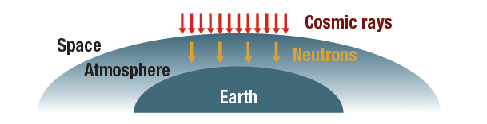
“Types” of Radiation Effects
Total Ionizing Dose
Single-Event Effects
  In Space
  Terrestrial (soft errors)
A single-event effect (SEE) is an unexpected microelectronic device response caused by a single radiation event.
In Space:
Sources of single events include galactic cosmic rays (heavy ions) and protons.
On Earth:
Sources of single events include alpha particles and terrestrial neutrons.

Slide 6
“Types” of Radiation Effects
Total Ionizing Dose
Single-Event Effects
  In Space
  Terrestrial (soft errors)
Dose Rate
  Upset
  Survivability
A dose rate effect can occur when a high-radiation event happens in a very short time (nuclear detonation).

Slide 7
Technology Trends in Radiation Effects
Hardness
800
250
90
32
Technology Node (nm)

Slide 8
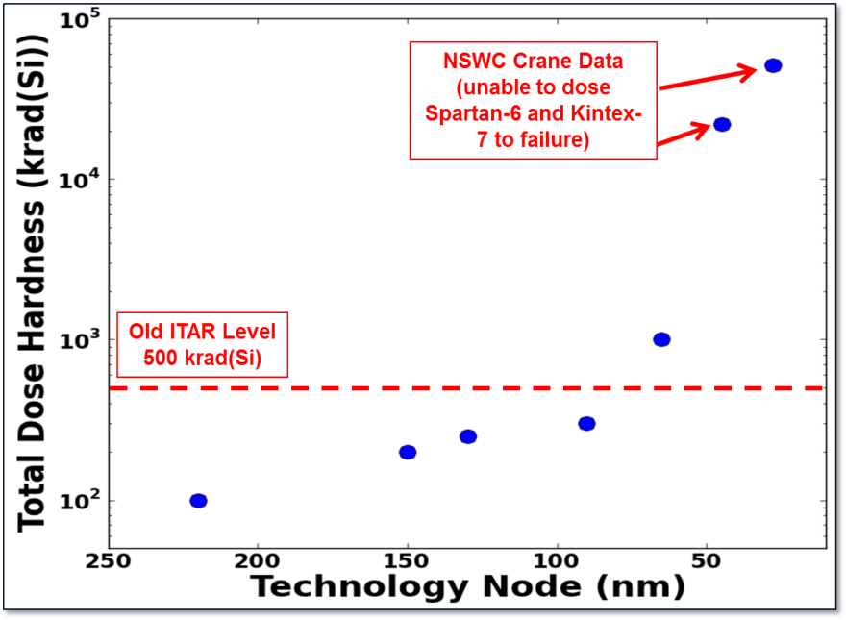
Total Dose Trends
Xilinx FPGAs were used to demonstrate radiation effects trends in bulk CMOS technologies
Advanced bulk CMOS technologies can be extremely radiation tolerant
Commercial sub-65nm CMOS processes can have total dose hardness levels exceeding 1 Mrad(Si)

Slide 9
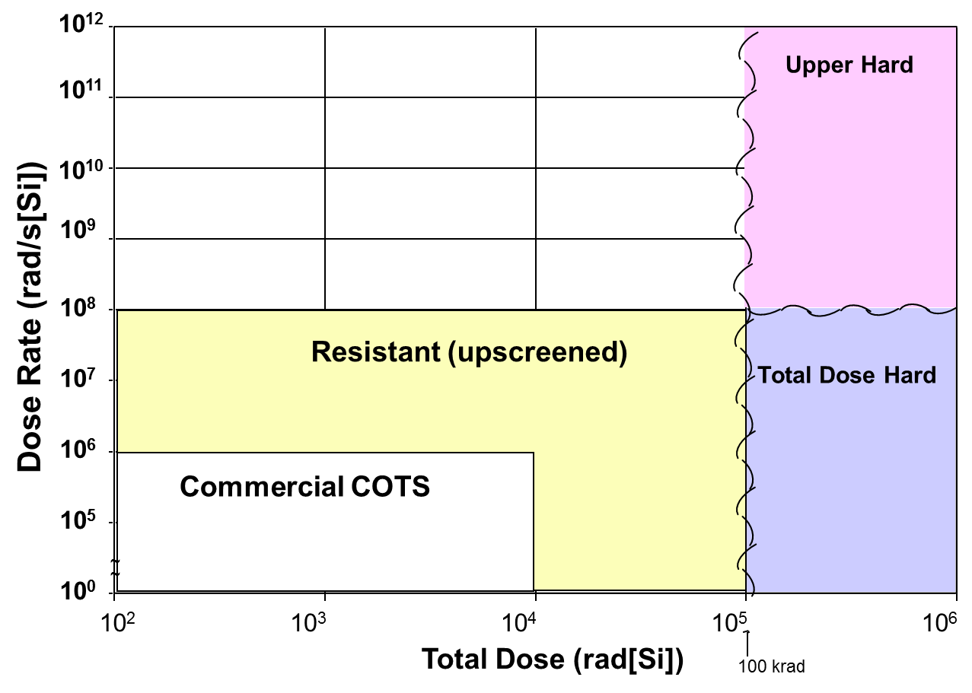
COTS Hardness – 20 years ago

Slide 10
Recent COTS Data Taken by Crane
Part Type & Family | Vendor | Process Node
FPGA - V5-QV (aka SIRF)* | Xilinx | 65
FPGA - Spartan-6 | Xilinx | 42
FPGA - Kintex-7 | Xilinx | 28
FPGA - Ultrascale | Xilinx | 20
NVM - CBRAM - 64Kb | Adesto | 130
NVM - NAND Flash - 8Gb | Samsung | 51
NVM - MRAM - 16 Mb* | Cobham | 130
NVM - MRAM - 16 Mb | Everspin | 130
Processor | Intel | 22
Processor | Intel | 14
Processor - GPU | Nvidia/TSMC | 16
Processor - GPU | Nvidia/Samsung | 14

Slide 11
2017 COTS Hardness
Other Digital (sub 90-nm)
Flash
14-nm FinFETs
130-nm
NVM

Slide 12
View from 2017
Strategic RH
Resistant (upscreened COTS)
130-nm
NVM
COTS
Space-Hard
(Commercial Processes with RHBD)

Slide 13
Commercial RHBD Example – Xilinx FPGA

Slide 14
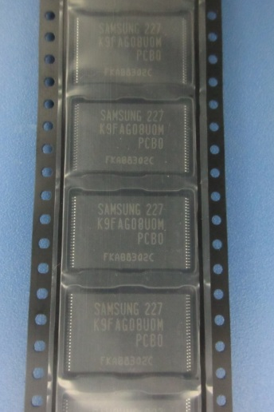
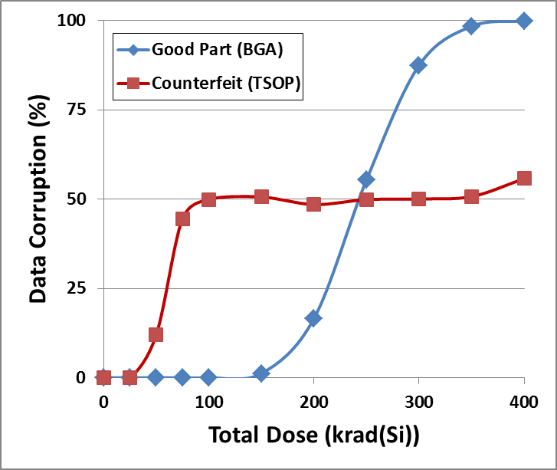
Counterfeits!
In 2013, NASA presented single event data on a 32-nm 16 Gbit Samsung SLC NAND flash
  K9FAG08U0M-HCB0
Conclusion – “The Samsung 16G NAND flash memory appears to be extremely well suited for space applications.”
  No destructive SEE events were observed
  Previous generation Samsung SLC flash devices did have destructive SEE events
No total dose testing was performed by Oldham (but he suspected that the device was total dose hard)
This 32-nm SLC Samsung flash may be the most inherent radiation tolerant NAND flash memory available.
Counterfeit NAND Flash
Gadlage et al., GOMACTech 2016
Radiation Comparison

Slide 15
Trust!!!
Every good hardware Trojan needs a trigger…
  And radiation is a really good at inducing:
    Glitches, bit flips, latchup, threshold voltage shifts, etc.
Systems vital to our national security work in radiation environments
  Nuclear weapons
  Satellites
Inadvertent Bit Flips Can Be Exploited
(Ex. Rowhammer)
Recent Chinese Paper on Using Latchup as a Trojan

Slide 16
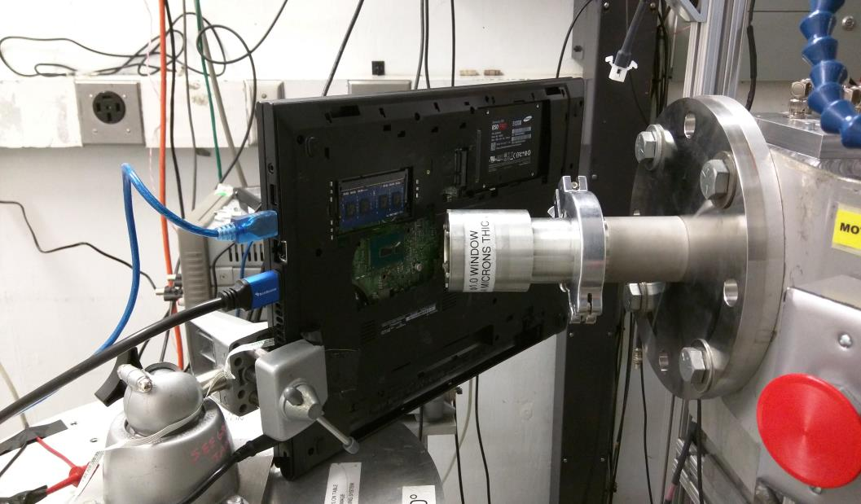
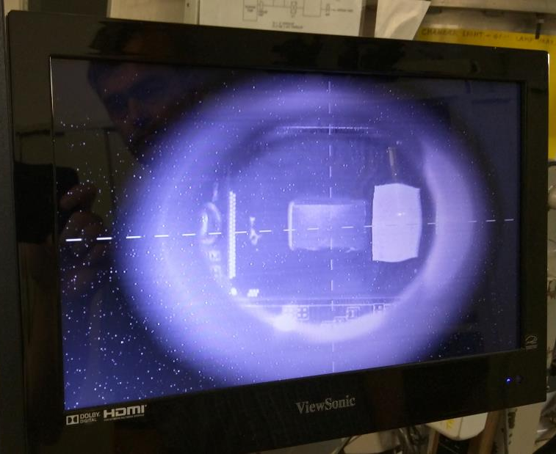

Single-Event Tests on 14-nm Intel Microprocessor
TAMU heavy ion beam focus
Test hardware: Dell Inspiron 3000 with 15W i3-5005U Broadwell under AC power with Samsung SSD
Test software: Microsoft Windows Server R2 running HWiNFO64 from SSD with HDMI output and USB keyboard & mouse
Work presented at the 2016 SEE Symposium, NSREC, and ITSFA

Slide 17
Broadwell Heavy Ion Hard Failures
Failures observed in Intel processors exposed to heavy ions:
  Type 1: System crash observed followed by inability to boot system for 30 to 90 minutes
  Type 2: Catastrophic failure (permanent inability to reboot)
  Observed independently by both Navy and NASA
  Occurs infrequently
    Very limited statistics
Broadwell Processor Heavy Ion Data

Slide 18
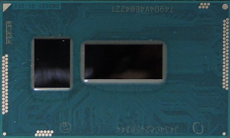
Hard Failure Location on Intel Package
32 nm planar PCH die
14nm FinFET processor die
147µm x 17µm sensitive area on PCH
14nm Intel microprocessor package contains two die
Scanning optical microscope used to raster both die with 1064 nm laser
Both die scanned with 1064 nm laser
  Generates electron hole pairs similar to a heavy ion
  Hard failures recreated only on small section of 32nm planar PCH
  Nonfunctional for ~10 minutes after laser exposure in sensitive area

Slide 19
The Problem with COTS
This Intel processor illustrates the problem with COTS in radiation environments in a nutshell:
  It offers capabilities far exceeding anything available on the rad-hard market
  And in some radiation environments (like total dose), it’s very hard
  But … there’s a single-event issue on a tiny fraction of one die, that we can’t simply fix
      Because we’re trying to use it in an environment the manufacturer doesn’t care about

Slide 20
Conclusions
State-of-the-art digital electronics can have a high level of inherent radiation tolerance
    Sub 65-nm COTS ICs can be multi-Mrad(Si) TID hard
    Commercial semiconductor manufacturers today commonly use RHBD techniques to mitigate soft errors
There are issues with COTS technologies
    They can be counterfeited
    Radiation makes a great Trojan trigger
    You can’t ‘fix’ the radiation problems

