Slide 1
Strategic Investments
to
Ensure Tomorrow
Matt Kay
Flight Division: Failure Analysis Chief Engineer
Microelectronics Integrity Meeting
August, 2017
DISTRIBUTION A. Approved for public release: Distribution Unlimited

Slide 2
Outline
Our Mission
Problem Statement
Existential Threats
Technical Challenges
Additional Constraints
Engagement
K-12 STEM Efforts
University Engagement
Employment
Missions Focus Areas
Strategic Missions
Electronic Warfare & Information Operations
Special Missions

Slide 3
The Scope of Our Mission
Nuclear Deterrence…
…to the War on Terror
Microelectronics requirements across the mission space

Slide 4
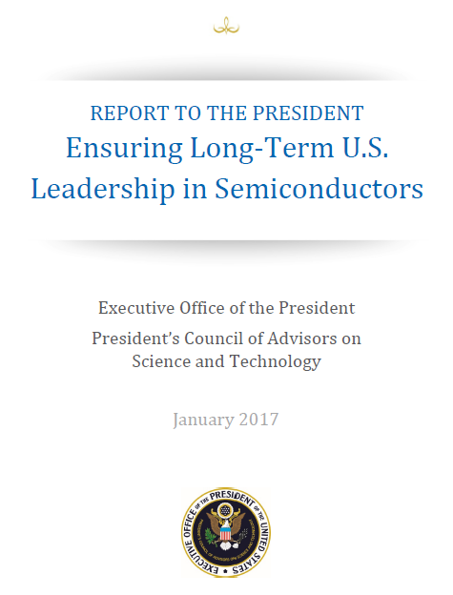
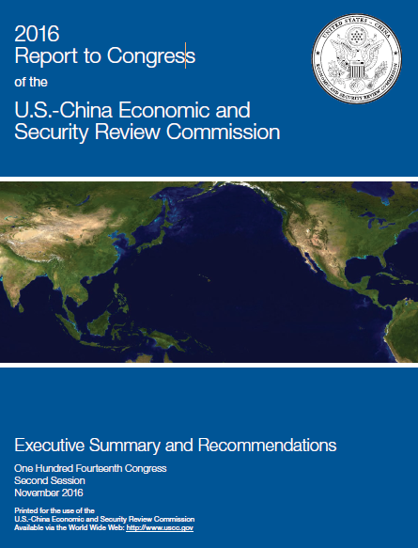
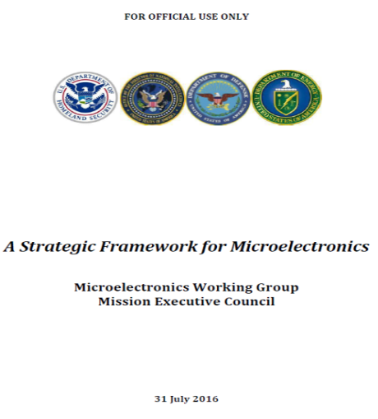
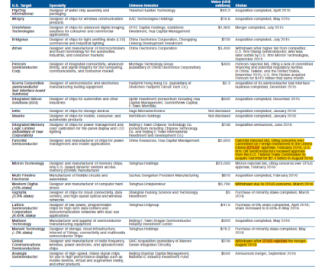
Trusted Microelectronics is National Security Concern
CFIUS
“The United States faces a distinct set of specific, semiconductor related national security challenges.”
“Enhance microelectronics in-house capabilities within USG agencies with microelectronics
Equities.“
“DON must build and/or sustain robust in-house research and development capability and develop strategies to accomplish this…….
Key Programs and Technology Investments:
- trusted electronics
- micro-miniature anti-tamper
- radiation hardened (RADHARD) electronics”
“The increased acquisition of U.S. assets by Chinese…. growing concern over economic and national security implications of such acquisitions”
* CFIUS - Committee on Foreign Investment in the United States

Slide 5
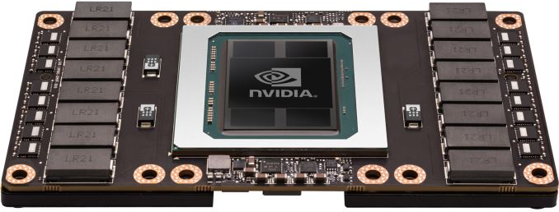
Tech Challenges: What is being built?
NVIDIA Tesla GPUs
15.3 Billion transistors IC
State Space →2^{N}
Moore’s law drives rapid evolution of technology
and with it complexity!
2 !!!
10⁹

Slide 6
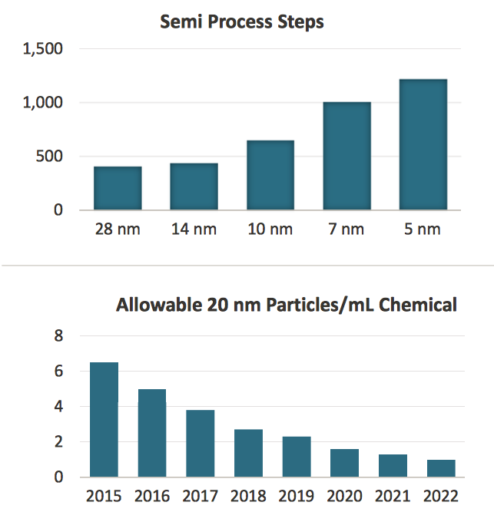
Tech. Challenges: What does it take to build it?
Filtering Out Fab Problems
An average of 4 million cubic feet of water flow over Niagara Falls every minute. Filtration down to 1 ppq is the equivalent of finding and removing one drop of impurity from this flow over 49 days. Source: Greenwich Mean Time

Slide 7
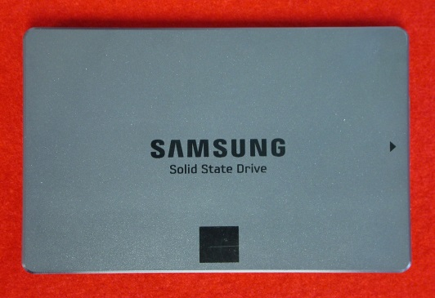
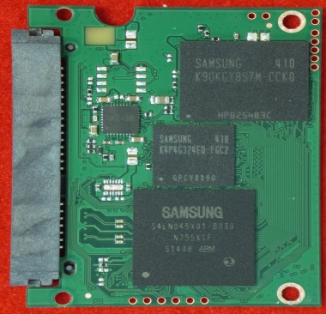
Tech. Challenge: What does it take to verify?
Manufacturing Verification:
5mm x 5mm Die
5nm x 5nm SEM pixel
8bit grayscale
100 layers
→ 8e¹⁴ bytes
Petabyte of Data to Analyze!!!!
TCAT: Terabit Cell Array Transistor

Slide 8
Take Away
Really, Really Important Mission
Really, Really Important Technology
Really, Really Hard Technical Problems
Great responsibility to be shouldered by our People!!!

Slide 9
Goals for Ensuring the Future
Personnel Development
Educate and train existing workforce
Strategic recruitment of future employees
Competence
Integrity
Judgement
Vision
Temporary faculty assignments, interns, postdocs
Innovation → Program Impactful Data
Risk and cost reduction for the DoD
Influence on open research
Publications
Technology transfer
Agreements (e.g., CRADAs)
Intellectual property (e.g., patents)
Economic development
Leadership!
Great Stewardship
Of Tax Dollars!!!

Slide 10
Total Life Cycle Support / Engagement
Employment
K - 12
Undergrad
University
Grad School
NSWC Crane
STEM Program
Undergrad Research
Pathways Internships
SMART
Ph.d. Fellowship
Temp Faculty
Grants
NISE 219
Innovation Labs
Interagency
Collaboration

Slide 11
K-12: STEM GOALS & OBJECTIVES
FACILITATE
Coordinated, collaborative,
and cohesive set of STEM
programs that motivate,
Cultivate, and attract
STEM talent
MOTIVATE
Students, parents,
teachers, and the
community within the
region to engage in
STEM discovery and
development
CULTIVATE
An innovative, technically
excellent future
STEM workforce
ATTRACT
A technically excellent
future STEM workforce
Identify current and future workforce needs
Develop STEM programs to meet the identified future workforce needs
Directly engage underrepresented populations in STEM
Provide meaningful mentorships and resources required for developing knowledge and skills required for STEM discovery and innovation
Develop outreach and ‘hard-touch’ STEM learning programs that highlight NSWC Crane personnel and technologies
Strengthen and promote the awareness of STEM relevant to NSWC Crane
Provide access to NSWC Crane facilities
Partner with other communities of stakeholders to strengthen regional STEM efforts
Provide and sustain STEM programs accessible by the region
Increase the awareness and importance of STEM
Foster discovery and innovation
Provide opportunities and resources required for learning that highlight knowledge and skills required for STEM discovery and innovation
STEM Coordinator:
Tina Closser
Distribution A – Approved for Public Release

Slide 12
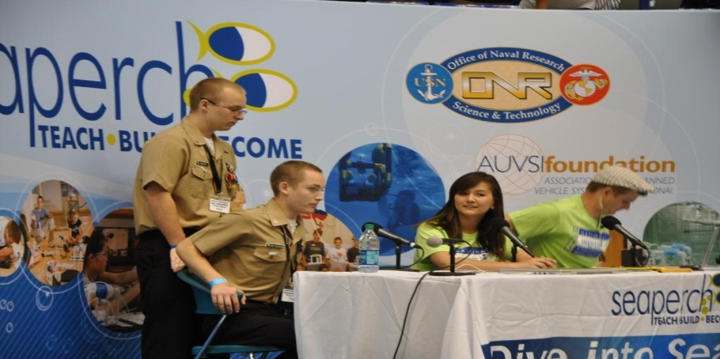
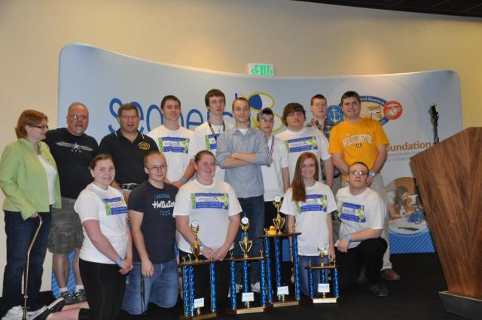
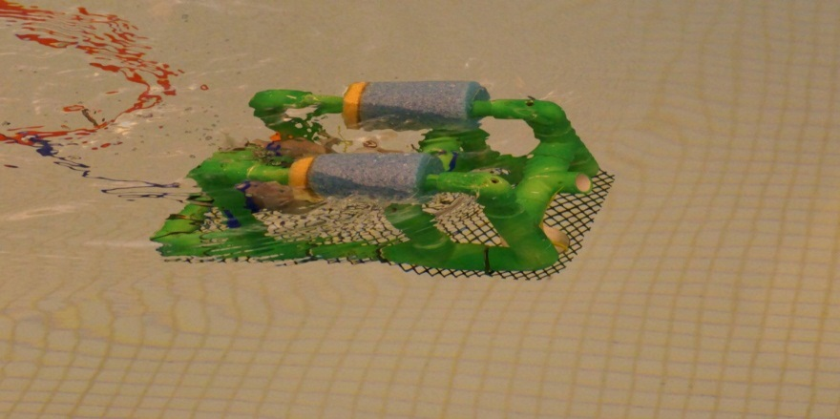
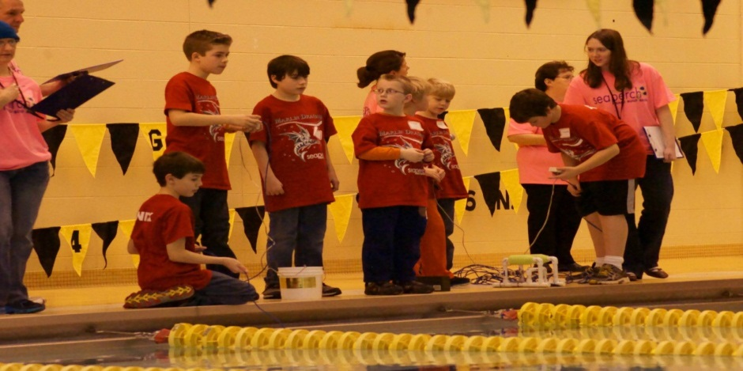
K-12: SeaPerch
Notes:
Two top pictures are of the Washington teams at Nationals both of the teams walked away with national titles
Bottom pictures are of regional competitions that we run annually

Slide 13
K-12: SeaPerch
Innovative underwater robotics program that equips students and teachers with the resources needed to build an underwater ROV
NSWC Crane in conjunction with University of Southern Indiana hold the state level competitions every year
Since the inception of the program, we’ve served over 1000 students
Notes:
May 2013 the Nationals were held in IUPUI,because since the SeaPerch competition started, three years ago, Indiana walked away with the bulk of the National titles. This past year was no different Indiana won 3 national titles.
SeaPerch is an affordable program that gives those without the funds to do FIRST competition a chance to compete in the robot realm

Slide 14
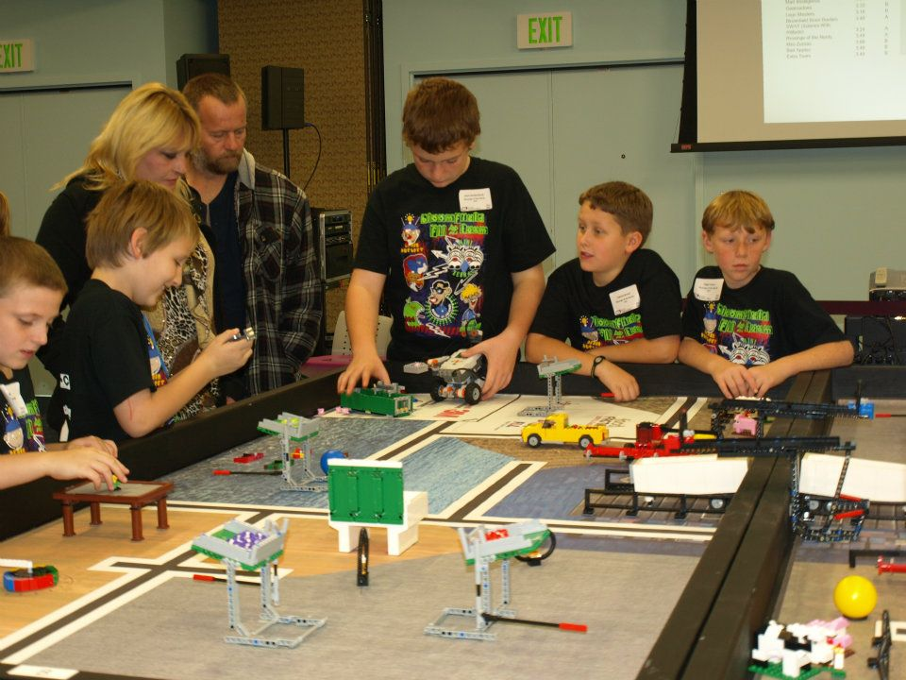
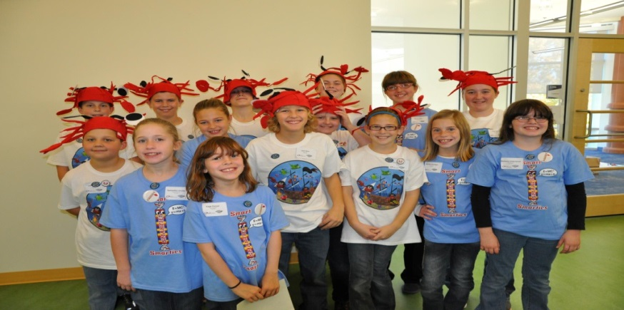
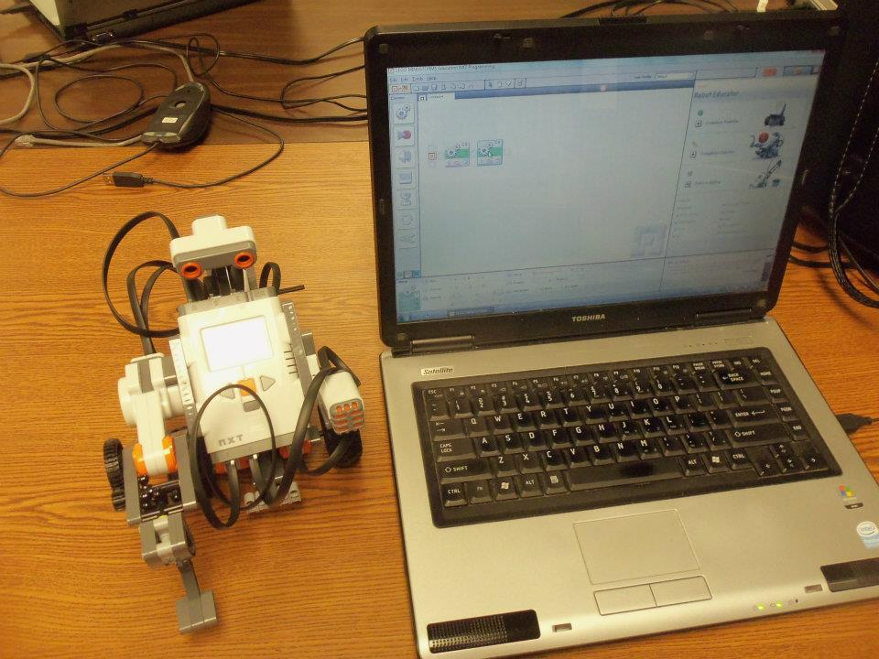
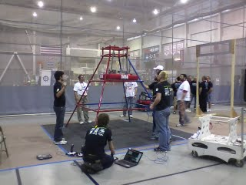
K-12: FIRST

Slide 15
K-12: FIRST
Extracurricular robotics STEM program with levels for K-12.
Last year we had at least ten employees mentor various FIRST teams
Leverage funding from NDEP to sponsor teams
Also worked with SAIC to sponsor teams
Since the inception of the STEM program, we’ve served over 300 students through FIRST
Notes:
The various teams are Jr. FLL (K-3); FLL (4-8 grade); FRC (8-12); FTC (8-12) [FTC is a little more expensive version of FRC]
Last year we had mentors for FLL, FTC, and FRC teams
NDEP – National Defense Education Program offers grants for DoD employees that mentor FIRST teams. We also worked with SAIC to match their employees with teams in need of kits (SAIC donates kits to teams with SAIC employees)

Slide 16
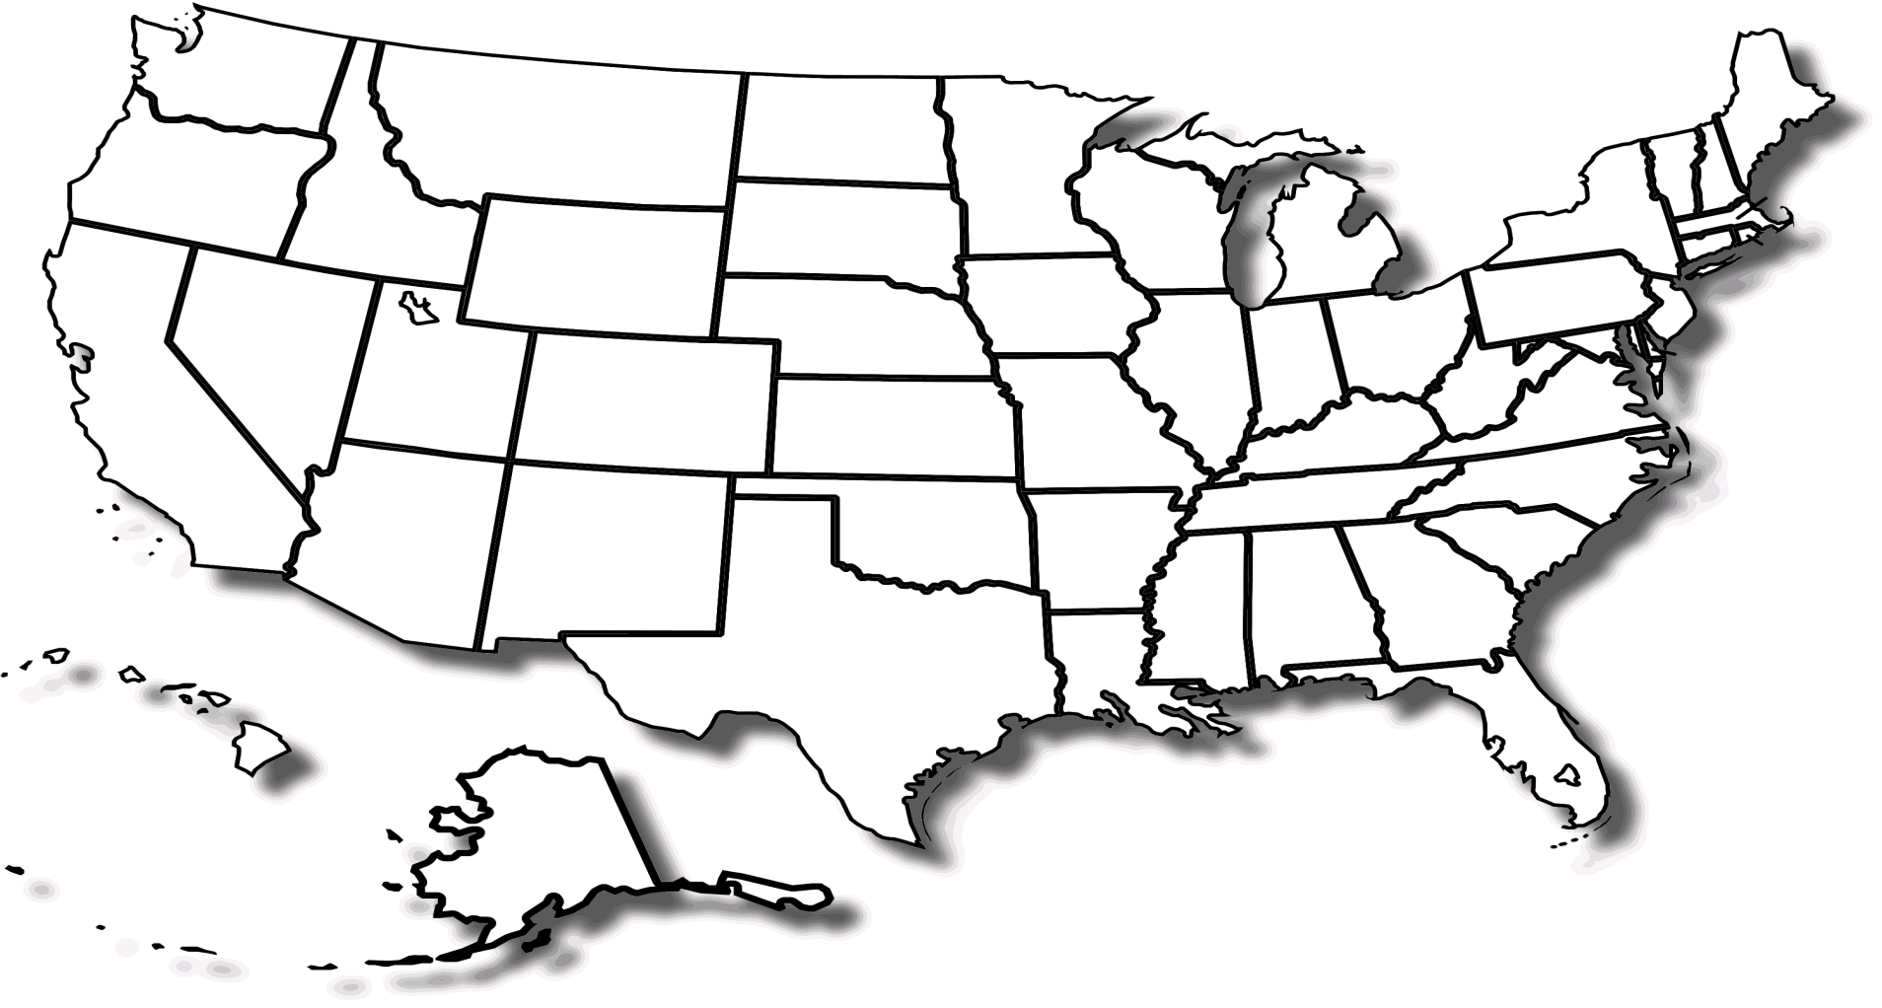
University: National Outreach
NSWC Crane PhD Academic Lab
NSWC Crane/Academia Agreements

Slide 17
University: STEM Outreach Programs
PhD Fellowships
SMART PhD Scholarships
Naval Research Enterprise Internship Program
Naval Engineering Education Consortium Grants
Grants/Cooperative Agreements
Temporary Faculty Hires
Post-doctoral Researcher On-Site Fellowships
Cooperative Research and Development Agreements
Educational Partnership Agreements
University Liaison: Dave Acton

Slide 18
University: Success Story
Tech Transfer in Cyber Security
2015: 3-year NEEC contract
Multi-CRADAs in place
2011-14: NSWC Crane PhD Fellow School of Informatics
Education/training for our existing workforce
Intended PhD graduate, plus three more in the program
Tailored training and education for a larger fraction of our workforce
2010
2014
2015
2016
2017
Development of the Cyber Security Workforce
Targeted hiring of PhD graduates (and the use of Navy Postdoc program)
ONR intern, Temporary Faculty participants
2014: Navy Task Force Cyber awakening & Cyber 4th Pillar added by NAVSEA
Mutual interest Commitment Persistence
Innovation in Cyber security
→
Establishment of new research directions and funding!
Numerous publications

Slide 19
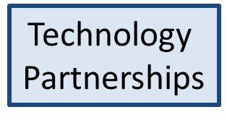
Applied Research Institute
Central Indiana Corporate Partnership
Establish a collaborative applied research environment between Indiana’s research universities and NSWC Crane
Create a robust entrepreneurial ecosystem and culture

Slide 20
Employment
APP
NSWC Crane
REEF
+
=
ATLAS
Challenge
Rapid Procurement
Fast Internet
Time
NISE/219: Internal Research and Development Funds
Lab Specialization to Address DoD challenges
Creating a culture of innovation that values leadership and employee engagement!!!

Slide 21
Thank You

