Slide 1
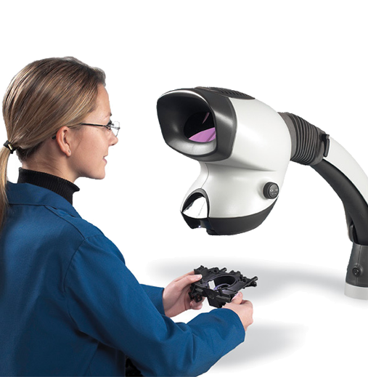
Human Factors for Strategic Parts Programs
UNCLASSIFIED UNLIMITED RELEASE
SAND2017-7713 C
Judi E. See, Ph.D., CPE
Sandia National Laboratories/ New Mexico
Org. 0151, Systems Analysis
jesee@sandia.gov, 505-844-4567
1-2 August 2017
UNCLASSIFIED UNLIMITED RELEASE

Slide 2
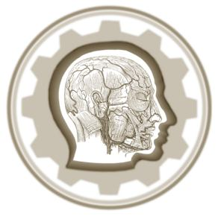
Purpose
UNCLASSIFIED UNLIMITED RELEASE
Describe human factors
Define human error
Discuss causes of human error and provide real-world examples
UNCLASSIFIED UNLIMITED RELEASE

Slide 3
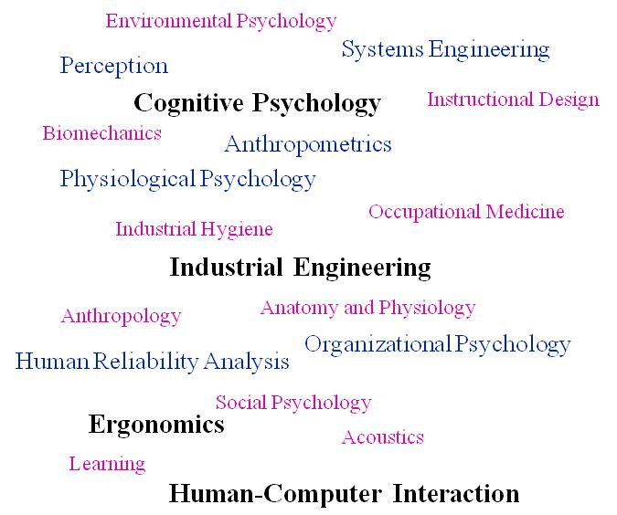
What is human factors?
UNCLASSIFIED UNLIMITED RELEASE
Scientific discipline that applies knowledge about human abilities, characteristics, and limitations to design jobs, equipment, and environments
A.k.a ergonomics and human-centered design
Human factors education
Advanced Master’s and Doctoral degrees
Industrial Engineering or Psychology Departments
Professional certification
Human factors is NOT
Human resources
Simple common sense
UNCLASSIFIED UNLIMITED RELEASE

Slide 4
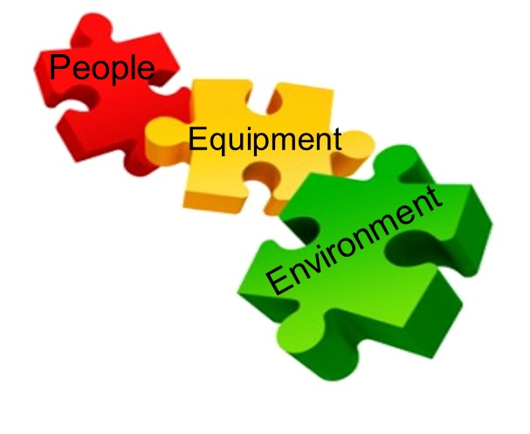
Human Factors in Systems Engineering
UNCLASSIFIED UNLIMITED RELEASE
System is a set of interrelated components that interact in an organized way to achieve a common goal
Equipment
Environment
People
Systems engineering is an interdisciplinary
approach to enable the realization of successful systems
Human factors is an important element
Focuses on human element of the system
Identifies human capabilities and limitations impacting system performance
Analyzes critical interactions between people and equipment
Mitigates negative impacts of environment on human performance
Noise
Glare
UNCLASSIFIED UNLIMITED RELEASE

Slide 5
When Should Human Factors Be Included?
UNCLASSIFIED UNLIMITED RELEASE
Optimally in conceptual design phase
Ensure proposed design is congruent with human capabilities and limitations
Address human element early before HW and SW are firmly established
Costs of incorporating human factors are reasonable if done early
Investment in human factors up front can yield cost savings
Avoid design changes late in development and rework during production or support activities
Costs to fix errors escalate exponentially over lifecycle
Errors can be 30 to 1500 times more costly to correct in operations as compared to design phase¹
Early incorporation of human factors means less reliance on training and procedures down the line
Errors are reduced when design is human-centered
UNCLASSIFIED UNLIMITED RELEASE

Slide 6
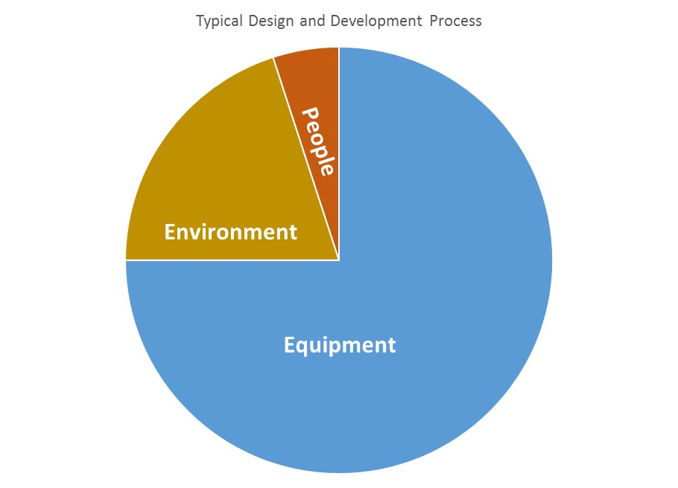
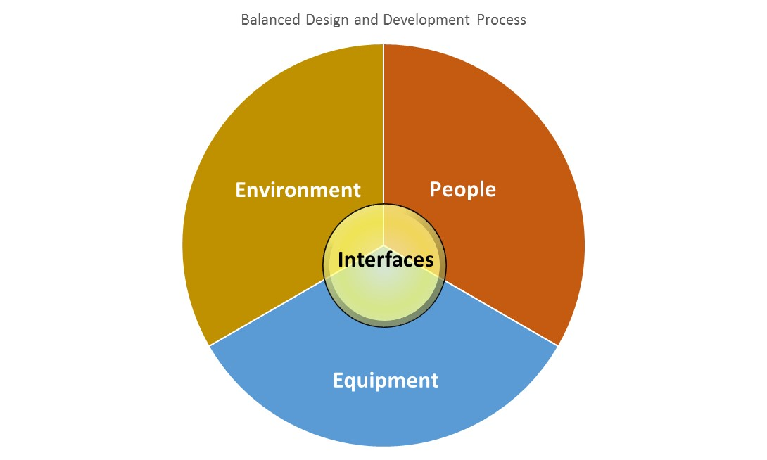
Systems Engineering Approaches
UNCLASSIFIED UNLIMITED RELEASE
Typical
Ideal
People are a critical component of the system, yet
Most approaches typically “forget” the people until after the system is fielded²
People and their interfaces with equipment and environment receive little to no attention
Focus equally on all system elements and their interfaces
Recognize that most problems stem from people^{3,4}
Up to 45% of nuclear power plant accidents
60% of aircraft accidents
80% of NASA Type A/B mishaps
90% of road traffic accidents
UNCLASSIFIED UNLIMITED RELEASE

Slide 7
What is Human Error?
UNCLASSIFIED UNLIMITED RELEASE
Failure of planned actions to achieve desired ends
Traditional View | Human Factors View
Inevitable Little can be done to prevent it | Performance is predictable Humans are reliable in certain conditions
Explanation of failures: blame the individual – find out what he/she did wrong | Explanation of failures: discover how people’s decisions and actions made sense under the given circumstances
Causes: carelessness, poor attitudes, and inattention to detail | Causes: increases in system complexity and poor system designs
Cures: “blame and train” | Cures: manage specific causes of error
UNCLASSIFIED UNLIMITED RELEASE

Slide 8
Typical Human Error Probabilities
UNCLASSIFIED UNLIMITED RELEASE
3 to 7 errors per hour are typical under normal conditions⁵
Up to 15 errors per hour in stressful or unusual conditions⁵
Pilots average 10 to 15 errors per hour⁶
By comparison, toggle switch fails once per million hours
Human Action | Human Error Probability
Select wrong switch | .003 (.001 to .009)
Mate connector incorrectly | .003 (.001 to .009)
Omit item in written procedure with >10 items, no checkoff | .01 (.003 to .03)
From Swain, A. D., & Guttmann, H. E. (1983). Handbook of Human Reliability Analysis with Emphasis on Nuclear Power Plant Application. Technical Report NUREG/CR-1278-F SAND80-0020. Albuquerque, NM: Sandia Corporation.
UNCLASSIFIED UNLIMITED RELEASE

Slide 9
Human Error Taxonomy
UNCLASSIFIED UNLIMITED RELEASE
Errors
Attentional Failures
Slip
Memory Failures
Unintended Action
Lapse
Errors
Rule-Based Mistakes
Knowledge-Based
Mistake
Routine Violations
Exceptional Violations
Intended Action
Violation
Sabotage
Different types of human error have different causes
Prevention and mitigation can be tailored to error types
UNCLASSIFIED UNLIMITED RELEASE

Slide 10
Preventing Human Error
UNCLASSIFIED UNLIMITED RELEASE
Error Type | Description and Prevention
Slip | Description: Cause: Prevention: Example: | Person does something, but not what they intended Poor display-control compatibility or deviation from routine Better displays/controls Record part size as .25 inches instead of .28 inches
Lapse | Description: Cause: Prevention: Example: | Person forgets to do something they meant to do Failure of prospective memory Checklists, procedures, explicit reminders Forget to replace a screw after inspection
Mistake | Description: Cause: Prevention: Example: | Person does what they intended, but act is inappropriate Lack of knowledge Training to improve knowledge or better displays Turn right but did not see one-way street sign
Violation | Description: Cause: Prevention: Example: | Person intentionally commits an inappropriate act Inadequate safety culture or insider threat Emphasis on safety culture or remedial training Intentionally ignore criteria in inspection procedure
UNCLASSIFIED UNLIMITED RELEASE

Slide 11
When and How Does Human Error Occur?
UNCLASSIFIED UNLIMITED RELEASE
Poor consideration of interfaces between one or more system components
Incident
Error Type
Cause
Prevention
Poor knobs, dials, switches
Make controls distinct visually and haptically
Use consistent layout
Pilot landing blunders
Slip
Multi-tasking and distractions
Put Tamagotchi in trunk
Warn driver to re-orient to the road ahead
Killer Tamagotchi toy
Mistake
Lack of resources
Remove ratchet from blast door site
Avoid 12-hour days
Missile silo explosion
Violation
Ambiguous displays
Use “wait” prompt
Provide informative error diagnosis and recovery
Set phasers on stun
Mistake
Changes in routine
Set up reminder cues
Use STAR when outside normal routine
“Forgotten” baby
Lapse
UNCLASSIFIED UNLIMITED RELEASE

Slide 12
Ambiguous Labels or Procedures
UNCLASSIFIED UNLIMITED RELEASE
Human error can occur if procedures are difficult to interpret
Ambiguous or vague steps
Technically inaccurate information
Mismatch between procedural steps and order tasks must be performed
Critical information that is missing
Lack of graphics for complex steps
References / branching to other procedures
More than one instruction in a step
Overuse of critical steps
Elevator control cables incorrectly adjusted during maintenance due to ambiguous procedures
Unclear which steps were needed for cable tension adjustment only
Many extraneous steps applied to other aircraft, not the 1900D
Turboprop plunges to the ground
Slip
UNCLASSIFIED UNLIMITED RELEASE

Slide 13
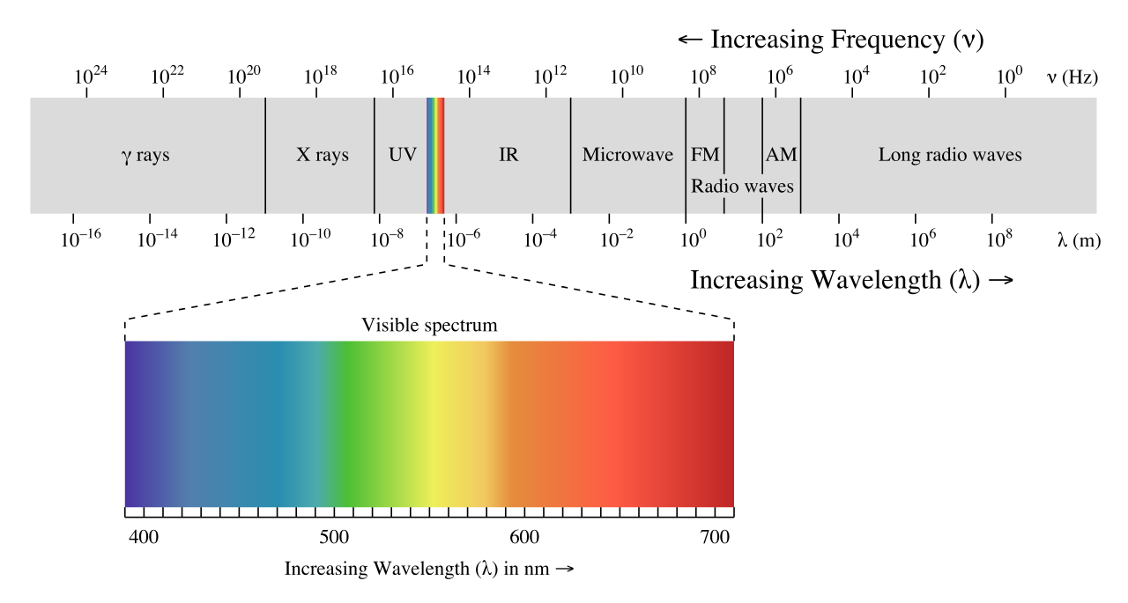
Disregarding Human Limitations
UNCLASSIFIED UNLIMITED RELEASE
Human error can occur if people are asked to perform tasks beyond their capabilities
Human vision limited to narrow band of electromagnetic spectrum
Colorblind people may have further limitations in visible range
People with normal color vision may still have problems if overall illumination, glare, and contrast are not taken into account
UNCLASSIFIED UNLIMITED RELEASE

Slide 14
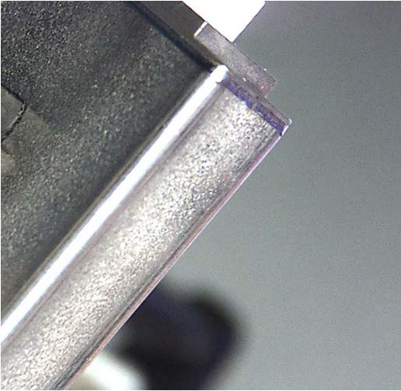
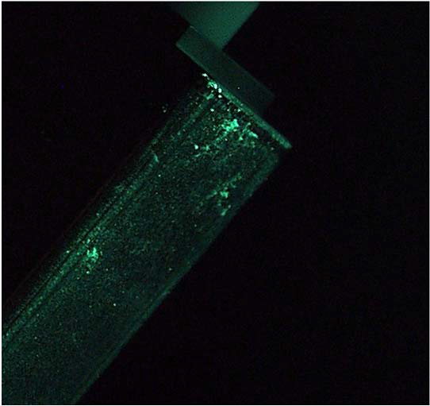
Disregarding Human Limitations - Example
UNCLASSIFIED UNLIMITED RELEASE
Inspectors repeatedly missed gel contamination on a part
Undetected gel contamination causes ruptures during welding
Parts must be scrapped altogether
Inspection under a green LED light eliminated the error
Mistake
BEFORE
AFTER
UNCLASSIFIED UNLIMITED RELEASE

Slide 15
Conclusions
UNCLASSIFIED UNLIMITED RELEASE
Include human factors early in design
Achieve a balanced systems engineering approach
Cheaper and easier than attempting to mitigate human error in a fielded system
Human error taxonomy helps identify causes and tailor future mitigations
Human error is a symptom of poor system design, not a root cause
UNCLASSIFIED UNLIMITED RELEASE

Slide 16
References
UNCLASSIFIED UNLIMITED RELEASE
Steicklein, J. M., Dabney, J., Dick, B., Haskins, B., Lovell, R., & Moroney, G. (2004). Error cost escalation through the project life cycle (Report JSC-CN-8435). Houston, TX: NASA Johnson Space Center. Houston, TX.
Schatz, S. (2016, February). Advanced distributed learning. Paper presented at the 2016 National Defense Industrial Association (NDIA) Human Systems Conference, Springfield, VA.
Pheasant, S. (1991). Ergonomics, work and health. Gaithersburg, MD: Aspen Publishers.
NASA Armstrong Flight Research Center (2017, May). Human factors and risk management: It’s not rocket science. Retrieved from https://sma.nasa.gov/docs/default-source/safety-messages/human-factors-and-mishap-prevention-v8---26-april-17_gg-cb-webversion_508v2.pdf?sfvrsn=2
Farris, R., & Richards, B. (2009, August). Session 4b: Human performance and organizational resilience. Paper presented at the 2nd International Symposium on Resilient Control Systems, Idaho Falls, Idaho.
Senders, J. W. (1980). Is there a cure for human error? Psychology Today, 17, 52-62.
UNCLASSIFIED UNLIMITED RELEASE

