Slide 1
Human Error Reduction of Risk
July 2016
DISTRIBUTION STATEMENT A: Approved for public release; distribution is unlimited.

Slide 2
Reduction of Risk
The Mil-spec compliant parts allows a foundation of consistency for electronic parts above commercial grade
However by itself – Mil-spec programs w/o a Total Quality Management (TQM) complement are not sufficient for high reliability applications
Simply Put: Mil-spec requirements shouldn’t be confused with quality requirements
Responsibility of Program to understand robustness of vendor quality program and make appropriate augmentation
Building on the Mil-spec foundation our program adds controls to reduce risk attributed to vendor controlled and monitored programs:
Documentation Control
Government controlled Source Control Drawings (SCD)
Critical processes identified & change controlled
Approved Parts & Vendor List (APVL)
Quality Oversight
Program Audits
Critical processes identified and change controlled
Program Quality Flow Down of Ordinance Directives & ISO9001/AS9100
Material Acceptance
Lot Acceptance Testing Program
Quality Conformance Inspections (QCI)
Certificate of Compliance (CoC)
DISTRIBUTION STATEMENT A: Approved for public release; distribution is unlimited.
Notes:
MIL SPEC IS A PERFORMANCE SPEC NOT A QUAILITY SPEC - responsibility of program to analyze and determine robustness of vendor quality program and make changes and augment to meet needs

Slide 3
Impacts to Reliability – Human Factors
Human Factors creep into Mil-Spec product & end up critical to reliability:
Where | How | Why
Supply Chain Gases Source material Consumables Tools | Procurement Acceptance | Poor requirement definition Checklists
Process Potting Soldering Forming Bonding Sealing | Tooling design, SW Design, Manual processing Handling | V&V shortcoming Wear & Tear Competency
Test & Evaluation Electronic Internal Radiographic | Interpetation Min/Max Requirements Documentation Data manipulation Test HW/SW | Understanding vs. misunderstanding What is documented vs. Experience Distractions
Strategic Applications strive for 100% mission success
To remove human factors we continue layer additional auditing, testing, & verification at the part level, sub-assembly, and system level.
DISTRIBUTION STATEMENT A: Approved for public release; distribution is unlimited.

Slide 4
Highest
Risk
Will Never Achieve Zero Risk
zero
DLA
Mil –Spec
LEEPP Program
Visual
Electrical
LAT/RLAT
Data Review
QCI
Qualification
Auditing
Enhanced Screening
Subassembly
Visual
Electrical
ATP
Data Review
Auditing
Class I process
System
Visual
Environmental
ATP
Data Review
Auditing
Class I process
Calibrations
Qualification
Surveillance
Baseline performance study
Operational Testing
Periodic calibration
Functional verification and testing
= significant human error risk
DISTRIBUTION STATEMENT A: Approved for public release; distribution is unlimited.
Notes:
Wording on first bullet.
Need risk chart showing risk going down
Calibrations, GCT, FBPA, Patrol Testing is different from Guidance vs. Missile Branch

Slide 5
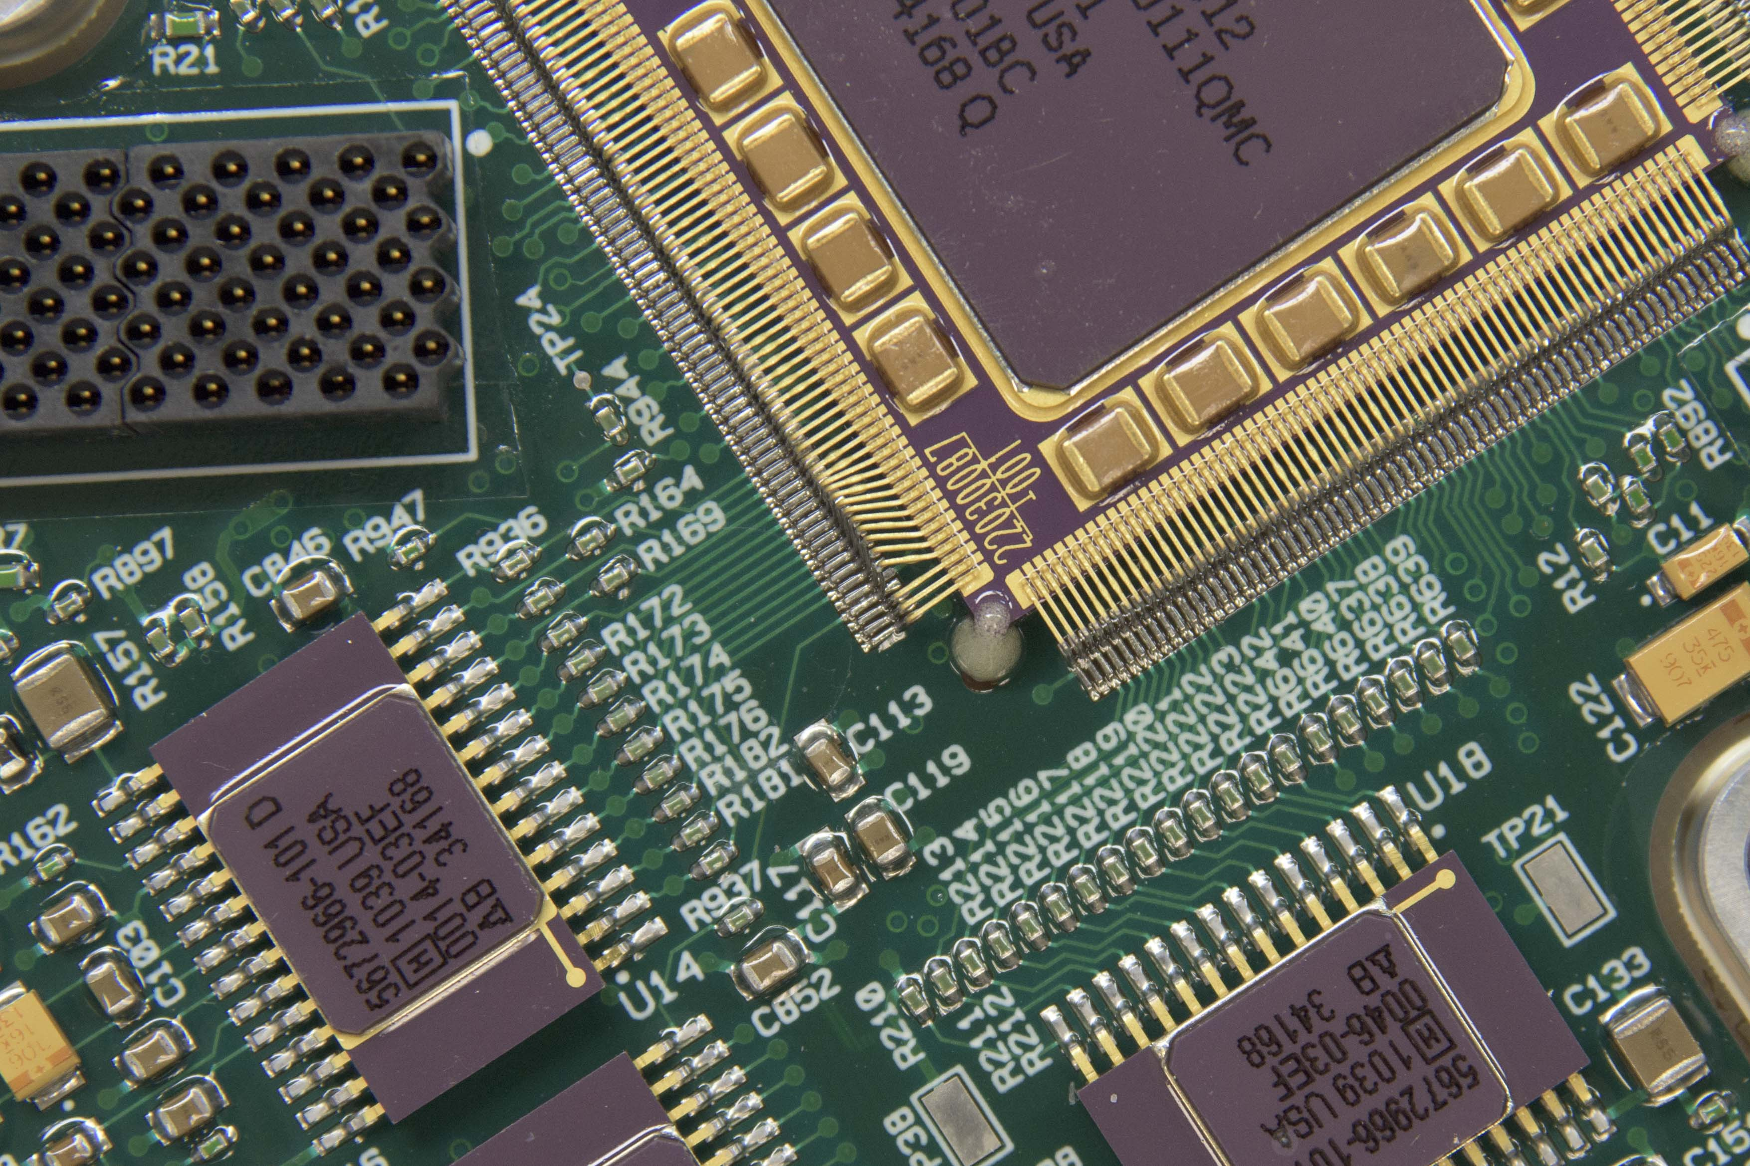
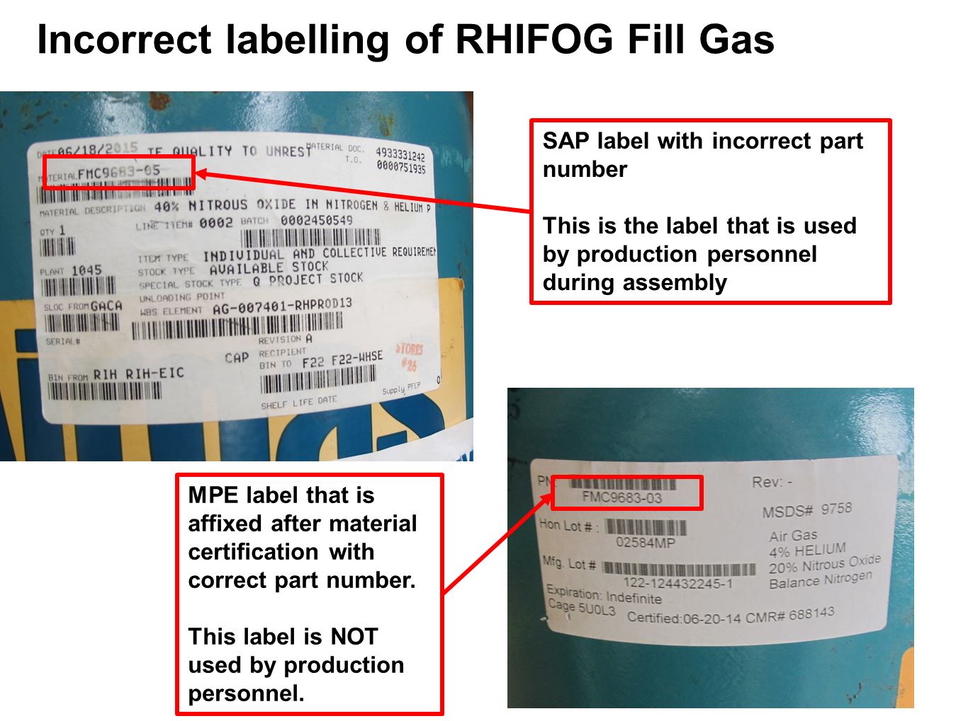
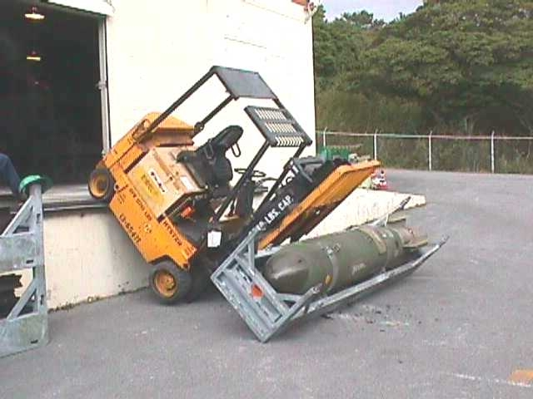
Human Factors Realized - Examples
Incorrect angle on connector
Bent Leads
Incorrect tab number on gas bottle
Oops…
DISTRIBUTION STATEMENT A: Approved for public release; distribution is unlimited.
Notes:
Examples

Slide 6
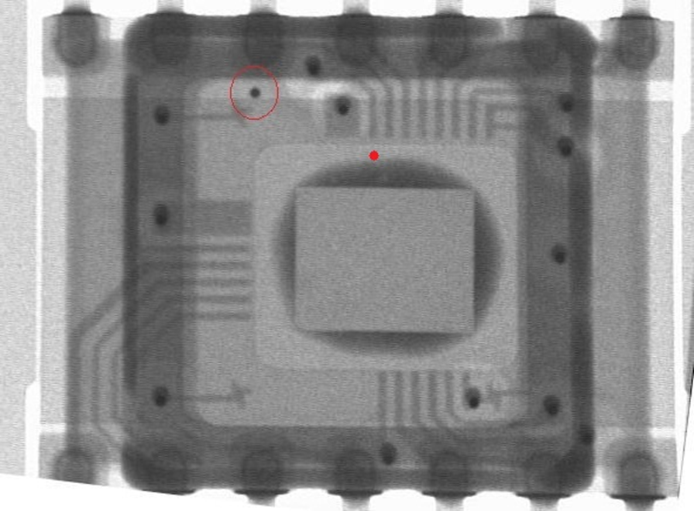
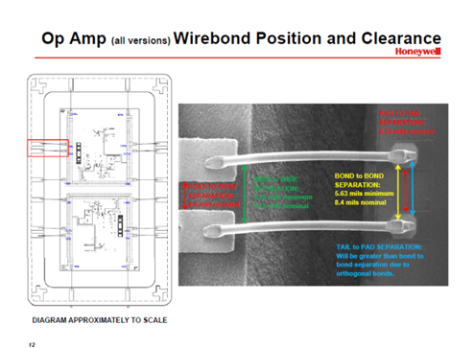
Defect requiring additional effort
Mobile Conductive Foreign Object Defect (mcFOD) in surface cavity electronic packages can escape traditional screens
Pre-Cap visual - dependent on human review
PIND is dependent on setup and defect (mass, shape of the defect, sensitivity)
X-ray detection – for most vendors dependent on Human review – Human Error
Electrical screens of all type may not be effective based on
Location of defect during testing
Movement of defect impacting timing of test
mcFOD size and distribution
Gap sizes between IC lines
Spacing of Power lines vs. Ground lines
Power levels and test Limit levels can be seen as “noise”
To further reduce risk – need to take additional steps
DISTRIBUTION STATEMENT A: Approved for public release; distribution is unlimited.

Slide 7
Even further actions to reduce mcFOD impact
Determine what is current state of detection and capture rate at our cavity package vendors
Determine what is Mil-spec process capabilities
Audit each vendor to determine methodology and consistency of processes
Pull statistically significant sample of parts from each vendor to determine capture rate to get a baseline
Determine if any vendors are “out of family” – higher risk
Determine best practice for detection and capture
Share and implement changes at vendor where applicable
Implement additional re-screen of inspection where appropriate
DISTRIBUTION STATEMENT A: Approved for public release; distribution is unlimited.

Slide 8
What we found….
Looking across multiple vendors with a statistically significant samples shows they were 96%-99.8% success in capturing mcFOD
Escapes will occur at all program vendors
Dependent on :
Floor implementation at each supplier
Decision making criteria at each supplier
Internal supplier verification of inspection efficiency
Each vendor was compliant to the requirement
Application varied widely between vendors
No vendor focused on the human condition
However, the vendor’s did not meet the intent – effective screen of defects due to human error
THIS is where we disacuss AUGMENTING the QUAILITY PROGRAM TO MEET INTENT – THEY WERE COMPLIANT BUT DID NOT WEED OUT HUMAN CONTRIBUTION
DISTRIBUTION STATEMENT A: Approved for public release; distribution is unlimited.

Slide 9
Best Practices and changes needed
During inspection there was no visual size indicator to allow human to compare vs. size specification (3 um)
Monitor resolution and contrast not optimized for defects
Inspector’s eye and feature fatigue – additional operators breaks and switch outs changes
Implemented efficiency checks and random samples at vendor and acceptance
additional PIND and XRAY inspections for parts
Characterization of test data with issues – characterize “noise” in test data
Environmental testing (including vibration)
DISTRIBUTION STATEMENT A: Approved for public release; distribution is unlimited.

Slide 10
Summary
The Mil-spec allows a foundation of consistency for electronic parts
In high reliability environments – mil spec is not sufficient without additional layers of risk reduction
Program risks need to take into account human error, especially in regard to defectivity inspections
Additional vendor steps and checks to reduce human error is necessary
mcFOD required additional risk reductions to bring to acceptable level
Risk cannot be zero with human error
Take appropriate steps to for your program
DISTRIBUTION STATEMENT A: Approved for public release; distribution is unlimited.

