Slide 1
Day 1 – New Hire Onboarding
Angela S. Hooker, Onboarding Program Manager
Day 1

Slide 2



NAVSEA First Impression Survey
WELCOME ABOARD!
Thank you so much for joining our team at NAVSEA.
Tell us about your Onboarding Experience by taking the Command’s First Impression Survey.
A survey link will be emailed to you approximately three months (90 days) from your onboarding date. We are LISTENING!
Survey Results
Dashboard
The survey is delivered via your Navy email. Please ensure your email is up-to-date in MyBiz & MilConnect.
You can complete the survey in 10 minutes and it is completely ANONYMOUS.
NAVSEA Human Resources Offices create Action Plans to improve the Onboarding Experience according to survey responses.
…right click image and select ‘Open Hyperlink.’
Notes:
The First Impression Survey is used by the Command to measure the quality of your onboarding experience.
The survey provides quantitative data to the Command, so they can understand strengths and weaknesses in the onboarding process.
This allows the Command to propagate best practices and create Action Plans to improve weaknesses.
Since the inception of the First Impression Survey, results have been shared with Human Resources Offices across the entire Command enabling process improvement.
In order to obtain the best data, participation from every New Hire is very important. The more we know, the more we can DO!
Survey results are viewable on the FIS SharePoint site by rick clicking on the image in the slide.
The survey is completely anonymous, so you will not be associated with your responses at all.
The survey is very short and can be completed in 10 minutes.
Approximately three months from your onboarding date, you will receive a link to access the survey.
The survey will be open for one week from when you initially receive the link.
Over the survey open period, you will receive reminder emails until you complete the survey.
We hope to hear from you about your experience. ☺

Slide 3
Onboarding Agenda – Day 1
Day 1
0830 Welcome / Roll Call / Housekeeping Information
0835 Information Assurance (IA) / Cyber Security Briefing
0905 Military Protocol Brief
0930 Security (PERSEC)
1000 Break 1
Payroll and Timekeeping
1025 Benefits Overview
1110 EEO Briefing
1200 Oath of Office/CO Brief
1230 Lunch
1330 Initial Ethics Training
Demonstration Project
1445 Break 2
1455 HR Paperwork
1515 Questions / Survey Wrap Up
For presentations or more onboarding materials, go to:
NSWCCD New Hires Page https://www.navsea.navy.mil/Home/Warfare-Centers/NSWC-Carderock/Career-Opportunities/Forms-for-New-Hires/
Continued on next slide

Slide 4




New Hire Cybersecurity Briefing
Presenter: ISSM TEAM Code: 1043
Notes:
This is a mandatory requirement for every new hire/transfer into Carderock.
As an employee of Carderock, we have a responsibility to protect all resource, regardless of what forms they take or how we obtain that information
NO NEED TO RETAKE THIS BRIEF!!!

Slide 5
Department of the Navy
(DON) IT Usage
NOTICE: Communications performed on government IT systems’ are routinely intercepted and monitored thus there is no expectation of personal privacy
Use the System Authorization Access Request (SAAR-N) form and process to access systems; use the Privileged Access Request form and process if administrative rights are needed for a system
Protect authenticators, i.e. password and personal identification numbers (PIN), Common Access Card (CAC), Alternate Logon Token (ALT) at all times
CAC, ALT, or other Authentication tokens shall not be left unattended at any time unless properly secured
Do not bypass security settings
Do not plug in unauthorized devices into systems (hard drives, phones, etc.)
Unsure about something? Ask your Cyber Workforce members or your Departmental Information Officer (DIO) beforehand
2
Notes:
Please note the disclaimer at the top. Communications are monitored for obvious reasons, so please try to conduct yourselves in a professional manner
With regards to system access:
The SAAR-N grants you your initial access to network resources (at some point you are asked to sign)
The PAA form grants you elevated (privileged access) to the network
The CSWF tracks PAAs for all members of the CSWF to ensure that training is up to update and we are staying compliant
Please protect all authenticators at all times (this was in the cyber awareness challenge/NAVSEA Security trainings)
CAC – Primary means of authentication; To be worn above the waist
If CAC becomes lost or stolen, report it immediately to your supervisor and Security office.
The network is equipped with numerous monitoring devices including intrusion detection and intrusion prevention systems that capture all network traffic for incident tracking, etc.
Unauthorized devices: External hard drives must be command approved; no usb sticks unless approved
Will cause work stoppage if violation occurs

Slide 6
DON IT “Do nots…”
Do not introduce or use unauthorized software, firmware, or public domain software without written authorization from the Local IA Authority. Refer to your Cyber Workforce Chain of Command (CWF/ISSO/DIO/ISSM) on guidance
Do not bring in or use any personally owned hardware or software
Do not bring in or use any previously owned hardware, software from another DoD or government Department/Agency. What may have been approved at the other Department/Agency may not be approved here.
Do NOT relocate, and/or change the network connectivity of IT equipment without authorization from the Local IA Authority or delegate. Coordinate your move with your Cyber Workforce members, NMCI support team and the RDT&E help desk where applicable.
DO NOT plug your device into any data port without being sure that you are connecting to the correct network (NMCI/RDT&E/NNPI). Coordinate with your Cyber Workforce members, NMCI support team, and the RDT&E help desk, where applicable.
Notes:
No personally owned hardware/software or hw/sw from any other government agency is allowed without written authorization from the Local cyber authority
DON Application and Database Management System (DADMS) is the DON's authoritative data source for system, application, database, network, and server information
Contact your DIO :
For additional software requests
DIO will need to submit change request and ITPR
If approved, software can be used for 30 days without DADMS approval
After 30 days, request must be made to DADMS team for official approval and association with our UIC
Software found on systems not approved will be removed/placed in quarantine-work stoppage
Contact the Service Desk:
To have equipment moved/relocated
Phone – telecom team
Network – network operations team
Data cables have color coding or numbers to identify their networks
Certain computers are only authorized for certain networks (how will you know? – work with your supervisor/DIO)
Talk about what happens when NMCI device gets plugged into NNPI, etc.
Please use due diligence and ensure that you are not causing a cybersecurity incident)
Reach out to your chain of command if you’re not sure

Slide 7
DON IT “Do nots…”
(continued)
Do not use Navy IT resources in a way that would reflect adversely on the Navy. Such uses include pornography, chain letters, unofficial advertising, soliciting or selling except on authorized bulletin boards established for such use, inappropriately handled classified information, violations of statute or regulation, Personally Identifiable Information (PII), and other uses that are incompatible with public service.
Do not place data onto Navy IT resources possessing insufficient security controls to protect that data at the required classification (e.g., Secret onto Unclassified). Examples of such would be Electronic Spillages and Network Shares.
Notes:
As mentioned before, the network is equipped with numerous monitoring devices to capture and log
Any thing that is not authorized by NAVSEA is prohibited from being used on your computer
Avoid Chain Letters (Explain)
Don’t move unlabeled media from SIPR to NIPR
Please make sure that data is being handled at the proper classification levels (classified at classified/unclass at unclass)
Do not share classified info with anyone who is not authorized to have access to that data.
Electronic spillages cause work stoppage, takes time to clean up, costly, counter-productive and can lead to disciplinary actions
The impacts spillages
It can disclose stealth and silencing or capability information being used by the Navy
It can disclose location, the types and quality of materials being used in testing
Allows threats to detect, classify and/or localize U.S. Navy submarines thereby reducing the ship's tactical capabilities.
Costly for cleaning up and can lead to decrease in training budget
Loss of man hours

Slide 8
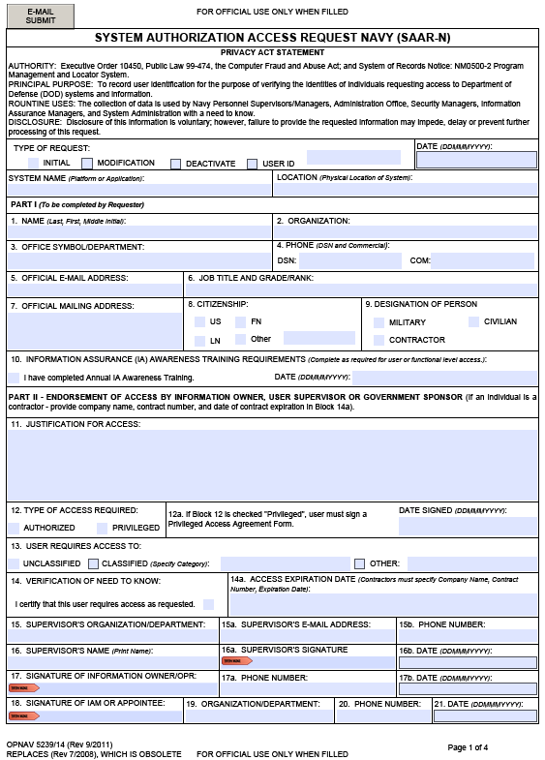
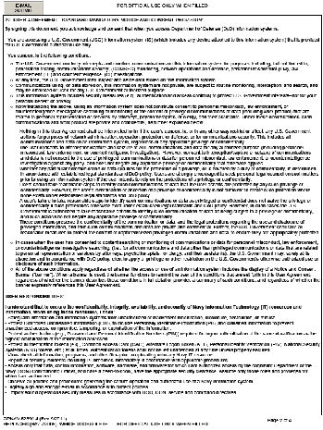
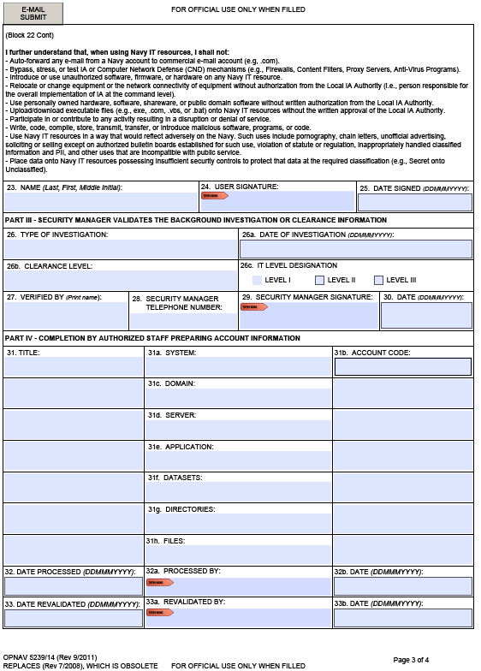
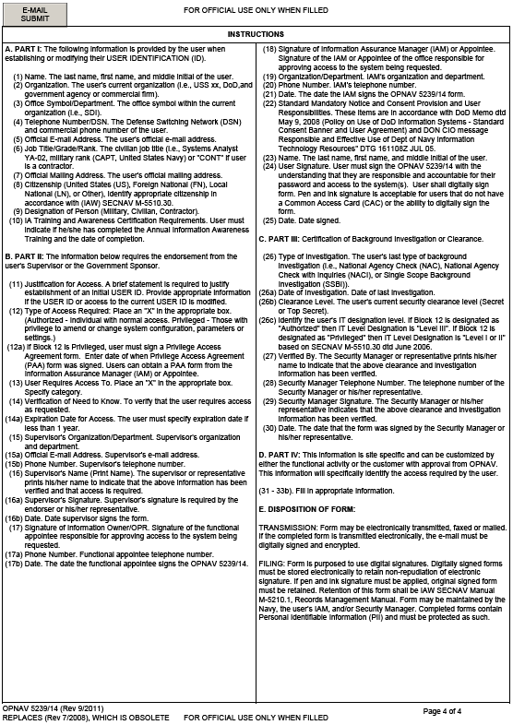
System Authorization Access Request-Navy
(OPNAV form 5239/14)
User Responsibilities:
Virus-check all information, programs, and other files prior to uploading onto any Navy IT resource.
Access only that data, control information, software, hardware, and firmware for which I am authorized access
by the cognizant Department of the Navy (DON) Commanding Officer, and have a need-to-know, have the
appropriate security clearance. Assume only those roles and privileges for which I am authorized.
Observe all policies and procedures governing the secure operation and authorized use of a Navy information
system.
Bypass, stress, or test IA or Computer Network Defense (CND) mechanisms (e.g., Firewalls, Content Filters,
Proxy Servers, Anti-Virus Programs).
Introduce or use unauthorized software, firmware, or hardware on any Navy IT resource.
Use personally owned hardware, software, shareware, or public domain software without written authorization
from the Local IA Authority.
Write, code, compile, store, transmit, transfer, or Introduce malicious software, programs, or code.
Notes:
All systems will be scanned and vetted before being placed onto the network
All users are vetted before giving access to the systems/networks
The SAAR-N is used to collect information on personnel in order to vet, and provide network access
Each time your access will be changed or department reassigned, a Modification SAAR-N will be submitted by your supervisor/DIO/AO

Slide 9
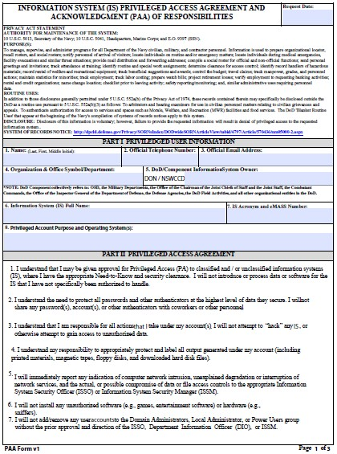
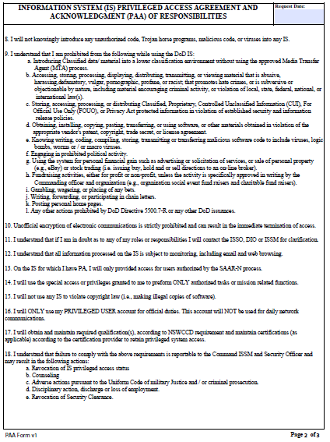
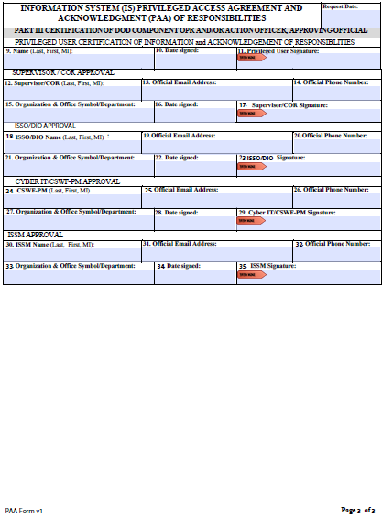
Privileged Access Account Agreement Responsibilities
1. I will not introduce or process data or software for the IS that I have not been specifically authorized to handle.
4. I understand my responsibility to appropriately protect and label all output generated under my account (including printed materials, magnetic tapes, floppy disks, and downloaded hard disk files).
6. I will not install any unauthorized software (e.g., games, entertainment software) or hardware (e.g., sniffers).
9. a. Introducing Classified data/material into a lower classification environment without using the approved Media Transfer Agent (MTA) process.
d. Obtaining, installing, copying, pasting, transferring, or using software, or other materials obtained in violation of the appropriate vendor's patent, copyright, trade secret, or license agreement.
I will obtain and maintain required qualification(s), according to NSWCCD requirements and maintain certification(s) (as applicable) according to the certification provider to retain privileged system access.
I understand that failure to comply with the above requirements is reportable to the Command ISSM and Security Officer and may result in the following actions:
  Revocation of IS privileged access
  Counseling
  Adverse actions pursuant to the Uniform Code of Military Justice and / or criminal prosecution
  Disciplinary action, discharge or loss of employment
  Revocation of Security Clearance
Notes:
The PAA is used to provide privileged access (System Administrator/Network Administrator/Developer Administrator)
You will be provided with a separate token - different from your CAC
Will be asked to take certain training, /acquire/maintain certifications each year
CEUs are tracked by the Cybersecurity Workforce team to ensure compliance

Slide 10
IT and Removable Media
Labeling
Ensure all applicable pieces of IT equipment are properly labeled with a classification sticker and a Carderock/detachment asset tag
  These two identifiers allow you to know it is government equipment
  Removable media, i.e. hard drives, CDs/DVD disks, etc., must be labeled appropriately
Reminder
Personally Identifiable Information (PII), Controlled Unclassified Information (CUI), and other classified material must be marked and protected as such
Notes:
Laptops, desktops, command issued external hard drives, printers…all must have a classification sticker (CLASSIFIED versus UNCLASSIFIED)
Prevents electronic spillage. So how does electronic spillage occur? Some examples you may encounter are:
classified information being processed on an information system that has not been specifically accredited to process classified information
spillage of classified information onto an unclassified system (placing classified data onto an unclass system/share)
classified information sent via email over an unclassified network
Any/all materials that contain PII and/or CUI must be indicated on the material and protected accordingly.
PLEASE CHECK AND RECHECK THE CONTENTS OF EMAIL BEFORE SENDING OVER UNCLASS NETWORK.

Slide 11
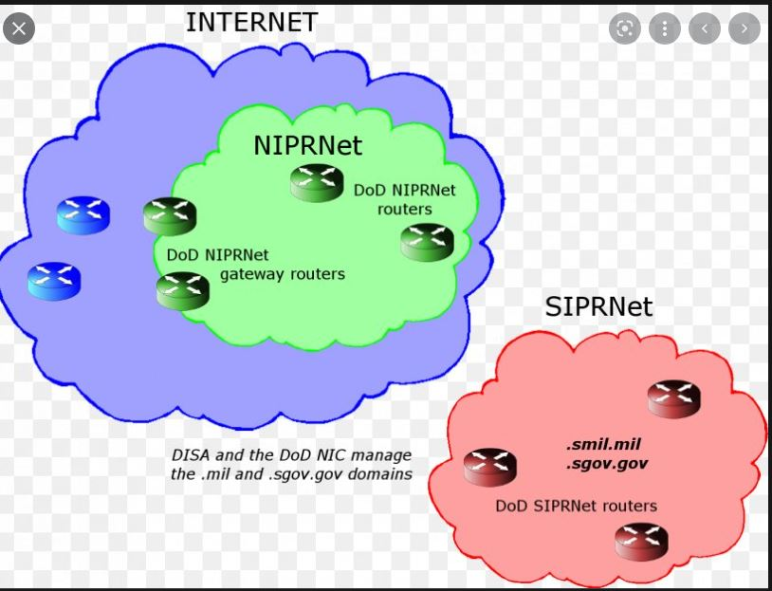
Non-Secure Internet Protocol Router Network
Secure Internet Protocol Router Network
Notes:
*NIPRNet:
-It is a private DoD network
-Used for exchanging "sensitive but unclassified" information
-The NIPRNet provides its users access to the Internet
*SIPRNet:
-System of interconnected networks used for exchanging “Classified” information
-Does not provide users access to the internet

Slide 12
Remote / Teleworking Precautions
Property Passes
  Required before taking government issued IT equipment home
  Must stay with the IT equipment at all times; recommend it is taped to the outside cover of the laptop
  Authorized for no more than 365 concurrent days (one year)
  See your immediate chain of command to get your property pass:
    https://wwwdd.nmci.navy.mil/navsea/mods/Tracker/?instance_id=258
NSWCCD has two networks: NMCI and RDTE
  NMCI laptop can connect to home network (Ethernet or Wi-Fi)
  RDTE equipment must be authorized by supervisor before taking home. Laptop can connect to home network (Ethernet or Wi-Fi).
  If provided RDTE VPN / Remote Access, recommended connect to the RDTE VPN solution within 15 minutes of being on a non RDTE Carderock network. Computers must connect to the RDTE network/VPN solution at least every 30 days to stay within compliance.
Protect assets at home the same way you would at work. Same policies and processes apply at home.
Notes:
*Within the RDT&E network there are a number of closed networks used for different purposes with no access to the internet

Slide 13

Suspicious/SPAM Email
Do not click on suspicious email links or attachments
Report SPAM/Phishing emails to local ISSM & NMCI https://www.homeport.navy.mil/support/articles/ report-spam-phishing-2010/ “NMCI_SPAM”
DO NOT 'Reply,' 'Reply to all,' or 'Forward' suspicious SPAM or phishing email to any other NMCI User/s.
DO NOT open or click on the links provided in the E-mail or attempt to visit any embedded site(s).
Never use the links in an e-mail, instant message, or chat session to access a supposed secure website.
Avoid filling-out any forms in email messages that ask for personal financial information.
DELETE the SPAM/phishing e-mail from your Inbox, if you forwarded the message per the SPAM handling guidance, Delete both the spam message and your sent message from your Deleted Items.
Notes:
Learn to recognize the red flags:
-Unknown senders
-Misspelled words/poor grammar
-Urgent/sensational subject lines – Your attention is needed immediately, OR Respond immediately to prevent your credit from being damaged
-Promises of financial gains, gifts, or prizes (lottery winnings/property prize winnings/helping the needy in foreign countries)
-Requests to verify your password or account

Slide 14
How to Report SPAM Email
Without opening the message, select the message in your Inbox.
In the Respond section, click More | Forward as Attachment.
To open the Microsoft Exchange Global Address List (GAL), click To and type the appropriate email address: NMCI_SPAM@navy.mil
Click Send.
Delete the message from your Inbox.
Delete the message you just sent from your Sent Items
Delete both the spam message and your sent message from your Deleted Items
ASSISTANCE: Contact the NMCI Service Desk at 1-866-THE-NMCI (1-866-843-6624) or by e-mail at ServiceDesk_Navy@nmci-isf.com.

Slide 15
Use of Email
If you suspect your NMCI machine has a virus, contact the NMCI Service Desk at 1-866-THE-NMCI (1-866-843-6624) or by e-mail at ServiceDesk_Navy@nmci-isf.com.
Do not forward or move government info/data onto non-government computers, i.e. forward emails to personal accounts, take work home to be executed on home computers (or vice versa)
All email containing CUI and/or PII shall be digitally signed and encrypted in accordance with current policies
Notes:
Update the slide deck to include RDT&E

Slide 16
Portable Electronic Devices (PEDs)
NAVSEA INSTRUCTION 2200.1, NAVAL SEA SYSTEMS COMMAND PHOTOGRAPHIC, AUDIBLE RECORDING AND PORTABLE ELECTRONIC DEVICES POLICY
Dated 20 April 2019
Highlights:
  All cameras (digital or film, still or video) and all sound recorders (analog and/or digital) MUST be approved through the security office (105) by filling out and submitting CARDEROCKDIV 5512/19 Audio/Visual Permit Request.
  No unofficial photos/videos can be taken on the installations (or detachments) using personal PEDs.
  Photo/video authorization will need to be obtained through the PAO prior to the imagery being captured.
  Hot spots & Wi-Fi are allowed with the approval from C-ISSM and ACSM
  Contractor PEDs, air-cards and WiFi need approval
    Not able to connect to our networks
  No PEDs were Controlled Unclassified Information (CUI) is exposed or discussed (can be switchable space)
  Personal Wearable Fitness Devices (PWFDs) need to be scrutinized.
  No Smart Watches or contractor equipment allowed in classified spaces
13
Notes:
Use the provided P.E.D. storage containers outside of each secured space
This is a bank of small storage units provided to store small items
The amount of available storage units vary depend on the size of the facility
A key is provided for each unit
Please do not take the key with you when you leave. Remember to return it to the storage unit.

Slide 17

Media Transfer Authority (MTA)
ONLY authorized/approved way to transfer media from a classified computer
If you are unsure, contact your supervisor or Departmental Information Officer (DIO) BEFORE transferring any information
Team 104- One Team, One Mission, Providing Solutions!
17
Notes:
So who is an MTA?
A Media Transfer Agent is a person who has received specific training and approved by the CO or someone designated by the CO (called the RMR) to WRITE data from a classified computer onto removable media.
Media Transfer Agents (MTAs) can transfer data from a classified system (SECRET or below) to electronic removable media (CD/DVD, Secure Digital (SD) cards, Tape, Flash Memory data storage devices, Multimedia Cards (MMC), removable hard drives, etc.).
MTA’s are trained to know the marking, safeguarding, and handling requirements for classified and all CUI (controlled unclassified information), to include removable media and Derivative Classification. All removable media must be properly labeled with classification markings and a traceable serial number
CARDEROCKDIV INSTRUCTION 5510.12 Policy:
The Carderock Division policy is that no person shall transfer any information residing on any classified information system either SECRET or below using removable media of any kind without the specific written approval by a NAVSEA Removable Media Representative (RMR).
Overall Intent of MTA (duties/responsibilities). Using all means necessary to prevent spillages and unauthorized disclosure of classified information
They have to know the marking, safeguarding, and handling requirements for classified and all CUI (controlled unclassified information), to include removable media and Derivative Classification. All removable media must be properly labeled with classification markings and a traceable serial number (date - MTA number - Initials - sequential number)
**ONLY an approved MTA may perform write events off of a classified computer!**
DON’T write classified data to removable media without an MTA or Witness. Requires at least two persons one being an SME!
ALWAYS use 2 person/Human review on all write events from a classified computer!
All data written from a classified computer to removable media must be tracked and logged. The paper trail should allow you to always know where removable media is whether destroyed, transmitted officially or stored.
If you do not know please contact your chain of command regarding MTA inquiries
“I did not know” is never an excuse.

Slide 18
Acceptable Use (non-compliance)
Failure to comply with acceptable use policies may result in:
Investigations
Security & NCIS notification
Defense Information System for Security (DISS) entries for some violations
Possible HR & Legal ramifications
Cybersecurity Violations Response Process:
  Employee’s supervisor will be notified in writing by the ISSM office
  Carderock employees causing cybersecurity violations will be verbally counseled by one of the ISSMs.
  Employees counseled by one of the ISSMs for cybersecurity violations will be mandated to re-take the “Cyber Security Awareness Challenge training” within 10 days of the initial incident report.
  Failure to comply with the mandated training will result in the employees account being disabled until certificate of completion is received by one of the ISSMs.
18

Slide 19
Division Cybersecurity Roles
Local Cyber Authority is the Division Commander
  Carderock Division Commander: Captain Matthew L. Tardy
Activity Chief Information Officer (ACIO)
  Michael Kirby michael.h.Kirby.civ@us.navy.mil – 202-487-5000
Deputy Chief Information Officer (DCIO)
  Katrina Moore, katrina.m.moore8.civ@us.navy.mil – 301-227-2236
Command Information System Security Manager (ISSM)
- Katrina Moore – Katrina.m.moore8.civ@us.navy.mil – 301-227-2236
Cyber Security Section Head
  - Tad Cowell, tad.e.cowell.civ@us.navy.mil – 301-227-0167
Alternate-Information System Security Manager(s) (A-ISSM)
  Dalton Harvey, dalton.Harvey.civ@us.navy.mil – 301-227-5049
  Aaron Jeter, aaron.e.jeter2@navy.mil – 301-227-1926
  Gary Steele, gary.steele2.civ@us.navy.mil – 301-227-1955
Department Information Officers (DIO)
  Gerson Caballero, Code 02, gerson.caballero1@navy.mil – 301-227-5994
  Kendall Smith, Code 10, Kendall.f.smith2.civ@us.navy.mil – 850-624-8389
  Carole Overman, Code 60, carole.a.overman.civ@us.navy.mil – 301-227-8501
  Don Kim, Code 70, don.kim3.civ@us.navy.mil – 301-227-5974
  Monica Walker, Code 80, monica.a.walker8.civ@us.navy.mil – 301-227-2540
If needed, contact your DIO to reach your departments:
  Information System Security Officers (ISSO)
  Cyber Workforce (CWF) Members

Slide 20


NAVY AND MILITARY PROTOCOL
Last Updated 11OCT2023
Notes:
Highlight all text in each block and type in new info.

Slide 21
Topics to be Covered
Department of Navy (DoN) Civilians
Military Personnel
Addressing Military Personnel
Navy Terminology
Some Basic Navy Customs
Riding a Ship

Slide 22
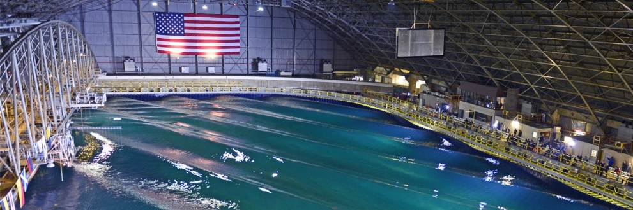
Life as a DoN Civilian
The Commanding Officer is Captain Matthew Tardy
You will likely have many opportunities to work directly with Navy, Marine, and other military officers and enlisted personnel
Many of our processes are based on military instructions, regulations or practices
Military names and acronyms pervade our work vocabulary
When working on ships, there is an expectation that civilians know some basic things about ship life, terms and customs
The military traditions and ceremonies are very powerful and motivating - civilians are expected to be familiar with them
Maneuvering and Seakeeping Basin
(MASK) Bldg. 18
Working as a DoN civilian places you in a different culture from a standard position in private industry.
Generally, you will work with and for civilians, but there are some differences between our work environment and private industry you should know…
Notes:
© Copyright PresentationGo.com – The free PowerPoint library

Slide 23
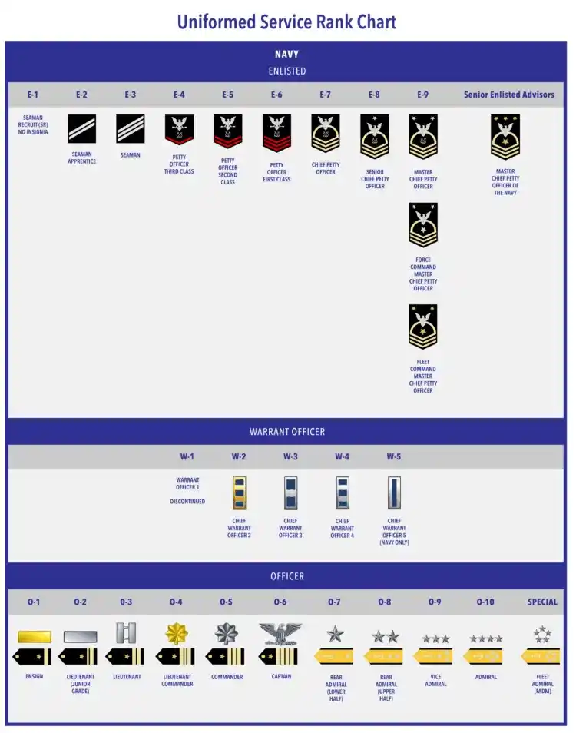

Three Categories of Military Personnel
Enlisted – Those who enlist in the service as non-commissioned officers and who perform the numerous specialized tasks that accomplish the mission
Warrant Officers – Specialists in their fields who are selected for positions between the ranks of officer and enlisted personnel (US Air Force does not have these)
Officers – Are commissioned by the President, specially trained military leaders who manage the Navy's personnel, ships, aircraft, and weapons systems.
Notes:
© Copyright PresentationGo.com – The free PowerPoint library

Slide 24
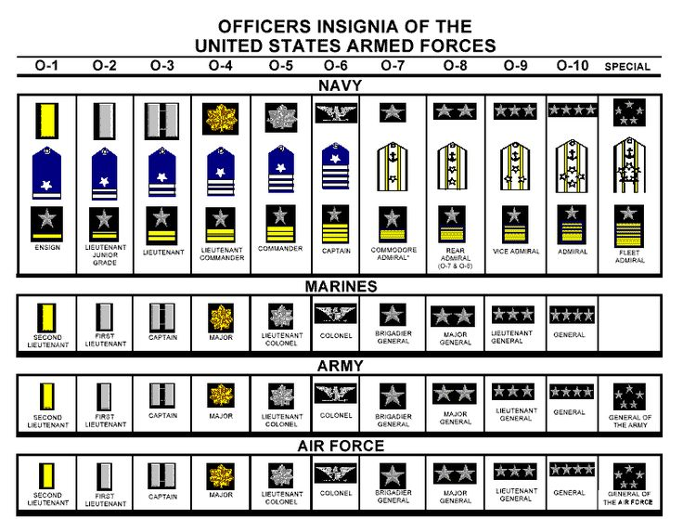
Military Officer Titles
Notes:
© Copyright PresentationGo.com – The free PowerPoint library

Slide 25

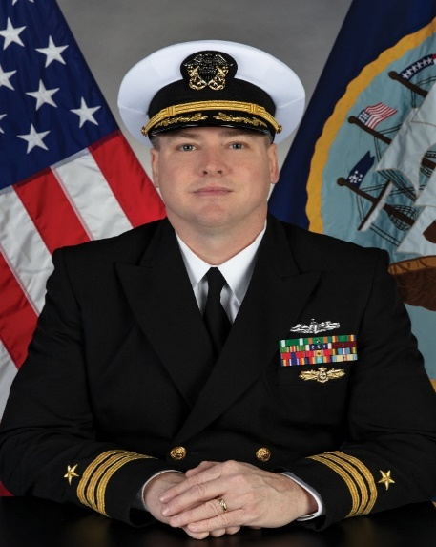
How to Interact with Senior Officers
Captain Matthew L. Tardy
Commanding Officer
Commander Gerald J. Lettich
Executive Officer
At most military installations, stand for Flag Officers and Commanding Officers (CO) when they enter a room or are announced
Generally, they are an O-5 or higher (Navy Commander or other Service Branch equivalent)
Sometimes they are announced before entering the room: “Officer on Deck!”
A salute is not necessary; civilians do not salute
Officers and CO’s avoid fraternization with enlisted sailors and soldiers – civilians may generally follow suit when in the presence of officers
Use “Sir” or “Ma’am” when appropriate
Use proper military speak when discussing common terms such as dates, time or ship terminology
Adhere to strict standards of timeliness and appearance when you are expecting to meet with a senior officer
Notes:
© Copyright PresentationGo.com – The free PowerPoint library

Slide 26
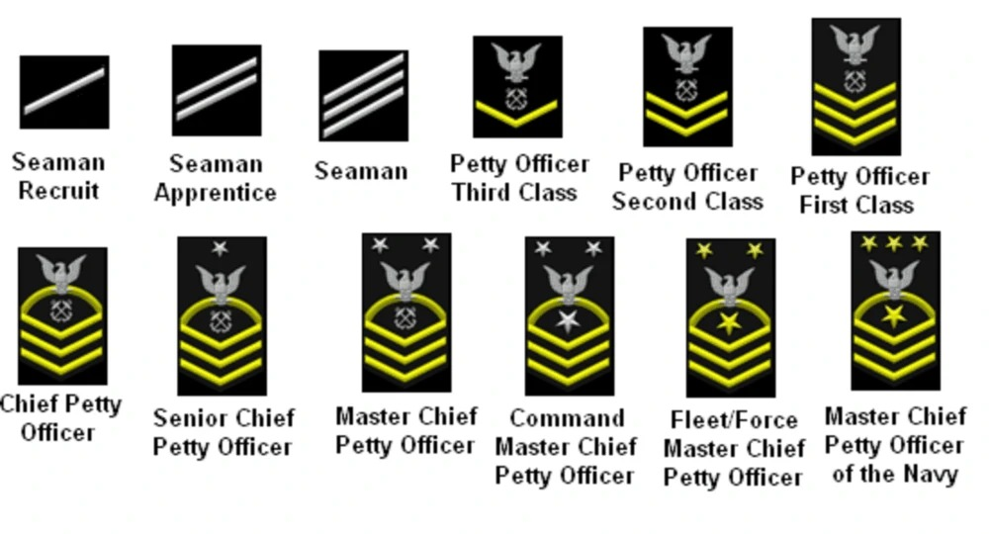
Navy Enlisted Titles
Rate: The Technical Specialty the Sailor works in (BM – BOATSWAIN’S MATE)
Rank: Signifies the level of authority, responsibility, and leadership (Similar to Grade level)
For a complete chart comparing officer ranks of all service branches, visit the
US DoD Military Officer Rank Insignia Website https://www.defense.gov/Resources/Insignia
Notes:
© Copyright PresentationGo.com – The free PowerPoint library

Slide 27
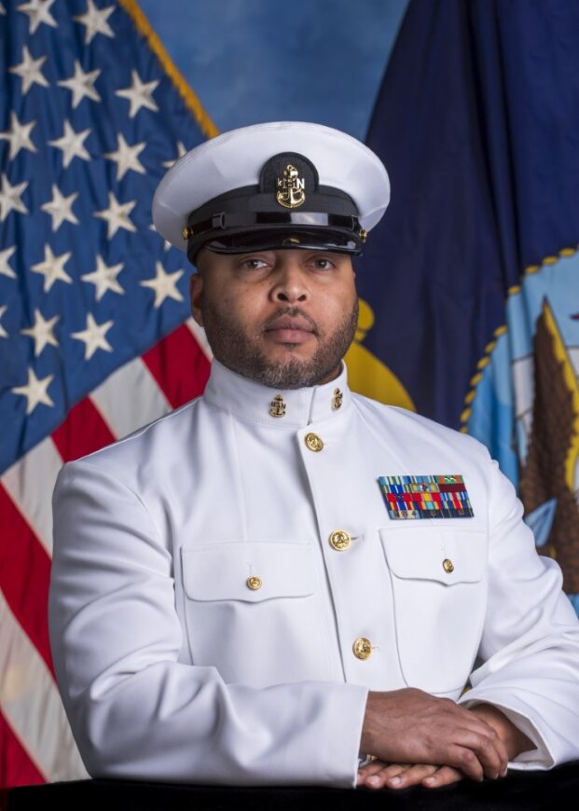
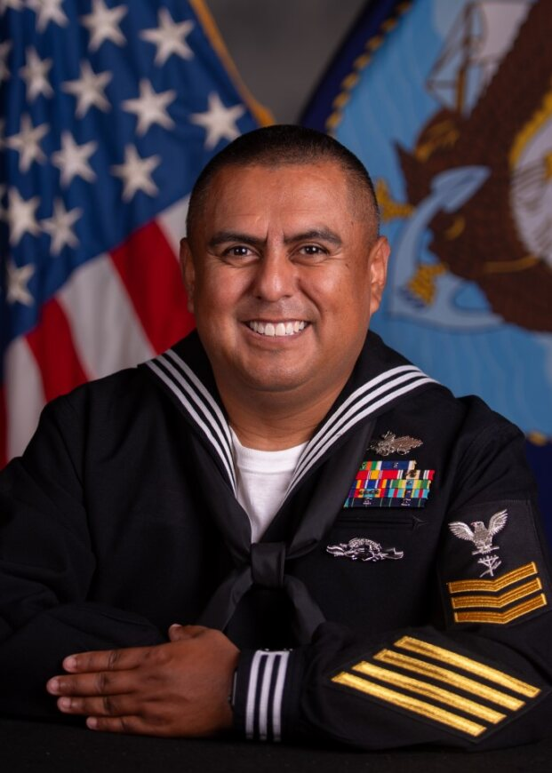

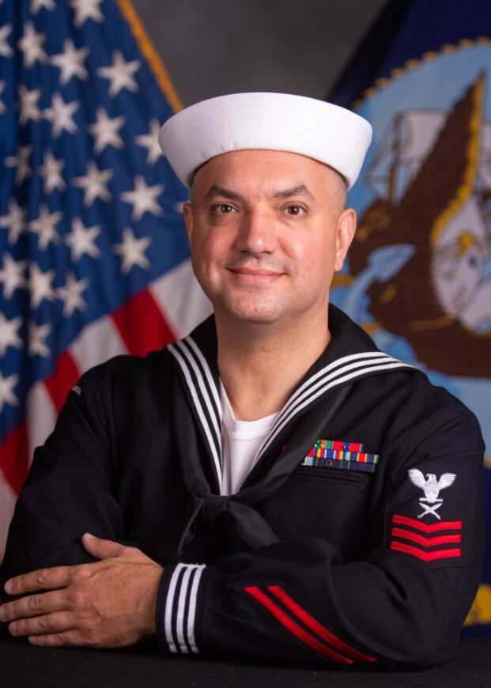
Enlisted Ratings at Carderock
YNC Delcon Ferguson
Chief Yeoman
CE1 Julio Rodriguez
Construction Electrician
MA1 Montril Rabion
Master-at-Arms
YN1 Jonathan Weiss
Yeoman
Notes:
© Copyright PresentationGo.com – The free PowerPoint library

Slide 28
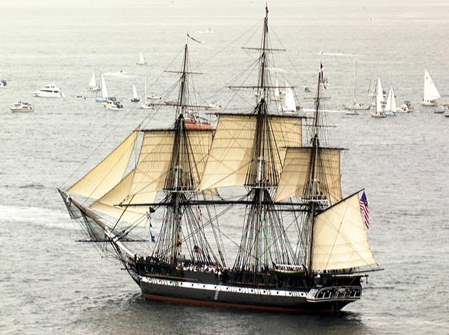
Navy Terminology
You may hear or be exposed to various Naval terms, particularly if you work with actual ships or people from shipyards. Here are some terms you will want to be familiar with. Many were derived from hundreds of years of naval operations across the globe.
Hull – The outside part of the ship that rides in or above the water line but below the main deck
Bow or Fore – Forward most part of the hull
Aft or Fantail – Back most part of the hull
Keel – The foundation of the ship, it is the very bottom most part of the hull and it usually forms a V or U shape
Stem – The forward most end of the keel
Stern – The after most end of the keel to which the rudder is usually attached
Bulkheads – The walls in the interior of the ship that divide it into compartments
Decks – Floors of the ship
Portholes – Windows of the ship
USS Constitution – “Old Ironsides”
Notes:
© Copyright PresentationGo.com – The free PowerPoint library

Slide 29
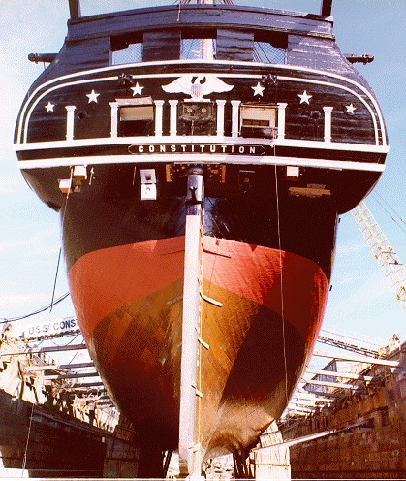
Navy Terminology
You may hear or be exposed to various Naval terms, particularly if you work with actual ships or people from shipyards. Here are some terms you will want to be familiar with. Many were derived from hundreds of years of naval operations across the globe.
Gangway – Walkway between the shore and the ship used for crew and passengers to board or leave
Go Aloft – Climb up ladders to go to higher decks in the ship
Go Below – Climb down ladders to get to lower decks.
Passageway – Essentially a walkway or hallway leading to other compartments.
Quarterdeck – Not actually a deck, but a designated compartment where official business and operations of the ship are carried out.
Starboard Side – Right hand side of the ship (looking towards the bow)
Port Side – Left hand side of the ship
USS Constitution in dry-dock during restoration/maintenance
Notes:
© Copyright PresentationGo.com – The free PowerPoint library

Slide 30
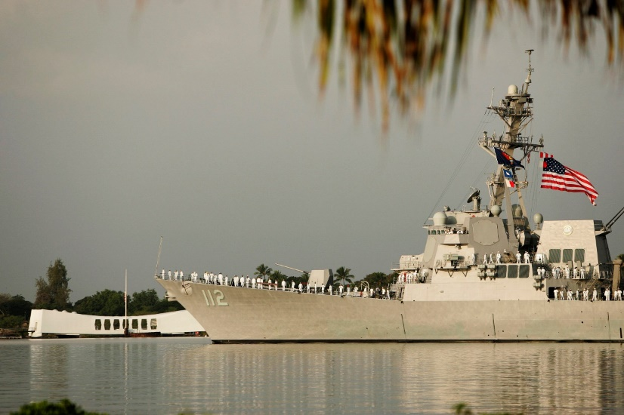
Riding a Ship
You may be assigned at some time to visit a ship to see the technology or system your are working on firsthand. Always remember the Ship is the Sailor’s home, and you are an onboard guest. It is therefore important to observe and respect the Navy’s customs and courtesies, and to always conduct yourself in a professional manner.
All NSWCCD employees planning to ride a ship will undergo shipboard training to learn the etiquette, safety, and procedures aboard ship.
Manning the Rails–USS Michael Murphy (DDG-112). A form of salute or honor; in this case, rendering honors to the USS Arizona memorial.
Notes:
© Copyright PresentationGo.com – The free PowerPoint library

Slide 31
Phonetic Alphabet
Phonetic Alphabet
Alpha
Bravo
Charlie
Delta
Echo
Foxtrot
Golf
Hotel
India
Juliet
Kilo
Lima
Mike
Aboard ships, signals are sent to one another as letters and/or numbers, which have meanings by themselves or in certain combinations. In the Allied Signals Book, “BZ” or “Bravo Zulu” means “Well Done”
November
Oscar
Papa
Quebec
Romeo
Sierra
Tango
Uniform
Victor
Whiskey
X-Ray
Yankee
Zulu
Notes:
© Copyright PresentationGo.com – The free PowerPoint library

Slide 32

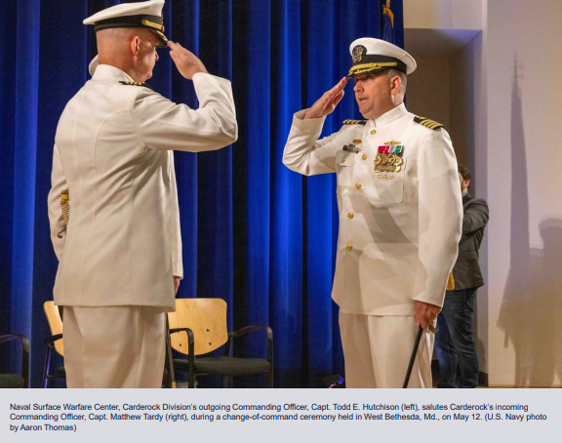
Change of Command Ceremony
The formal passing of responsibility, authority, and accountability of command from one officer to another
Rich in naval tradition and quite formal
The relieving orders are read and the outgoing Commanding Officer has the opportunity to say goodbye. The new Commanding Officer reads the order of assignment to command and officially “reports for duty”
Generally happens approximately every 3 years here at NSWC Carderock.
Notes:
© Copyright PresentationGo.com – The free PowerPoint library

Slide 33


Daily Honoring of the Colors
Colors are observed every day at 0800 and sunset
If you observe that this ceremony is about to begin, follow these guidelines:
  If driving, pull over and wait for the ceremony to conclude
  If walking, stop, face the direction of the flag or music, and cover your heart with your right hand until the ceremony is concluded
Notes:
© Copyright PresentationGo.com – The free PowerPoint library

Slide 34
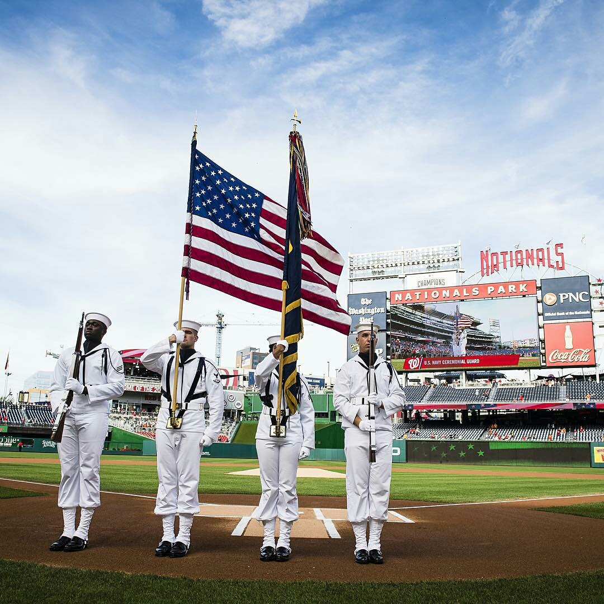
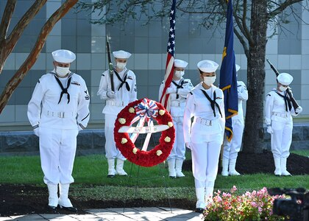
Ceremonial Honoring of the Colors at Events
A Color Guard will move forward with the Flags to present to all people present
All present rise and face the Color Guard
The National Anthem is played
At this time, all military members salute while the music plays
All civilians remove their hats and place their right hand over their hearts
The Flag may be referred to as: “The Flag”, “The Colors”, “The Standard” or
“The National Ensign”
Notes:
© Copyright PresentationGo.com – The free PowerPoint library

Slide 35
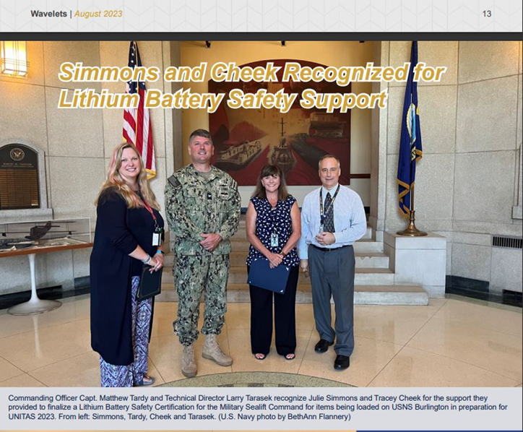
Recognition by the CO or Executive
Navy employees can receive recognition from the CO or an Executive from NSWCCD or another military activity for a job well-done
A formal letter of recognition may be sent
A formal awarding of honor or recognition in the correct venue may take place, e.g.:
  A department technical award
  A NSWCCD award at the annual awards ceremony
Notes:
© Copyright PresentationGo.com – The free PowerPoint library

Slide 36
VERG
If you are interested in learning more about the Carderock Veterans Employee Resource Group (VERG) please reach out to the following personnel:
lawrence.j.pugliese.civ@us.navy.mil, laurel.l.martin2.civ@us.navy.mil or bethann.flannery.civ@us.navy.mil

Slide 37
In Closing…
These are just some of the interesting facets of Navy and Military protocol.
For more information on Navy Protocol, you can research several Navy and commercial websites.
Here are a few suggestions:
Official Site of the United States Navy –www.navy.mil
Official website of the Department of Defense – www.defense.gov
Naval History and Heritage Command – www.history.navy.mil

Slide 38
Personnel Security Briefing
NSWCCD PERSEC, 301-227-1408
24 AUG 2023
Insert appropriate Distribution or CUI statement here

Slide 39
Security Message
The protection of U.S. Government assets including people, property, and both classified and controlled unclassified information is the responsibility of each and every member of the Department of Navy (DON), regardless of how it was obtained or what form it takes. Our vigilance is imperative. Anyone with access to these resources has an obligation to protect it.
The very nature of our jobs dictates we must lead the way in sound security practices. Anything less is simply not acceptable.
You may face legal and/or administrative sanctions if you knowingly, willfully or negligently commit security violation.
39

Slide 40

Personnel Security Program (PSP)
The objective of the Personnel Security Program is to make a reasonable determination that individuals granted access to classified information or assigned to sensitive positions are and will remain loyal, trustworthy, and reliable
40
Notes:
The objective of the PSP is to authorize initial and continued access to classified information and/or initial and continued assignment to sensitive duties to those persons whose loyalty, reliability and trustworthiness are such that entrusting them with classified information or assigning them to sensitive duties is clearly consistent with the interests of national security.

Slide 41


Beginning Process
(future NSWCCD personnel)
(1) PERSEC receives “New Hire Package” containing individuals information and Addendum
(2) Determine if individual is eligible for position.
If YES, Cleared to onboard If NOT, initiate T3/T5 investigation
Determine loyalty, trustworthiness and of good character
Clear for onboarding
(3) Attend PERSEC Brief and complete SF312 Non-disclosure Agreement Form
(4) Granting of Access

Slide 42
Security Clearances
Employment with the NSWCCD requires you to maintain eligibility for access to classified information.
Complete Electronic Questionnaires for Investigation Processing (e-QIP) system every 5 years.
Access to classified information will be authorized at the level necessary to perform your duties.
42

Slide 43
Access Eligibility Process
Eligibility Determination
Administrative action, usually involving a form of background investigation and adjudication determination
+
Access
SF 312
The ability and opportunity
to obtain knowledge of
classified information.
This can involve seeing,
hearing, or touching classified information, material, or equipment.
Classified Information Nondisclosure Agreement:
All persons authorized access to classified information are required to sign a SF 312, a legal contractual agreement between you and the
U.S. Government.
=
+
Need-to-Know
Determination made by an authorized holder
of classified information that a prospective recipient requires access to perform a lawful and authorized government function.
43

Slide 44
PSP Terminology
Term
Description
A determination, made by the CAS, that a person is able and willing to safeguard classified information and occupy a national security sensitive position.
Access is granted only when facts and circumstances indicate that access to classified information is consistent with the national security interest of the United States.
A temporary and limited granting of access to classified information. You will not be granted additional access to special programs.
Security Clearance Eligibility
Access
Temporary Access
44
Notes:
The term “security clearance eligibility” has replaced “security clearance,” when referring to a formal determination made by an authorized adjudicative entity that an individual meets national security standards. Security clearance eligibility is officially recorded and subject to due process procedures. Security clearance now refers to a state that exists whenever eligibility has been properly established by an authorized adjudicative entity and access has been properly authorized by the command. Security clearance is understood to exist at the level of access authorized.
When a command authorizes access to classified information pending completion and formal adjudication of the required PSI, this action was termed “interim clearance” in the past. However, EO 12968 standards more accurately refer to this action as “temporary access” because it is an access determination under command purview. It is not a clearance determination and it carries no due process benefits.

Slide 45
Adjudication Guidelines
13 Adjudicative Guidelines
Each guideline contains three parts:
  The Concern: A description of the behavior or situation that could create a risk to national security interests.
  Conditions that could raise a security concern and may be disqualifying: A description of the actual behaviors or situations that are of concern pertaining to the individual’s eligibility for information and/or assignment to sensitive duties.
  Mitigating Factors: A description of conditions that could mitigate the security concern.
A - Allegiance to the U. S.
B - Foreign Influence
C - Foreign Preference
D - Sexual Behavior
E - Personal Conduct
F - Financial Considerations
G - Alcohol Consumption
H - Drug Involvement
I - Psychological Conditions
J - Criminal Conduct
K - Handling Protected Information
L - Outside Activities
M - Misuse of Information Technology Systems
45
Notes:
9 Adjudicative Factors:
(1) The nature, extent, and seriousness of the conduct;
(2) the circumstances surrounding the conduct, to include knowledgeable participation;
(3) the frequency and recency of the conduct;
(4) the individual's age and maturity at the time of the conduct;
(5) the extent to which participation is voluntary;
(6) the presence or absence of rehabilitation and other permanent behavioral changes;
(7) the motivation for the conduct;
(8) the potential for pressure, coercion, exploitation, or duress; and
(9) the likelihood of continuation or recurrence.

Slide 46


Your Security Clearance
Position Sensitivity Types
Noncritical Sensitive
Critical Sensitive
Special Sensitive
Investigation Types
  T3 / T3R
  T5 / T5R
  Levels of Security Access Requirements
TOP SECRET
SECRET
CONFIDENTIAL
You MUST coordinate with your Security Manager for all matters concerning security clearance/access
46

Slide 47
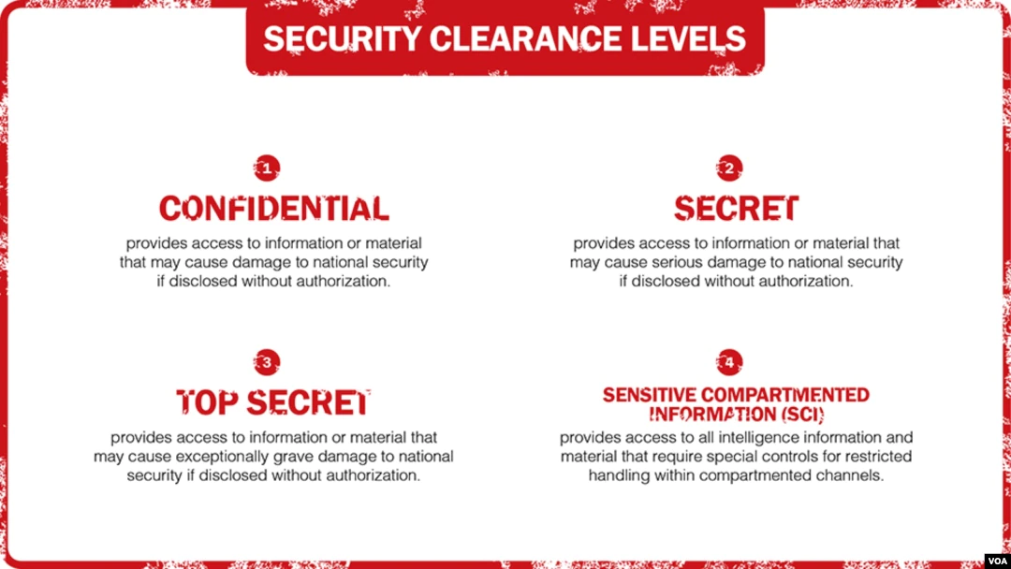
Unauthorized Disclosure
Confidential : If leaked, may cause damage to national security
Secret: If leaked, may cause serious damage to national security
Top Secret: If leaked, may cause exceptionally grave damage to national security
Sensitive Compartmented Information(SCI): If leaked, may cause inestimable damage to national security

Slide 48

Security Violations and Infractions
Security Incidents - failure to comply with established security procedures.
Violations - Any knowing, willful, and negligent action for security regulations, and result in, or could be expected to result in, the loss or compromise of classified information.
Compromise - an unauthorized disclosure of classified information (i.e., disclosure to one who does not have a valid clearance, authorized access, or a need to know).
Infractions - Any knowing, willful or negligent action contrary to the requirements of an order or its implementing directives that do not constitute a ‘violation’, as defined above.
Immediately report all security incidents to:
Melissa Berlo
Activity Security Manager
Code 105 Security Office
301-227-1408/1511
melissa.d.berlo.civ@us.navy.mil
48

Slide 49
Personnel Security
A security clearance is a privilege, not a right.
When you accept the privilege of access to classified information, you are also accepting the responsibilities that accompany this privilege. It is your personal, moral, and legal responsibility to protect classified information within your knowledge, possession and control.
This is a LIFELONG responsibility!
49

Slide 50
Continuous Evaluation Program
Employees must recognize and avoid behaviors that might jeopardize their security clearance.
In accordance with CARDEROCKDIVINST 5500.4E for Continuous Evaluation Program, dated 22 FEB 17: individuals are required to report to their supervisor or appropriate security personnel and seek assistance for any incident or situation that could affect their continued eligibility for access to classified information. Individuals shall be initially and periodically briefed thereafter, to ensure familiarity with pertinent security regulations and the standards of conduct required of individuals holding positions of trust.
***The ultimate responsibility for maintaining eligibility to access classified information rests on YOU!***
50

Slide 51
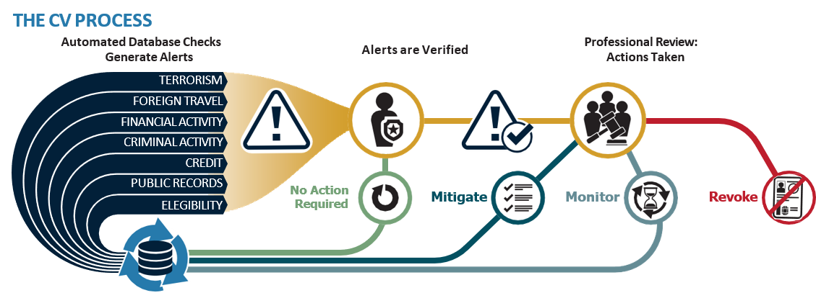

CONTINUOUS EVALUATION
Continuous Evaluation Program (CEP) Reporting
Automated Continuous Evaluation System (ACES)
An ongoing screening process to review the background of an individual who is assigned to a sensitive position or has access to classified information or material
Under continuous monitoring, the Government will automatically collect information ranging from your boat registration to your divorce.
You are continuously assessed in over 15 databases!
51
Notes:
Cleared employees are required to report any information pertaining to the following:
1. Any suspicious contacts, including:
o Foreign travel to or through a foreign or attendance at international conferences at which representatives of such a country will be in attendance
o Establishment of residency in a foreign country by an employee’s spouse or member of his/her immediate family or the acquisition of relatives, through marriage, who live in such a country
o Any association with or intention to represent a foreign interest (RFI)
o Any instances in which someone approaches you and requests information pertaining to classified or sensitive information when such person does not have a legitimate “need-to-know” and/or is willing to “pay” you for such information
o Sabotage, espionage, and any subversive or suspicious activity
NOTE: ACES is a DoD tool to automatically query government and commercial databases between periodic reinvestigation cycles in order to detect serious, yet unreported, issues of security concerns. ACES uses established adjudication criteria to identify issues, such as financial anomalies, criminal incidents and foreign connections.

Slide 52

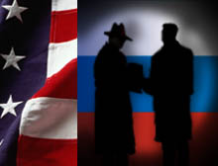

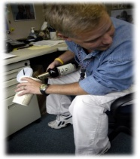





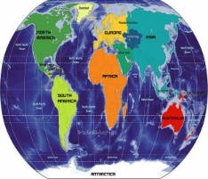

Self-Reporting
Self-reporting is mandatory and emphasizes personal integrity
With this privilege comes the obligation to report certain activities
Foreign Travel
Foreign Contacts
Marriage/Divorce
Alcohol Abuse
Drug Use
Incarceration/
Arrest
Psychological or Substance Abuse Counseling
Foreign
Allegiance
Loss/Compromise
of Classified Info
*Foreign
Influence
Bankruptcy/
Credit Issues
*Foreign Ownership, Control or Influence (FOCI) concerns
52
Notes:
Employees must recognize and avoid behaviors that might jeopardize their security clearance.
Supervisors must remind employees of these responsibilities and encourage reporting.
Individuals are required to report to their supervisor or the appropriate security official.
Co-workers have an obligation to advise their supervisor or appropriate security official.
Supervisors and managers shall play a critical role in assuring the success of the CEP.

Slide 53
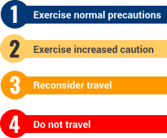

Foreign Travel
Check our Travel Advisory and Alerts for your destination!
https://travel.state.gov/content/travel/en/international-travel/International-Travel-Country-Information-Pages.html
Level 1 - Exercise Normal Precautions: This is the lowest advisory level for safety and security risk. There is some risk in any international travel. Conditions in other countries may differ from those in the United States and may change at any time.
Level 2 - Exercise Increased Caution: Be aware of heightened risks to safety and security. The Department of State provides additional advice for travelers in these areas in the Travel Advisory. Conditions in any country may change at any time.
Level 3 - Reconsider Travel: Avoid travel due to serious risks to safety and security. The Department of State provides additional advice for travelers in these areas in the Travel Advisory. Conditions in any country may change at any time.
Level 4 – Do Not Travel: This is the highest advisory level due to greater likelihood of life-threatening risks. During an emergency, the U.S. government may have very limited ability to provide assistance. The Department of State advises that U.S. citizens not travel to the country or to leave as soon as it is safe to do so. The Department of State provides additional advice for travelers in these areas in the Travel Advisory. Conditions in any country may change at any time.
NOTE:
Be aware that you may be a target for a foreign entity. If you are approached with suspicious behavior and feel someone’s trying to obtain information, it’s your responsibility to report to the Commanding Officer as soon as possible!
Report unofficial foreign travel : ronald.l.heffner.civ@us.navy.mil
If you are in-access/read-in to a special sensitive program, contact the Special Security Officer (SSO) for any additional foreign travel reporting requirements.

Slide 54
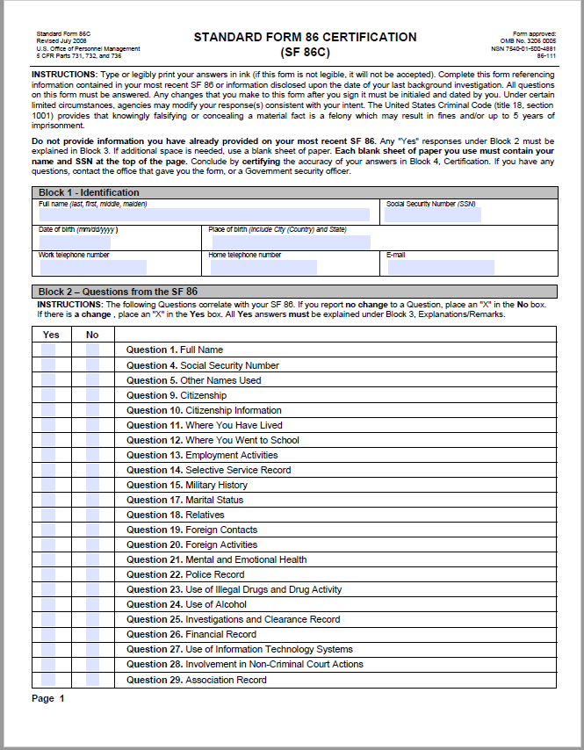
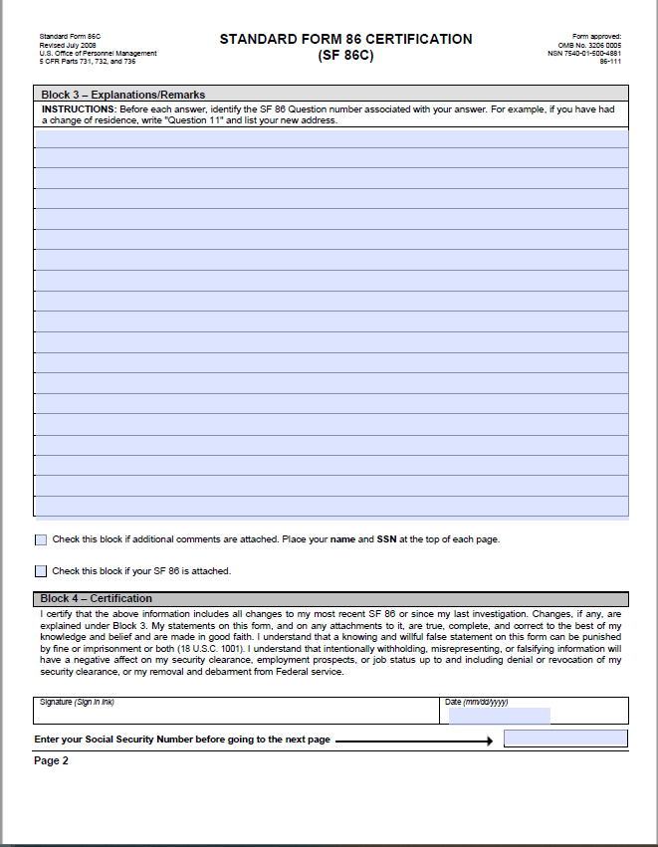
HOW TO SELF REPORT
(1) Type in web browser
https://cuthill.aw3s.navy.mil/intra/code10/security/sf86.html
(2) Select Standard Form 86 Certification (SF86C)
(3) Fill in electronically
(4) Print & Sign with ink
(5) Scan and send ENCRYPTED to NSWCCD_PERSEC@us.navy.mil
(6) Also, Check out Security Executive Agent Directive 3- Reporting Requirements for Personnel with Access to Classified Information or Who Hold a Sensitive Position

Slide 55


Individual Responsibility
Becoming familiar with local security regulations pertaining to your assigned duties
Notify your supervisor or Activity Security Manager (ASM) when you become aware of information with potentially serious security significance regarding someone with access to classified information or assigned to sensitive duties
Notify your Security Official of changes in your status that could affect your security clearance eligibility
To determine, before disseminating classified information, that the prospective recipient has been authorized access, has a need to know and can properly protect (store) the information
It is your personal responsibility to avoid personal behavior that could render your eligibility for access to classified information or assignment to sensitive duties.
Report to your CO, activity head or designee for any individual regardless of nationality, whether within or outside the scope of the individual's official activities, in which illegal or unauthorized access is sought to classified or otherwise sensitive information
It is your obligation to report information that could have an impact on the security clearance eligibility of an individual who has access to classified information
OPSEC is a security and risk management process that prevents sensitive information from getting into the wrong hands
55

Slide 56

Supervisor Responsibility
Supervisors play a key role and must continuously evaluate their employees, with the goal of early detection, allowing employees the opportunity to seek help and mitigate any incidents.

Slide 57
Other Key Security Functions/Processes
Common Access Card (CAC)
Official ID pass to base
Grants access to buildings/restricted areas/systems
Programmed at Security Office
Wear at all times, above the waist
Access Controls
LENEL card readers on buildings/restricted areas
Access list rosters
Safe combinations
Need-to-know
Visitor Control
Official visits/Special events (ceremonies, STEM competition, etc.)
Sponsorship – need justification/POC
Complete and sign SECNAV Form 5512/1
Escorted/unescorted
Destruction of Information
Classified material – NSA approved shredders, Destruction Facility
Controlled Unclassified Information – NSA approved shredders, locked gray shred bins, Destruction Facility
Must prevent reconstruction of information
Special Assignments/Access Briefings
North Atlantic Treaty Organization
Restricted Data
Naval Nuclear Propulsion Information
Courier Authorization
Foreign Travel
Camera Passes
NOTE:
These and other processes will be covered in more detail in other security briefings.

Slide 58

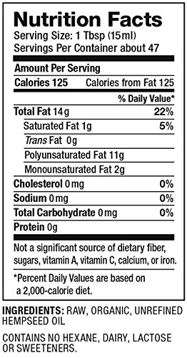


Recent Updates
THC/Marijuana use is illegal for ALL employees that have eligibility. This includes student interns that return to work for the federal government (including government contractors) after graduating from college.
All foreign crypto currency and stocks must be reported unless they are managed by a brokerage based in the United States (TSP for example).
THC stock ownership is not allowed per recent guidelines and is a reporting requirement. Disassociation with the stock is a mitigating situation per CAS.
The energy drink Rockstar Unplugged will cause a positive urinalysis. Be aware of what you are consuming or using on your body. It is your responsibility! Products that contain more than .03% THC remain illegal. FDA does not certify the THC percentage of commercially produced CBD products.

Slide 59

Personnel Requiring Items
All employees assigned to Washington Naval Yard need a Visit Request completed in DISS BEFORE you go there. Please contact your Administrative Official or supervisor.
All employees will complete an SF312 at end of briefing.
Those that require an attestation statement will complete it “after our briefing” today.
17

Slide 60
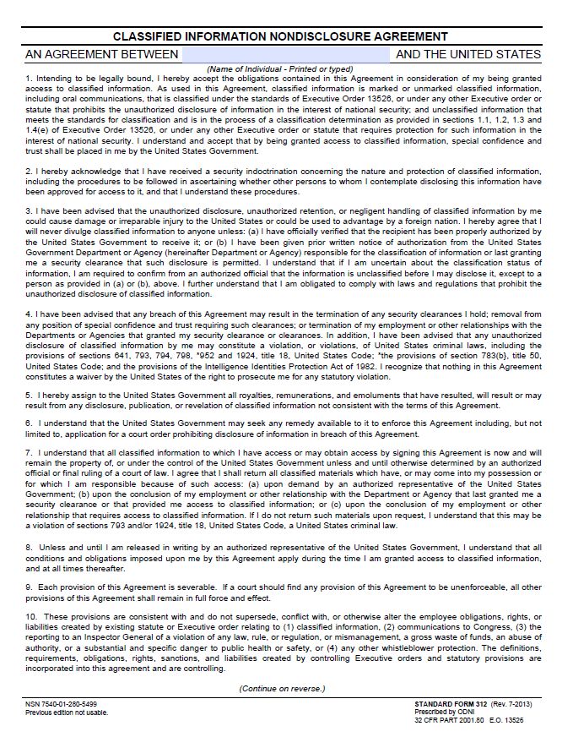
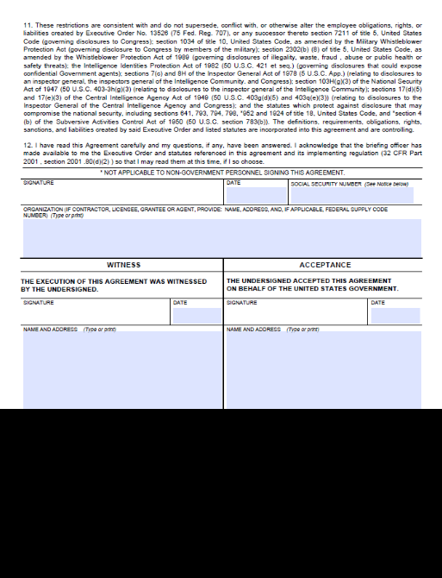
Classified Info Non-Disclosure
SF-312, Classified Information Nondisclosure Agreement
Full Name
SSN
Signature
Witness
Debriefing
Lifetime
FRONT
BACK
NOTE: Please review Titles 18 and 50 of the U.S. Code and other references identified on the SF312
60
Notes:
Individuals granted a Top Secret clearance or access to a specially controlled access category or compartment, such as Special Access Programs and Sensitive Compartmented Information, must sign the SF-312 Form and, in addition, must attest orally to their responsibility to safeguard classified information in the presence of an individual designated to preside over the attestation and another witness.

Slide 61
PERSEC POC Information
David Hess, PERSEC LEAD, david.p.hess3.civ@us.navy.mil
Terry Tate, terry.l.tate.civ@us.navy.mil
Lynnette Wilson, lynnette.wilson.civ@us.navy.mil
Afton Alvarado, afton.n.alvarado.civ@us.navy.mil
Please call 301-227-1408 and ask to speak to the PERSEC Specialist on duty if you wish to talk to one of us.

Slide 62
62

Slide 63
BREAK 1

Slide 64
Payroll & Timekeeping
Kristy Ross and Bianca Teel
Code: 013
Insert appropriate Distribution or CUI statement here

Slide 65
Transfer & New Employees
  Transfer Employees:
  Provide your last LES from your departing Command to Payroll Office upon on-boarding to ensure your leave is properly converted over into our system.
  You will receive 2 LES:
    1- Departing command ($0.00)
    2- LES from NSWCCD with pay details
  New Employees…. No action
Insert appropriate Distribution or CUI statement here

Slide 66
Time and Attendance
  Time should be recorded in ERP daily and your time should equal 80 RG (regular) hours at the end of each pay period.
  Overtime/Credit/Leave must be approved before earning/using time. Request must be submitted/approved in Leave, Overtime, Comp Time User System (LOCUS) Tool.
  All employees will be defaulted to an AWS-5 (Maxi-Flex) Work Schedule, unless otherwise requested by employee or supervisor.
  myPay is available within 1 to 2 pay periods of onboarding.
Insert appropriate Distribution or CUI statement here

Slide 67
Time and Attendance Systems/Tools
  Navy ERP – System for recording/approving time
  User Wizard – System for registering a LOCUS account
  LOCUS – System for submitting/approving leave, overtime, compensatory time requests.
Insert appropriate Distribution or CUI statement here

Slide 68
Hours of Work and Work Schedules
  80-Hour Basic Work Requirement:
  0530-1900: Employees must complete the 80-hour basic work week requirement Monday-Friday between 0530-1900. (AWS-5)
  Standard Business Hours/Workweek:
  0730-1600: The standard business hours and workweek represent the hours that the office (Command) is considered open business and in need of coverage Monday-Friday.
  Core Hours:
  0930-1430: Core hours represent the time of day the Command expects to deal with the majority of its business, and, therefore, must be adequately staffed Monday-Friday.
  Lunch:
  Employees are instructed to take a 30-min (0.5 min.), non-paid break for lunch daily.
    Lunch may not be taken immediately at the beginning of workday or immediately prior to quitting time.
    An employee on AWS-5 (Maxi-Flex Schedule) who works 6 or fewer hours on a particular workday is not required to observe an unpaid lunch break on that day.
Insert appropriate Distribution or CUI statement here

Slide 69
Hours of Work and Work Schedules
Work Schedules:
  AWS 0 (Basic Work Schedule)
    Consists of five 8-hours days M-F (40 hrs/wk & 80 hrs/pay period)
    FIXED daily arrival/departure: 0730-1600
  AWS 5 (Maxi-Flex Work Schedule)
    This schedule allows for flexibility in meeting 80-hr bi-wkly work requirement
    Employees may vary daily arrival 0530-0930 and departure 1430-1900. Core hours must be met. (supervisor discretion)
    80 hr basic work M-F between 0530-1900 (supervisor discretion)
    Maximum number of regular hours (RG) that can be working in a given workday is 10. (anything over 10 hrs is compensatory/overtime)
  AWS 6 (Compressed Work Schedule)
    Enables employee to complete basic 80 hr work requirement in fewer than 10 workdays.
    FIXED daily arrival/departure times, number of hrs worked per day, and regular day off (RDO). (supervisor discretion, arrival/depart times, number of hrs worked and RDO must be specified and documented)
  AWS 8 (Part-Time Work Schedule)
    Permanent part-time employee may not work less than 16 hrs or more than 32 hrs in workweek
    FIXED scheduled days and scheduled number of hours for each workday
    Employees may vary daily arrival 0530-0930 and departure 1430-1900. (supervisor discretion)
Insert appropriate Distribution or CUI statement here

Slide 70
COMMONLY USED “A/A TYPE” CODES
  Most commonly used Attendance and Absence (A/A) Type Codes in ERP:
  Basic Time Entry:
    Regular (Graded) – RG
  Leave:
    Annual Leave – LA
    Holiday Leave – LH
    Sick Leave - LS
    Court Leave – LC
    Military Leave – LM
    Admin Leave - LN* (only to be used when approved/directed by HR, Payroll Office, or Commanding Officer)
  Compensatory Time:
    Travel Comp Time Earned – CB
    Travel Comp Time Taken – CF
    Credit Hours Earned – CD
    Credit Hours Taken – CN
    Comp Time Earned – CE
  Comp Time Taken - CT
  Overtime:
    Overtime Scheduled – OS
    Overtime Unscheduled – OU
  Telework:
    Telework Regular– TW
    Telework Situational – TS
Insert appropriate Distribution or CUI statement here

Slide 71
DTS TRAVEL & GOVT TRAVEL CHARGE CARD (GTCC)
  New Employees:
  Contact the Travel Office to set up your DTS account
  New Employees should apply for GTCC upon onboarding (preferably within the first 1-2 pay periods)
  Transferring Employees:
  Contact the Travel Office to ensure your DTS Profile and GTCC has been properly transferred under the NSWCCD Hierarchy
Please contact Travel Office BEFORE your first travel!!!!
Insert appropriate Distribution or CUI statement here

Slide 72
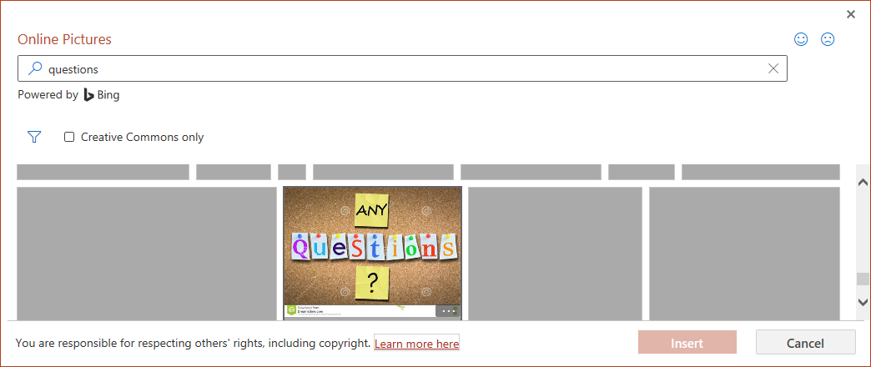
QUESTIONS
Additional Time & Attendance information can be found in the NSWCCD’s Time & Attendance Instruction/Manual located on Carderock’s Intranet at https://cuthill.aw3s.navy.mil/wcm/docs.php?doctype_id=6
Insert appropriate Distribution or CUI statement here

Slide 73
POINTS OF CONTACT
Employee Services Division Head
Kristy Ross - 301-204-0277 kristina.l.ross.civ@us.navy.mil
Payroll Office/LOCUS:
Bianca Teel - 301-646-1285 bianca.a.teel.civ@us.navy.mil
Travel Office:
Brittany Payne - 301-503-0786 brittany.b.payne.civ@us.navy.mil
Denise Lyles-Leonard - 301-227-1659 denise.w.lyles-leonard.civ@us.navy.mil
David Callis - 301-538-9825 david.a.callis.civ@us.navy.mil
Sean Dixon - 301-538-9792 kennard.s.dixon.civ@us.navy.mil
Hernan Truque - 301-538-9575 hernan.m.truquehurtado.civ@navy.mil
Government Travel Charge Card:
Nikki O'Bryan 301-538-9029 lyniqua.s.obryan.civ@us.navy.mil
Insert appropriate Distribution or CUI statement here

Slide 74
Benefits
Meredith Miller, Code 1014
2023

Slide 75
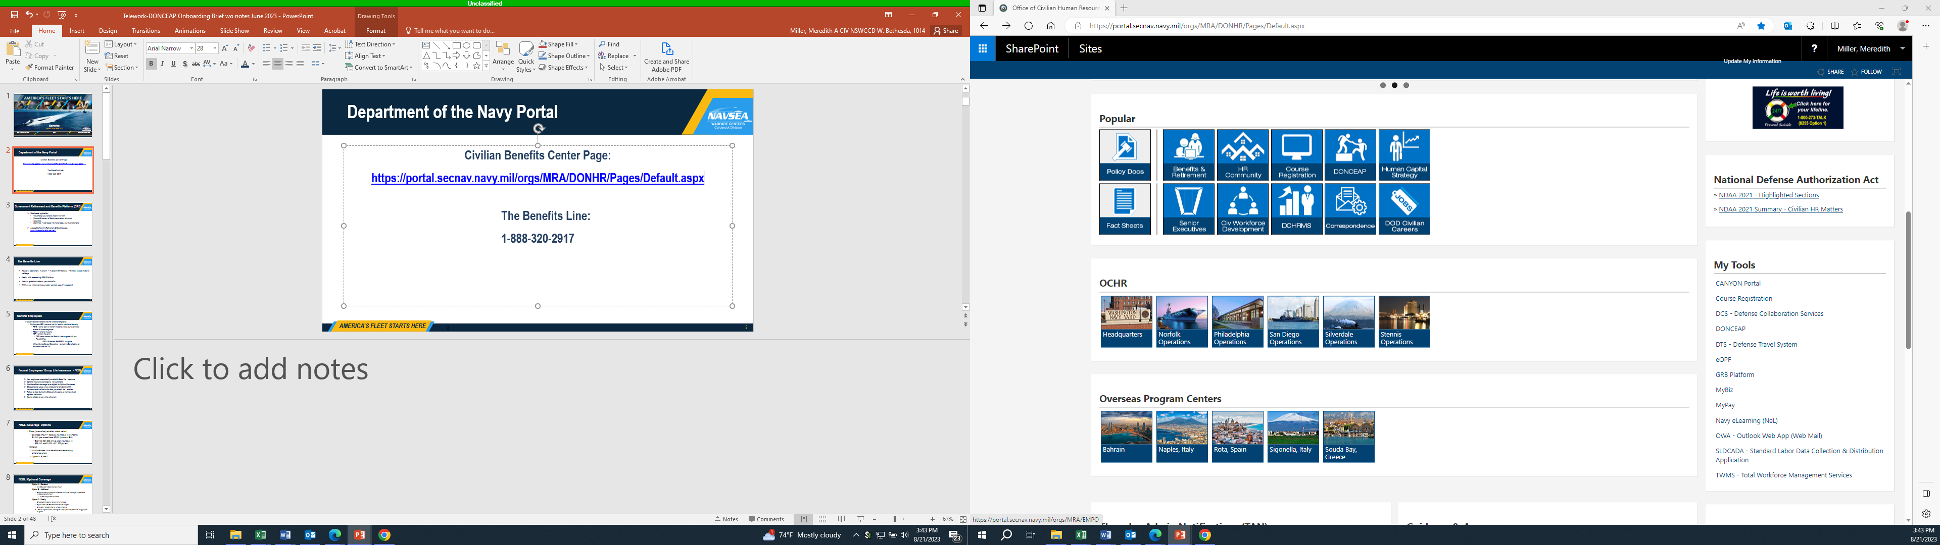
Department of the Navy Portal
Civilian Benefits Center (CBC) Page:
https://portal.secnav.navy.mil/orgs/MRA/DONHR/Pages/Default.aspx

Slide 76
Government Retirement and Benefits Platform (GRB)
Web-based application
  View/change your benefits (health, life, TSP)
  Personal Statement of Benefits and various retirement calculators
  eSeminars – web-based information about your federal benefits
Accessible from the Retirement & Benefits page: https://civbenefits.dc3n.navy.mil/

Slide 77
The Benefits Line
888-320-2917
Hours of operation: 7:30 am – 7:30 pm ET Monday – Friday, except federal holidays
Assist with accessing GRB Platform
Answer questions about your benefits
Will have a retirement counselor contact you, if requested

Slide 78
Transfer Employees
If you are a direct transfer and not a rehired employee:
  Review your LES to ensure that ALL benefits transferred correctly
    FEHB - carrier plan will remain the same unless you have moved outside of the coverage area
    FEGLI - remains the same
    TSP - remains the same
      TSP Loans- contact the Benefits Line to update with new Payroll Office
    FEDVIP-contact BENEFEDS to update
    Military Service Deposit Deductions-contact the Benefits Line for assistance from the CBC

Slide 79
Federal Employees’ Group Life Insurance- FEGLI
New employees automatically enrolled in Basic life insurance
Optional insurance coverage is not automatic
Must have Basic coverage to be eligible for Optional insurance
60 days to sign up as a new employee for any Optional life insurance and is effective the date you submit the election
Failure to elect during the 60 days is the same as having waived optional insurance
May be eligible to carry into retirement

Slide 80
FEGLI Coverage Options
  Basic (automatically enrolled, unless waived)
    Coverage amount = base pay rounded up to the nearest $1,000, plus an additional $2,000 (known as BIA)
      Example: $34,500 annual salary rounds up to $35,000; add $2,000 = $37,000 pay out
  Optional
    Must be elected and must have basic before electing optional coverage
    Options A, B, and C

Slide 81
FEGLI Optional Coverage
Option A - Standard
  $10,000 added to Basic coverage amount
Option B - Additional
  Salary rounded up to nearest $1,000 times the number of multiples elected added to Basic coverage amount
  Up to 5 multiples can be elected
Option C - Family
  Only covers the death of eligible family members; covers eligible children under age 22 or any age if incapable of self-support prior to age 22
  Spouse death- $5,000 times the number of multiples; child death- $2,500 times the number of multiples
  Up to 5 multiples can be elected

Slide 82
Opportunities to Make FEGLI Changes
You may waive (cancel) life insurance coverage at any time
After one full year from the date of waiver you can apply to re-enroll (requires a physical at your own expense)
Various life events allow changes to FEGLI within 60 days of the event (marriage, divorce, birth of a child, etc.)
No Annual Open Season For Life Insurance - OPM announces periodic open seasons, but it is very uncommon

Slide 83
Federal Employees Health Benefits – FEHB
You must make an election to be covered; coverage is NOT automatic
60 days to make election
Effective beginning of the next pay period in which election is made
Government pays approximately 72% - 75% of total premium amount
May be eligible to carry into retirement

Slide 84
Choosing an FEHB Plan
Choosing the right FEHB plan should be based on your own personal needs.
There are resources available to assist you:
  Guide to Federal Benefits
  https://www.opm.gov/healthcare-insurance/healthcare/plan-information/plans/
  Plan Comparison Tool
  https://www.opm.gov/healthcare-insurance/healthcare/plan-information/compare-plans/
You are not locking yourself into an FEHB plan for life.

Slide 85
Types of FEHB Enrollment
Self Only
Self Plus One
Self and Family
Eligible family members:
  Spouse
  Children under age 26: adopted child or recognized natural child; step child or foster child living in regular parent-child relationship; child any age who is incapable of self-support (disability existed before age 26)

Slide 86
Opportunities to Make FEHB Changes
Federal Benefits Open Season
  Annually in November through December; dates are announced
  Enroll, change plans, or change options
  Elections become effective the first day of the first full pay period in January
Various life events allow changes to FEHB within 31 days before and 60 days after the event (marriage, divorce, birth of a child, etc.)

Slide 87
Federal Employees Dental and Vision Insurance Program (FEDVIP)
Supplemental insurance coverage
No government contribution to the premiums; however, premiums are paid on a pre-tax basis
If you are eligible for FEHB and not on a temporary appointment, you are eligible for FEDVIP
60 days from date of appointment to elect, during the annual Federal Benefits Open Season, or with certain qualifying life events
Dental and vision are separate; can enroll in one or both
To enroll: www.benefeds.com

Slide 88
Flexible Spending Accounts (FSA)
Pay for eligible out-of-pocket health and dependent care expenses with pre-tax dollars
60 days from entry on duty, or until October 1 to elect
You must enroll in FSAs for each year that you choose to participate – election does not roll over into next year
“Use it or lose it” - Any unspent DCFSA funds will be lost; up to $610 (2023) in unspent funds under HCFSA and LEX FSA will be carried over into the next plan year, if you have re-enrolled
To enroll in FSAFEDS : https://www.fsafeds.com/fsafeds/index.asp or call 877-372-3337

Slide 89
Thrift Savings Plan – TSP
Traditional vs. Roth
  Traditional = contributions are taken out of LES before taxes
    Taxes will be paid when the money is withdrawn from TSP
    As of 10/1/2020, new hires are automatically enrolled in TSP with 5% of basic pay
  Roth = contributions are taken out of LES after taxes
https://www.tsp.gov

Slide 90
Free Money! TSP Agency matching
  Agencies match up to 5% of the employee’s own contributions under FERS
  FERS employees are immediately eligible for agency automatic 1% contribution and agency matching contributions up to 4%.
    The agency automatic 1% contribution is equal to 1% of your basic pay and is paid whether or not you contribute your own money.
**CSRS employees do not receive government matching contributions

Slide 91
Retirement Coverage
  FERS-Further Revised Annuity Employee (FERS FRAE) - Contribution rate of 4.4%
      Pays into FERS and Social Security
      Began effective Jan 1, 2014 for new hires
  Temporary Appointments less than 1 year
      FICA only Code 2
      Pays into Social Security only
      Eligible to elect FEHB if appointment is 90 days or more
      Ineligible for FEGLI, Retirement and TSP

Slide 92
Service Credit Deposits - 3 Types
Military Service (Called “Military Deposit”)- work with your staffing specialist.
  Allows you to buy Active Duty or ACDUTRA (including reservists).
  Must be paid before retirement.
What you will need (Follow instructions on DONHR portal):
  RI 20-97, Estimated Earnings request—send to Branch of Service to request estimated earnings
  Application to Make Military Deposit
  Documentation is necessary for periods requesting military deposit, including ALL DD214’s or orders.

Slide 93
Service Credit Deposits- 3 Types (cont’d)
2. Temporary Service (Civilian Deposit)
Allows you to buy civilian federal service under FICA
Only service before 1/1/89 can be paid under FERS
3. Refunded Service (Civilian Redeposit)
Allows you to buy service for which you may have taken a refund of retirement contributions.
Paying a deposit or redeposit is not mandatory.
*Be aware of the impact

Slide 94
Designation of Beneficiaries
Outlines your desire to have your benefits paid out in a particular way upon your death
If you complete forms, it is your responsibility to keep them up-to-date and reflecting your current wishes.
Access them on the CBC page, print them, sign in presence of two witnesses, keep a copy and mail original to CBC
Benefits for which you can designate a beneficiary: Life Insurance (SF 2823), Unpaid Compensation (SF1152), Thrift Savings Plan (TSP 3), Retirement and Federal Employees' Compensation Act Death Gratuity Payment (SF3102)

Slide 95
Order of Precedence
If there is no designated beneficiary, to your widow or widower
If none, to your child or children in equal shares - share of any deceased child is distributed among that child's descendants
If none, to your parents in equal shares or the entire amount to your surviving parent
If none, to the executor or administrator of your estate
If none, to your next of kin under the laws of the State where you lived at the time of your death
** For life insurance, qualifying court orders or assignment of benefits on file take precedence

Slide 96
Be Sure To:
Keep mailing address current!
  Notify your Payroll Office via MyPay website - https://mypay.dfas.mil/
  Notify your Health Insurance Carrier
  Notify your Employing Activity (HRO)
Update/Confirm Beneficiary Information Yearly

Slide 97
Contact Information
CBC
*Phone: 1-888-320-2917
*Email: navybenefits@navy.mil
*Please do not include Privacy Act or other Personally Identifiable Information such as date of birth or social security number in your email correspondence.
*Beneficiary Form Mailing Address:
OCHR Norfolk Operations Center
ATTN: CBC
NNSY Building 17
Portsmouth Va 23709
Meredith Miller - Code 1014: meredith.a.miller21.civ@us.navy.mil

Slide 98

QUESTIONS???

Slide 99
Telework
Sue Rossi, Code 1014
2023

Slide 100

Telework Policies
Telework Enhancement Act of 2010
Requires agencies to establish policy under which eligible employees may be authorized to telework without diminishing employee performance or agency operations
Required authorized teleworkers to enter into a written agreement with an agency manager
OPM Guide to Telework and Remote Work in the Federal Government
Outlines telework information to assist Federal Agencies, managers and supervisors and other staff responsible for implementing telework and supervising employees
Equips employees to better understand the day-to-day aspects of telework and remote work as workplace flexibilities
Distribution Statement Goes Here 100

Slide 101
Telework Policies
DoDI 1035.01
Updated telework policies and procedures for DoD employees in accordance with the TEA of 2010 and OPM guidance
Required the use of the DoD Telework Agreement, DD Form 2946 and telework training prior to the commencement of a new telework arrangement
SECNAVINST 12271.1 w/CH-01
Establishes policy, assigns responsibilities, and identifies requirements for the DON telework program
NAVSEAINST 12620.1B
Updates overarching policy and procedures governing the NAVSEA Enterprise telework program
CARDEROCKDIVINST 12620.1A
Establishes telework & remote work policy and delegation of authority to approve civilian telework agreements

Slide 102
Telework Defined
A voluntary arrangement where an employee performs assigned official duties and other authorized activities during any part of regular, paid hours at an approved alternative worksite.
Telework does not include any part of work done while on official travel or mobile work, e.g., site audits, inspections, or investigations.
A place away from the regular worksite that has been approved for the performance of assigned official duties. It may be a private home or other approved worksite.

Slide 103
Types of Telework
Regular and Recurring
An approved work arrangement where an eligible employee works at an alternative worksite on a regularly scheduled, ongoing, and recurring schedule
Type hour code “TW”
Situational / Ad Hoc
Telework that is approved on a case-by-case basis, where the hours worked at an alternative worksite are not part of a previously approved, regular telework schedule.
Type hour code “TS”
Examples: result of inclement weather or emergency, a medical appointment or other approved leave, to complete short-term special assignments or to accommodate special circumstances even though the telework may occur continuously for a specific period.

Slide 104
Telework Eligibility
Characteristics of the work and the employee, evaluated separately, that identify suitability for telework or remote work, as determined by the supervisor or other appropriate management official in the employee’s chain of command.
Eligible positions are then designated as either eligible for only situational or regular/recurring schedules.
Position Ineligibility
Requires daily handling of classified or unprotected CUI materials
Requires daily physical presence due to and onsite activity/materials or face-to-face contact with others
Employee Ineligibility
Conduct has resulted in disciplinary action in the past 12 months
Employee
PROHIBITED
Employee officially disciplined for AWOL of more than 5 days in any calendar year
Officially disciplined for viewing, downloading, or exchanging pornography on a Federal Government computer while performing Federal Government duties
Performance rating of record is unsatisfactory
Failure to meet performance requirements of agreement
Recently assigned to newly appointed entry-level position

Slide 105

Individual Suitability
Whether an individual is suitable for approval is determined by the supervisor
during the request process
Suitable
Employees who occupy eligible positions and exhibit suitable work performance/conduct
Employees who possess a working familiarity with their organization
May Not Be Suitable
Employees whose performance or conduct warrants closer supervisory direction than telework may provide
Employees recently assigned or newly appointed to trainee or entry level positions
Probationary/trial employees
Arrangement is feasible for individual and organizational performance

Slide 106

Required Telework Training
Employees and supervisors must meet mandatory training requirement before a telework arrangement commences.
Read Policies & Procedures
Ensure you acknowledge terms and conditions of the agreement
Complete Required Waypoints Training
“00-DON Telework Training for Employees”
every two years

Slide 107
Closure/Dismissal Situations & Duty Hours
Employees on approved telework agreements are responsible to ensure that they are telework-ready upon hearing of potential inclement weather in the event Federal government offices are closed for public business.
All teleworkers, regardless of the type of agreement (Regular & Recurring or Situational), are required to work during dismissal and closure situations. Plan to be telework-ready when severe weather is forecast. Failure to prepare will not be a reason to grant weather and safety leave.
Teleworkers who are unable to work due to illness or dependent care responsibilities must request and take appropriate leave during office closure or dismissal situations.
If other circumstances prevent performance of duties, the employee must contact the supervisor, who will determine the appropriate duty or leave status to account for the employee.

Slide 108
Requesting Telework
Telework will be requested using the Telework Agreement Routing System (TARS). We have instructions available for submitting your request. Email susan.m.rossi2.civ@us.navy.mil for the document.
Required telework training is “00-DON Telework Training for Employees” (available in Waypoints). Complete every two years.
Access TARS at https://wwwdd.nmci.navy.mil/navsea/mods/Tracker/?instance_id=274. If you are new to using the NAVSEA Trackers, you will be prompted to create your account when you log in. If you have used them before, you should get right into the site.

Slide 109
Are you a remote employee?
Enter your remote work agreement in TARS for record-keeping purposes.
For Regular Official Worksite, regardless of your location, select “9500 MacArthur Blvd, West Bethesda, MD 20817” – this is the location of the Command headquarters for all employees. This includes anyone located at detachment sites.
Select “Regular & Recurring” first. This will give you the option of choosing “Remote Distant” or “Remote Local,” as applicable. Do not choose Situational if you are remote. If you are unsure which option to choose, speak with your supervisor.

Slide 110
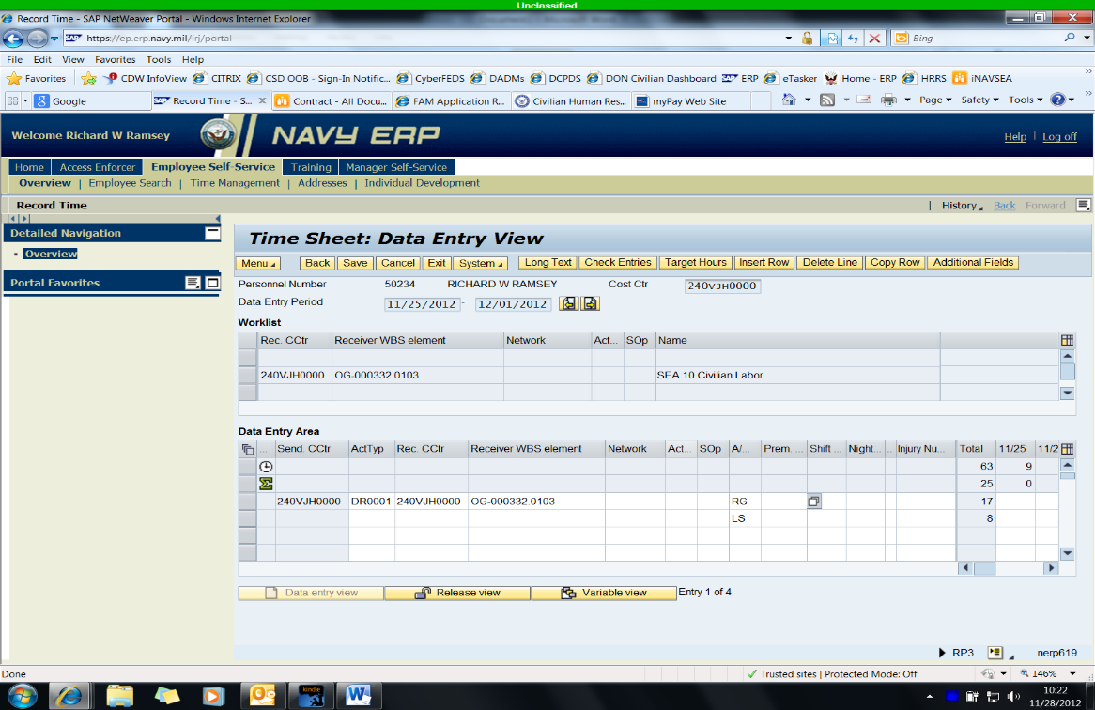
Recording Telework Hours
Employees and supervisors must ensure accurate telework codes are reflected in ERP for each and every session of telework.
Insert time code in “Premium Number” Column
“TW” Regular & Recurring
“TS” Situational
Notes:
Here is a look at the ERP timekeeping screen. You will enter the NWA you are charging and the type of hours you are working – that would be RG. Then insert the appropriate time code in the Premium Number column. If you are a remote employee, you will ALWAYS enter RG ONLY for your time, even if you are reporting to the official worksite. Since your remote worksite is your duty station, you are NOT teleworking.

Slide 111

Keys to Success
  What hours am I expected to work?
  Adhere to all workplace rules
  Remain engaged
  Plan ahead and document work
  Provide contact information
  Be flexible
  Practice OPSEC
  Record telework in ERP
  Keep telework agreement current
Notes:
To be a successful teleworker, ensure you understand what is expected of you. (read tips)

Slide 112

Questions?
Point of Contact:
Sue Rossi
Labor & Employee Relations Branch
Code 1014
Phone: 215-275-9017
susan.m.rossi2.civ@us.navy.mil

Slide 113
DONCEAP
Meredith Miller, Code 1014
2023
Insert appropriate Distribution or CUI statement here

Slide 114
Department of Navy Civilian Employee Assistance Program
Your life’s journey—made easier
No matter where you are on your journey, there are times when a little help can go a long way toward achieving your goals. From checking off daily tasks to working on more complex issues, your program offers a variety of services, resources and tools to help make your life a little easier.
Provided at no cost to you and your household members
Completely confidential service available 24/7/365

Slide 115
Most Common Reasons People Contact DONCEAP
Manage stress Depression
Relationship difficulties Anxiety
Help to cope with change Grief and loss
Anger issues Lack of support
Alcohol or drug problems Work-life balance concerns
Sleep disturbance Conflict with a supervisor or coworker
Notes:
DONCEAP is so much more than crisis and mental health situations. They are there for every situation that arises in your life. If you are relocating, they have resources. If you have aging parents, they have resources. Life coaches to help you achieve goals in your personal and professional life. This is free and confidential to you and your family members. This is NOT a CAC enabled site. You can access from any device.
Save this in your wok and personal brower.
Check out the LifeMart app to save money from childcare and travel to Disney and other theme parks.

Slide 116
What is offered and how do I get it?
Counseling Service
Legal Service
Financial Services
Lifestyle Coaching
Senior Care Management
LifeMart
24/7 phone support for DONCEAP - call 1-844-366-2327 or 1-800-262-7848 (TTY) https://magellanascend.com/Home/Index?timeout=true

Slide 117
NSWCCD DONCEAP POC
Meredith Miller
meredith.a.miller21.civ@us.navy.mil
215-300-3671

Slide 118
Equal Employment Opportunity
New Employee Brief
Wanda Jimenez-Barkdoll (she/her)
Deputy Director EEO, Diversity & Inclusion, NSWC Carderock Division
Christina W. Suggs (she/her)
EEO Complaints Program Manager,
NSWC Carderock Division

Slide 119
AGENDA
Definitions/Policies
Title VII Complaints Process
Alternative Dispute Resolution (ADR)
Anti-Harassment / Hostile Work Environment
Reasonable Accommodations

Slide 120

WHAT IS EEO?
Equal Employment Opportunity
  Fair Consideration
  No Discrimination
  No Harassment
  Reasonable Accommodations
  Resolving Disputes

Slide 121

OUR MISSION
Service the Carderock Command at all levels
  Detachments
  Navy Yard
  NSWC/NUWC HQ
Oversee and ensure that:
  The workforce reflects the nation’s diversity
  The workplace is free of discrimination and harassment

Slide 122
EEO POLICIES
Equal Employment Opportunity Policy Statement
Prevention of Sexual/Non-sexual Harassment
Reasonable Accommodations
Alternative Dispute Resolutions (ADR) Process
All of the Carderock EEO policies are located on official bulletin boards & online at: https://cuthill.crdr.navy.mil/intra/code10/hr/eeo.html

Slide 123
COMPLAINTS PROCESS
Title VII Complaints Process

Slide 124

COMPLAINT PROCESS
An employee, applicant, or former employee contacts the EEO office within 45 calendar days of an alleged discriminatory act (an action has to have occurred)
It is the employee/applicant’s PERCEPTION of the alleged discriminatory act

Slide 125
BASIS FOR COMPLAINTS
Race
National Origin
Color
Religion
Sex
Age
Reprisal/Retaliation***
Disability
Genetics
Civil Rights Act of 1964
Title VII
Equal Pay Act of 1963
Lily Ledbetter Act of 2009
Age Discrimination in Employment Act of 1967
The Rehabilitation Act of 1973
(Sections 501 and 505)
Americans with Disabilities Amendments Act of 2008
Genetic Information Nondiscrimination Act of 2008

Slide 126
BASIS DEFINITIONS
Race: defined as (a) a class or group of individuals with common characteristics, interests, appearance, or habits as if derived from a common ancestor or (b) a division of mankind possessing traits that are transmissible by descent and sufficient to characterize it as a distinct human type. EX: American Indian or Alaskan Native, Asian, Black or African-American, Native Hawaiian or Other Pacific Islander, White or Caucasian
National Origin: defined as, but not limited to because of an individual’s or ancestors' country of origin or because an individual has the physical, cultural, or linguistic characteristics of a particular national origin group. EX: Hispanic, Middle-Eastern, African, etc.
Color: Color discrimination can occur in the absence of racial discrimination when members of the same race are treated differently because of their differing skin pigmentation/ complexion/shade/tone.

Slide 127
BASIS DEFINITIONS
Religion: Guidelines state, "…a belief is religious not because a religious group professes that belief, but because the individual sincerely holds that belief with the strength of traditional religious views." Therefore, all types of religious beliefs are protected by the law, including traditional organized religions, such as Christianity, Islam, or Judaism, and non-traditional faiths, such as paganism. A lack of a religious belief is also included in the definition, so atheists, agnostics, and humanists are also protected.
Sex: Male, Female, Pregnancy, Lesbian, Gay, Bisexual, Transgender, Non-Binary, Gender Non-Conforming
Equal Pay Act (EPA) of 1963 & Lily Ledbetter Act of 2009: Prohibits sex-based wage discrimination between men and women in the same establishment who perform jobs that require substantially equal skill, effort, and responsibility under similar working conditions.

Slide 128
BASIS DEFINITIONS
Age: The Age Discrimination in Employment Act (ADEA) of 1967 - The ADEA prohibits discrimination in employment on the basis of age against individuals 40 years of age and older.
Reprisal/Retaliation: Protection from reprisal against any person who becomes involved in the EEO process. Witnesses, aggrieved persons/complainants, representatives, management officials, counselors, and members of the EEO staff are all protected.
Disability: The Rehabilitation Act of 1973 and Americans with Disabilities Amendment Act of 2008 prohibits discrimination on the basis of mental and physical disability.
Genetics: Genetic Information Nondiscrimination Act of 2008 (GINA) - it is illegal to discriminate against employees or applicants because of genetic information.

Slide 129
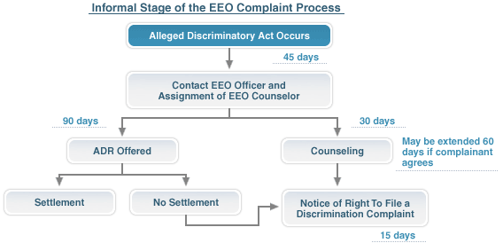
INFORMAL STAGE (PRE-COMPLAINT)
All Calendar Days

Slide 130
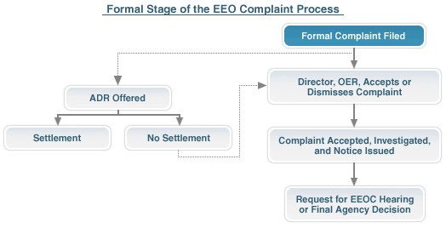
FORMAL STAGE (COMPLAINT)
All Calendar Days
*does not determine merit
up to 180 days
30 days
**Appeal to EEOC or File Civil Action

Slide 131
ADR/MEDIATION
Alternative Dispute Resolution
(ADR)

Slide 132

ALTERNATIVE DISPUTE RESOLUTION (ADR)
Alternative Dispute Resolution (ADR) is “any procedure that is used to resolve issues in controversy, including, but not limited to, conciliation, facilitation, mediation, fact finding, mini-trials, arbitration, and the use of ombuds, or any combination thereof.”
Administrative Dispute Resolution Act of 1996
Mediation is the Navy’s preferred method of early resolution.
Mediation is a process in which an impartial third party assists in finding a mutually acceptable solution to their dispute.
  It is both voluntary and confidential
Current positive resolution rate across DON is 58.11%

Slide 133

MEDIATION
Mediation in the EEO Process – Title VII Basis included
Mediation in Non-EEO or Workplace Conflicts – No Title VII Basis included
  Same process – 4 or 5 basic stages
  Same benefit – less time and less cost involved
Participation in mediation is NOT a guarantee
that you automatically get what you request

Slide 134
ANTI-HARASSMENT
Anti-Harassment and
Hostile Work Environment

Slide 135

HARASSMENT/HOSTILE WORK ENVIRONMENT
Unwelcome talk or conduct that is sufficiently severe or pervasive and
unreasonably interferes with an individual’s job performance or creates an intimidating, hostile or offensive working environment.
The harasser can be a person's supervisor, a supervisor in another area, a co-worker, or someone who is not an employee of the agency, such as a contractor or customer.
Supervisors MUST take prompt and appropriate corrective action. “That’s just the way they are” is not an acceptable response.

Slide 136

INDIVIDUAL RESPONSIBILITIES
If you feel that you have been harassed you should take action as soon as possible
If you feel comfortable enough to talk with the person you feel has harassed you, let them know that their conduct toward you is unwelcome, unacceptable, and must not continue
Report the incident to your supervisor (the CO should also be notified of all allegations of harassment)
Document every incident in writing, with details about the other
person’s behavior and how you responded to it

Slide 137

AVENUES TO ADDRESS HARASSMENT
Command or Management Investigation
  CO is notified by management or EEO office
  Either CO or Dept Head assigns an investigator
  Investigator provides report & decision is made
EEO Complaint

Slide 138
DISABILITY & REASONABLE ACCOMMODATIONS
Individuals with Disabilities
&
Reasonable Accommodations

Slide 139

DISABILITY
Three-part definition:
  A physical or mental impairment that substantially limits
  one or more major life activities;
  A record of having such an impairment;
  Being regarded as having a disability

Slide 140

REASONABLE ACCOMMODATIONS
What is a Reasonable Accommodation (RA)?
Any change to a job, the work environment, or the way things are usually done that allows an individual with a disability to apply for a job, perform job functions, or enjoy equal access to benefits available to other individuals in the workplace.

Slide 141

REASONABLE ACCOMMODATIONS
Reasonable Accommodations (RAs) are modifications or adjustments for:
  Job application process (screen-reader compatible, alternate formats)
  Performing the essential functions of the job (interpreters, readers, computer software/hardware)
  Removing physical barriers to enable employees with disabilities to enjoy equal benefits and privileges (office, cafeteria, etc. that comply with Federal Accessibility Standards)

Slide 142
REASONABLE ACCOMMODATIONS (CONT’D)
Who can request a reasonable accommodation (RA)?
  An employee, family member, or representative of the employee may let the employer know that (s)he needs an adjustment or change at work for a reason related to a medical condition
  A supervisor when (s)he:
    Knows that the employee has a disability,
    Knows, or has reason to know, that the employee is experiencing workplace problems because of a disability,
    Knows, or has reason to know, that the disability prevents the employee from requesting a reasonable accommodation
  An applicant during the application process

Slide 143


REASONABLE ACCOMMODATIONS (CONT’D)
How is a Reasonable Accommodation (RA) requested?
  A request does not have to be in writing
  There are no magic words – plain English, the words ‘reasonable accommodation’ need not be used
When it is communicated by the employee or other appropriate individual that there is a need for an adjustment or change at work for a reason related to a medical condition,
the RA process begins.

Slide 144
REASONABLE ACCOMMODATIONS (CONT’D)
Once an RA request is made, the Agency has 45 calendar days to process
  Interactive discussion should begin immediately – a continuous dialogue throughout the RA process between the supervisor, the RA coordinator and the employee.
  Request is forwarded to Reasonable Accommodation (RA) Coordinator
    Depending on specific circumstances and/or the complexity of the RA request, other parties may be consulted at the discretion of the RA Coordinator, to include representative from HR office, CIO, OGC, safety, etc. to determine:
      Whether the individual meets the definition of a qualified individual with a disability (QIWD);
      The medical condition, nature of the disability, and work-related functional limitations;
      The doctor’s information as the disability of the employee and recommendation on accommodation
      What the employee’s needs are
      An effective accommodation

Slide 145

REASONABLE ACCOMMODATIONS (CONT’D)
When is medical documentation required?
  When a disability and/or the need for accommodation is not obvious,
  management may ask the individual for medical documentation
  regarding his/her disability and functional limitations
  The employee has not previously provided sufficient medical
  documentation to substantiate that they have a disability and/or the need for the Reasonable Accommodation.
Be aware that when medical documentation is requested, the clock stops and does not restart until we receive it.

Slide 146

REASONABLE ACCOMMODATIONS (CONT’D)
Decision to Accommodate
  A qualified employee with a disability is entitled to an effective accommodation, not the accommodation of choice
    Must be sufficient to meet job-related needs of the individual
    Must remove workplace barrier(s) that impede employment benefits
  The employee’s supervisor is responsible for the final decision

Slide 147

REASONABLE ACCOMMODATIONS (CONT’D)
Decision NOT to Accommodate
  An accommodation may be denied only when:
    The individual is determined to not have a disability, as defined under the ADA/Rehab Act
    The person cannot perform the essential functions of the job with or without an accommodation, and reassignment efforts were unsuccessful
    The accommodation creates an undue hardship
    The individual posed a direct threat to health or safety

Slide 148

REASONABLE ACCOMMODATIONS (CONT’D)
Denials of RA Requests
  Written notification
  If an alternate reasonable accommodation is offered, justification for that decision should be explained
  Must provide an explanation of informal procedures available for a review of the denial action
    ADR (EEO complaint not required)
    File EEO complaint based upon denial
    No Statutory and/or Collective Bargaining Claims
    (Carderock has no Union)
    Administrative Grievance Procedures*
*Employees covered under the SECNAVINST 12771.2, DON Administrative Grievance System

Slide 149
STAFF
EEO, Diversity and Inclusion Office
Located in Building 42, Suite 201
  Wanda Jimenez-Barkdoll (she/her)
  Deputy Director, EEO, Diversity & Inclusion
  barkdoll.w.jimenez.civ@us.navy.mil
Christina W. Suggs (she/her)
EEO Complaints Program Manager
christina.w.suggs.civ@us.navy.mil
  Kelly Taira (she/her)
  Reasonable Accommodation Coordinator
  kelly.h.taira.civ@us.navy.mil
  Rebekah Knodel (she/her)
  Lead Sign Language Interpreter*
  rebekah.k.knodel.civ@us.navy.mil
  Vacant
  Affirmative Employment Coordinator
  Ciara Morales (she/her)
  Sign Language Interpreter*
  ciara.a.morales2.civ@us.navy.mil
  Jet Griffin (he/him)
  Sign Language Interpreter*
  jethro.r.griffin.civ@us.navy.mil
  *To request interpreting services, please email:
  usn.bethesda.nswccrdbdamd.mbx.interpreting-services@us.navy.mil

Slide 150

Questions?

Slide 151
CO Welcome and Oath of Office Brief

Slide 152
THE OATH WE TAKE
5 USC SEC 3331 Requires that an individual, except the President, elected or appointed to an office of honor or profit in the civil service or uniformed services, shall take the following oath:

Slide 153

OATH OF OFFICE STATEMEMT
I (state your name) do solemnly swear (or affirm) that I will support and defend the Constitution of the United States against all enemies, foreign and domestic; that I will bear true faith and allegiance to the same; that I take this obligation freely, without any mental reservation or purpose of evasion; and that I will well and faithfully discharge the duties of the office on which I am about to enter. So help me God.

Slide 154
LUNCH
(Return at 1330)

Slide 155
Ethics Briefing
Office of Counsel, Code 00L
Distribution Statement A: Approved for Public Release; unlimited distribution

Slide 156

Top Five Topics
Gifts
Financial conflict of interest
Impartiality
Misuse of Position
Hatch Act
Notes:
These are the five topics we will be talking about today. Note, this presentation is intended to provide you a general overview. If you have questions about the deeper details on these specific topics, myself or my team are happy to chat offline regarding your specific situation.

Slide 157

Gifts From an Outside Source
What is a Gift?
Unless permitted by exception, an employee may not solicit or accept gifts
  From a prohibited source (e.g., Navy contractor)
  Given because of official position (e.g., local country club offers free membership to CO of an installation)
Notes:
Gift is defined as anything of monetary value.
A gift can be tangible or intangible. It can be a gratuity, favor, discount, cash, gift certificate, gift card, entertainment, hospitality, loan, forbearance,
Here, general rule is that unless permitted by an exception, an employee may not solicit or accept a gift from a prohibited source, given because of your official position.
Prohibited source: any “person” seeking official action by the employee’s agency; does business or seeks to do business with the agency; conducts activities regulated by the agency; has interests that may be substantially affected by performance or non-performance of the agency or the employee’s official duties.

Slide 158
Gifts from Outside Source
Even if an exception exists, employees should consider declining an otherwise permissible gift if they believe that a reasonable person with knowledge of the relevant facts would question the employee’s integrity or impartiality as a result of accepting the gift.
Some relevant factors to consider are whether --
  (1) The gift has a high market value;
  (2) The timing of the gift creates the appearance that the donor is seeking to influence an official action;
  (3) The gift is provided by a prohibited source;
  (4) Acceptance would provide the donor with significantly disproportionate access
Notes:
Even if an exception exists, you still should consider the optics of the circumstances.
“What would a reasonable person think about the situation should you accept the gift?”
Here are some factors to consider. Note, “market value" is the retail price that you, the recipient of the gift, would have to pay to purchase it. If you cannot readily determine the retail value of a gift, you may estimate its value by reference to the retail cost of items of similar quality.

Slide 159



Gifts From an Outside Source
Exception to gift prohibition
  Gifts of $20/less per occasion and no more than $50 from one source in a calendar year; (focus is FMV [or face value] of gift)
  Gifts motivated by personal or family relationship
  Gifts based on outside business or employment relationship
  Widely attended gatherings
  Social invitations from non-prohibited source
  Meals in foreign areas
Notes:
Some of the notable exceptions from this list: (1) Gifts of $20 or less/no more than $50 from one source in a calendar years; (2) Gifts motivated by personal or family relationship; and (3) Widely attended gatherings.
WAG = “meeting, conference, or other event where it’s expected to be attended by a large number of people representing a wide range of interests (e.g., open to members from throughout an industry or profession) and that will provide expected attendees an opportunity to exchange ideas and views

Slide 160

Gifts From an Outside Source
What should I do with a prohibited gift?
  Return it
  Pay fair market value
  If perishable, give to charity, share among co-workers or destroy
  Reciprocation is not allowed
Notes:
This is a list of acceptable ways to dispose of a prohibited gift. Some notable ones: return the gift; if perishable (like cookies or cupcakes), share among your co-workers, assuming we all return to the office. Otherwise, destroy the gift.

Slide 161
Gifts Between Employees
Unless there is an exception, the general rule is that an employee shall not give his official superior a gift
  Two exceptions:
    Occasional Basis
    Special Infrequent Occasion
Occasional Basis
  Items, other than cash, with a value of $10 or less
  (e.g., birthday, holiday)
  Food and refreshments shared in office
  Personal hospitality at residence
  Items given in connection with receipt of personal hospitality
Notes:
Aside from gifts from prohibited sources, the other area where gifts may be an issue is where gifts are given between employees. Here is the general rule for official superiors – “Don’t Do IT UNLESS…”
-Occasional basis –
Examples of such - e.g., Hosting coworkers in your home for a team party/dinner (personal hospitality); doughnuts and coffee in the office

Slide 162
Gifts Between Employees
Special Infrequent Occasion
  Personal significance such as marriage, illness, birth, or adoption of child
  Termination of superior-subordinate relationship such as retirement, resignation or transfer
*NOTE: JER limitation of $300
Notes:
Special Infrequent Occasion (marriage, illness, the birth or adoption of a child or an occasion that terminates a subordinate-official superior relationship, such as retirement, resignation, or transfer).
“JER” – Is the DoD Supplementary Ethics Regulations

Slide 163

Conflicting Interests
Two Laws
18 U.S.C.
SECTION 208
Criminal Statute
Conflicting Financial Interest
5 C.F.R. SECTION 2635.502
Standards of Conduct Regulation
Appearance of Partiality
Notes:
Conflicting interests: where the interests in your personal life butt up against or overlap with your interests in your professional life - official role/duty as a federal employee.
Two relevant laws when it comes to conflicting interests:

Slide 164
18 U.S.C. SECTION 208 (Financial Conflicts)
Prohibits government employees from taking official action with respect to a particular matter if
  They have a financial interest in the matter, and
  The particular matter will have a direct and predictable effect on that interest.
Example:
  You own stock in Raytheon
  You are asked to serve on a technical evaluation panel where Raytheon is one of the offerors
  Do you have a conflict?
  Note: $15,000 exemption in a matter
Notes:
-Read the slide about the prohibition
-Answer to the question: YES!
-Note 5 CFR 2640.202: $15,000 exemption noted at the bottom involves publicly traded stock. There is an exemption where you own no more than $15,000 (aggregate amount) in publicly traded stock in a company involved in the matter. Here, the matter we’re talking about here is a solicitation for a federal procurement.

Slide 165
18 U.S.C. SECTION 208 (Continued)
Financial interests of the following are imputed to the government employee:
  Spouse
  Minor child
  Organization which the employee serves as officer, director, general partner or employee
  Person with whom employee is negotiating for employment
Example:
  Your spouse’s grandmother died last year and left him/her Lockheed Martin (LM) stock.
  You are evaluating a proposal submitted by Lockheed Martin for a NSWCCD requirement
  Do you have a conflict?
Notes:
In analyzing whether you have a conflict of interest under the criminal statute, we impute the interests of these persons or entities to you.
Answer: YES!

Slide 166

18 U.S.C. SECTION 208 (Continued)
Remedial Action: 208 Conflict
  Recusal/Disqualification
  Divestiture
  Waiver
Notes:
So what happens if you have a conflict of interest?
Waiver Process:
-Request made through the ethics’ chain of command
-Approval can only be granted by SES/flag officer in employee’s chain, after consulting with ethics counselor and receiving Navy GC approval
Waivers are rarely granted.

Slide 167

5 C.F.R. SECTION 2635.502 (Impartiality)
Appearance of Partiality
  If there is no 18 U.S.C. 208 conflict of interest, a government employee may still have an appearance problem under the Standards of Conduct Regulation 5 C.F.R. 2635.502
  Do not participate in a matter, without written supervisory approval, if
    The matter is likely to affect the financial interests of a member of the employee’s household, or
    A person with whom the employee has a “covered relationship” is involved in the matter
Notes:
Second relevant law when talking about conflicts of interest
Concerned about appearances

Slide 168
5 C.F.R. SECTION 2635.502 (Continued)
An employee has a covered relationship with, for example:
  A member of the employee’s household
  A relative with whom the employee has a close personal relationship
  A person for whom the employee’s spouse, parent or dependent child is an employee
  Any person with whom the employee has been employed within the last year
  A person with whom the employee has a business or financial relationship
  An organization in which the employee is an active participant (e.g., committee chairperson)
Notes:
These are examples of what constitutes a “covered relationship”
“Employee’s household” = construed broadly to include, for example, adult children and parents living with the employee, as well as others sharing the employee’s house,
whether or not related to her/him (although it would not include a houseguest
who lives in the house for a month or less)

Slide 169
5 C.F.R. SECTION 2635.502 (Continued)
Example 1:
  Your brother recently was hired by Northrop Grumman
  You are serving on an evaluation panel where NG is one of the offerors
Example 2:
  You were hired six months ago – you had been working at General Dynamics (GD)
  You do not own GD stock
  You are asked to serve on an evaluation panel for GD
Notes:
Example 1: Is there an appearance problem? Financial interest of brother would be imputed to you, assuming you were close and stayed in frequent contact with him
Example 2: Is there an appearance problem? There may be a conflict of interest despite no ownership in stock. Is the employee working on the same matter (e.g., project that you worked on as a GD employee) with this procurement? From an appearance standpoint, it doesn’t look good.
Reasonable person standard is important here.
These scenarios aren’t very clear-cut, and are very fact dependent. It’s important to come to our office is hash these issues out with me or one of our other ethics counselors.
Also, Section 1117 of FY22 NDAA two year restriction would be applicable to Example 2.

Slide 170
Former Employment
Section 1117 of the National Defense Authorization Act for Fiscal Year 2022
  DoD Standards of Conduct Office (SOCO) Advisory 22-01
  Applies to new DoD employees coming from non-Federal employment on or after December 27, 2021
Prohibits DoD personnel, from participating in a particular matter where the employee’s former employer is involved, and the employee has been employed with DoD within the last two years from the date the employee terminated his/her non-Federal employment with that former employer.
170
Notes:
Additional former employer and seeking employment recusals
Concerned with those scenarios involving new hires terminating non-Federal employment on or after 12/27/21, and become Federal/DoD employees.
Section 1117 Does Not Apply retroactively, meaning if you terminated employment prior to 12/26/21, this Section will not apply.
Two year recusal period

Slide 171
Former Employment (Continued)
Example:
You quit your job at Deloitte on January 7, 2022, and begin your NSWCCD employment on January 10, 2022.
On February 12, 2022, you are assigned to a team, to which Deloitte is a support contractor, assisting your financial team in running reports for certain auditing actions your Department is responsible for.
Can you participate in these activities in your new role with NSWCCD?
171
Notes:
Answer: No
Section 1117 prohibits you from participating in particular matters involving Deloitte for a 2 year period.
You are prohibited from working on particular matters involving Deloitte until January 7, 2024.

Slide 172
Misuse of Position
-Use of public office for private gain.
-Endorsing any product, service, or company.
-Use of nonpublic information
-Misuse of government property or official time
Notes:
4th Topic we’ll talk about today is misuse of position.

Slide 173
Use of Public Office for Private Gain
Example: You were asked by a friend to find out why his grant application has not yet been granted by the Office of Naval Research (ONR). You call over to a colleague at ONR to find out the status of your friend’s grant application.
Example: You have an outside business selling cookware. You invite your subordinates to your house this weekend to participate in a cookware party where you will be selling your cookware.
Notes:
These are two examples where you will be seen misusing your public office for private gain
May even border on an issue of using non-public information (e.g., office roster).

Slide 174
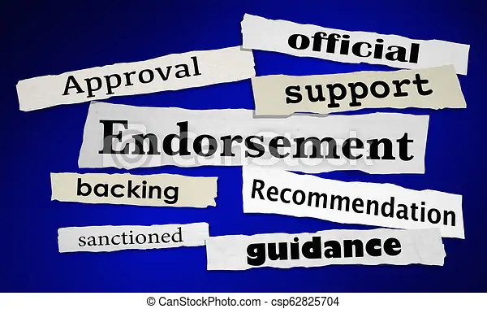
Endorsements
You may not use, or permit someone else to use, your official authority to imply the government endorses any personal activity
  Be wary of interviews to discuss effectiveness of product
  Letters of reference are acceptable in certain circumstances
  Fundraising and official speech
Notes:
This is a second way of misusing your position-endorsements
Purpose of the rule is to maintain public’s confidence that the Government operates in an impartial and objective manner.
Exceptions:
-Letters of recommendation/character references, provided that you have worked with the individual in the course of federal employment or if the individual is applying for federal employment.
-Fundraising-DoD JER identifies specific entities where assisting in fundraising activities sponsored by those groups is permissible; and
-DoD employees may participate in their official capacities as speakers or panel members in a non-federal entity’s event as “logistical support”
-Public speaking request process allows for an analysis of these opportunities.

Slide 175
Endorsements (Continued)
Example:
You have served on a planning committee charged with formulating best practices for your Department.
This committee is made up of both federal and non-federal personnel.
One of the contractor personnel that participates on the committee has asked you to write her a letter of recommendation for a federal job vacancy she intends to apply for.
Can you write the letter using official letterhead and your official title?
175
Notes:
Answer: Yes, provided that you have personal knowledge of this person’s ability or character based on your work with this individual participating on the planning committee.

Slide 176

Use of Non-Public Information
Example: In your private capacity, you are involved in an organization to save the whales. You become aware of a Navy project that has not yet been released to the public. You are concerned the project may harm the whales.
-Can you inform your organization about the Navy project?
Notes:
Third Example of misuse of official position – misuse of non-public information
If the information isn’t available in the public realm-e.g., you can’t Google it and find it, then it’s best not to disclose the information to those who don’t have authorization to receive it or use it for your own personal endeavors.
Answer- NO!

Slide 177
Use of Non-Public Information (Continued)
Example: At lunch, some of your coworkers were talking about developing some specifications for an upcoming Solicitation that NSWCCD will soon issue for proposals. A friend of yours works for a company that offers services in the relevant business area tied to this pending Solicitation, and you think it might help him if he knew about what's coming along.
Do you think it’s permissible to tell him about the upcoming Solicitation, without discussing the specifications?
177
Notes:
Answer: That depends on whether the Solicitation itself is public information. If NSWCCD has already publicized that it will be issuing the Solicitation in the near future, it may be ok. If information about the Solicitation has not been made known to the public and is not authorized to be made known upon request, then it is nonpublic information and cannot be disclosed.
Any non-public information would not be fair game for disclosure. Remember, you cannot use (or allow someone else to use) non-public information to benefit yourself or some other person.
Note, it makes no difference that you heard about the information at the lunch table and not as a result of your official duties. If the fact that the agency is going to pursue the Solicitation is public, you can certainly make sure your friend knows when the agency publishes or makes available information about the procurement.

Slide 178

Misuse of Government Property or Official Time
You may only use government property for official and authorized purposes.
  You may not use it to send emails about your personal business. (JER).
You may not use official time to conduct your personal business.
Notes:
Fourth way of misusing your official position. This one is self-explanatory
Note, there is a de minimum use policy for Government property, in particular using your government computer
Think twice about printing out your family vacation itinerary using the office printer because you are too cheap to replace the cartridge on your home printer.
Also, don’t use your official work time to conduct phone calls for your personal business.

Slide 179
Hatch Act
-Applies to Executive branch employees of the Federal Government
-Limits certain political activity in the work place
-But Why?
-To ensure federal programs are administered in a nonpartisan fashion
-Protect employees from political coercions in the workplace
-Ensure federal employees are advance based on merit and not political affiliation.
179
Notes:
“Political activity” – activity directed to the success or failure of a (1) political party; (2) candidate for partisan political office; or (3) a partisan political group
All DoD employees may not:
(1) solicit, accept, or receive political contributions;
(2) may not run for public office in a partisan election (i.e., political party affiliation);
(3) may not use your official authority to affect outcome of election
Bottom-line: You cannot engage in political activity while on duty, in a federal building (even if off-duty), wearing a uniform or official insignia, or while using a government vehicle.

Slide 180

Hatch Act (Continued)
All DoD Employees May:
Place a campaign sign in their yard;
Place A campaign bumper sticker on their personal car;
Make financial contributions to political parties or candidates running for partisan political office;
Express personal opinions on candidates and issues
Attend political events
Participate in nonpartisan elections
Follow, like, or comment on the social media pages of a candidate for partisan office, a political party, or a partisan group
180
Notes:
Some examples of what activity is not prohibited by the Hatch Act.
Can you march in a protest or participate in a rally (e.g., BLM)? Yes, just don’t do it on Government time and do not wear any NSWCCD apparel, etc. Attending a march or protest is not per se an activity affiliated with a political party.

Slide 181

Hatch Act (Continued)
All DoD Employees MAY NOT :
Host or serve as the POC for a fundraiser
Ask for donations by mail, email, or social media
Invite others to a fundraising event
Solicit through a phone bank
Share or like a fundraising post on social media
Run for public office in a partisan election
Use Agency resources or non-public information to engage in political activity
181
Notes:
Some examples of what is prohibited activity under the Hatch Act.
Remember to consult an ethics counselor to make sure your specific circumstances don’t put you in danger of noncompliance.

Slide 182
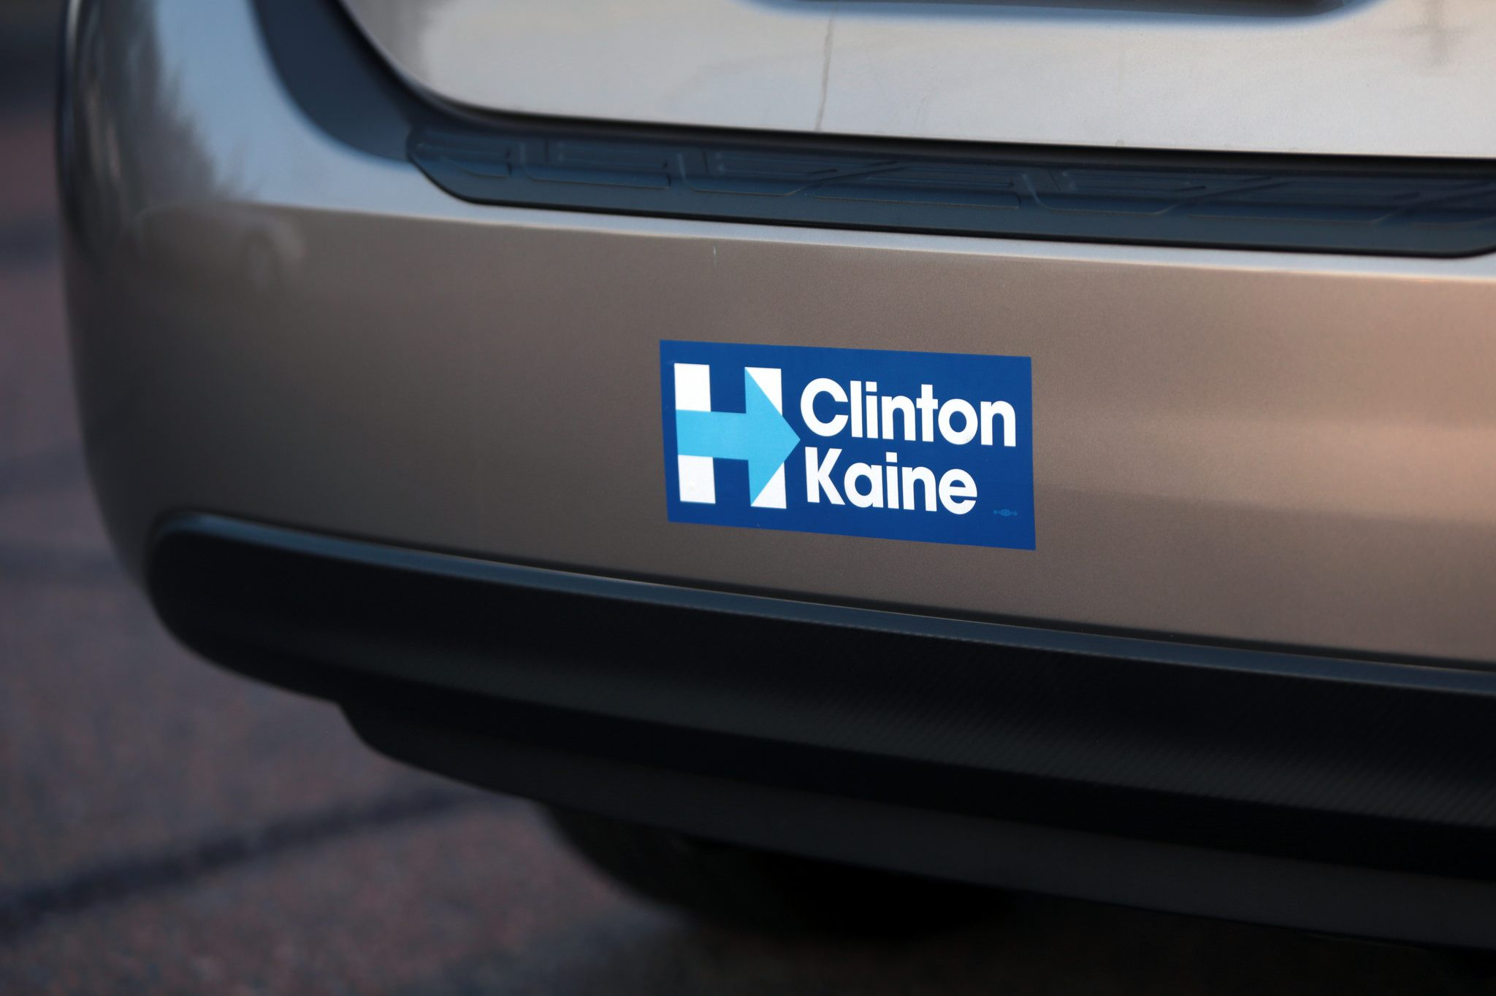
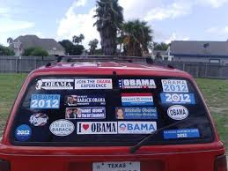
Hatch Act (Continued)
Which one is appropriate?
Or
182
Notes:
Answer: The picture on the left with one bumper sticker.
DoD employees may place A political bumper sticker on their personally owned vehicles. More than one can appear as too excessive.
Note, bumper stickers that express messages such as “Repeal the healthcare law;” “Right-to-life;” “Pro-choice;” “I support the war;” “Peace not war” are ok, and wouldn’t constitute the “political activity” that the Hatch Act is designed to prohibit. Use of these types of bumper stickers is not associated with a political party.

Slide 183

NSWCCD Ethics Counselors
Tuwana Cummings (Counsel)
tuwana.h.cummings.civ@us.navy.mil
Toya McLendon (Deputy Counsel)
toya.m.mclendon.civ@us.navy.mil
Justin Briones
justin.v.briones2.civ@us.navy.mil
Karissa Johnson
karissa.a.johnson8.civ@us.navy.mil
Gail Kessler
gail.d.kessler.civ@us.navy.mil
Tel: 301-227-3566
183

Slide 184
The End
Questions??
Remember: CYA
184
Notes:
C-onsult Y-our A-ttorney

Slide 185
Demonstration Project
HR, Code 1013

Slide 186
Demonstration Project (DEMO)
Implemented in 1997 as a STRL – Science & Technology Reinvention Laboratories from the National Defense Authorization Act of 1995 – P.L. 103-337.
-That Act allowed the Science and Technology Reinvention Laboratories to take the initiative in reinventing their Commands to be better able to pursue their missions, and it specifically allowed them to conduct an innovative, cost-effective Personnel Demonstration Project as part of that process
Many commonalities are shared by each of the STRL Demonstration Projects, such as: - Broad banding, also referred to as pay banding or grade banding; - Performance management centered on contribution or performance; - Simplified job classification; - Enhanced recruitment and staffing; and - Modified reduction-in-force.

Slide 187
Addendums
Addendums are required for every position
Addendums are a clear statement of your duties and the extent of your responsibilities
Addendums document specifics of the position such as knowledge, skills and abilities (KSAs), areas of expertise, assigned program/project area, and other requirements for the position.
You should review your addendum with your supervisor within 30 days of onboarding
Aid in setting performance goals

Slide 188
Career Paths
Demo positions are divided into three career paths:
  ND – Professional Engineering and Scientific positions in the 100, 400, 800, 1300 and 1500 families, and selected series in the 0100 family.
  NT – Administrative and Technical career path covers professional or specialist positions in administrative, technical and managerial career fields.
  NG – General Support covers assistant and clerical positions and positions providing specialized facilities support.
  Note- We also have WG/WL positions that follow OPM guidance.
All career paths include supervisors and
students in the applicable fields.

Slide 189
Career Progression
Within the ND and NT career path, each band represents a step in the normal career progression of a profession
Band 1: Student trainee
Band 2: Entry level
Band 3: Advanced trainee
Band 4: Journeyman
Band 5: Supervisor/expert
Band 6: Manager/world class expert

Slide 190
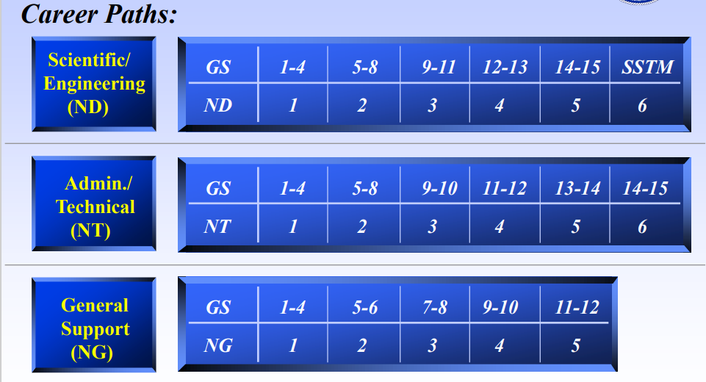
Career Paths and Broad Bands

Slide 191
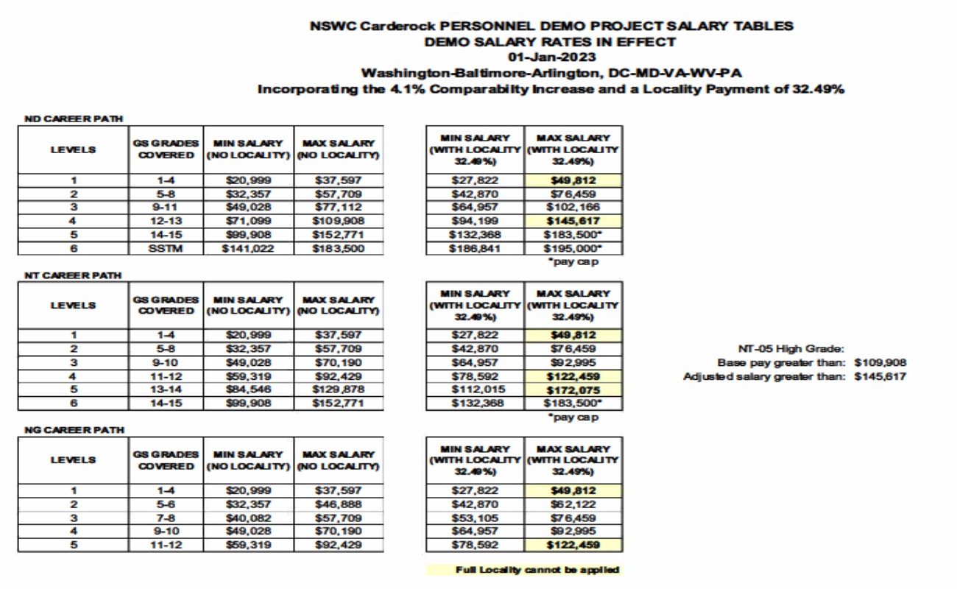
DEMO Salary Table

Slide 192

Questions

Slide 193
BREAK 2

Slide 194
Human Resources Paper Work
Review HR Paper Work
Complete Tax Forms
FastStart, W4, and State (if applicable)
Complete All Pending Forms
SF-61, 2nd OF 306 signature, SF256, SF181 and any questionnaires or forms not marked complete.

Slide 195
Beneficiary Forms Information
- Unpaid Compensation of Deceased Civilian Employee (SF-1152)
- Federal Employee Group Life Insurance (FEGLI) Designation of Beneficiary (SF-2823)
- Federal Employees Retirement System (FERS) Designation of Beneficiary (SF-3102)
- Thrift Savings Plan (TSP) Designation of Beneficiary (TSP-3)
SF-1152, SF-2823 and SF-3102, mail to:
OCHR NORFOLK: Operations Center
ATTN: Civilian Benefits Center
NNSY, Building 17
Portsmouth, VA 23709-5000
TSP-3, mail to:
ThriftLine Service Center
C/O Broadridge Processing
PO Box 1600
Newark, NJ 07101-1600
Please retain a copy of your beneficiary forms for yourself. Please don’t hesitate to contact me if you have questions or concerns

Slide 196
Onboarding Follow-Up
Topics Covered
Addendums
SF50
eOPF
LES / myPay
MyBiz
Waypoints
TWMS
Classified Technical Information Center
Unauthorized Commitments
ERP
Travel
Quality Management
General Equipment Custodial Training
Special Programs Information Session
Upcoming Onboarding Follow-Up Dates
(3rd Wednesday of Each Month)
November 15th

Slide 197
Wrap-Up
Wrap-Up / Questions
Surveys

