Slide 1
NAVSEA WARFARE CENTERS
Battle Lab Overview
DISTRIBUTION A (21-017): Approved for public release. Distribution is unlimited.
NAVSEA WARFARE CENTERS

Slide 2
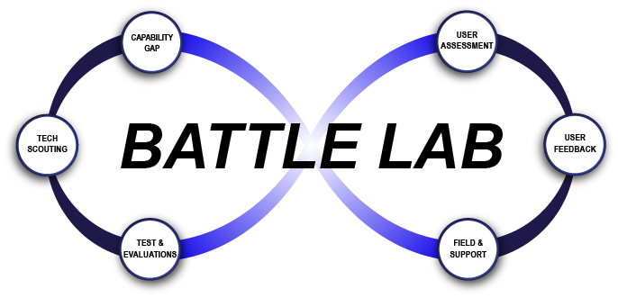
What is Battle Lab?
New concept of operations being executed in support of explosive ordnance disposal (EOD) and physical security technology and equipment
Hosted and executed by Naval Surface Warfare Center Indian Head (NSWC IHD) EOD Department
Utilizes existing department subject matter experts (SME) to provide objective reviews of technologies being considered for use by Department of Defense (DoD) EOD, Force Protection / Physical Security communities, and interagency partners
Combines technical expertise and evaluation with assessments in operational environments and user feedback to provide actionable data on commercial-off-the-shelf (COTS)/government-off-the-shelf (GOTS) equipment
Not mission funded, requires sponsor funding to execute work
Goal: Provide a cycle of equipment review and evaluation to feed capability gap assessment, COTS/Modified COTS buying decisions, requirements development, and technology implementation at the speed of relevance

Slide 3
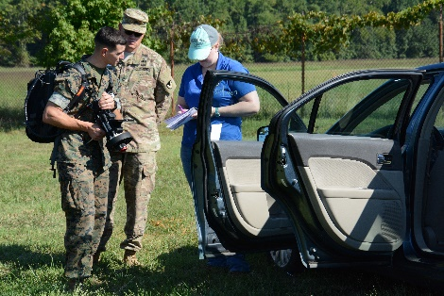
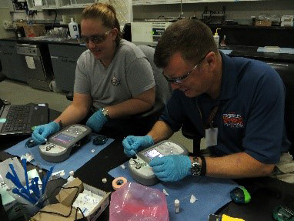
What does Battle Lab Do?
Capabilities and limitations assessments of equipment and technology
Operational assessments of equipment and technology, to include user participation and feedback
Mission-based assessments to evaluate how emerging technology can be integrated into current EOD or other physical security mission sets
Information sharing with EOD and physical security community
Recommendations based on the data can be made with full understanding of user needs and requirements

Slide 4
Concept of Operations
Identify gap
Community evaluates system in realistic scenarios
Find potential solutions
Gather user insight
Assess technical capabilities and limitations of solutions
Support current &
future technology user needs
Capability
Gap
Technical Scouting
Test & Evaluations
User Assessment
User
Feedback
Field &
Support
-User feedback on existing systems
-Technical assessment
-Threat assessment
-EOD statements of Need
-AoA
-BAA/vendor inputs
-SME knowledge
-internal developments
-User defined parameters
(not reqt’s)
-Scaled to sponsor need and timeline
-Community that needs the system
-Military utility
-Operational effectiveness and suitability
-Supports procurement decisions
-Identifies areas for developer improvement
-Identifies capability gaps
-Systems that best meet user needs now
-Provide procurement pathways & support
-SMEs maintain awareness of latest tech

Slide 5
Battle Lab Division (D3)
Combines technical expertise and evaluation with assessments in operational environments and user feedback to provide actionable data on COTS/GOTS equipment
Key Assessment Areas:
Demonstration and Assessment Team (DAT)
Integration of warfighter inputs with developmental technology
Explosive Detection Equipment (EDE)
Evaluation of systems to detect or ID explosives and threats
EOD Technology Assessment (ETA)
New organization focused on evaluation of emerging and available technology for EOD
Key Facilities:
Explosive ranges
Analytical chemistry lab
Geographically diverse organization
Concrete Operational Systems
Conceptual Systems
Warfighter
Workshop
Capability
& Limits
Assessment
Operational
Demonstration
Limited
Technical
Assessment
Military
Utility
Assessment
Extended
Field User
Evaluation

Slide 6
Demonstration and Assessment Team (DAT)

Slide 7
DAT Vision
Leverage discovery, investigation and innovation of Science and Technology (S&T) efforts to explore potential solutions sets for existing and future warfighting capability gaps
Facilitate and enhance through the Operational Forces Integration and Engagement process and realistic Experimentation, EDA S&T efforts leading to capabilities that provide operational effectiveness and operational suitability to enable versus restrict!
Notes:
Slide is already Distro A
- Recommend adding POCs like the EDE slide has

Slide 8
Warfighter Integration
“Secret Sauce”
“Geek/Warrior Marriage” yields Operational Relevance
Scientists and engineers who rarely have military experience need to understand how Marines/Sailors/Soldiers/ Airmen fight and how gear must perform
Technologies provide useful capability and are not obsolete before they are fielded
Users get an idea of “how to use” the technology, not just how the technology works
Key to success: Operators provide input early and participate upfront: feedback after the system is fielded is TOO LATE!
“Desired“ Capability
Design
_{User}
_{Input and} _{Participation}
Assess
Build
Demo
Test
Example S&T Development Cycle
User Input Leads to Reduced Cycles and Cost to Achieve Operational Utility
Notes:
Slide is already Distro A

Slide 9
OFCI&E Continuum
Begin with the end in mind...Transition
Degree of Warfighter Involvement
Conceptual Systems
Concrete Operational Systems
Warfighter
Workshop
Capability
& Limits
Assessment
Operational
Demonstration
Limited
Technical
Assessment
Military
Utility
Assessment
Extended
Field User
Evaluation
- 50/50 Split
-SMEs & Ops Forces
- Tech SME setup
- Ops Forces employ
- Mission vignettes
-Technically
Capable
Effective
Suitable
- Fielding assessment
- Cyber assessment
Field
- Ops Forces employ
- SMEs in reserve
- Full mission-based
scenarios
- Full assessment of
operational utility
- Effective? Suitable?
- DOTMLPF
assessment
- Transition
considerations
- Cyber assessment
Field
- Leave at MUA site
- Ops Forces use
- Real world ops
- SMEs on call
- Collect data
- Effective
- Suitable
- DOTMLPF
assessment
- Transition
considerations
- Cyber assessment
Field
Limited Objective Experiments
Technology Readiness Levels
- Capabilities/ Limits
- Safety
- Operations & Fielding Considerations
- Lab or Tech Site
- Ranges or Field
- Assess/Refine Cyber approach
- Technology
- Operational Scenarios
- Technical Subject Matter Expert (SME) lead
- Warfighter uses
Stakeholder
Validate Cyber approach
Ranges or Field
- Stimulation
- Capabilities
- Missions
- Concept of Ops
- Tactics. Techniques, Procedures
- DOTMLPF*
- Human Factors
- Identify Cyber approach
Warfighter Workshops can be conducted across the spectrum of events to gather and inject focused warfighter feedback
* Doctrine, Organization, Training, Materiel, Leadership And Education, Personnel & Facilities
Notes:
Slide already Distro A (18-038)

Slide 10
Operational Expertise
Substantial Operational Test and Evaluation (T&E) Experience
Access to personnel who worked at Operational T&E Force, Marine Corps Operational T&E Activity, and Air Force Operational T&E Activity
Support to Rapid Fielding Directorate and Office of the Secretary of Defense staff for Joint Capability Technology Demonstrations development and assessments
Design of experiment and mission-based test design experience
DAWIA T&E and Program Management Certifications
International T&E Association (certified T&E professionals)
Automated surveys and data collection tools, real time GPS tracking, mission reconstruction, and videography capabilities
Unique Operationally Focused Cyber Assessment Expertise
Cyber defense analysts with operational background bring boots-on-ground pragmatism to information security
“Baked-in, not bolted-on” approach enhances success

Slide 11
Explosive Detection Equipment (EDE)

Slide 12
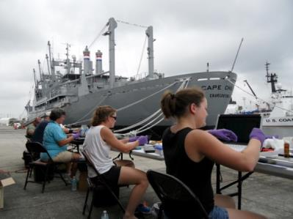
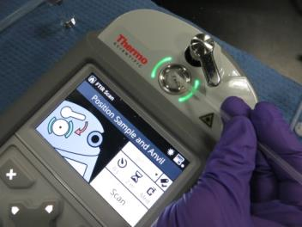
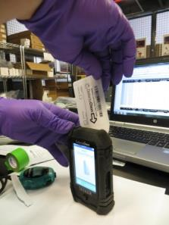
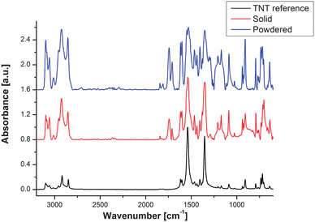
EDE at a Glance
Explosive Detection Technical Direction Agent for the Department of Defense
Provide explosive detection technical expertise to EOD and physical security communities
Full-range of T&E services
Explosives Detection and Explosive Device Detection
Relevant, realistic test articles and materials
Screening, forensic, and expeditionary
technologies and CONOPs
Tailored, mission-specific explosive detection recommendations
End Users
Requirements Generation
Demonstrations and Sales
EDE
Program Sponsors
Industry & Academia
Developmental R&D and Testing

Slide 13
EDE Capabilities
200+ unique systems evaluated since 2002
Variety of test options
Gov’t or vendor site meetings/demonstrations
Quick look evaluations at vendor’s site
Reduced or Full Scope Evaluations at NSWC IHD
Operational test at user/sponsor defined site
Government / industry partnerships
Live explosive ranges for operational testing
Stump Neck Annex
Army Research Lab Blossom Point Research Facility
Chemical Lab
Analytical instrumentation
Explosive standards printers
Explosive and HME synthesis facilities
Explosive Detection-Specific Security Classification Guide

Slide 14
EOD Technology Assessment (ETA)

Slide 15
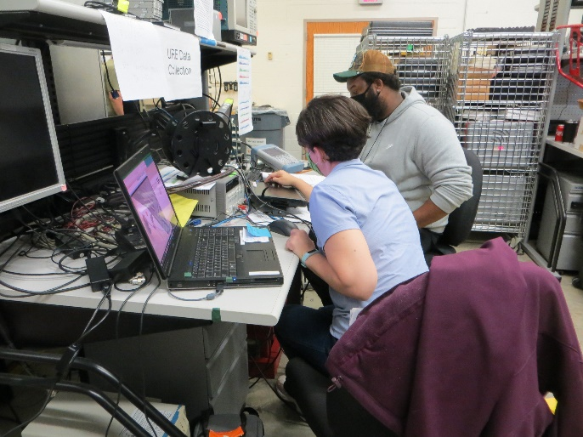
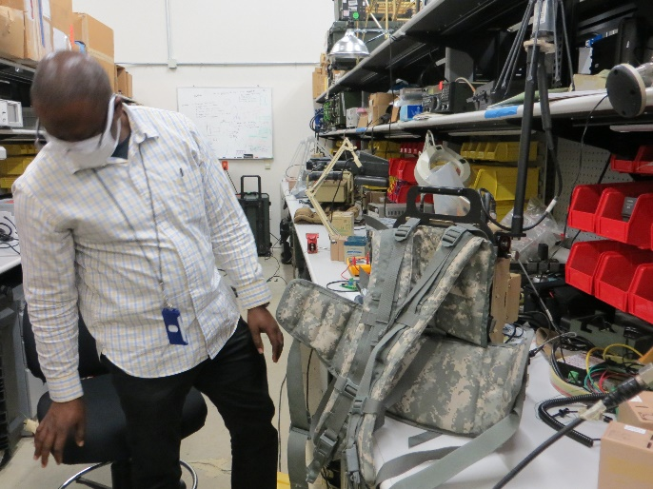
ETA Overview
New branch focusing on providing technical assessments to the EOD program decision makers in each service, and where applicable, jointly considered items
Branch comprises former EOD technicians, engineers, T&E personnel and project management support
All with experience in testing and evaluation of EOD equipment
Projects contain a wide range of technology from robotics to disrupters to additive manufacturing
Joint EOD Portal and NSWC IHD internet page in development
Facilitate information sharing with those making buying decisions
Allows for wider notice of upcoming events and requests for information

Slide 16
ETA Way Forward
Enhance and develop partnerships with sponsors and organizations that support EOD-related efforts
Foster the Battle Lab concept of operations within EOD Department
Identify technology roadmaps, interests of stakeholders, and acquisition/tech refresh timelines
Get involved in EOD community organizations and events

Slide 17
Points of Contact
Catherine Eaton
Battle Lab Division Director
301-744-5064
catherine.eaton@navy.mil
SIPR: catherine.eaton@navy.smil.mil
Christian Breault
DAT Branch Manager
858-204-0909
christian.g.breault1@navy.mil
David M. Thomas
Cyber Security Test Lead
951-306-9019
david.m.thomas9@navy.mil
SIPR: david.m.thomas1@navy.mil
Ken Sheehy, PMP, CTEP
Operational Test and Evaluation Lead
301-542-4240
ken.sheehy@navy.mil@navy.mil
SIPR: Kenneth.Sheehy@navy.smil.mil
Trenton Spencer
EDE Branch Manager
301-744-5160
trenton.spencer@navy.mil
Michael Shepard, Ph.D.
EDE Senior Technologist
301-744-5167
michael.r.shepard@navy.mil
Jill Phillips, Ph.D.
EDE Project Lead
301-744-6936
jill.phillips@navy.mill
Owen Burns
ETA Branch Manager (Acting)
301-744-5258
owen.burns@navy.mil
SIPR: owen.burns@navy.smil.mil
Cristina Spencer
ETA Business Development Lead
301-744-5372
cristina.spencer@navy.mil
SIPR: cristina.spencer@navy.smil.mil

