Slide 1
Counterfeit Avoidance
Where will the road lead?
Bob Bodemuller
Supplier Quality Principle Engineer

Slide 2
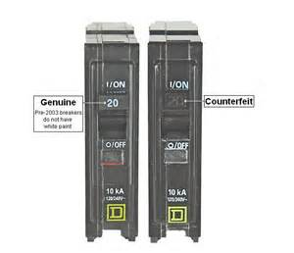
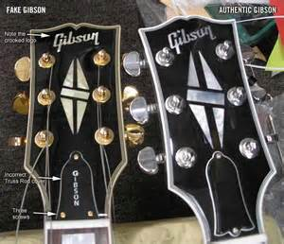
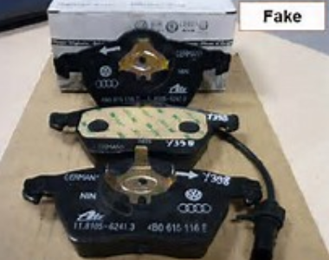
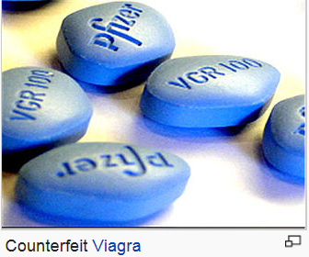
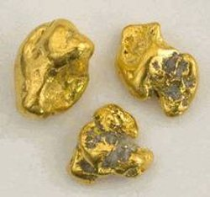
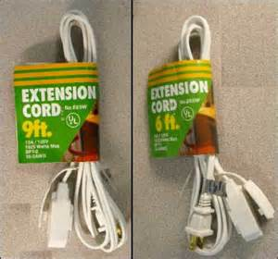
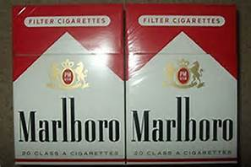
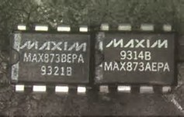
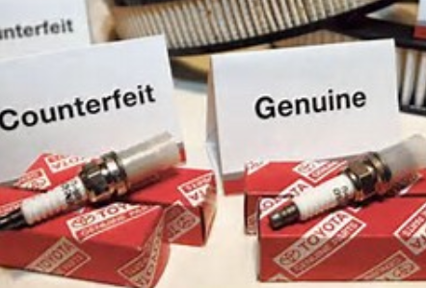
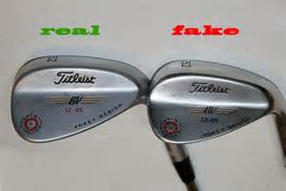
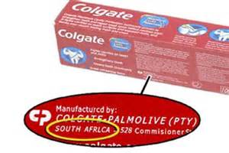
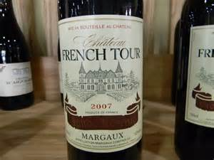
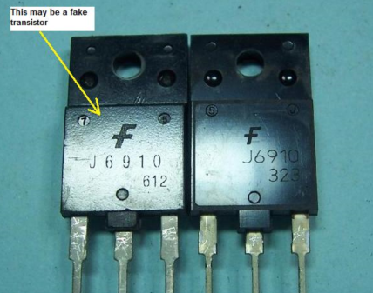
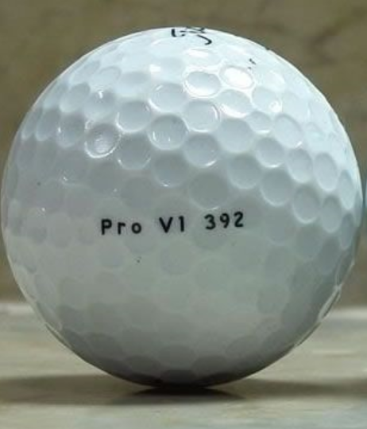
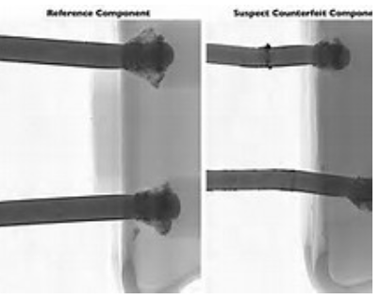
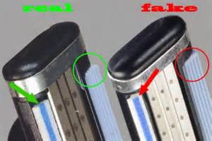
Can You Tell the Difference?

Slide 3
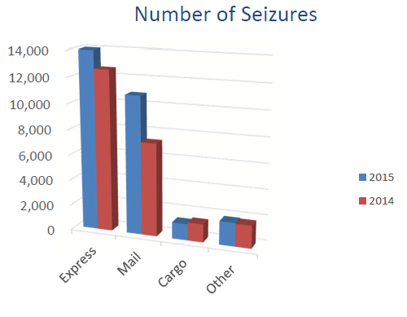
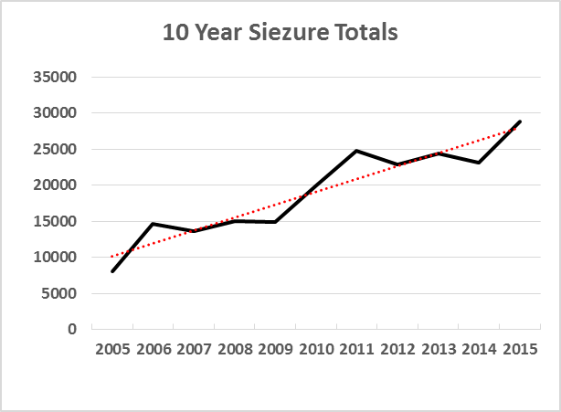
Traceability
FY 2015 Percent
Trading Partner MSRP of Total
China $ 697,083,700 52%
Hong Kong $ 472,331,251 35%
Singapore $ 10,267,324 Less than 1%
India $ 6,409,028 Less than 1%
United Kingdom $ 4,358,128 Less than 1%
Korea $ 3,788,572 Less than 1%
United Arab Emirates $ 3,432,950 Less than 1%
Italy $ 2,849,267 Less than 1%
Malaysia $ 2,345,427 Less than 1%
Canada $ 1,973,812 Less than 1%
All Others $ 147,655,882 11%
Total FY 2015 MSRP $ 1,352,655,882 Total FY 2014 MSRP $ 1,226,347,540
Number of Seizures 28,865 Number of Seizures 23,140
China and Hong Kong made up 87% of 2015 seizures
Data from:
Intellectual Property Rights
Seizure Statistics
Fiscal Year 2015
Source by Manufacturer’s Suggested Retail

Slide 4
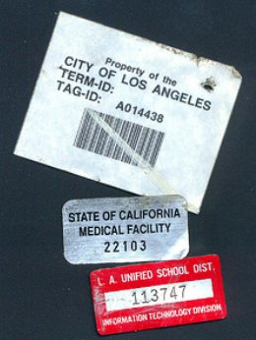
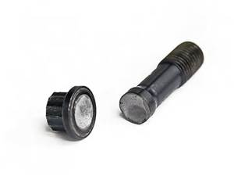
Why is this issue so difficult?
Aging systems resulting in obsolescence
Diminishing Sources for parts
Economic
Cost
Schedule pressures
Minimum Buys
Sources of parts
Authentic parts manufactured in Asia
Profitable and growing capability to counterfeit
Organized crime
Counterfeits more difficult to detect
May not affect fit, form or function
Tests, visuals and failure analysis may not detect counterfeits
Follow the money…
Counterfeiters are good & getting better …
They are fast and agile

Slide 6
Pending Regulations
DFARS 2014-D005 – Further Implementation
Released for public comment 9/21/15
Defines “Trusted Supplier”
Requires traceability from OCM to product acceptance by the government
DFARS 2015-D020 – Trusted Suppliers for Electronic Parts
Focus on the requirement that DoD shall obtain electronic parts from trusted suppliers, and establish qualification requirements pursuant to which DoD may identify trusted suppliers
DFARS 2016-D010 – Cost of Remedy for Use or Inclusion of Counterfeit Electronic Parts
Amends c)(2)(B) with regard to the allowability of costs of counterfeit electronic parts or suspect counterfeit electronic parts and the cost of rework or corrective action that may be required to remedy the use or inclusion of such parts.
DFARS 2016-D013 – Amendments Related to Trusted Suppliers
makes contractor and subcontractor identification and use of additional trusted suppliers subject to approval (as well as review and audit) by appropriate DoD officials.
Many questions … lots of confusion

Slide 7
Trusted Suppliers
Proposed Rule, DFARS Case 2014-D005
Trusted supplier means:
(1) The original manufacturer of a part;
(2) An authorized dealer for the part;
(3) A supplier that obtains the part exclusively from the original component manufacturer of the part or an authorized dealer; or
(4) A supplier that a contractor or subcontractor has identified as a trustworthy supplier, using DoD-adopted counterfeit prevention industry standards and processes, including testing
What is exclusively?
How do you “identify”… audit/certification?

Slide 8
Traceability
Proposed Rule, DFARS Case 2014-D005
(4) Processes to—
(i) Enable tracking of electronic parts from the original manufacturer to product acceptance by the Government, whether the electronic parts are supplied as discrete electronic parts or are contained in assemblies; …
How?
Does AS5553B comply?

Slide 9
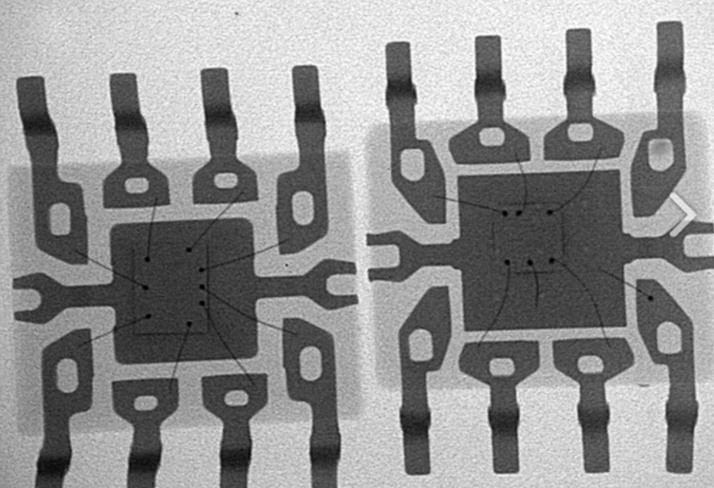
Industry standards

Slide 10
Industry Consensus Standards
How will AS9100 play with these requirements?
G-19
G-19A Testing AS6171
G-19AD Authorized Distribution AS6496
G-19C Compliance Various
G-19CI OCM, System Integrators, etc. AS5553
G-19D Independent Distribution AS6081
G-19T Definitions AIR6273
G-21 Materials AS6174
Make it data driven?
Standards look in review view mirror. Potentially give counterfeiters the blueprint for detection
Is an industry consensus standard based approach realistic for DFARS compliance?

Slide 11
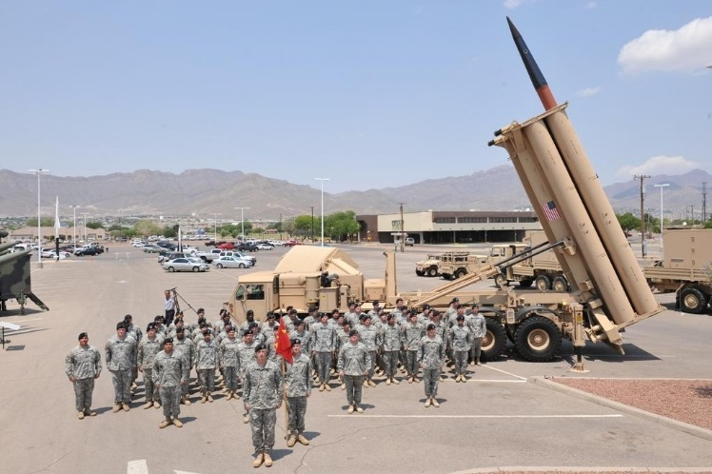
Lockheed MFC Strategy

Slide 12
Lockheed Martin Definition
(a) definition of counterfeit “work”
… means Work that is or contains unlawful or unauthorized reproductions, substitutions, or alterations that have been knowingly mismarked, misidentified, or otherwise misrepresented to be an authentic, unmodified part from the original manufacturer, or a source with the express written authority of the original manufacturer or current design activity, including an authorized aftermarket manufacturer…
Applies to all materials not just electronic parts

Slide 13
MFC Counterfeit Strategy
Subject Matter Expertise
Corporate Counterfeit Working Group Member
Knowledge Transfer & Communication
Communications in place to include Legal, DCMA, GSC, QMS, etc.
Engaged with “new business” to examine counterfeit mitigation as a market discriminator
Supplier Engagements
Partnered with GSC/programs to review supplier changes to Corp Docs and text notes
Perform supplier surveys as required
Command Media & Business Processes
Align CRX-126, Counterfeit Electronic Parts and Material with MFC contractual requirements
Influence procedures to improve risk mitigation processes
Nexpert identified
Developed MFC control plan for all “work”
MFC command media aligns with CRX-126 requirements, i.e. DFARS
Review and update training
Material Risk Mitigation
Risk Analysis & Prioritization
Proactive Validations
Survey & Audit Activity
Educate, Communicate & Drive Risk Prevention Measures

Slide 14
Summary
Traditional industry systems and methods were not designed to detect deliberate and deceptive product alterations
Threat is Real & Growing …Prevention Methods must Out Pace the Threat
Continue to Evolve, Educate, Communicate & Enforce Prevention Measures
Government requirements are growing for counterfeit avoidance systems at all tiers of the supply chain
Systems based on trust are no longer trustworthy
Notes:
This is a summary of what general controls we currently have in place and what activities are underway. For example, communications through councils, use of GIDEPS for Counterfeits, Procedures, Training, and Requirements flowown are in place.
Underway at various stages of completion are design refresh and obsolescence planning, finding and certifying brokers , distributors and test houses

Slide 15
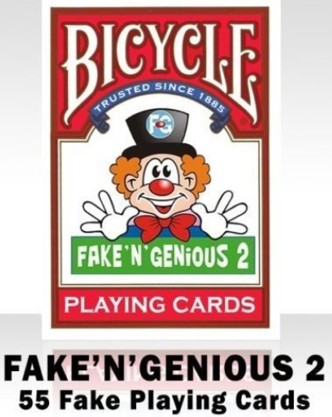
Questions
Contact Info:
Bob Bodemuller
972-603-0033
robert.a.bodemuller@lmco.com

